Slide 1
The DCIM Project at VMware Project Review and Technology Adoption Case Study
April, 2016

Slide 2
DCIM Onboarding Capability by Functional-Area and User-Role
Asset Management
Scoping
Cable Management
Discovery
Change Management
Tenant Projects
Capacity Management
Power Management
Scoping
Analytics
Tools
Floor Plans
Migration
Maintenance
Cards Configured
Connection Points
Operations Workflows
Operations Automation
Automated Cautions
Tenancy Services
Forecasts
Change Validations
Change Discovery
Operations
DNS Validate
Inventory
PDU Network
SNMP Polling
Operations
Port Inventory
Lab-Tech DCIM Champions | Power Manager | Lab-Tech | Operations Manager | Reservations Manager
Reservations Manager | Reservations Manager | Reservations Manager | Reservations Manager | Lab Manager
Tenant Manager | Operations Manager | Operations Manager | Tenant Manager | Operations Manager

Slide 3
DCIM Logical Use-Cases
User-Role + Usage-Scenarios
Delivery Priority | Objective Theme | DCIM User can…
1 | Lab Technician Lab Manager DCIM Power User | Use scanning tools directly integrated with NLyte for Asset Management operations. Create, View, and Edit asset records. Bulk-Edit Tools User (DCIM Power User Only) Site-Level DCIM Champion (DCIM Power User Only)
2 | Reservations Manager | Manage cabinet-level space utilization. Create, update, and delete rack-unit reservations per tenant change request. Initiate “what if…?” change management scenarios.
3 | Power Manager | Manage cabinet-level power utilization and monitoring operations. Create, update, and delete constrained-cabinet markers.
2 | Operations Manager | Manage site-level operations workflows, processes, activities, and tasks. Create and Update workflows and processes. Monitor Operational QA Metrics.
3 | Tenant Manager | Manage business-group and end-user asset assignments. Create and Update tenancy records.
1 | Catalog Manager | Manage the global materials catalog. Create, Update, and Delete materials records.
4 | Analytics Manager | Manage DCIM Analytics. Create global DCIM reports. Support executive-level analytics requirements.
Notes:
https://vmshare.vmware.com/engineering/techops/tig/wdc/Lists/DCIMSPIN/AllItems.aspx
https://vmshare.vmware.com/engineering/techops/tig/wdc/Lists/DCIMUSECASES/AllItems.aspx

Slide 4
DCIM Onboarding – Asset Management SITE = <NAME HERE>
Contributors
DCIM Champion <NAME>
DCIM Solutions Consultant <NAME>
[Role] Managers <TBD>
Stakeholders
Lab Manager <NAME>
Operations Leads <NAMES>
DCIM Consumers <NAMES>
Scoping
(1 week)
Roles
Floor Plans
(2 weeks)
CAD Import
Migration
(1-N weeks)
Cleaning
Schedule
Data-Sources
Operations
(continuous)
Cabinets
Tools
(1 week)
NLyte
Tools VM
Access
Training
Mapping
Import
Exceptions
Maintenance
Workflow
Validations
Validations
Audits
Improvement
Tasks | Status | Start/End | Issues | Owner

Slide 5
DCIM Onboarding – Power Management SITE = <NAME HERE>
Contributors
DCIM Champion <NAME>
DCIM Solutions Consultant <NAME>
[Role] Managers <TBD>
Stakeholders
Lab Manager <NAME>
Operations Leads <NAMES>
DCIM Consumers <NAMES>
Scoping
(1 week)
Roles
PDU Network
(2-N weeks)
Network Subnets
SNMP Polling
(1 week)
NLyte Polling Services
Schedule
Data-Sources
Operations (continuous)
Inventory
(2-N weeks)
PDU Models
Testing and Diagnostics
Cabinet/PDU Assignment
Data Import
PDU Configure
DNS IP Ranges
Routing
Management Software Integration
Operations Center
Reports
Validations
Constraint Detection
Tasks | Status | Start/End | Issues | Owner

Slide 6
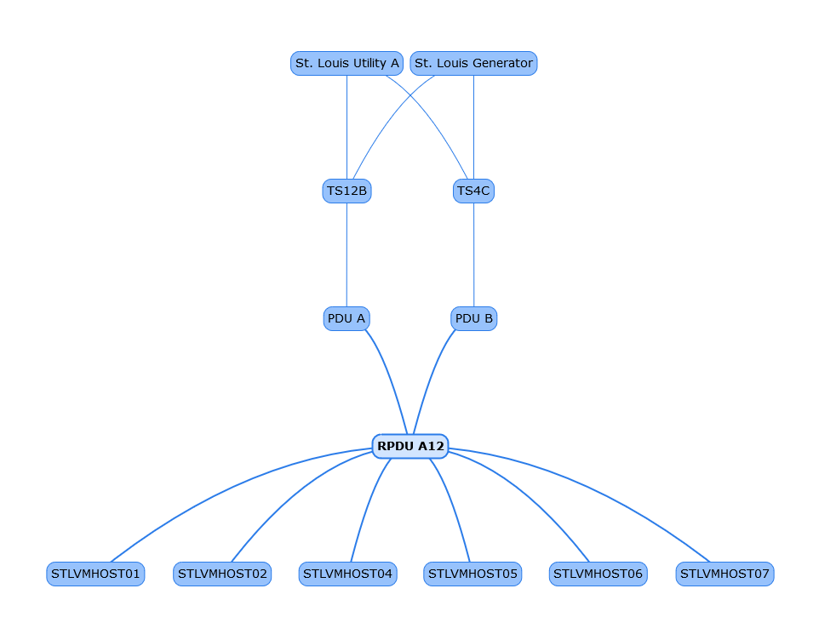
DCIM Onboarding – Cable Management Functional Capability
Discovery
(Automated)
Software Driven Discovery of Devices, Network Cards, and Port Type
Cards Configured
Software Driven Mounting of Network Cards within NLyte Asset Records
Connection Points
Software Driven Association of Connections between Devices
DNS Validations
Port Inventory
Software Driven Inventory of Ports per Card per Device
Continuous Validations of Device Configuration

Slide 7
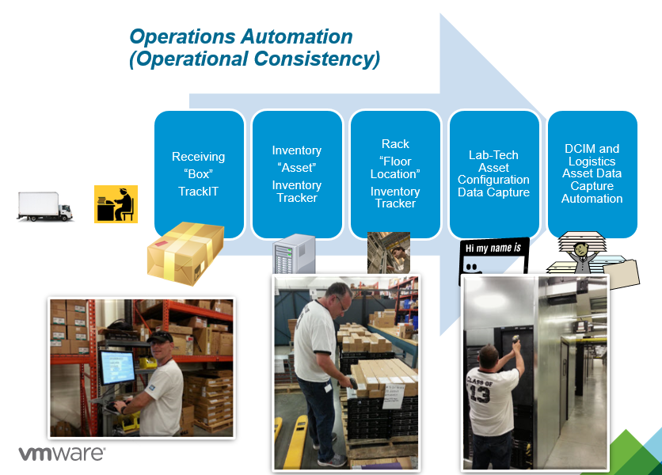
DCIM Onboarding – Change Management Functional Capability
Tenant Projects
Elevation Changes by Customer Requirement
Operations Automation
Software Assisted Operations Use-Cases
Change Validations
Software Driven Validations
Change Discovery
Operations Workflows
Site-Level Operations Use-Cases
Software Driven Continuous Validations of Device Configuration
Integration with OrderNow
PSC Decision Support
Receive
Deploy
Move
Decom
RMA
Receive
Deploy
Move
Decom
RMA
Audit
OrderNow
DNS
Change Notifications
Discrepancy Reports

Slide 8
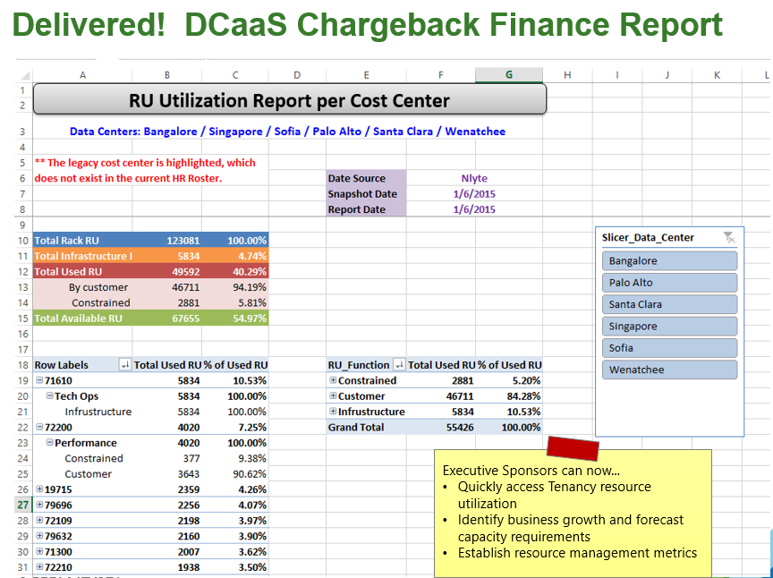
DCIM Onboarding – Capacity Management Functional Capability
Analytics
NLyte Reports
Tenancy Services
Elevation Operations (View, Change)
Forecasts
Facility Planning Analytics
Automated Cautions
Software Driven Cautionary Reports
Custom Reports
DCIM Portal
Power Threshold
Space Threshold
Change Request
Notifications

