Slide 1
Vmware DCIM A Case Study
Phil Pennington, DCIM Solutions Architect, VMware IT

Slide 2

DCIM Technology Adoption Operational Readiness
Roles + Workflow + Automation
People + Process + Tools
Asset
Management
Change
Management
Analytics and
Forecasting
Metrics
Data Consistency
Operational Consistency

Slide 3
DCIM Onboarding Plan Technology Adoption by Functional-Area and User-Role
People + Process + Tools = Roles + Workflow + Automation
Asset Management
Tenant Manager
Change Management
Site Manager
Power Management
Capacity Management
Cable Management
Environmental Management
Reservations Manager
Operations Manager
Power Manager
Site Manager
Site Manager
QA Manager
Reservations Manager
Catalog Manager
Reservations Manager
Site Manager
Reservations Manager
Operations Manager
QA Manager
QA Manager
Operations Manager
Power Manager
Operations Manager

Slide 4
DCIM Logical Use-Cases per User-Role
User-Role + Usage-Scenarios
Delivery Priority | Objective Theme | DCIM User can…
1 | Operations Manager | Use scanning tools directly integrated with NLyte for Asset Management operations. Create, View, and Edit asset records. Use Bulk-Edit tools to Create, View, and Edit asset records. Manage site-level operations workflows, processes, activities, and tasks.
2 | Reservations Manager | Manage cabinet-level space utilization. Create, update, and delete rack-unit reservations per tenant change request. Initiate “what if…?” change management scenarios.
3 | Power Manager | Manage cabinet-level power utilization and monitoring operations. Create, update, and delete constrained-cabinet markers.
2 | QA Manager | Define standard projects, workflows, and processes. Monitor Operational QA Metrics.
3 | Tenant Manager | Manage business-group and end-user asset assignments. Create and Update tenancy records.
1 | Catalog Manager | Manage the global materials catalog. Create, Update, and Delete materials records.
4 | Analytics Manager | Manage DCIM Analytics. Create global DCIM reports. Support executive-level analytics requirements.

Slide 5
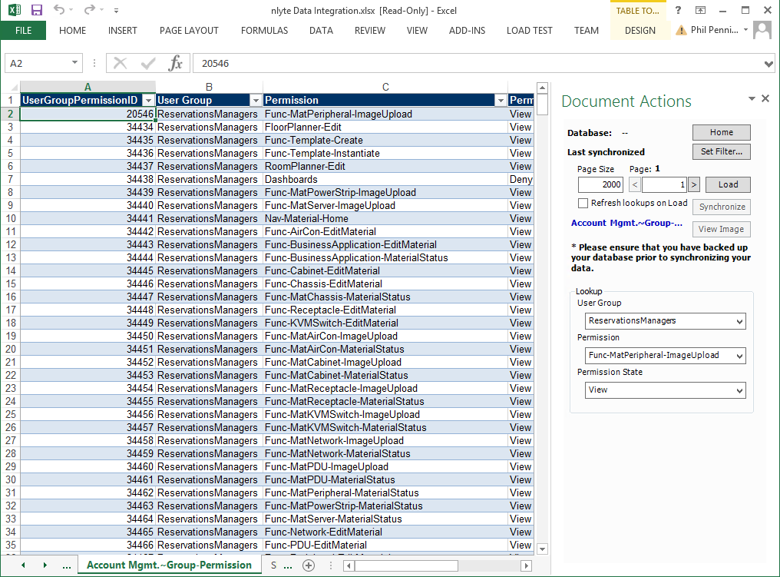
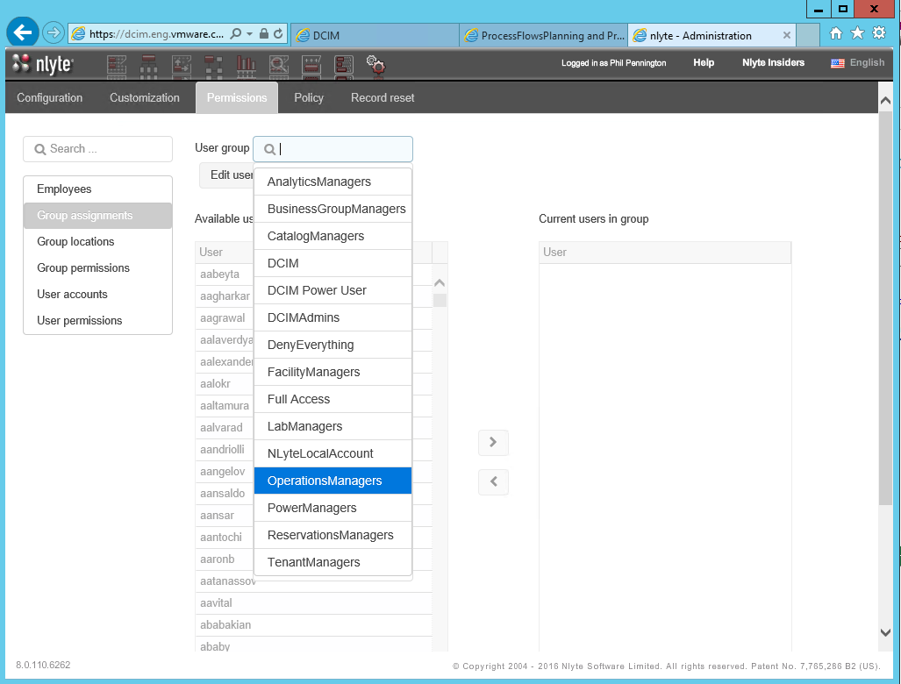
DCIM User Role Configuration
Customize the Tool to Recognize Users by Role
Delivery Priority | Objective Theme | DCIM User can…
1 | Operations Manager | Use scanning tools directly integrated with NLyte for Asset Management operations. Create, View, and Edit asset records. Use Bulk-Edit tools to Create, View, and Edit asset records. Manage site-level operations workflows, processes, activities, and tasks.
2 | Reservations Manager | Manage cabinet-level space utilization. Create, update, and delete rack-unit reservations per tenant change request. Initiate “what if…?” change management scenarios.
3 | Power Manager | Manage cabinet-level power utilization and monitoring operations. Create, update, and delete constrained-cabinet markers.
2 | QA Manager | Define standard projects, workflows, and processes. Monitor Operational QA Metrics.
3 | Tenant Manager | Manage business-group and end-user asset assignments. Create and Update tenancy records.
1 | Catalog Manager | Manage the global materials catalog. Create, Update, and Delete materials records.
4 | Analytics Manager | Manage DCIM Analytics. Create global DCIM reports. Support executive-level analytics requirements.

Slide 6
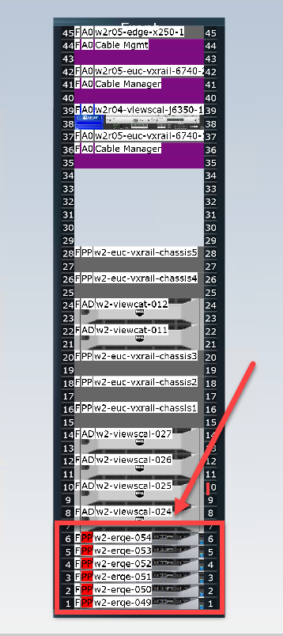
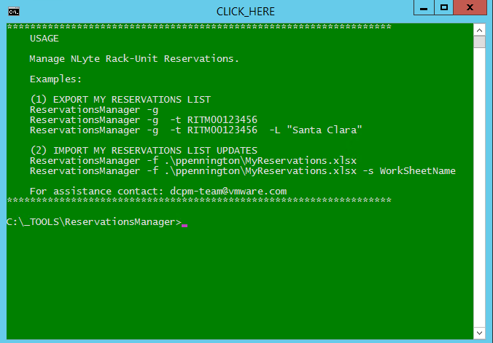
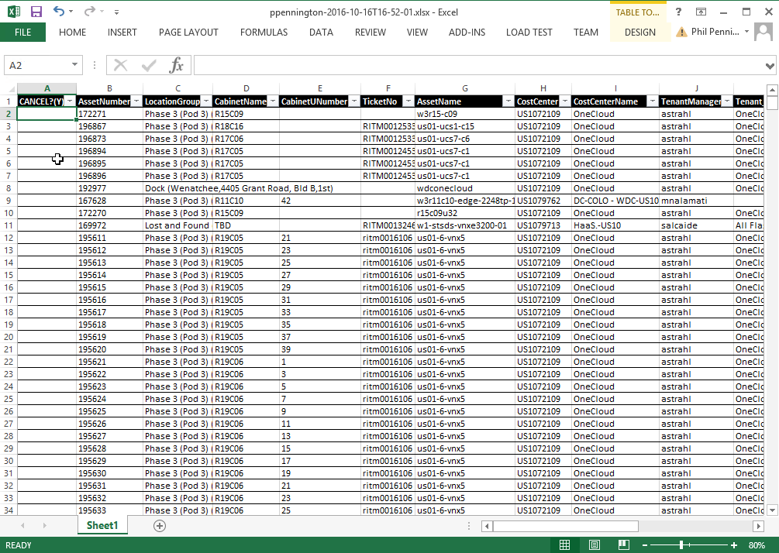
Example: Reservations Manager – Reserve RU
User-Role + Usage-Scenarios

Slide 7
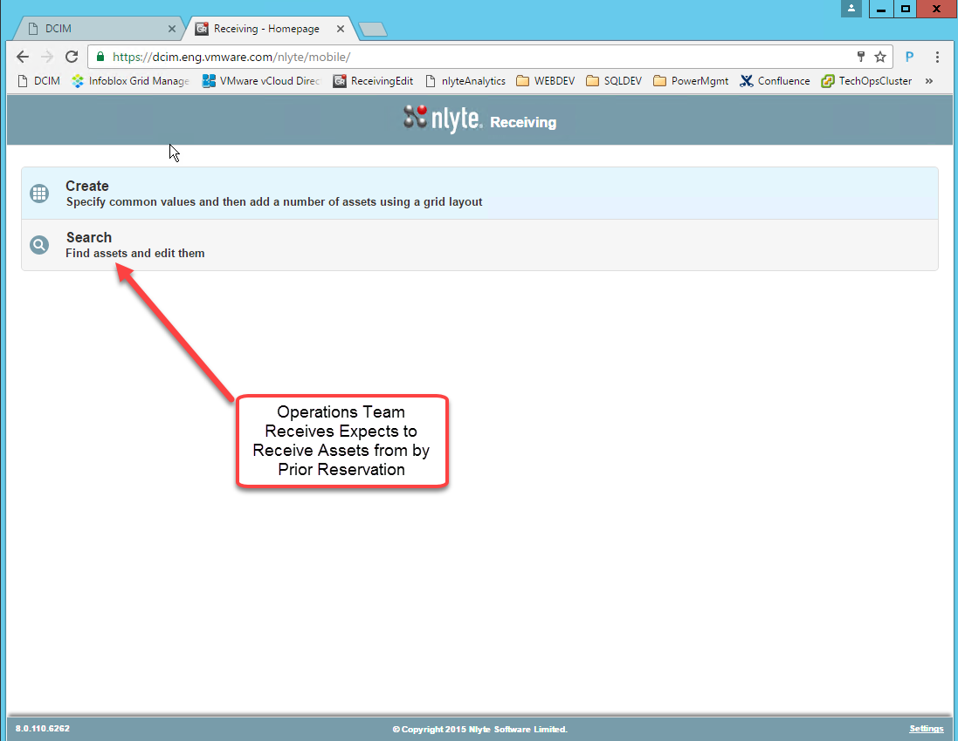
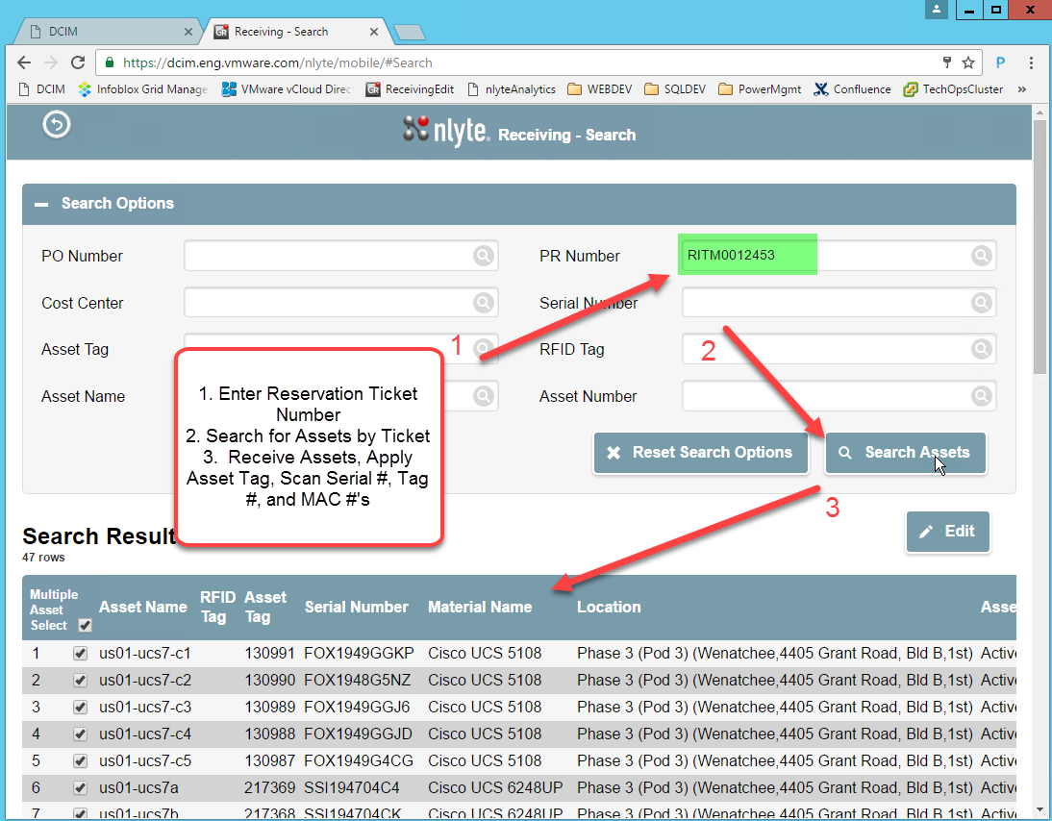
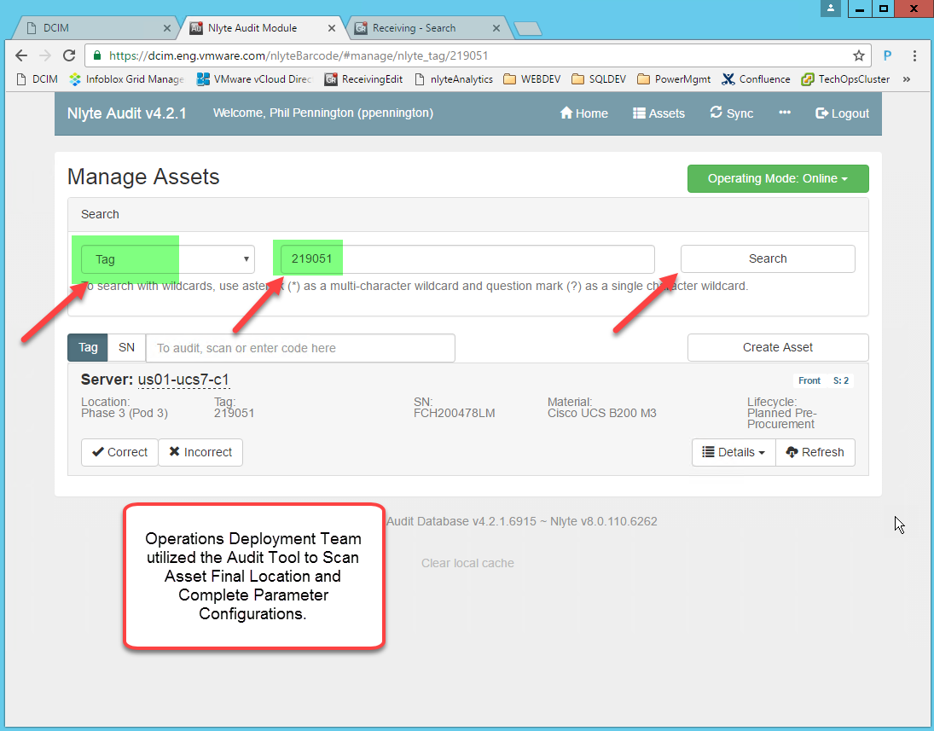
Example: Operations Manager – Receive Assets
User-Role + Usage-Scenarios

Slide 8
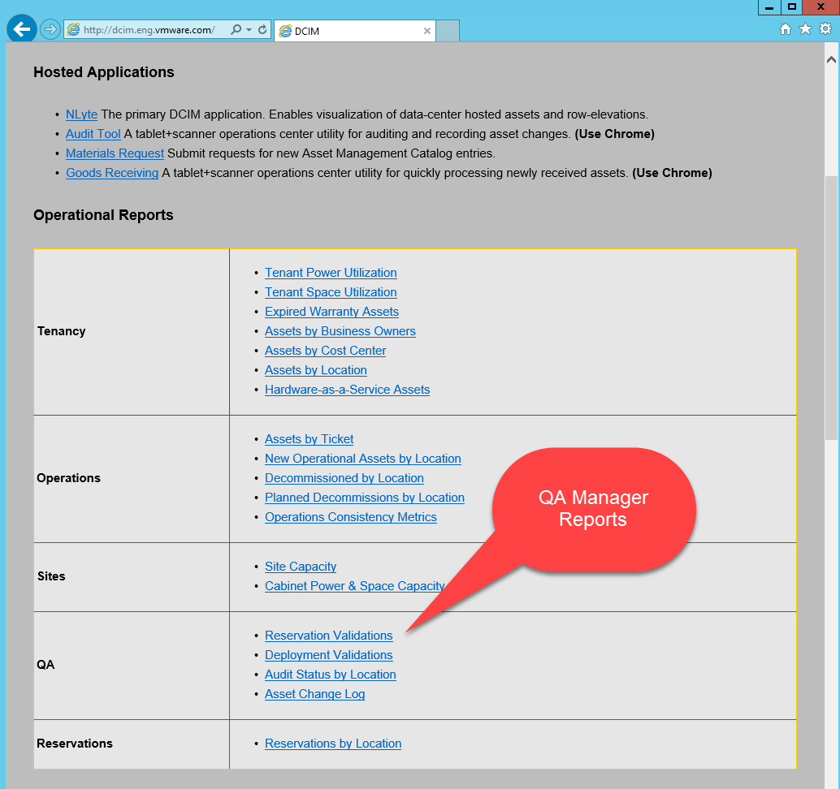
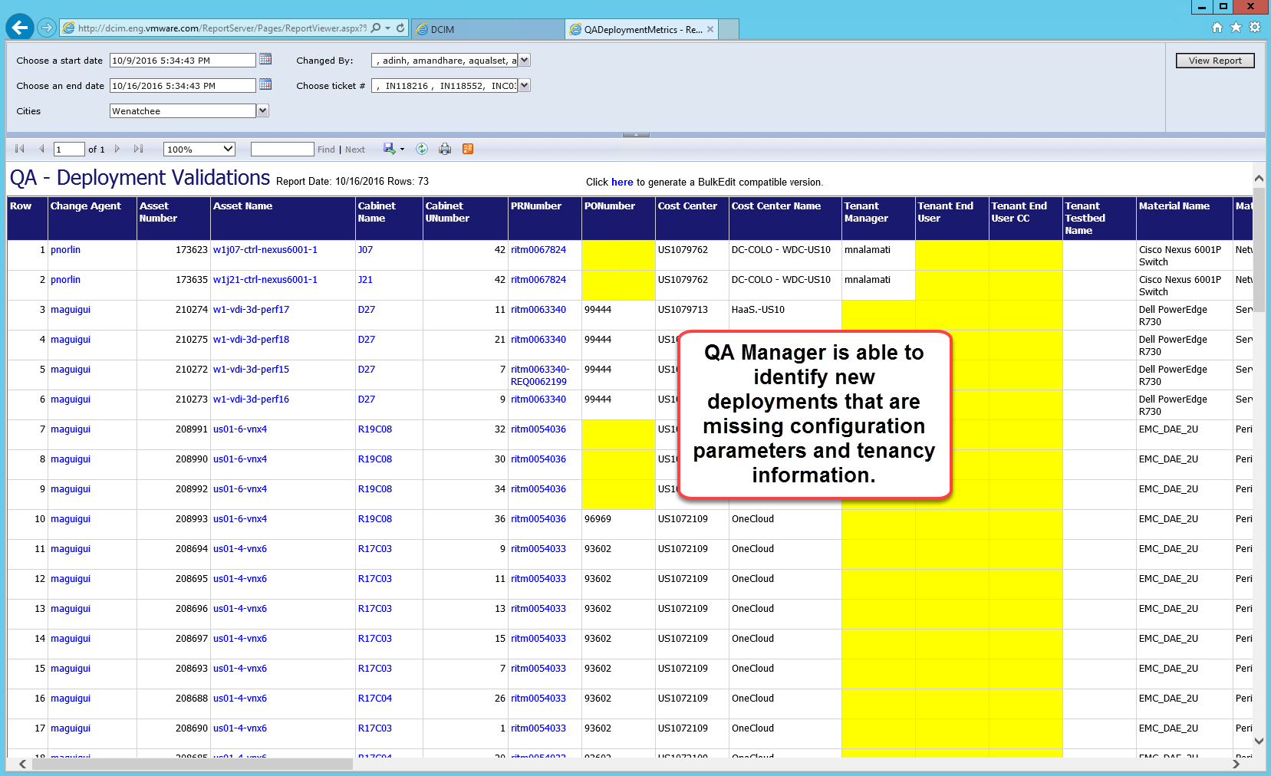
Example: QA Manager – Validate Deployments
User-Role + Usage-Scenarios

Slide 9
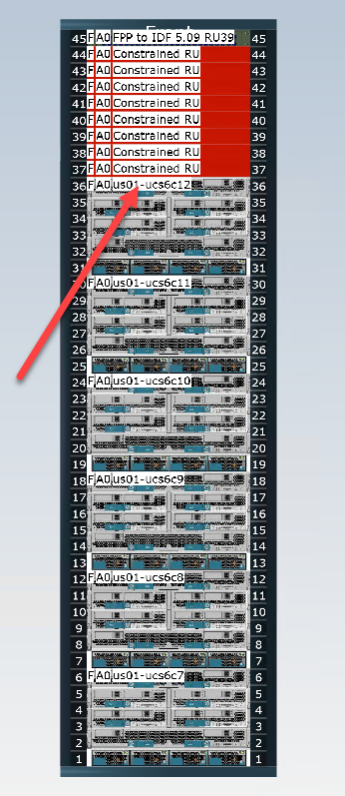
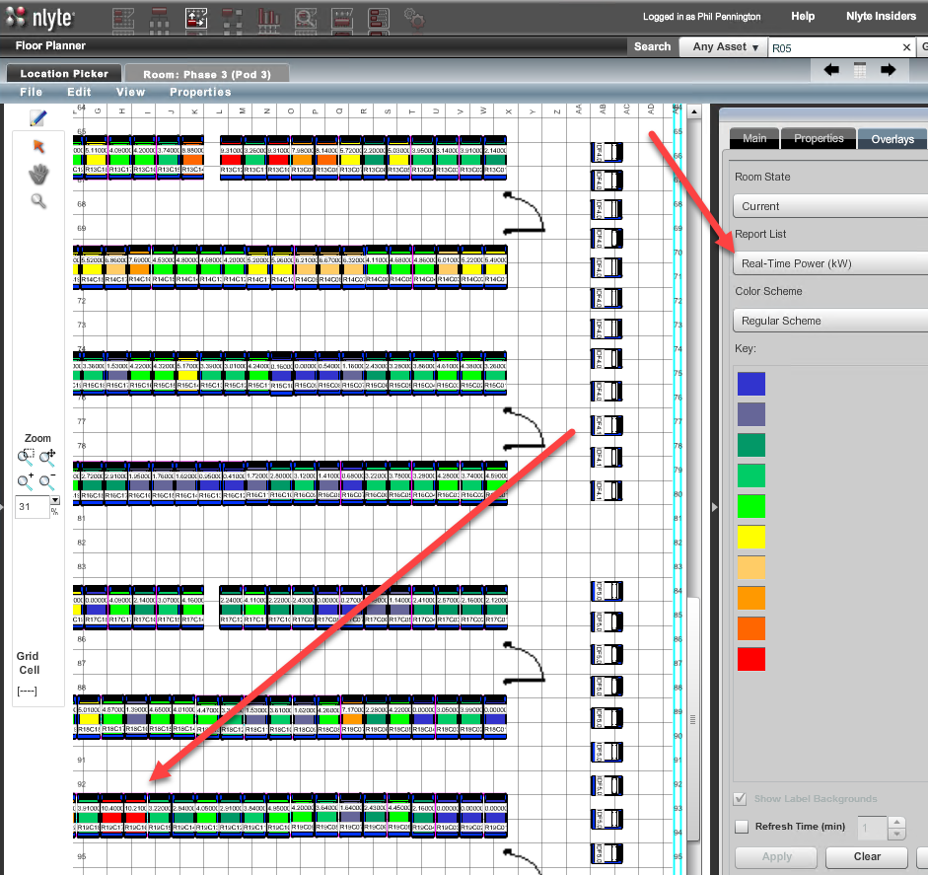
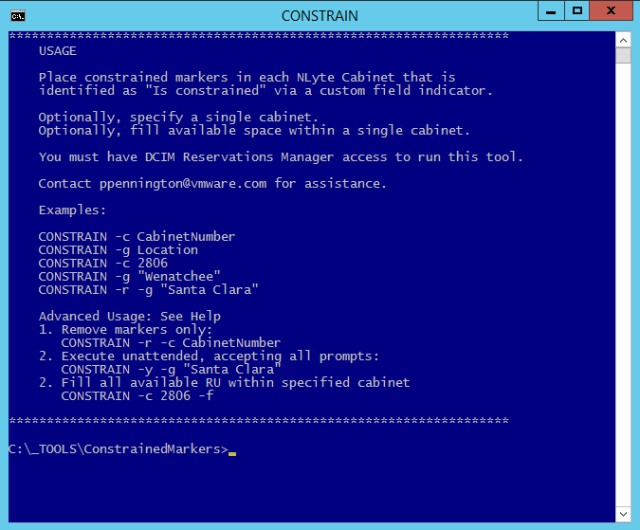
Example: Power Manager – Constrain Cabinets
User-Role + Usage-Scenarios

Slide 10
DCIM Onboarding Plan Technology Adoption by Functional Area
Asset Management
Scoping
Change Management
Sensor Network
Power Management
Capacity Management
Cable Management
Environmental Management
Tools Training
Tenancy
Scoping
Analytics
Discovery
Floor Plans
Data Migration
Operations
Workflows
Automation
Validations
Discovery
PDU Network
SNMP Polling
Operations
Inventory
Alerts
Reservations
Forecasts
Port Inventory
NIC/HBA Configuration
Switch-Port Map
DNS Validation
Monitoring
Alerts
Analytics

Slide 11
DCIM Onboarding – Asset Management SITE = <NAME HERE>
Contributors
DCIM Champion <NAME>
DCIM Solutions Consultant <NAME>
[Role] Managers <TBD>
Stakeholders
Site Manager <NAME>
Operations Leads <NAMES>
DCIM Consumers <NAMES>
Scoping
(1 week)
Roles
Floor Plans
(2 weeks)
CAD Import
Migration
(1-N weeks)
Cleaning
Schedule
Data-Sources
Operations
(continuous)
Cabinets
Tools
(1 week)
NLyte
Tools VM
Access
Training
Mapping
Import
Exceptions
Maintenance
Workflow
Validations
Validations
Audits
Improvement
Tasks | Status | Start/End | Issues | Owner

Slide 12
DCIM Onboarding – Power Management SITE = <NAME HERE>
Contributors
DCIM Champion <NAME>
DCIM Solutions Consultant <NAME>
[Role] Managers <TBD>
Stakeholders
Site Manager <NAME>
Operations Leads <NAMES>
DCIM Consumers <NAMES>
Scoping
(1 week)
Roles
PDU Network
(2-N weeks)
Network Subnets
SNMP Polling
(1 week)
NLyte Polling Services
Schedule
Data-Sources
Operations (continuous)
Inventory
(2-N weeks)
PDU Models
Testing and Diagnostics
Cabinet/PDU Assignment
Data Import
PDU Configure
DNS IP Ranges
Routing
Management Software Integration
Operations Center
Reports
Validations
Constraint Detection
Tasks | Status | Start/End | Issues | Owner

Slide 13
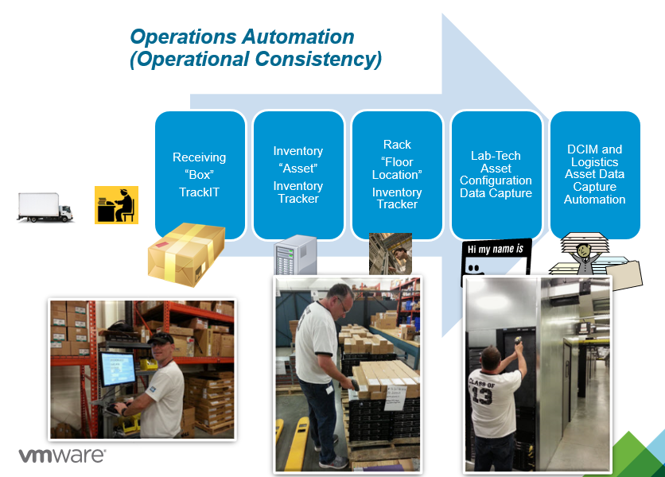
DCIM Onboarding – Change Management Functional Capability
Tenant Projects
Elevation Changes by Customer Requirement
Operations Automation
Software Assisted Operations Use-Cases
Change Validations
Software Driven Validations
Change Discovery
Operations Workflows
Site-Level Operations Use-Cases
Software Driven Continuous Validations of Device Configuration
Integration with OrderNow
PSC Decision Support
Receive
Deploy
Move
Decom
RMA
Receive
Deploy
Move
Decom
RMA
Audit
OrderNow
DNS
Change Notifications
Discrepancy Reports

Slide 14
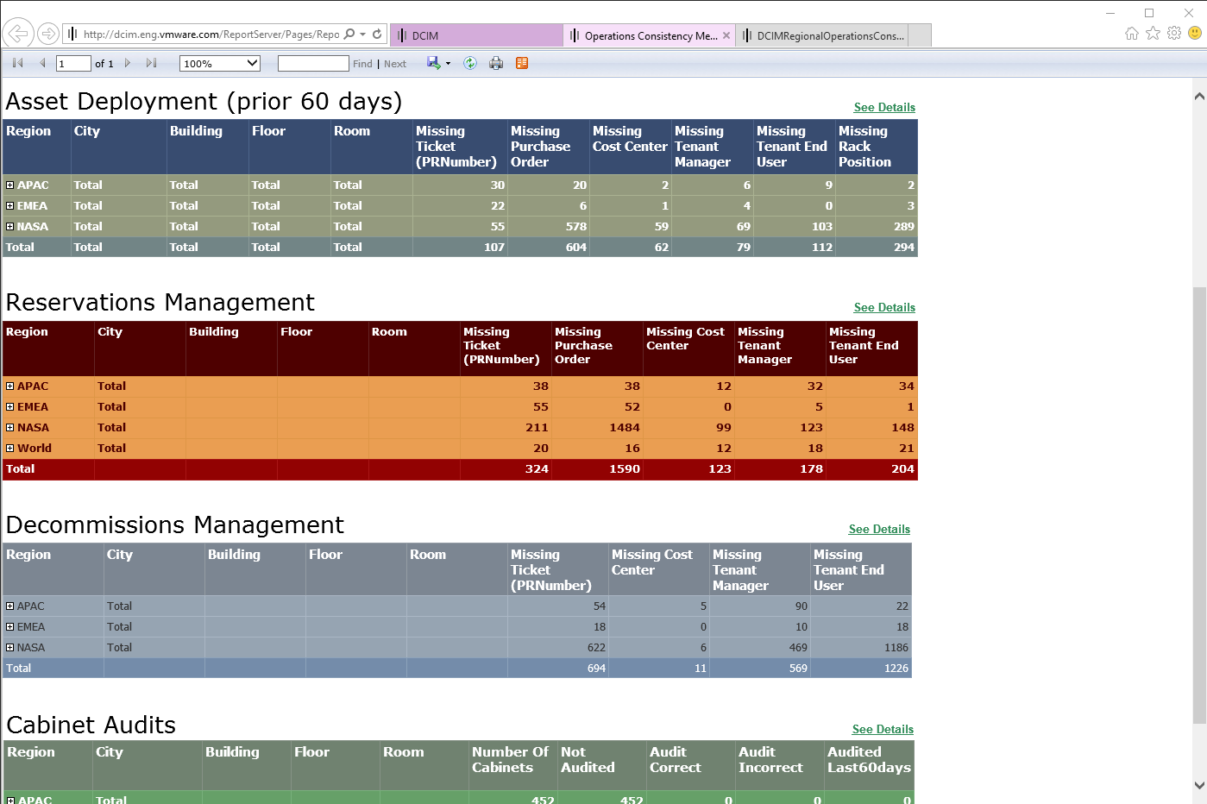
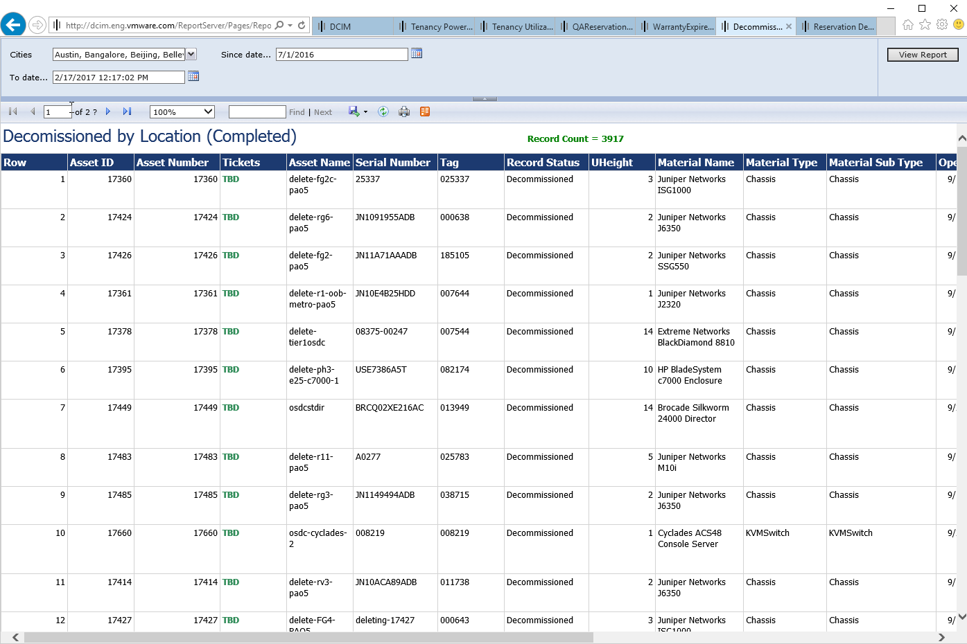
DCIM Onboarding – Capacity Management Functional Capability
Analytics
NLyte Reports
Tenancy Services
Elevation Operations (View, Change)
Forecasts
Facility Planning Analytics
Automated Cautions
Software Driven Cautionary Reports
Custom Reports
DCIM Portal
Power Threshold
Space Threshold
Change Request
Notifications

Slide 15
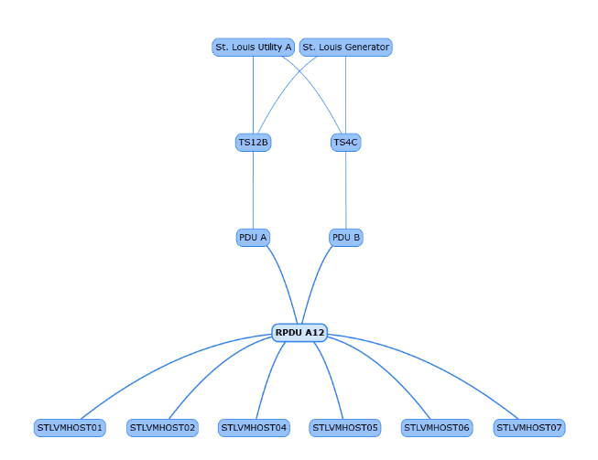
DCIM Onboarding – Cable Management Functional Capability
Discovery
(Automated)
Software Driven Discovery of Devices, Network Cards, and Port Type
Cards Configured
Software Driven Mounting of Network Cards within NLyte Asset Records
Connection Points
Software Driven Association of Connections between Devices
DNS Validations
Port Inventory
Software Driven Inventory of Ports per Card per Device
Continuous Validations of Device Configuration

Slide 16
DCIM Onboarding – Sponsorship Success Criteria
Sponsorship Level | Enterprise Roles | Accountability
Executive | Vice-President CxO | Signature sponsors of the corporate “DCIM Initiative” Evangelizes corporate initiatives Chair of major milestone project reviews
Business | Sr. Directors General Managers Regional Directors | Business stakeholders Enable cross-team collaboration Approve project objectives, plans, and deliverables Assign and enable technical resources
Technical | Operations Managers DCIM Solutions Consultants Technical IT Operations Staff | Execute the DCIM Onboarding Plan Establish Operations team roles Establish Operations workflows Implement technical solutions Achieve project milestone deliverables Scale-out via training and role enablement

Slide 17

Please let us know how we did!
Thank You For Attending!
“VMware DCIM : A Case Study”
-- FILL OUT THE SURVEY
Given to you at registration

