Slide 1
Technology Adoption
An Example of Capability Envisioning…
Increase process automation!
Roles + Workflow + Automation
Business Insights
Capacity Management
Metrics
Data Consistency
Change Management
Power Management
How do we increase Operational Consistency in order to harvest Business Insights?
Asset Management
Operational Consistency
Notes:
KEY POINT : We need to increase our Operational Consistency by applying even more Automation!
Everyone naturally expects consistent data. Good business decisions depend upon insights gained from consistent business operations analytics. Even so, few seem to understand the intrinsic relationship between business operations capability and resultant quality of analytical information. Business sponsors often expect consistency in reporting that would be impossible without corresponding prior operations enablement.
The following illustration depicts this correspondence. You may recognize that the shape of the curve between the axis is exponential and not directly proportional. This shape works in our favor per the following observations.
• A slight increase in Operational Consistency (i.e. a movement to the right along the horizontal axis) results in a dramatic increase in Data Consistency (i.e. upward movement along the vertical axis). In other words, a small operational improvement can go a long way.
• How can we know our consistency position on this curve? That’s a function of metrics. Operational Consistency measurements provide insights into where we are at any point in time.
• How can we improve our consistency position? That’s the art and science of Operations Management involving People, Processes, and Technologies. Or, more specifically, the organizational application of Roles, Workflow, and Automation to business processes.

Slide 2
iPaaS Technology Adoption
Capability Envisioning…
Enable Self-Service by Role & Increase Automation!
Roles + Workflow + Automation
Business Insights & Value
Metrics
Integration Workflow Automation Capability
Integration Persona Role-Group Capabilities
Information Consistency
Integration Governance Capability
iPaaS API Catalogs Capability
iPaaS API Services Capability
Complex Integrations Capability
How do we increase Operational Consistency in order to harvest Business Value?
Business-Domain Data & Workflow Modeling Capability
Operational Consistency
Notes:
KEY POINT : We need to increase our Operational Consistency by applying even more Automation!
Everyone naturally expects consistent data. Good business decisions depend upon insights gained from consistent business operations analytics. Even so, few seem to understand the intrinsic relationship between business operations capability and resultant quality of analytical information. Business sponsors often expect consistency in reporting that would be impossible without corresponding prior operations enablement.
The following illustration depicts this correspondence. You may recognize that the shape of the curve between the axis is exponential and not directly proportional. This shape works in our favor per the following observations.
• A slight increase in Operational Consistency (i.e. a movement to the right along the horizontal axis) results in a dramatic increase in Data Consistency (i.e. upward movement along the vertical axis). In other words, a small operational improvement can go a long way.
• How can we know our consistency position on this curve? That’s a function of metrics. Operational Consistency measurements provide insights into where we are at any point in time.
• How can we improve our consistency position? That’s the art and science of Operations Management involving People, Processes, and Technologies. Or, more specifically, the organizational application of Roles, Workflow, and Automation to business processes.

Slide 3
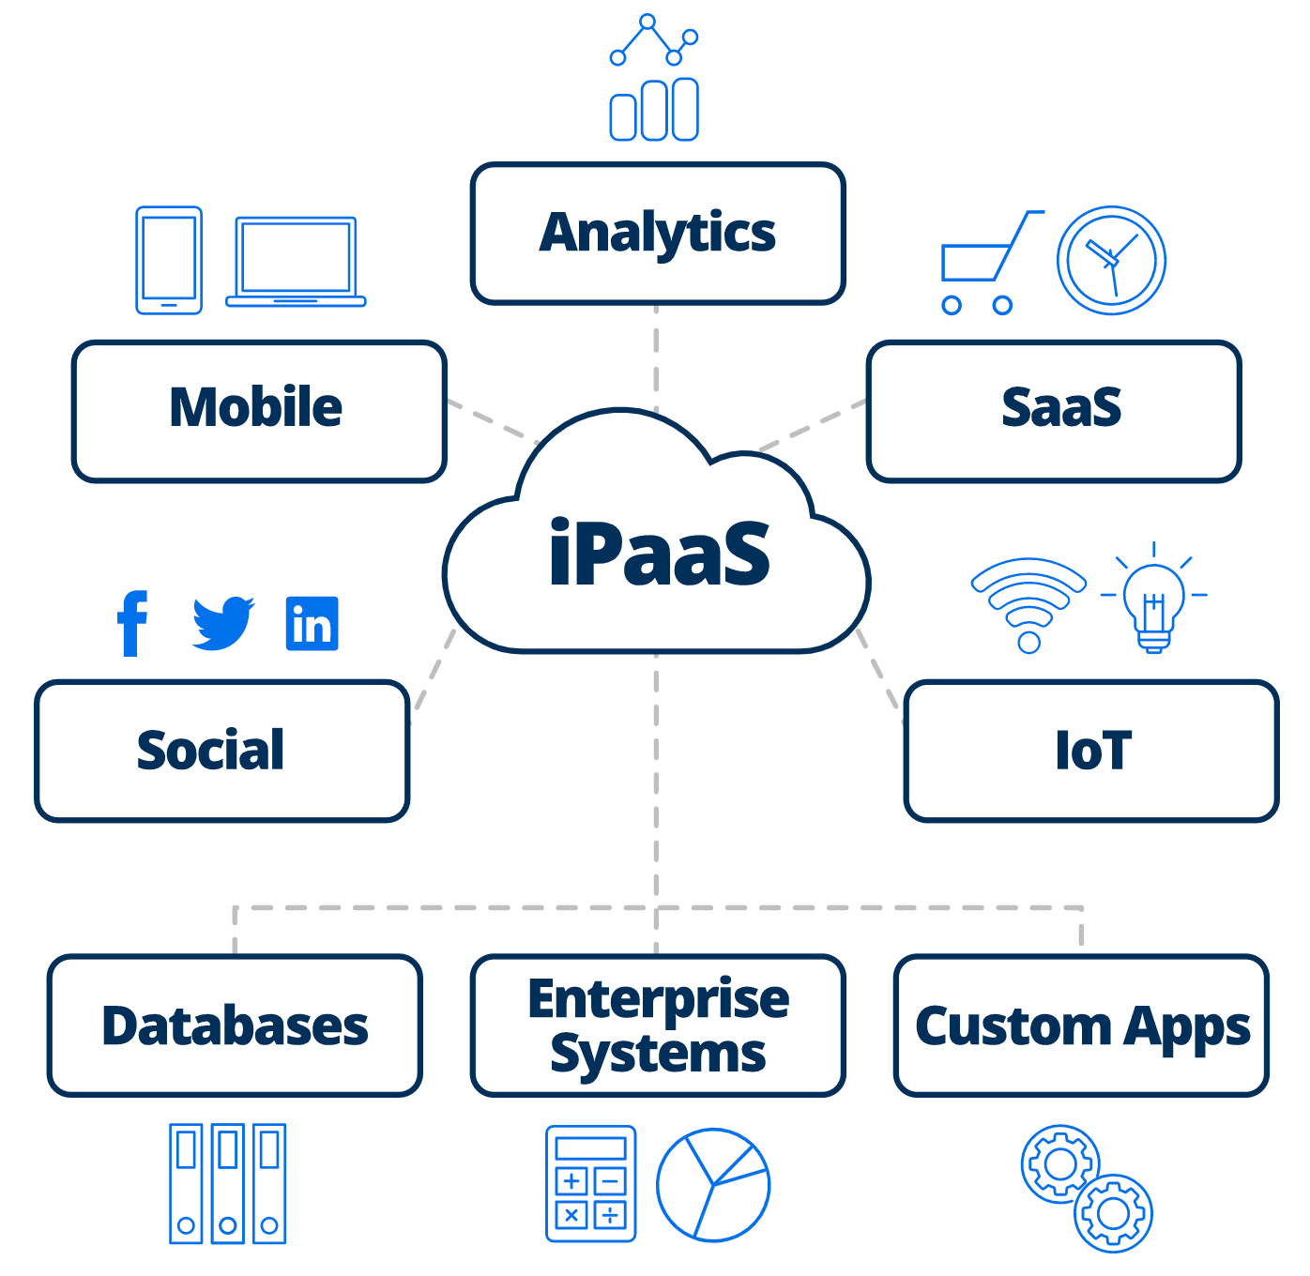
iPaaS Capability Goals
How does this help the business?
  Accelerate Integration Initiatives – more quickly enable digital transformation.
  Spend more time on higher value integration activities – re-use of prebuilt connectors.
  Expand integration capacity – even business users can create and management integrations.
  Change integrations rapidly – dynamic data-model discovery.
  Progress business transformations – democratize business data.
  Migrate legacy applications – move from enterprise to SaaS.
  Enable Master Data Management – replicate and synchronize.
  Support multiple integration paradigms – batch, streaming, & events.
  Manage integration security – minimize distributed connections.
  Reduce application development complexity – single integration hub.
  Reduce operational complexity – single pane of glass management.
  Increase business agility – CI/CD component architecture.
Notes:
How can iPaaS help the business?
You can accelerate your integration initiatives.
With iPaaS, you can significantly reduce the time it takes to integrate applications, making integrations available much more quickly to speed your digital transformation initiatives.
You can spend more time on higher value integration activities.
Because it provides pre-built, validated connectors that are already integrated with application-specific APIs, with iPaaS, you won’t have to write low-level connectivity code. The iPaaS vendor commits to maintaining connectors and ensuring compatibility with key applications.
You can expand your integration capacity.
The high-level tools of iPaaS can be used by your integration specialists, business analysts, and even citizen integrators, allowing you to expand the pool of people creating and managing your integrations. This not only accelerates the availability of new integrations, it also reduces the burden on your IT department so that they can focus on higher value activities.
You can change your integrations rapidly.
Because your business and the technologies you use change constantly, iPaaS helps you adapt quickly with a consistent user interface that lets you update or evolve your integrations to match—a requirement of most digital transformation efforts.
You can progress your transformation into a digital business.
A digital business exploits digital technologies to create new business models in which the physical and digital worlds combine. Among its many characteristics, a digital business operates at a high speed and efficiency. iPaaS helps progress your transformation toward becoming a digital business, breaking down barriers between data silos and integrating them together. It makes the right information available to the right people instantly so that they can make decisions and take action quickly. This not only helps people work smarter, but also more efficiently because integrating applications and data can automate much of your business processes by eliminating unnecessary manual data entry.
What can you use iPaaS for?
An iPaaS is a vital component within a digital transformation initiative. No matter where you host your data and applications (in the cloud or on-premises), iPaaS can help you:
Exchange data between your applications in near real-time to streamline your business processes, enhance your customer and employee experiences, and empower your corporate decision makers. For example, you can integrate your Salesforce Sales Cloud instances with your on-premises enterprise-level ERP platform like Microsoft Dynamics AX or a cloud-based ERP solution like Microsoft Dynamics 365 Operations to give your end users of both systems complete views into your customer and order-fulfillment activities. Learn best practices for creating this type of integration.
Migrate data from legacy applications to modern, cloud-based business systems to make your business more agile. For example, you can map, transform, and move data from and older business system such as Microsoft Dynamics CRM 4.0 on-premise to a cloud CRM like Salesforce or Microsoft Dynamics 365. iPaaS can help you migrate data such as accounts, contacts and opportunities in the correct order to preserve relationships between the data in the new system. Many companies also use custom fields and custom objects, which the iPaaS can discover and include in the migration process.
Replicate data on a regular basis for your analytics and archiving processes to help you uncover new insights, or for scheduled financial reporting. You can create a single view of formatted data from multiple data sources within a data warehouse, or raw data within a data lake. You can replicate data continuously or on a scheduled basis. For example, you can replicate the data in a CRM system like Salesforce or Microsoft Dynamics 365 to a local Oracle, MySQL or Microsoft SQL Server database.
Integrate external data from sensors and embedded devices into your business processes to gain real-time views of your business environment and the market. iPaaS makes it easier to integrate smart devices that connect to networks outside of your corporate firewall.

Slide 4
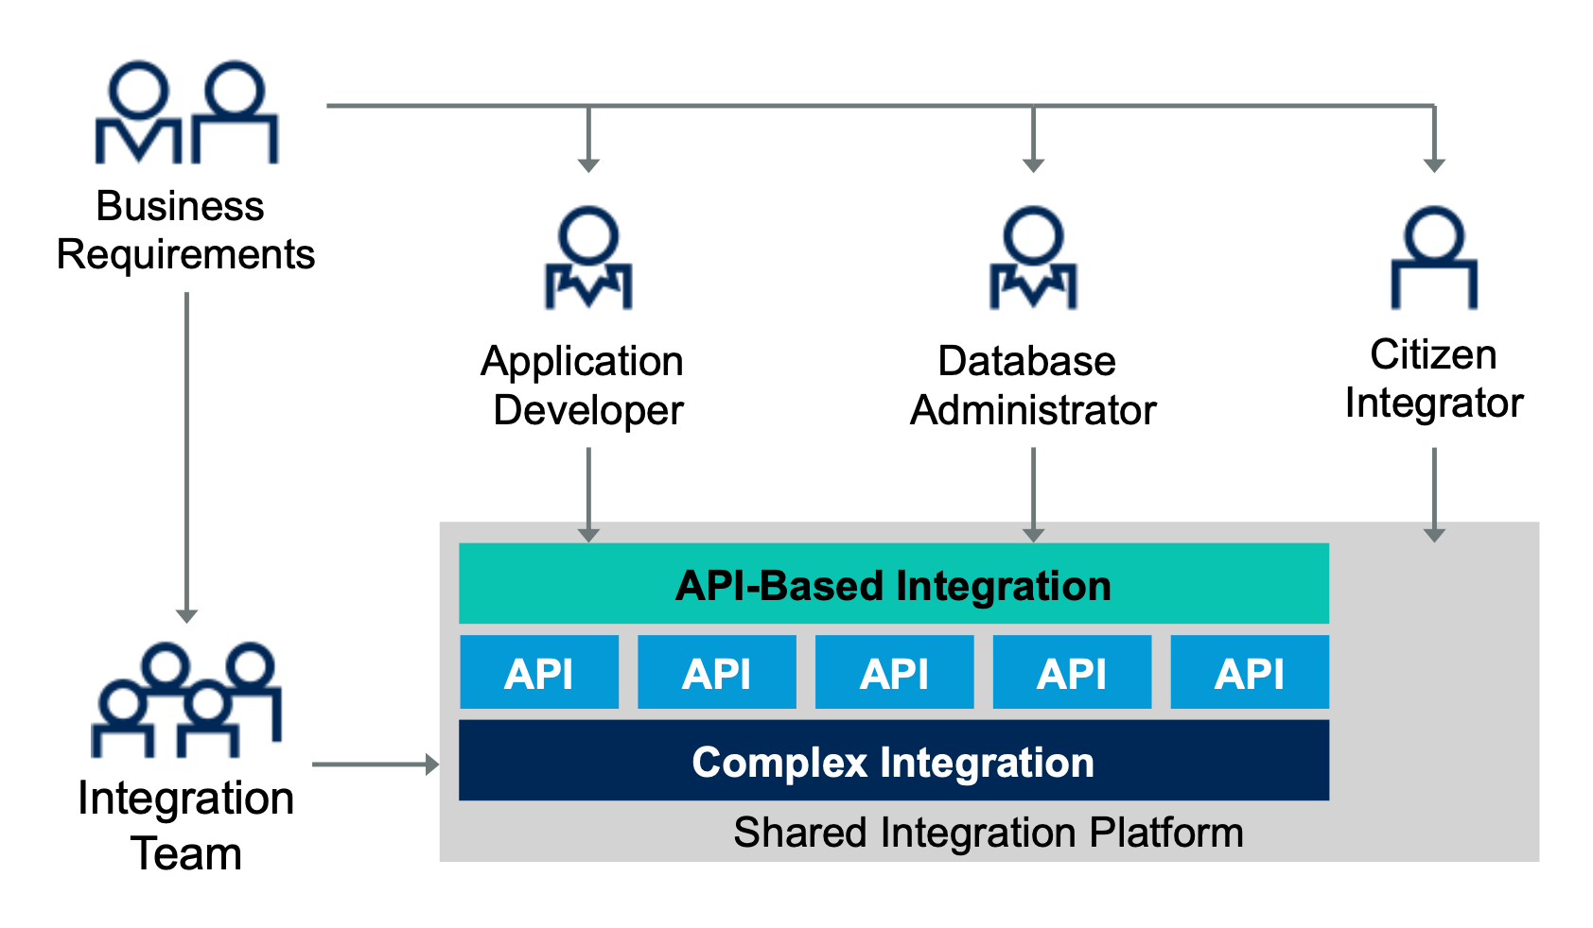
A New Way of Working…!
Integration by Persona leveraging a common Integration Platform (Roles + Workflow + Automation)

Slide 5
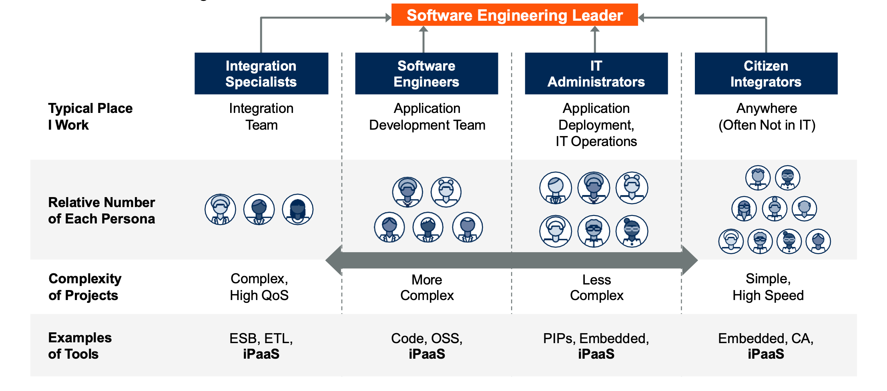
Key Integration Personas
Enablement by Role-Group and Usage Scenarios with a variety of Tools and Automation Capabilities
Roles + Workflow + Automation
High-Skill Integrators
No-Code Tools Users

Slide 6
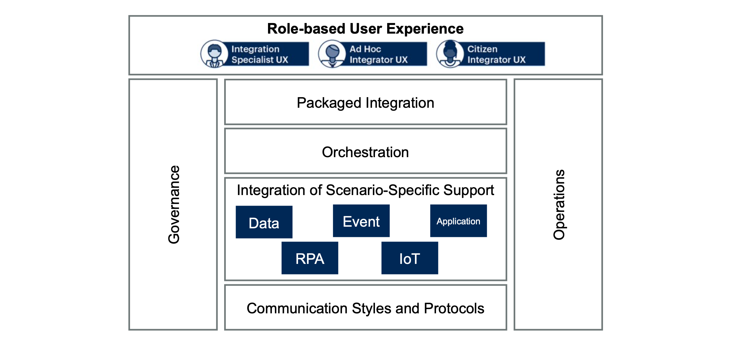
iPaaS Solution by Functional Area
A Hybrid Integration Platform Capability Framework (Roles + Workflow + Automation)
How to realize this Platform Capability Framework…?
Use a matrix to identify current and required capabilities based on business domains, personas, and use-cases.
Create a democratized hybrid integration platform consisting of multiple capabilities by iPaaS functional-area.
Provide clear guidance on when to use each integration technology.

Slide 7

Integration Persona Capability Matrix
What types of Integrations can be done by whom?
 | Specialist (ESB) | Specialist (ETL) | Ad Hoc (App Dev) | Ad Hoc (DBA) | Ad Hoc (SaaS Admin) | Citizen (Bus Analyst)
Legacy Integration
Agile Integration
Data Synchronization
Streaming Integration
Publish & Subscribe
Notes:
Personas by skill, experience, and tooling can accomplish integrations by type.

Slide 8
Integration Persona Capability Matrix
What business systems or product integrations can be done by whom?
 | Specialist (ESB) | Specialist (ETL) | Ad Hoc (App Dev) | Ad Hoc (DBA) | Ad Hoc (SaaS Admin) | Citizen (Bus Analyst)
Legacy Integration
Agile Integration
Data Synchronization
Streaming Integration
Publish & Subscribe
SFDC
Oracle
Svc Now
SFDC
Oracle
Svc Now
SFDC
SFDC
Oracle
Oracle
Oracle
Svc Now
Svc Now
SFDC
Notes:
Personas by skill, experience, and domain can accomplish integrations by type and by product technology.

Slide 9
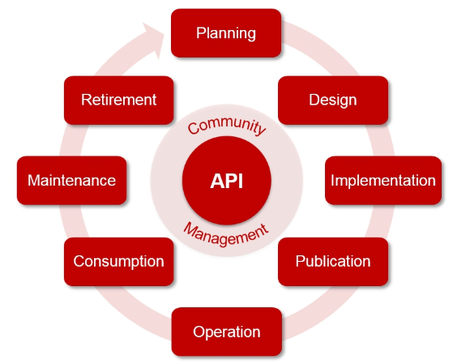
API Management Technical Capability
Platform as a Service

