Slide 1
Trained to Discern the Difference
Religion, Worship, Sacrifice, and the Obedience of Faith
“But solid food is for the mature, whose perceptions are trained by practice to discern both good and evil.”
(Hebrews 5:14)
https://tinyurl.com/TeachTheWord
Notes:
Hold on title while men settle. Four words, one question, and a training plan.

Slide 2
The Interrupted Lesson
Hebrews 5:10–12 → What was the writer teaching when he stopped?
One of the most uncomfortable sentences in the New Testament:
“For though you should in fact be teachers by this time, you need someone to teach you the beginning elements of God’s utterances.” (Hebrews 5:12)
By this time. The writer is doing math on them → years in the faith against what scriptural concepts they can digest → and the numbers don’t work.
But look at what he was teaching when he stopped:
v.10 → Christ, “a high priest in the order of Melchizedek”
v.11 → much to say, hard to explain… “you have become sluggish in hearing”
The solid food they couldn’t chew was the meaning of priesthood and sacrifice.
So that is our meal today… Four concepts, one question, and a training plan.
This message is a gift from God’s Word. Use it → for you, your family, your church.
Notes:
[CLICK] Heb 5:12 quote. Land “by this time.”
[CLICK] The math paragraph.
[CLICK] vv.10–11 — the interrupted subject: priesthood and sacrifice. That is the meat of this letter.
[CLICK] Our meal today. A gift — for your family if not for you.

Slide 3
The Four Layers
Four concepts Scripture uses with precision → a conceptual stack
4. Obedience of Faith
the SETTLED PATTERN (Romans 1:5; 16:26)
Obedience of Faith: The whole gospel stack aligned → a life reorganized around what it claims. Not one dramatic act.
3. Sacrifice
the COST → the disposition made visible
Sacrifice: “Take your son → your only son, whom you love” (Gen 22:2). Faith became visible at the raised knife (Heb 11:17–19).
2. Worship
the DISPOSITION → the heart aimed at God
Worship: “In spirit and truth” (John 4:23–24). But a disposition is invisible → even to its owner.
1. Religion
the FORM → observance, attendance, identity
Religion: James says a man can practice the form; deceive his heart → “futile” (James 1:26).
Alone, it proves nothing.
Notes:
Teach the stack with fingers, one word per layer.
[CLICK] Layer 1 Religion — the form. [CLICK] Layer 2 Worship — invisible disposition. [CLICK] Layer 3 Sacrifice — worship’s currency; Abraham. You find out what a man worships by what he’ll pay. [CLICK] Layer 4 — obedience of faith; opens and closes Romans.

Slide 4
The Sobering Part
Each layer can exist without the ones above it…
Religion without worship → the Pharisee → honoring with lips, heart far away (Isa 29:13)
Worship without sacrifice → sentiment → sincere feeling that never lands (Ezek 33:31–32)
Sacrifice without obedience → Saul → real animals, real altar, edited command (1 Sam 15)
Samuel’s verdict:
“Does the Lord take pleasure in burnt offerings and sacrifices as much as he does in obedience? Certainly, obedience is better than sacrifice.”
(1 Samuel 15:22)
Saul had layer three → and thought it was layer four.
Notes:
[CLICK] Religion w/o worship. [CLICK] Worship w/o sacrifice. [CLICK] Sacrifice w/o obedience — Saul. [CLICK] Samuel’s verdict — read the quote. [CLICK] The line: layer three mistaken for layer four.

Slide 5



Failures of Perception
Malachi’s priests - Saul - Uzzah → they could not see it…
MALACHI — the best kept, the blemished offered.
“You ask, ‘How have we offended you?’” (Mal 1:7)
SAUL — kept the best of the flock; burned a sacrifice anyway.
“I have done what the Lord said.”
(1 Sam 15:13)
UZZAH — a new cart; thirty thousand saw no problem.
“We did not seek him according to the prescribed ordinance.”
(1 Chr 15:13)
Not mainly failures of willpower → failures of perception.
Men at layer one or three, sincerely certain they stood at layer four. An untrained perception can’t tell the layers apart → and it can’t audit itself.
“Solid food is for the mature, whose perceptions are trained by practice to discern both good and evil.” (Hebrews 5:14)
Discernment = telling form from disposition from cost from settled obedience.
Notes:
[CLICK] Malachi — they answer “How have we offended you?” and MEAN it. Let it hang: they can’t see it.
[CLICK] Saul believes his own report.
[CLICK] Uzzah — correct to “bringing the Ark up to Jerusalem”; nobody in the procession perceived it.
[CLICK] The lesson: perception failures; can’t audit itself. The infant doesn’t know he’s an infant.
[CLICK] Heb 5:14 — the answer.

Slide 6
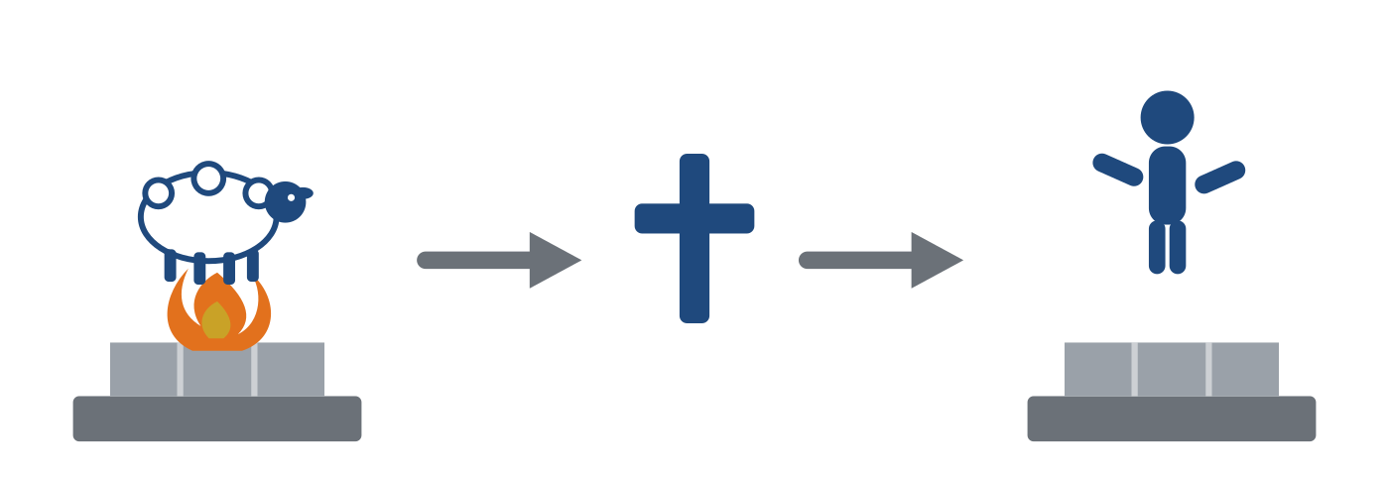
The Altar Today
Do Christians offer sacrifices?
Half of our instinct is right: the atoning sacrifice is finished → once for all (Heb 10:10). No altar you build adds anything to it.
“Therefore, I exhort you, brothers and sisters, by the mercies of God, to present your bodies as a sacrifice → alive, holy, and pleasing to God → which is your reasonable service.” (Romans 12:1)
Sacrifice didn’t end. It changed material. The Substitute has died → so what goes on the altar? You do. Alive.
You are “a holy priesthood, offering spiritual sacrifices acceptable to God through Jesus Christ” (1 Peter 2:5)
praise, good done, possessions shared
→ “God is pleased with such sacrifices” (Heb 13:15–16).
Notes:
[CLICK] The guard first: atonement finished, once for all. Say it plainly.
[CLICK] Romans 12:1 — read slowly.
[CLICK] Graphic + the hinge line: “Sacrifice didn’t end. It changed material.” Pause both sides of it.
[CLICK] 1 Pet 2:5 + Heb 13 — the New Covenant sacrifices named.

Slide 7
You Are the Priest
Malachi’s question arrives with no middleman…
Malachi was written to priests → about the quality of their offerings.
→ Apostle Peter just made you the priest (1 Peter 2:5).
“You bring the blind and lame… offer it to your governor! Will he be pleased with you?” (Malachi 1:8)
Would you hand your employer → your commanding officer → the quality of attention you hand your King?
The old standard crossed the covenants untouched: The best. The whole. The unblemished.
“I will not offer to the LORD my God burnt sacrifices that cost me nothing.” (2 Samuel 24:24)
Notes:
[CLICK] Priesthood transfer — feel the weight.
[CLICK] Mal 1:8 — deliver as the dry sarcasm it is; don’t raise your voice.
[CLICK] The application question.
[CLICK] David’s line — the cleanest 12 words in the OT on cost.

Slide 8
The Question of the This Day
Body and Mind → your best, or the leftovers?
The offering is now yourself → body and mind.
Are you offering your best and most costly possession → or the leftovers?
The last eight minutes of the day → half-asleep, phone drained, no thirst for the Word…
Brothers, that’s the blemished lamb. Just made of minutes instead of wool.
And notice → Paul said bodies, then: “be transformed by the renewing of your mind” (Romans 12:2)
Body and Mind. The living sacrifice has two parts → and the second is where this lands.
Notes:
[CLICK] The question of the night.
[CLICK] The blemished lamb of minutes — quietly, first person: “I’ve brought that lamb.”
[CLICK] Body AND mind — sets up the training.

Slide 9
The Training
Romans 12:2 is Hebrews 5:14 in Paul’s handwriting
Why does the mind get renewed?
“…so that you may test and approve what is the will of God → what is good and well-pleasing and perfect.” (Romans 12:2)
The renewed mind exists to discern the Good. Living sacrifice and trained perception are verses one and two of the same paragraph. Renewing your mind in the Word is your sacrifice — the daily portion of it.
The method is the Berean one: “they eagerly received the message, examining the scriptures carefully every day to see if these things were so.” (Acts 17:11) They checked an apostle → and Luke calls them noble.
Eager → they wanted it true. Examining → daily reps, watching God draw the line: Cain and Abel · Nadab · Saul · Uzzah · Malachi · Ananias → hundreds of repetitions until perception is calibrated. Like any trade: the tradesman’s eye spots the crooked joint without a tape measure.
The man not in the Book isn’t missing information → he’s missing the training data.
Sincere…, but uncalibrated: Like Uzzah → building new carts his whole life, never feeling the wheels wobble → unaware of the original instructions
Notes:
[CLICK] Rom 12:2 — invite them to open it and check.
[CLICK] The loop: renewed mind exists to discern the Good.
[CLICK] Acts 17:11 — both halves; noble.
[CLICK] Eager + Examining; the reps list; the tradesman’s eye.
[CLICK] Missing the training data — new carts, wheels never wobble.

Slide 10
The Stack, Completed → First by the King
The same letter finishes the lesson → Hebrews 10
“Sacrifice and offering you did not desire, but a body you prepared for me… Then I said, ‘Here I am: I have come → it is written of me in the scroll of the book → to do your will, O God.’” (Hebrews 10:5, 7)
Obedience of Faith : “I have come to do your will”
Aligned once, completely, in Him.
“By that will we have been made holy → once for all.” (Heb 10:10)
He completed the stack before He asked you to climb it. Yours is a thank offering, not a payment.
Sacrifice : the full cost, a body, nothing kept back
Worship : perfect heart
Religion : perfect form
Notes:
[CLICK] Heb 10:5,7 — Psalm 40 in the mouth of Christ.
[CLICK×4] Build the gold stack: form, heart, cost, obedience.
[CLICK] Aligned once, completely, in Him — mercy first, altar second.

Slide 11
Offer Your Sacrifices with the Obedience of Faith
Priests of the Most High God → the training plan…
Every Morning: One chapter. Before the phone. Your first minutes, not your last → the unblemished ones.
Eager, and examining. Lay your mind on the altar and let God train your eyes.
“All authority in heaven and on earth has been given to me. Therefore, go and make disciples of all nations, baptizing them in the name of the Father and the Son and the Holy Spirit, teaching them to obey everything I have commanded you. And remember, I am with you always, to the end of the age.” (Matthew 28:18–20)
The Apostle instructs… “by this time, you ought to be teachers.”
Offer your sacrifices with the Obedience of Faith.
https://tinyurl.com/TeachTheWord
Notes:
[CLICK] Tomorrow morning — the whole assignment.
[CLICK] Matthew 28 — hit the bolded words: authority, go, disciples, baptizing, teaching, obey.
[CLICK] The callback — you ought to be teachers.
[CLICK] Final line. Then stop.

