Slide 1
Romans
Introduction
1:1-17
https://tinyurl.com/RomeGospel
Notes:
Consider the effects of grace vs works theology. Contrast with early Christian believes and practices.
Consider that the letter reflects Paul’s premise that the Roman Church is mature, established, and practicing within the Kingdom of God already. What does this imply relative to other Pauline letters?
Consider the premise that “Faith calls for Action”. For Example, why did Luther reject James’ letter but embrace Romans so deliberately?
False teaching… why did Jesus and His Apostles spend so much energy addressing this issue?
I John 1:18-28

Slide 2
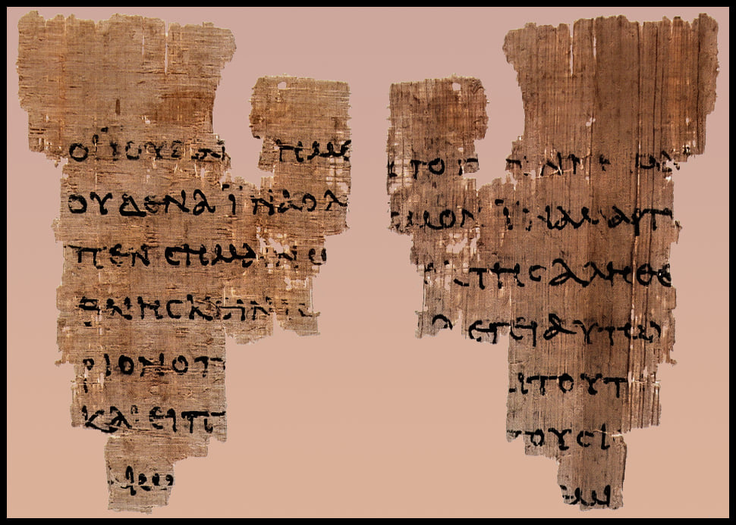
Notes:
Oldest Gospel of John fragment - Discover Historic Jesus
discoverhistoricjesus.com/oldest-gospel-of-john-fragment/
Earliest New Testament Fragment - The BAS Library
library.biblicalarchaeology.org/sidebar/earliest-new-testament-fragment/

Slide 3
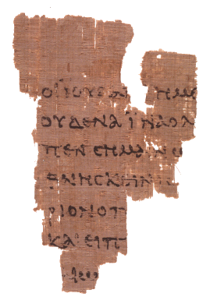
Papyrus 52: A Fragment of John’s Gospel
This small fragment of John's Gospel, less than nine centimeters high and containing on one side part of verses 18:31-33 and on the other part of verses 18:37-38. It is one of the collection of Greek papyri in the John Rylands Library, Manchester, UK.
The importance of this fragment is quite out of proportion to its size, since it may, with some confidence, be dated in the first half of the second century (~125 AD, +/- 25). Thus, it ranks as the earliest known fragment of the New Testament in any language. It provides us with invaluable evidence of the spread of Christianity in areas distant from the land of its origin and of the preservation of precious eye-witness accounts of God’s spoken Word.
What does it say?
https://discoverhistoricjesus.com/oldest-gospel-of-john-fragment
Notes:
John 18:31-38 Pilate told them, “Take him yourselves and pass judgment on him according to your own law!” The Jewish leaders replied, “We cannot legally put anyone to death.” (32) (This happened to fulfill the word Jesus had spoken when he indicated what kind of death he was going to die.) (33) So Pilate went back into the governor’s residence, summoned Jesus, and asked him, “Are you the king of the Jews?” (34) Jesus replied, “Are you saying this on your own initiative, or have others told you about me?” (35) Pilate answered, “I am not a Jew, am I? Your own people and your chief priests handed you over to me. What have you done?” (36) Jesus replied, “My kingdom is not from this world. If my kingdom were from this world, my servants would be fighting to keep me from being handed over to the Jewish authorities. But as it is, my kingdom is not from here.” (37) Then Pilate said, “So you are a king!” Jesus replied, “You say that I am a king. For this reason I was born, and for this reason I came into the world – to testify to the truth. Everyone who belongs to the truth listens to my voice.” (38) Pilate asked, “What is truth?” When he had said this he went back outside to the Jewish leaders and announced, “I find no basis for an accusation against him.
Prior generations of Christians were tasked not only with evangelizing the World, but also with preservation of the Gospel even under extreme circumstances.
Our generation is tasked with what?

Slide 4
The Fine Print Our responsibility…
“These [Bereans] were more fair-minded than those in Thessalonica, in that they received the word with all readiness, and searched the Scriptures daily to find out whether these things were so.”
Acts 17:11
“But sanctify the Lord God in your hearts, and always be ready to give a defense to everyone who asks you a reason for the hope that is in you, with meekness and fear;”
1 Peter 3:15
“Be diligent to present yourself approved to God, a worker who does not need to be ashamed, rightly dividing the word of truth.”
2 Timothy 2:15
“Beware lest anyone cheat you through philosophy and empty deceit, according to the tradition of men, according to the basic principles of the world, and not according to Christ.”
Colossians 2:8
Notes:
Why would Jesus state that the reason he was here was because of Truth? John 18:37
Begin with a discussion of the nature of Truth
John 18:31-38
Why would Jesus state “Truth” as the cause for which He had “come into the world”…?
Religious truth? Reality? Intellectual? Universal?
Nature of truth
How do we know that we know something?
Facts, evidences, and interpretation.
Knowledge without experience (e.g. 2+2=4).
Knowledge from experience (e.g. we can walk outside, look, and verify that my car is a black Honda Element).
But, how can we “experience” an abstract concept that we all acknowledge as existing and “true” (e.g. 2+2=4)…?
Law of non-contradiction (e.g. No such thing as a round square). This is the basis for all logical thinking.
Correspondence – How any proposition corresponds to reality?
Correlation – How do all the facts correlate?

Slide 5
The Grace of God Revealed The Theme
“Blessed is he whose transgression is forgiven,
whose sin is covered,
Blessed is the man to whom
the LORD does not impute iniquity,
And in whose spirit there is no deceit.”
(Psalm 32:1-2)
Notes:
THE QUESTIONS:
How can a perfectly just God forgive sins?
How can sinful man find favor with a righteous God?
Why does a just God allow evil to persist?
Others…?
GRACE: A term easily spoken but profound in meaning.
Eph. 2:8 “For by grace you have been saved through faith, and that not of yourselves; it is the gift of God, not of works, lest anyone should boast.
Romans is the definitive Gospel according to Paul. The impact on History via the letter to the Roman Christians is profound:
Romans displays:
God’s righteousness
Our iniquity, and
God’s remedy through Grace
The connection between Grace and Faith
A type of Faith that calls for action. Demonstrated obedience in response to God’s Grace. A Righteousness imputed (2 Cor. 5:21).
Psalms 32:1-2
“no deceit”… honest with others and with oneself.
“not impute iniquity”…. Convey righteousness.

Slide 6
Faith, Hope, and Love An Outline
FAITH, chapters 1-8
1-3 Sin
4-5 Salvation
6-8 Sanctification
HOPE, chapters 9-11
9 Israel – Past
10 Israel – Present
11 Israel - Future
LOVE, chapters 12-16
Practical Christian Living
Kingdom Servants
The Just shall live by Faith…
Notes:
Paul’s letters tend to demonstrate a pattern of thought… 1 Cor. 13
Chapters 1-3 – Establishing the Situation, Problem, and Implications, leading to a Needs Analysis.
The three types of Man
The Natural Man
The Moral Man
The Spiritual Man
The Elements of Reality
Origins
Meaning
Morality
Destiny
We are all part of a fallen race
CH1: Pagan or Natural Man – Evidence from Creation enough! Guilty!
CH2: Moral Man – Doesn’t live-up to his own conscience! Guilty!
CH3: Spiritual Man – Commitment and sincerity are flawed! Guilty!
God’s greatest problem:
To compromise His hatred of sin would be to compromise His character.
How does a Just God justify sinful man?
How can God permit man to enjoy the destiny originally prepared for him?

Slide 7
Introduction Chapter 1:1-17
Verses 1-6
Why is the sacred/secular dichotomy so pervasive?
What is needed?
Verses 7-15
Verses 16-17
Sacred
Secular
Gospel
Law
Notes:
Verses 1-6
v2 - Gospel of God; see 1 Cor. 15:1-4; establishing link to OT ; Gospel is of a Person - Jesus
v3 – Prophetic validation of Him; see 2 Peter 1:19-21; made of the seed of David (flesh); declared to be the Son (power)
v4 – Confirmed to be the Messiah by predicted and factual Resurrection from death; see Acts 2:22-36
v5 – Through Him; for His name; see Acts 2:21,22,32,36 Acts 4:12
v6 – Called ; see Gal. 3:24-29
Verses 7-15
v7 – Saints “holy”; see Gal. 3:24-29
v8 – Must’ve thrilled the hearer in Rome; they’ve heard of our Faith (what sets Christianity apart?)
v9 – Not saying this lightly; serving with his spirit – a fulltime thing; being real/honest; coming from the depths of his spirit
v10 – Expressing his desire to come there an become a part of their lives
v11,12 – Share in the ministry; gift of encouragement together
v13 – Planned to go; anxious to be a part of their work; produce a harvest
v14 – Greeks=civilized; barbarians=non-Greeks (cultures) : Acts 3:28 (Jesus changed the intrinsic value of mankind!)
v15 – With everything in me, I’m ready to preach the Gospel to those in Rome
Verses 16-17
Not ashamed of the Gospel; Paul will stand-up this Gospel against any Religion (e.g. Jewish), it will stand the test. Paul will answer those Jewish critics who say “the righteousness of this Gospel doesn’t compare to the righteousness demanded by the Law”. See Heb. 8:12-13, righteous).
Power of God for everyone who believes; Speaks to God’s strategy, or plan, of redemption for all of mankind
It reveals the righteousness of God; see 1 Cor. 2:7-10
What is meant by “From Faith to Faith…”?
The Faith of those from the previous Covenants to the Faith of those within the New Covenant.
From a Faith that appropriated righteousness (i.e. to those that did what was right) to a Faith that receives the Gift of righteousness (i.e. to those that are declared
From a Faith that made people walk like Saints to a Faith that calls them Saints before they’ve even walked like one.
Others?
There is a righteousness preached in the Old Law, but the righteousness preached via the Gospel is greater.
In Paul’s day, the Judaizers sought to diminish the Gospel by claiming the Gospel to be less righteous than the Law. In a similar way today, the post-modern culture seeks to diminish the Gospel by relegating it to the realm of non-rational, unscientific, personal preference. Discuss the modern dilemma of the sacred versus secular dichotomy.
Why is the sacred/secular dichotomy so pervasive? What is needed? Luke 10:42
Rom 12:1-8 Therefore I exhort you, brothers and sisters, by the mercies of God, to present your bodies as a sacrifice – alive, holy, and pleasing to God – which is your reasonable service. (2) Do not be conformed to this present world, but be transformed by the renewing of your mind, so that you may test and approve what is the will of God – what is good and well-pleasing and perfect. (3) For by the grace given to me I say to every one of you not to think more highly of yourself than you ought to think, but to think with sober discernment, as God has distributed to each of you a measure of faith. (4) For just as in one body we have many members, and not all the members serve the same function, (5) so we who are many are one body in Christ, and individually we are members who belong to one another. (6) And we have different gifts according to the grace given to us. If the gift is prophecy, that individual must use it in proportion to his faith. (7) If it is service, he must serve; if it is teaching, he must teach; (8) if it is exhortation, he must exhort; if it is contributing, he must do so with sincerity; if it is leadership, he must do so with diligence; if it is showing mercy, he must do so with cheerfulness.

Slide 8
The Just Shall Live by Faith Habakkuk 2:4
What is the meaning of this phrase relative to the Patriarchal, the Mosaic, and the Christian eras?
Within each era, the believer’s relationship to God is based upon God’s promises.
Within each era, sin is dealt with in accordance with God’s instruction, the believer simply obeys and accepts by faith.
The Righteousness of God is revealed from Faith to Faith… 2 Cor. 5:21 ”For He made Him who know no sin to be sin for us, that we might become the righteousness of God in Him.”
The Just…
Who?
Romans 1:17
…Shall Live…
How?
Galatians 3:11
…By Faith.
What?
Hebrews 10:38
Notes:
What does God want? Mankind’s Righteousness vs God’s Righteousness
For I desire mercy and not sacrifice, and the knowledge of God more than burnt offerings. (Hosea 6:6)
Thus says the LORD: "Let not the wise man glory in his wisdom, Let not the mighty man glory in his might, Nor let the rich man glory in his riches; But let him who glories glory in this, That he understands and knows Me, That I am the LORD, exercising lovingkindness, judgment, and righteousness in the earth. For in these I delight," says the LORD. (Jeremiah 9:23-24)
"Has the LORD as great delight in burnt offerings and sacrifices, As in obeying the voice of the LORD? Behold, to obey is better than sacrifice, And to heed than the fat of rams. (1 Samuel 15:22)
He has shown you, O man, what is good; And what does the LORD require of you but to do justly, To love mercy, And to walk humbly with your God? (Micah 6:8)

Slide 9
Romans 1-4… Truth, The Nature of Mankind, and Worldviews
Truth is objective, knowable, and personified in Jesus of Nazareth. (John 14:6-11; John 18:37; Acts 2:22)
The Natural Man recognizes God’s creativity and intelligence in the created order; but suppresses the truth in unrighteousness. (Romans 1)
The Moral Man recognizes how things ought to be; but falls short of God’s goodness revealed via his own conscience and rationality. (Romans 2)
The Religious Man recognizes that God exists, and that God has expectations; but succumbs to selfish pride, artificial authority, arrogance, and hypocrisy. (Romans 3)
The Just Man relies upon God’s promise, lives by faith; and receives the blessing of imputed righteousness. (Romans 4)
Notes:
God’s Problem and Man’s Need
Situation
Problems
Implications
Needs Analysis

Slide 10
Mankind’s ‘Righteousness’ as a Worldview Origins → Meaning → Morality → Destiny
What is man that You are mindful of him, And the son of man that You visit him? For You have made him a little lower than the angels, And You have crowned him with glory and honor. You have made him to have dominion over the works of Your hands; You have put all things under his feet… (Psalms 8:4-6)
For I bear them witness that they [Israel] have a zeal for God, but not according to knowledge. For they being ignorant of God's righteousness, and seeking to establish their own righteousness, have not submitted to the righteousness of God. For Christ is the end of the law for righteousness to everyone who believes. (Romans 10:2-4)
Materialism – Matter is all that there is; the ultimate reality.
Rationalism – Human Reason is the standard of all truth.
Empiricism – Claims that the ultimate foundation of knowledge is sensation or experience.
How do these “roots of human philosophies” view mankind?
How do these “roots of human philosophies” view God?
Notes:
The Psalms provide a theological and practical framework for evaluating and rejecting false worldviews. They consistently direct attention to God’s supremacy, the reliability of His Word, and the futility of trusting in human constructs.
Several psalms encourage discernment, critique of false beliefs, and affirm the supremacy of God’s truth over human philosophies.

