Slide 1
The Source of Unity
Unity as Divine Witness
What does Oneness in the Trinity Teach Us?
“I am not praying only on their behalf, but also on behalf of those who believe in me through their testimony, that they will all be one, just as you, Father, are in me and I am in you. I pray that they will be in us, so that the world will believe that you sent me. The glory you gave to me I have given to them, that they may be one just as we are one – I in them and you in me – that they may be completely one, so that the world will know that you sent me, and you have loved them just as you have loved me. (John 17:20-23)
Phil@UsefulEngines.com
https://tinyurl.com/sa846z8m
Notes:
“I am not praying only on their behalf, but also on behalf of those who believe in me through their testimony, that they will all be one, just as you, Father, are in me and I am in you. I pray that they will be in us, so that the world will believe that you sent me. The glory you gave to me I have given to them, that they may be one just as we are one – I in them and you in me – that they may be completely one, so that the world will know that you sent me, and you have loved them just as you have loved me. (John 17:20-23)

Slide 2
Knowing God via the Social Order A “Desired State” of Relationships
“The LORD God said, ‘It is not good for the man to be alone.’” Genesis 2:18
Is this a qualitative statement? (i.e. “could be better”)
Is this an ethical statement? (i.e. “is not right; ought to be different”)
Against what standard does God refer to in the context of this statement?
Aloneness is bad in an ethical sense because it contradicts the nature of God, who is three-in-one: God Himself exists in community and relationship; man, who is made in His image, is supposed to do the same. This concept forms the basis of a true, God-centered understanding of the social order.
To go against God’s design is to deny His character.

Slide 3
Psalm 133 – The Beauty of Unity Among God’s People The unity and harmony of God’s people reflect His relational nature
Psalm 133 celebrates the unity of believers, which mirrors the unity within the Trinity and reflects the relationship between Christ and the Church.
Key Verses:
Psalm 133:1 "How good and pleasant it is when God’s people live together in unity!"
Psalm 133:3 "It is as if the dew of Hermon were falling on Mount Zion. For there the LORD bestows his blessing, even life forevermore."
Key Themes:
Highlights the corporate aspect of the union between believers and God.
Depicts unity as a source of blessing and a reflection of God’s desired state for His people.
Notes:
Psalm 133 – The Beauty of Unity Among God’s People

Slide 4
The Triune Nature of God Unity, Relationships, Roles, Equality, Authority, Submission
The Father with the Son
“The Father and I are one.” John 10:30
“So Jesus said to them again, ‘Peace be with you. Just as the Father has sent me, I also send you.’” John 20:21
The Son with the Holy Spirit
“But I tell you the truth, it is to your advantage that I am going away. For if I do not go away, the Advocate will not come to you, but if I go, I will send Him to you. And when He comes, He will prove the world wrong concerning sin and righteousness and judgment…”
John 16:7-8
The Father, The Son, The Holy Spirit
“Therefore go and make disciples of all nations, baptizing them in the name of the Father and the Son and the Holy Spirit, teaching them to obey everything I have commanded you. And remember, I am with you always, to the end of the age.”
Matthew 28:19
The Father with the Holy Spirit
“But the Advocate, the Holy Spirit, whom the Father will send in my name, will teach you everything and will cause you to remember everything I said to you.”
John 14:26
Notes:
The Father, The Son, The Holy Spirit
“Therefore go and make disciples of all nations, baptizing them in the name of the Father and the Son and the Holy Spirit, teaching them to obey everything I have commanded you. And remember, I am with you always, to the end of the age.”
Matthew 28:19
The Father with the Holy Spirit
“But the Advocate, the Holy Spirit, whom the Father will send in my name, will teach you everything and will cause you to remember everything I said to you.”
John 14:26
The Father with the Son
“The Father and I are one.” John 10:30
“So Jesus said to them again, ‘Peace be with you. Just as the Father has sent me, I also send you.’” John 20:21
The Son with the Holy Spirit
“But I tell you the truth, it is to your advantage that I am going away. For if I do not go away, the Advocate will not come to you, but if I go, I will send Him to you. And when He comes, He will prove the world wrong concerning sin and righteousness and judgment…”
John 16:7-8

Slide 5
The Union between God and You Christianity is rooted in a living relationship with God
John 15:5 "I am the vine; you are the branches. If you remain in me and I in you, you will bear much fruit; apart from me you can do nothing."
Galatians 2:20 "I have been crucified with Christ and I no longer live, but Christ lives in me."
Colossians 1:27 "Christ in you, the hope of glory."
Psalm 139:7-10 "Where can I go from your Spirit? Where can I flee from your presence? If I go up to the heavens, you are there; if I make my bed in the depths, you are there. If I rise on the wings of the dawn, if I settle on the far side of the sea, even there your hand will guide me, your right hand will hold me fast."
Psalm 73:23-26 "Yet I am always with you; you hold me by my right hand. You guide me with your counsel, and afterward you will take me into glory. Whom have I in heaven but you? And earth has nothing I desire besides you."
Psalm 16:8 "I keep my eyes always on the LORD. With him at my right hand, I will not be shaken."
Notes:
This union is both spiritual and relational, marking Christianity as a faith rooted in a living relationship with God.
- John 15:5: "I am the vine; you are the branches. If you remain in me and I in you, you will bear much fruit; apart from me you can do nothing."
- Illustrates the intimate connection between believers and Christ, emphasizing dependence on Him for spiritual life.
- Galatians 2:20: "I have been crucified with Christ and I no longer live, but Christ lives in me."
- Highlights the transformative reality of being united with Christ.
- Colossians 1:27: "Christ in you, the hope of glory."
- Speaks of the indwelling presence of Christ as the basis for eternal hope.
--------- Relevant Psalms
- Psalm 139:7-10 "Where can I go from your Spirit? Where can I flee from your presence? If I go up to the heavens, you are there; if I make my bed in the depths, you are there. If I rise on the wings of the dawn, if I settle on the far side of the sea, even there your hand will guide me, your right hand will hold me fast."
- Affirms God’s intimate and omnipresent relationship with His people, a cornerstone of the mystical union.
- Psalm 73:23-26 "Yet I am always with you; you hold me by my right hand. You guide me with your counsel, and afterward you will take me into glory. Whom have I in heaven but you? And earth has nothing I desire besides you."
- Expresses the believer's deep, personal connection with God as their ultimate source of strength and guidance.
- Psalm 16:8 "I keep my eyes always on the LORD. With him at my right hand, I will not be shaken."
- Emphasizes the stability and confidence that come from remaining close to God.

Slide 6
The Union between Christ and the Church The "Bride of Christ” and the "Body of Christ”
1 Corinthians 12:12-13 "Just as a body, though one, has many parts, but all its many parts form one body, so it is with Christ. For we were all baptized by one Spirit so as to form one body."
Ephesians 5:25-27 "Husbands, love your wives, just as Christ loved the church and gave himself up for her to make her holy."
John 17:20-21 "My prayer is not for them alone. I pray also for those who will believe in me through their message, that all of them may be one, Father, just as you are in me and I am in you."
Psalm 133:1 "How good and pleasant it is when God’s people live together in unity!"
Psalm 22:22-25 "I will declare your name to my people; in the assembly I will praise you. You who fear the LORD, praise him!"
Psalm 87:3-5 "Glorious things are said of you, city of God: 'I will record Rahab and Babylon among those who acknowledge me—Philistia too, and Tyre, along with Cush—and will say, ‘This one was born in Zion.’ Indeed, of Zion it will be said, 'This one and that one were born in her, and the Most High himself will establish her.'"
Notes:
The Church is described as the Bride of Christ (Revelation 19:7-8) and the Body of Christ (1 Corinthians 12:27), illustrating the profound collective relationship with Christ.
- 1 Corinthians 12:12-13 : "Just as a body, though one, has many parts, but all its many parts form one body, so it is with Christ. For we were all baptized by one Spirit so as to form one body."
- Emphasizes the collective unity of believers as the Body of Christ.
- Ephesians 5:25-27 : "Husbands, love your wives, just as Christ loved the church and gave himself up for her to make her holy."
- Portrays Christ’s sacrificial love for the Church, reinforcing the idea of corporate oneness.
- John 17:20-21 : "My prayer is not for them alone. I pray also for those who will believe in me through their message, that all of them may be one, Father, just as you are in me and I am in you."
- Reflects Jesus’ desire for unity among believers, mirroring the unity within the Trinity.
------------ Relevant Psalms
- Psalm 133:1 "How good and pleasant it is when God’s people live together in unity!"
- Reflects the unity of believers, paralleling the oneness of Christ and the Church.
- Psalm 22:22-25 "I will declare your name to my people; in the assembly I will praise you. You who fear the LORD, praise him!"
- Highlights the collective worship and unity of God’s people as the Body of Christ.
- Psalm 87:3-5 "Glorious things are said of you, city of God: 'I will record Rahab and Babylon among those who acknowledge me—Philistia too, and Tyre, along with Cush—and will say, ‘This one was born in Zion.’ Indeed, of Zion it will be said, 'This one and that one were born in her, and the Most High himself will establish her.'"
- Celebrates the communal relationship of God’s people, connected as citizens of His kingdom.

Slide 7
The Union between Husband and Wife Marriage reflects the relationship between Christ and Church
Ephesians 5:31-32 "For this reason a man will leave his father and mother and be united to his wife, and the two will become one flesh. This is a profound mystery - but I am talking about Christ and the church."
Genesis 2:24 "That is why a man leaves his father and mother and is united to his wife, and they become one flesh."
Matthew 19:5-6 "So they are no longer two, but one flesh. Therefore, what God has joined together, let no one separate."
Psalm 45:6-7 "Your throne, O God, will last forever and ever; a scepter of justice will be the scepter of your kingdom. You love righteousness and hate wickedness; therefore God, your God, has set you above your companions by anointing you with the oil of joy."
Psalm 128:3-4 "Your wife will be like a fruitful vine within your house; your children will be like olive shoots around your table. Yes, this will be the blessing for the man who fears the LORD."
Notes:
Marriage serves as an earthly symbol of the divine relationship between Christ and His Church.
- Ephesians 5:31-32 : "For this reason a man will leave his father and mother and be united to his wife, and the two will become one flesh. This is a profound mystery—but I am talking about Christ and the church."
- Links the marital relationship to the union between Christ and the Church.
- Genesis 2:24 : "That is why a man leaves his father and mother and is united to his wife, and they become one flesh."
- Establishes the foundational principle of marital oneness.
- Matthew 19:5-6 : "So they are no longer two, but one flesh. Therefore what God has joined together, let no one separate."
- Reinforces the sanctity of the marital bond, reflecting God’s intended unity.
----------------- Relevant Psalms
- Psalm 45:6-7 "Your throne, O God, will last forever and ever; a scepter of justice will be the scepter of your kingdom. You love righteousness and hate wickedness; therefore God, your God, has set you above your companions by anointing you with the oil of joy."
- While a royal psalm, it is often seen as reflecting the relationship between Christ (the Bridegroom) and His Church (the Bride).
- Psalm 128:3-4 "Your wife will be like a fruitful vine within your house; your children will be like olive shoots around your table. Yes, this will be the blessing for the man who fears the LORD."
- Celebrates the harmony and unity of a God-centered marriage, symbolizing the deeper union of Christ and His Church.

Slide 8
Potential Dysfunctions and Barriers That which disrupts your relationship with God and others
Numbers 15:38-39 "You will have these tassels to look at and so you will remember all the commands of the LORD, that you may obey them and not prostitute yourselves by chasing after the lusts of your own hearts and eyes."
Jeremiah 2:13 "My people have committed two sins: They have forsaken me, the spring of living water, and have dug their own cisterns, broken cisterns that cannot hold water."
1 John 2:15-16 "Do not love the world or anything in the world. If anyone loves the world, love for the Father is not in them."
Psalm 106:35-37 "They mingled with the nations and adopted their customs. They worshiped their idols, which became a snare to them."
Psalm 51:10-12 "Create in me a pure heart, O God, and renew a steadfast spirit within me. Do not cast me from your presence or take your Holy Spirit from me. Restore to me the joy of your salvation and grant me a willing spirit, to sustain me."
Notes:
Seeking significance outside of God’s design, such as through idolatry or selfish desires, disrupts intimacy with God and others
- Numbers 15:38-39 : "You will have these tassels to look at and so you will remember all the commands of the LORD, that you may obey them and not prostitute yourselves by chasing after the lusts of your own hearts and eyes."
- Warns against spiritual adultery and idolatry.
- Jeremiah 2:13 : "My people have committed two sins: They have forsaken me, the spring of living water, and have dug their own cisterns, broken cisterns that cannot hold water."
- Describes how turning away from God leads to seeking fulfillment in inadequate substitutes.
- 1 John 2:15-16 : "Do not love the world or anything in the world. If anyone loves the world, love for the Father is not in them."
- Highlights the dangers of misplaced affections that hinder union with God.
-------------- Relevant Psalms
- Psalm 106:35-37 "They mingled with the nations and adopted their customs. They worshiped their idols, which became a snare to them."
- Warns against idolatry and the spiritual adultery that breaks intimacy with God.
- Psalm 51:10-12 "Create in me a pure heart, O God, and renew a steadfast spirit within me. Do not cast me from your presence or take your Holy Spirit from me. Restore to me the joy of your salvation and grant me a willing spirit, to sustain me."
- Reflects the need for repentance and restoration when sin disrupts intimacy with God.
- Psalm 115:4-8 "But their idols are silver and gold, made by human hands. They have mouths, but cannot speak, eyes, but cannot see... Those who make them will be like them, and so will all who trust in them."
- Highlights the futility of seeking fulfillment outside of God.

Slide 9
The Heart of the Christian Gospel Restoration of a covenant relationship with God
John 17:3 "Now this is eternal life: that they know you, the only true God, and Jesus Christ, whom you have sent."
John 14:16-17 "And I will ask the Father, and he will give you another advocate to help you and be with you forever—the Spirit of truth. The world cannot accept him, because it neither sees him nor knows him. But you know him, for he lives with you and will be in you.“
2 Corinthians 5:17-18 "Therefore, if anyone is in Christ, the new creation has come: The old has gone, the new is here! All this is from God, who reconciled us to himself through Christ."
Psalm 16:11 "You make known to me the path of life; you will fill me with joy in your presence, with eternal pleasures at your right hand.“
Psalm 23:1-4 "The LORD is my shepherd, I lack nothing. He makes me lie down in green pastures, he leads me beside quiet waters, he refreshes my soul.”
Psalm 34:8 "Taste and see that the LORD is good; blessed is the one who takes refuge in him."
Notes:
The Gospel centers on the restoration of relationship with God, accomplished through Christ’s life, death, and resurrection.
- John 17:3 : "Now this is eternal life: that they know you, the only true God, and Jesus Christ, whom you have sent."
- Defines eternal life as knowing God personally and relationally.
- John 14:16-17 : "And I will ask the Father, and he will give you another advocate to help you and be with you forever—the Spirit of truth. The world cannot accept him, because it neither sees him nor knows him. But you know him, for he lives with you and will be in you."
- Speaks of the Holy Spirit’s indwelling presence, a vital part of the believer’s union with God.
- 2 Corinthians 5:17-18 : "Therefore, if anyone is in Christ, the new creation has come: The old has gone, the new is here! All this is from God, who reconciled us to himself through Christ."
- Highlights the transformative power of the Gospel, reconciling believers to God.
---------- Relevant Psalms
- Psalm 16:11 "You make known to me the path of life; you will fill me with joy in your presence, with eternal pleasures at your right hand."
- Captures the essence of eternal life: intimacy and joy in God’s presence.
- Psalm 23:1-4 "The LORD is my shepherd, I lack nothing. He makes me lie down in green pastures, he leads me beside quiet waters, he refreshes my soul."
- Demonstrates God’s personal care and relationship with His people.
- Psalm 34:8 "Taste and see that the LORD is good; blessed is the one who takes refuge in him."
- Invites believers into a personal and experiential relationship with God.

Slide 10
Who is God? What does He want? The God of Order and Relationships
“Dominion and awe belong to God; He establishes order in the heights of heaven.” Job 25:2
“For God is not a God of disorder…” 1 Corinthians 14:33
“He who has My commandments and keeps them, it is he who loves Me. And he who loves Me will be loved by My Father, and I will love him and manifest Myself to him.” John 14:21
“For whoever does the will of God is my brother and sister and mother.” Mark 3:35
Social Disorder is a Human Pathology…
“For where you have envy and selfish ambition, there you find disorder and every evil practice.” James 3:16

Slide 11
God’s Desired State for His Church Are we to be Overcomers?
How to Overcome and be Right with God…
“If anyone says ‘I love God’ and yet hates his fellow Christian, he is a liar because the one who does not love his fellow Christian whom he has seen cannot love God whom he has not seen. And the commandment we have from Him is this: that the one who loves God should love his fellow Christian too. Everyone who believes that Jesus is the Christ has been fathered by God, and everyone who loves the Father loves the child fathered by Him. By this we know that we love the children of God: whenever we love God and obey His commandments. For this is the love of God: that we keep His commandments. And His commandments to not weigh us down, because everyone who has been fathered by God overcomes the world.” 1 John 4:20 – 5:4
God’s Expectations, Our Accountability
“I am the Alpha and the Omega, says the LORD God – the one who is, and who was, and who is the come – the All-Powerful!” Revelation 1:8
“The one who has an ear had better hear what the Spirit says to the churches. To the one who overcomes, I will permit him to eat from the tree of life that is in the paradise of God.” Revelation 2:7
“The one who has an ear had better hear what the Spirit says to the churches. The one who overcomes will in no way be harmed by the second death.” Revelation 2:11
Notes:
Not a “Works Religion”, rather a “Total Commitment Religion”
“Follow Me” not “Study Me”
------------------------
God’s Expectations, Our Accountability
“I am the Alpha and the Omega, says the LORD God – the one who is, and who was, and who is the come – the All-Powerful!” Revelation 1:8
“The one who has an ear had better hear what the Spirit says to the churches. To the one who overcomes, I will permit him to eat from the tree of life that is in the paradise of God.” Revelation 2:7
“The one who has an ear had better hear what the Spirit says to the churches. The one who overcomes will in no way be harmed by the second death.” Revelation 2:11
How to Overcome and be Right with God…
“If anyone says ‘I love God’ and yet hates his fellow Christian, he is a liar because the one who does not love his fellow Christian whom he has seen cannot love God whom he has not seen. And the commandment we have from Him is this: that the one who loves God should love his fellow Christian too. Everyone who believes that Jesus is the Christ has been fathered by God, and everyone who loves the Father loves the child fathered by Him. By this we know that we love the children of God: whenever we love God and obey His commandments. For this is the love of God: that we keep His commandments. And His commandments to not weigh us down, because everyone who has been fathered by God overcomes the world.” 1 John 4:20 – 5:4

Slide 12
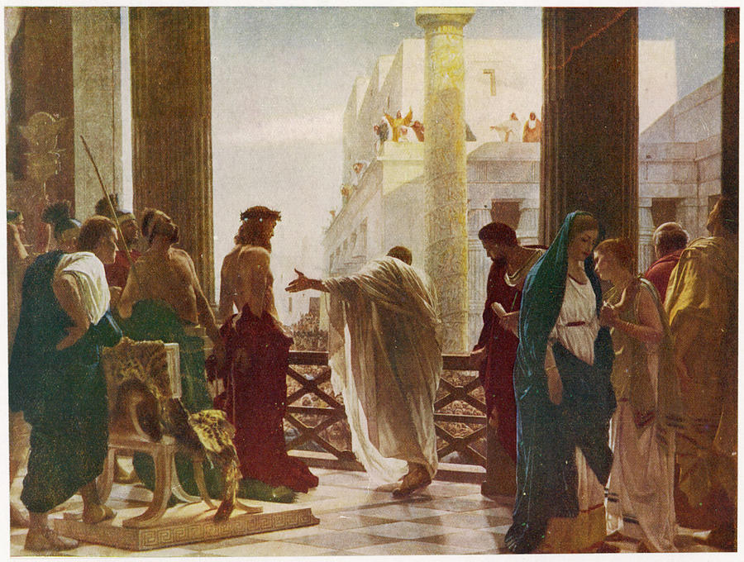
The Call to a Unifying Truth A Call to which Cohort? (John 18:37)
Notes:
Consider the “Cohorts” present at the Pilate inquiry.
Pharisees – lacked discernment (Matt 16 : able to predict weather, but not able to see the signs of the time). A time when both the Pharisees and Sadducees were unified.
Romans – “Might is Right” – reading the wrong signs – ignoring significance of situational context – “the end justifies the means”
Jesus – A cohort of 1 (Trinity?). Speaking to whom?
Joh 18:33-37
(33) So Pilate went back into the governor’s residence, summoned Jesus, and asked him, “Are you the king of the Jews?”
(34) Jesus replied, “Are you saying this on your own initiative, or have others told you about me?”
(35) Pilate answered, “I am not a Jew, am I? Your own people and your chief priests handed you over to me. What have you done?”
(36) Jesus replied, “My kingdom is not from this world. If my kingdom were from this world, my servants would be fighting to keep me from being handed over to the Jewish authorities. But as it is, my kingdom is not from here.”
(37) Then Pilate said, “So you are a king!” Jesus replied, “You say that I am a king. For this reason I was born, and for this reason I came into the world – to testify to the truth. Everyone who belongs to the truth listens to my voice.”
Joh 14:6
(6) Jesus replied, “I am the way, and the truth, and the life. No one comes to the Father except through me.
Joh 14:23
(23) Jesus replied, “If anyone loves me, he will obey my word, and my Father will love him, and we will come to him and take up residence with him.
I Cor. 2:13-16
“…but we have the mind of Christ”

Slide 13
A Call to Discernment A Key Capability of the Divine Truth Cohort
Matthew 16:1-4
Religious elite able to “discern the weather” but not the “prophetic signs”.
2 Corinthians 11:1-4
[False Doctrine]…”you will put up with it!” Illustrates a Lack of Discernment.
2 Thessalonians 5:16-22
“Do not despise Revelation (i.e. preaching).” Scripture, discernment, testing.
2 Timothy 2:15-17
Practice doctrinal precision. Avoid the dogmas of self-image and self-worth influencers.
1 Timothy 6:3-5 ; 11-16
Guard the Truth. Gain skills for distinguishing truth from falsehood and from half-truth.
1 John 2:20-29
Constant conflict – The Truth vs. Lies. Abide in Him and His Teaching.
Notes:
There are two things that are in constant conflict – The Truth and The Lies
Knowledge is only valuable if it becomes the driving force in the choices we make. The right choices requires knowledge. A pattern of right choices suggests Wisdom.
What is the greatest need in the Church today? The biggest problem? (A lack of discernment) (Accepting the wrong choices) (Failing to recognize the signs)
Eclectic Theology – a quilted collection of patterns that makes no sense. No discernment, no discrimination. No rhyme nor reason. Indiscriminate. Contemporary Christian scene exhibits no discriminating judgements about any theological ideas. How dare you question any viewpoint?
Biblical Christianity is fighting for its life. This growing lack of Spiritual Discrimination out-strips any other problem we now see in the Church.
We are warned against teachers “who tickle our ears” with certain messages, warned against false teachers, demonic forces, perverse teachings, commandments of men, ideas that are deceitful, empty philosophies, traditions of men, corrupters of the Word of God, false prophets, agents of Satan.
There is a world of chaos and confusion. The system in which we live is pitted against the Truth of God.
Know the Truth. Have Discernment.
God has given you Himself (Jesus) who is Truth, The Holy Spirit that you may know Truth, His Word that you may test Truth. How terrible that you may ignore these and yet be deceived.
Scriptural Interpretation with Precision is warranted. Amateur versus Professional. Knowing Sound Doctrine. Lack of Doctrinal Clarity and Conviction.
Don’t spend time thinking about what “they” think versus what “He” thinks.“ “…but we have the mind of Christ” (1 Cor. 2).
It’s essential to be able to say “that’s right” and “that’s wrong”. There is often an unwillingness to disagree.
There has to be constant and healthy debate about Truth in the Church. Be Opinionated… Declare “that’s wrong” and “that’s right”. Don’t be subjective…
Jay Adams wrote… “From the garden of Eden with its two trees – one allowed, one forbidden – to the eternal destiny of the human being in heaven or in hell, the Bible sets forth two and only two ways: God’s way and all others. Accordingly, people are either saved or lost. They belong to God’s people or the world. There is Gerizim, the mount of blessing, and Ebal, the mount of cursing. There is the narrow way and the wide way. One leads to eternal life, the other to eternal destruction.
“There are those who are against and those who are with us. There are those within the kingdom and those outside the kingdom. There is life and death, truth and falsehood, good and bad, light and darkness, the kingdom of God and the kingdom of Satan, love and hatred, spiritual wisdom and the wisdom of the world. And Christ is said to be the way, the truth, and the life; and no one may come to the Father but by Him. He is the only name under the sky by which one may be saved.”
And that is exactly the way the Bible presents itself. It presents truth and error, God’s way and everybody else’s way. There’s a right way, there’s a wrong way. There’s a right interpretation of a passage, and every other interpretation is the wrong one. There’s a right theology, and anything that disagrees with it is a wrong theology. There is a right way to understand God, Christ, the Holy Spirit, and salvation, and a wrong way. This is on every page of the Bible, from the beginning to the end of Scripture. This antithetical kind of thinking is everywhere.

Slide 14
How to Discern Truth A Biblical Call to Discernment
1 Thessalonians 5:21–22 “Test everything; hold fast what is good. Abstain from every form of evil.” → Paul calls believers to actively evaluate teachings and influences rather than accept them blindly.
1 John 4:1 “Beloved, do not believe every spirit, but test the spirits to see whether they are from God.” → A direct command to discern between truth and deception, especially spiritual and doctrinal influences.
Hebrews 5:14 “But solid food is for the mature, for those who have their powers of discernment trained by constant practice to distinguish good from evil.” → Discernment develops through spiritual maturity and disciplined practice.
Matthew 7:15–20 “By their fruit you will recognize them.” → Jesus teaches discernment by evidence—truth is recognized by the fruit it produces.
Notes:
Discerning truth is essential for unity in the church. Without spiritual discernment, believers may fall into error, deception, or harmful division. Scripture calls God’s people not only to know the truth, but to test, examine, and uphold it.
Discernment defends unity by:
Preventing division over false or misapplied doctrine.
Protecting the flock from spiritual manipulation.
Promoting maturity, which leads to clarity, humility, and shared understanding.
Practice:
Measure claims by Scripture (Acts 17:11).
Assess outcomes through spiritual fruit (Galatians 5:22–23).
Encourage thoughtful dialogue rooted in love and truth (Ephesians 4:15).
Read:
Phil. 1:9-11

Slide 15
The Art of Deception Discernment counters Deception
“All warfare is based on deception.” — Sun Tzu, The Art of War
Church Application: Misunderstanding and deception—intentional or not—are strategic tools of spiritual warfare. Division in the church often begins when truth is distorted or obscured.
“The first casualty of war is truth.” — U.S. Senator Hiram Johnson (1917)
Church Application: In times of tension or disagreement, truth is often compromised by fear, pride, or presupposition—undermining unity.
“In war, truth is so precious that she should always be attended by a bodyguard of lies.” — Winston Churchill
Church Application: When believers begin to guard their positions or reputations with rhetorical smokescreens rather than honest dialogue, relational breakdown is inevitable.
Notes:
Here are three insightful quotes that associate war with deception, useful for exploring how misinterpretation, false assumptions, or divisiveness can function like warfare within a community or church.
1. “All warfare is based on deception.”
— Sun Tzu, The Art of War
Context: This foundational quote sets the tone for Sun Tzu’s philosophy, emphasizing that misleading the enemy is a strategic necessity.
Church Application: Misunderstanding and deception—intentional or not—are strategic tools of spiritual warfare. Division in the church often begins when truth is distorted or obscured.
2. “The first casualty of war is truth.”
— Attributed to U.S. Senator Hiram Johnson (1917)
Context: This saying reflects how propaganda, misinformation, and emotional manipulation quickly overshadow objective facts in any conflict.
Church Application: In times of tension or disagreement, truth is often compromised by fear, pride, or presupposition—undermining unity.
3. “In war, truth is so precious that she should always be attended by a bodyguard of lies.”
— Winston Churchill
Context: Churchill used this line during WWII to justify the necessity of military deception in protecting national security.
Church Application: When believers begin to guard their positions or reputations with rhetorical smokescreens rather than honest dialogue, relational breakdown is inevitable.

Slide 16
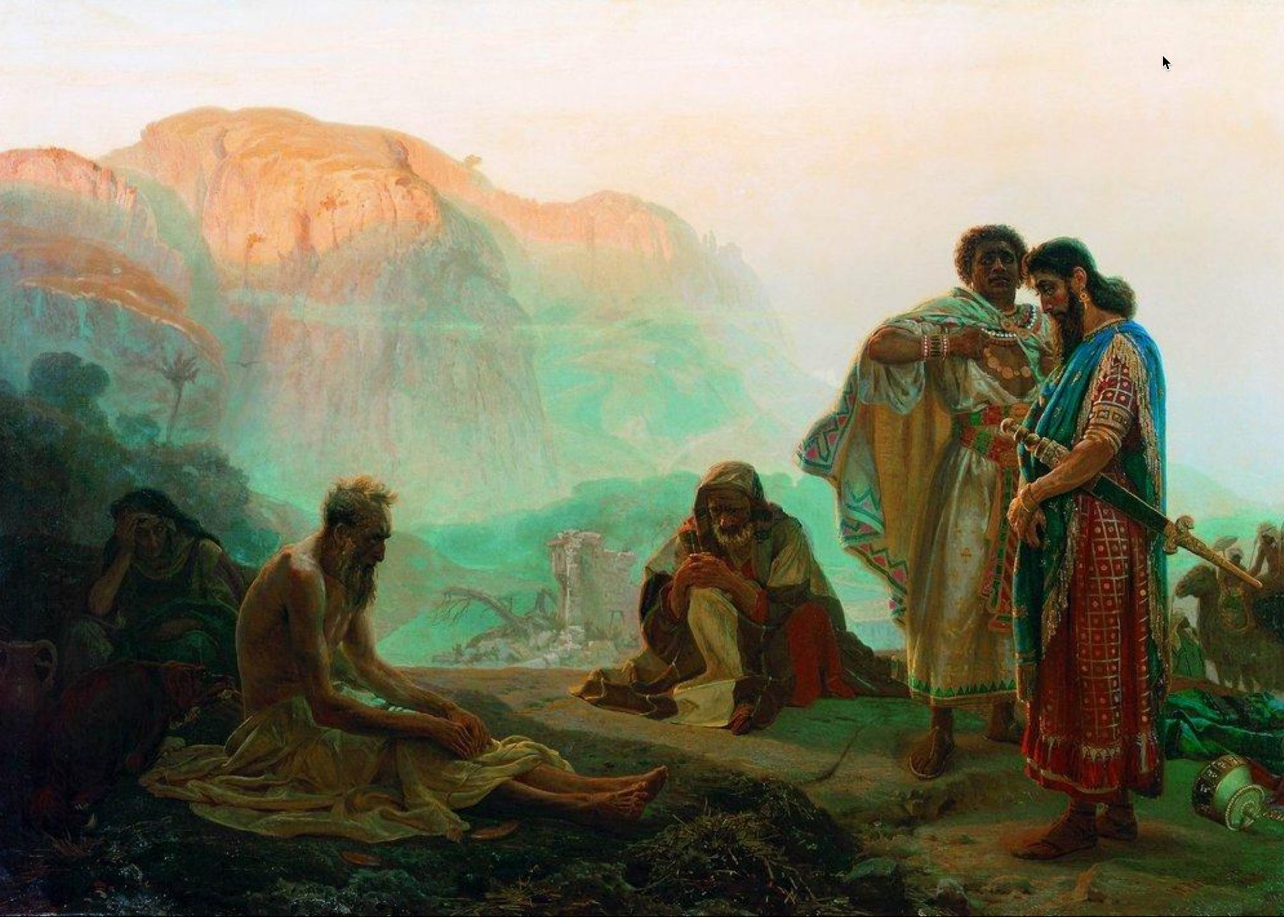
Job’s Friends Practice Discernment
Notes:
Job’s friends—Eliphaz, Bildad, Zophar, and Elihu—offer insight into how faulty presuppositions can damage relationships and cloud theological truth. Each speaks as if he fully understands the reason for Job’s suffering, but their shared assumptions are flawed.
Key Observations:
1. Job’s character reputation indicates that his friends would also have been people of high character. Each appears to “know God”.
2. The Satan (Accuser) appears to have overtaken Job’s friends. Each friend ultimately accuses Job of sin. They have become Delegated Accusers.
3. Ultimately, Job succumbs to the attack on his character (Job 42:3). But what was his sin? Where did Job’s sin originate (i.e. the Mind).

Slide 17
Presuppositional Thinking Faulty presuppositions damage relationships and cloud theological truth
Suffering is always the result of sin Assuming a direct correlation between personal sin and suffering, leaving no room for mystery or divine testing.
“Consider now: Who being innocent has ever perished?” – Eliphaz (Job 4:7)
God’s justice is immediate and visible Assuming God always rewards or punishes visibly and swiftly.
“Surely God does not reject one who is blameless…” – Bildad (Job 8:20)
Human wisdom can fully explain divine action Assuming an understanding of God’s ways through tradition or reason.
“Are God’s consolations not enough for you…?” – Eliphaz (Job 15:11)
Suffering may be preventative or instructive, not always punitive Presuming to speak with divine authority.
God does all these things to a person… to turn them back from the pit.” – Elihu (Job 33:29-30)
Confession and repentance will instantly fix the problem Assuming that doing so will immediately restore his fortunes.
“If you put away the sin that is in your hand… then you will lift up your face without shame.” – Zophar (Job 11:14–15)
Notes:
All four speakers operate from flawed presuppositions: that Job’s suffering must be deserved. They demonstrate how misapplication of truth, even when well-intended, leads to false counsel and further division. Their failure underscores the need for humility, context, and compassion in theological dialogue—directly applicable to preserving unity in the church.
What Is Presuppositional Thinking?
Presuppositional thinking involves starting with assumptions that shape how we interpret reality, truth, and Scripture. These assumptions are often unexamined but deeply rooted in our worldview—our overarching framework for making sense of life, meaning, morality, and destiny.
Example: If someone presupposes that "truth is relative," they will interpret Scripture selectively, potentially dismissing clear biblical commands as "contextual" or outdated.
How It Leads to Incorrect Assumptions
Confirmation Bias: We only accept interpretations that match what we already believe.
Cultural Filtering: We interpret eternal truths through the lens of modern trends or preferences (e.g. self-image or influencer dogmas).
Doctrinal Rigidity: We assume our denominational position is the only legitimate one without examining Scripture afresh.
These errors contribute to theological division, moral confusion, and church disunity—precisely the issues your course aims to resolve.

Slide 18
Presuppositional Thinking Faulty presuppositions damage relationships and cloud theological truth
Job’s Response and Divine Admonition: While Job rightly resists the flawed arguments of his friends and maintains his innocence, he eventually slips into self-righteousness and questions God's justice. In chapters 38–41, God responds not by explaining Job’s suffering but by humbling him with a series of rhetorical questions that reveal divine sovereignty and human limitation.
“Who is this that obscures my plans with words without knowledge?” – God to Job (Job 38:2)
Though Job never curses God, he does accuse God of injustice, and this presumption is what God corrects. Job’s error is not moral failure, but intellectual and theological presumption; assuming that God must explain Himself.
“Surely I spoke of things I did not understand, things too wonderful for me to know.” – Job (Job 42:3)
Insights: Even the righteous can err in trying to defend themselves or interpret God's will. The Friend’s assumptions demonstrate how sincere but shallow theology can lead to misjudgment and further pain. The story of Job reminds us to approach others with humility, listen well, and trust God’s sovereignty even when His purposes are hidden. We must practice discernment to avoid becoming delegated accusers like Job’s Friends. The pathway to restored understanding and unity is humble submission to divine wisdom.
Notes:
Discernment via Truth Tests
1. Correspondence Test
Truth must correspond to reality.
Example: If we say “God is love” (1 John 4:8), then our actions and church culture should reflect this.
Application: Church unity must correspond to the visible fruit of love, peace, and mutual care—not just doctrinal statements.
2. Correlation Test
Truth must cohere with other known truths.
Example: “Grace saves” and “Faith without works is dead” must correlate (Ephesians 2:8–10 + James 2:17).
Application: Interpret Scripture in context of the whole Bible to avoid false dichotomies (e.g., truth vs. love, grace vs. accountability).
When divisions arise in the church—doctrinal, relational, or practical—they often spring from presuppositions that haven’t been tested against objective truth.
Teaching mature Christians to:
Recognize their assumptions,
Test ideas against Scripture and observable fruit, and
Ensure coherence within the whole counsel of God can help resolve disagreements, strengthen unity, and promote humble discernment.

