Slide 1
Righteousness Revealed
For I am not ashamed of the gospel of Christ, for it is the power of God to salvation for everyone who believes, for the Jew first and also for the Greek. For in it the righteousness of God is revealed from faith to faith; as it is written,
"THE JUST SHALL LIVE BY FAITH."
(Romans 1:16-17)
https://tinyurl.com/RightWithGod
Notes:
Expanded Discussion Questions
Why is it dangerous to define righteousness by culture or personal experience? (“Man” becomes the measure of all things.)
Why does God’s righteousness expose both our sin and our hope? (God is thus recognized as the measure of all things.)
Why This Matters for the Whole Study
If we misunderstand righteousness at the start, everything else breaks.
If righteousness starts with man, we end in pride or despair.
If righteousness starts with God, we end in humility and trust.
This sets up the entire contrast of the study:
The righteousness of man is self-made and unstable.
The righteousness of God is revealed, given, and life-giving.
Rom 3:9-26 What then? Are we better than they? Not at all. For we have previously charged both Jews and Greeks that they are all under sin. (10) As it is written: "THERE IS NONE RIGHTEOUS, NO, NOT ONE; (11) THERE IS NONE WHO UNDERSTANDS; THERE IS NONE WHO SEEKS AFTER GOD. (12) THEY HAVE ALL TURNED ASIDE; THEY HAVE TOGETHER BECOME UNPROFITABLE; THERE IS NONE WHO DOES GOOD, NO, NOT ONE." (13) "THEIR THROAT IS AN OPEN TOMB; WITH THEIR TONGUES THEY HAVE PRACTICED DECEIT"; "THE POISON OF ASPS IS UNDER THEIR LIPS"; (14) "WHOSE MOUTH IS FULL OF CURSING AND BITTERNESS." (15) "THEIR FEET ARE SWIFT TO SHED BLOOD; (16) DESTRUCTION AND MISERY ARE IN THEIR WAYS; (17) AND THE WAY OF PEACE THEY HAVE NOT KNOWN." (18) "THERE IS NO FEAR OF GOD BEFORE THEIR EYES." (19) Now we know that whatever the law says, it says to those who are under the law, that every mouth may be stopped, and all the world may become guilty before God. (20) Therefore by the deeds of the law no flesh will be justified in His sight, for by the law is the knowledge of sin. (21) But now the righteousness of God apart from the law is revealed, being witnessed by the Law and the Prophets, (22) even the righteousness of God, through faith in Jesus Christ, to all and on all who believe. For there is no difference; (23) for all have sinned and fall short of the glory of God, (24) being justified freely by His grace through the redemption that is in Christ Jesus, (25) whom God set forth as a propitiation by His blood, through faith, to demonstrate His righteousness, because in His forbearance God had passed over the sins that were previously committed, (26) to demonstrate at the present time His righteousness, that He might be just and the justifier of the one who has faith in Jesus.

Slide 2
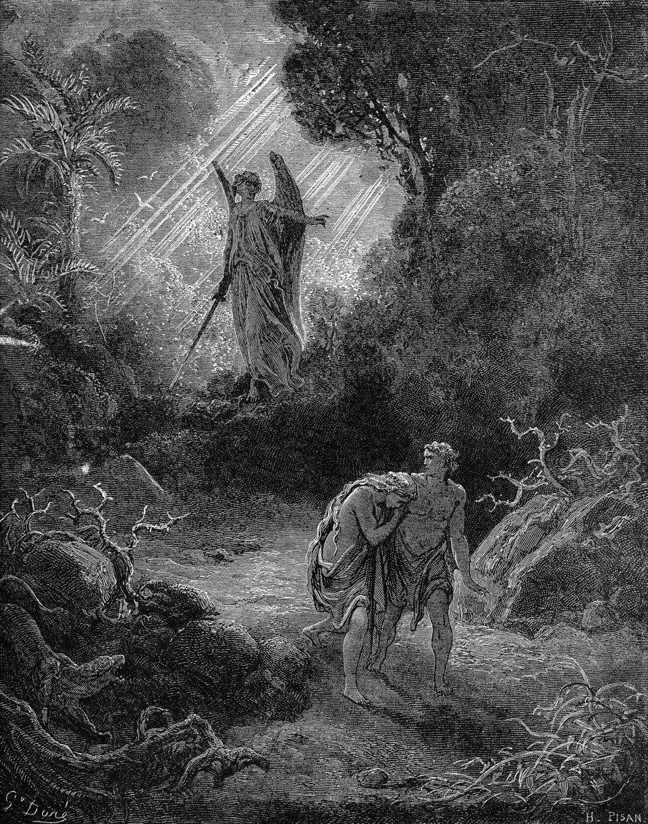
Uncertainty - The Soil of Human Righteousness
Genesis 3:10 “I was afraid …, so I hid.”
Fear leads people to ask:
  Am I safe?
  Am I accepted?
  Am I right?
Uncertainty drives fear.
Fear demands control.
Control creates systems.
Systems shape behaviors.
Behaviors become ideology.
Ideology defines social norms.
Human Righteousness
Notes:
Uncertainty, Human Righteousness, the Rise of Man-Made Systems
From the beginning, sin introduced uncertainty.
When man lost trust in God, he gained fear.
Fear demands control.
Control produces systems.
Instead of resting in God’s righteousness, humans build substitutes.
Image from: https://commons.wikimedia.org

Slide 3
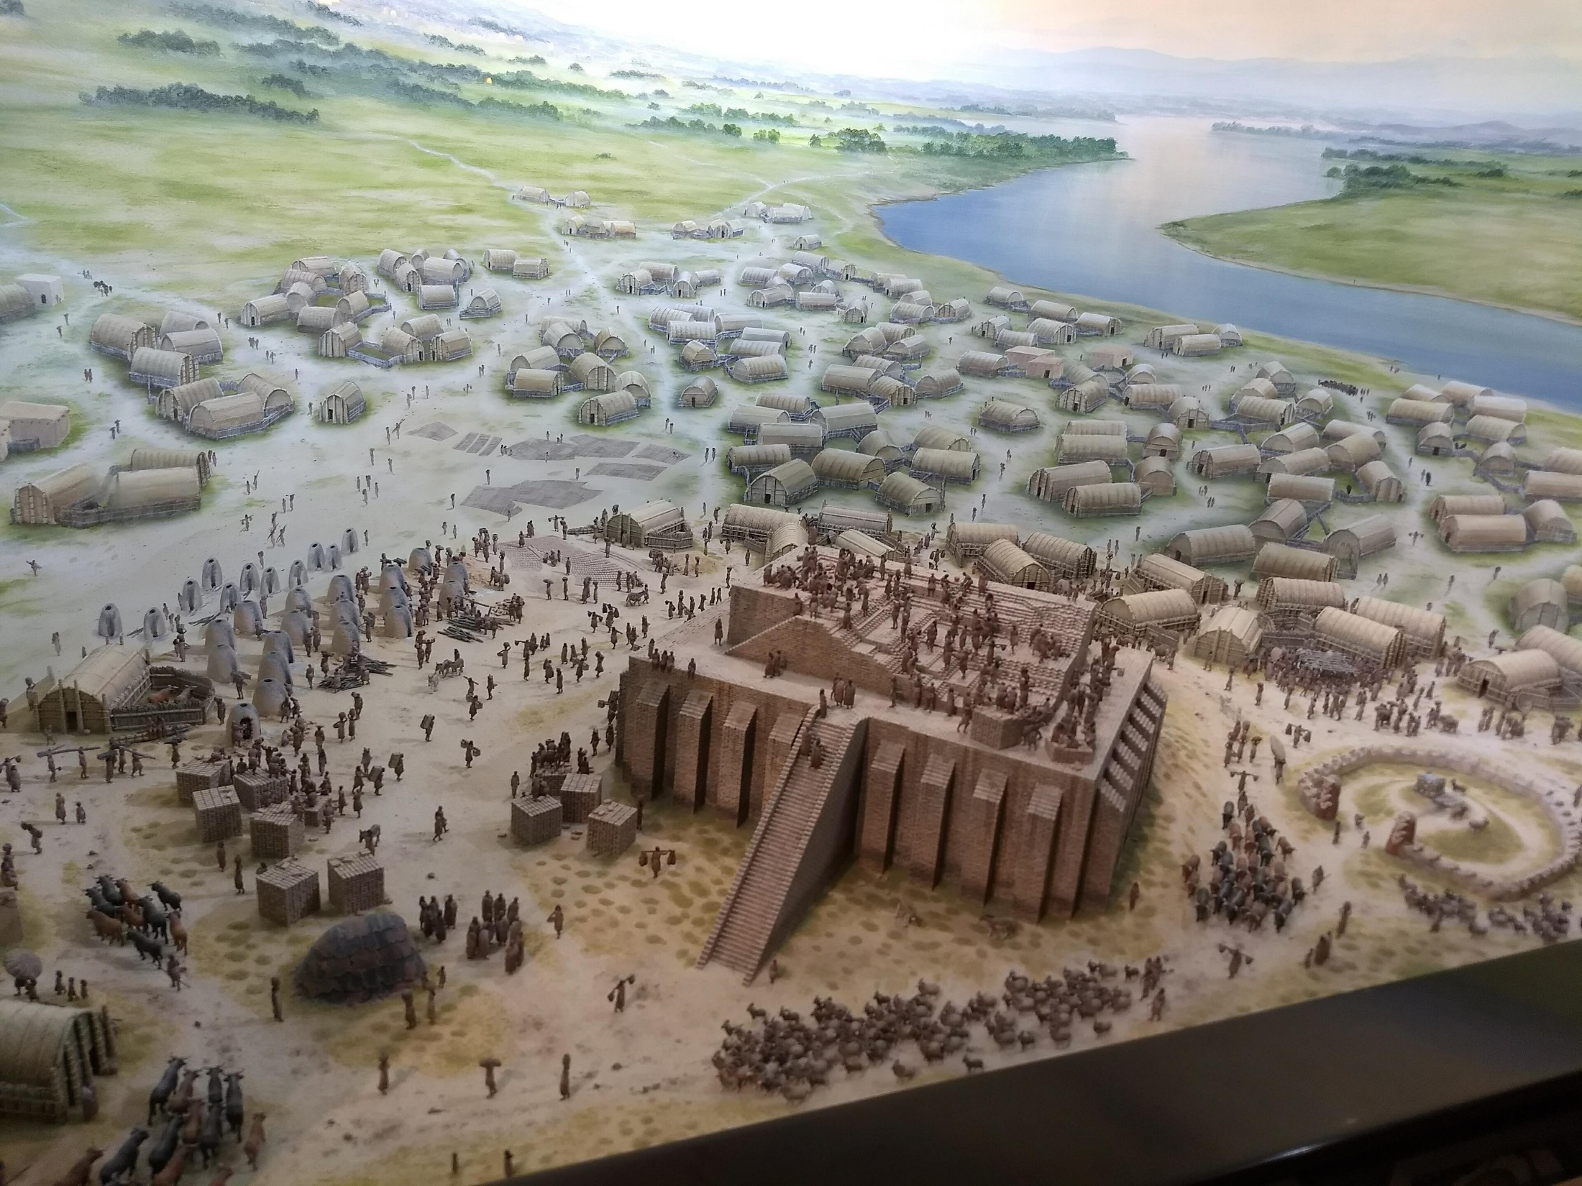
Romans 10:3 They sought to establish their own righteousness and did not submit to God’s righteousness.
Notes:
Jeremiah 17:5 “Cursed is the one who trusts in human beings… and whose heart turns away from the LORD.”
Social contracts replace trust in God with trust in consensus.
Image from: https://commons.wikimedia.org

Slide 4
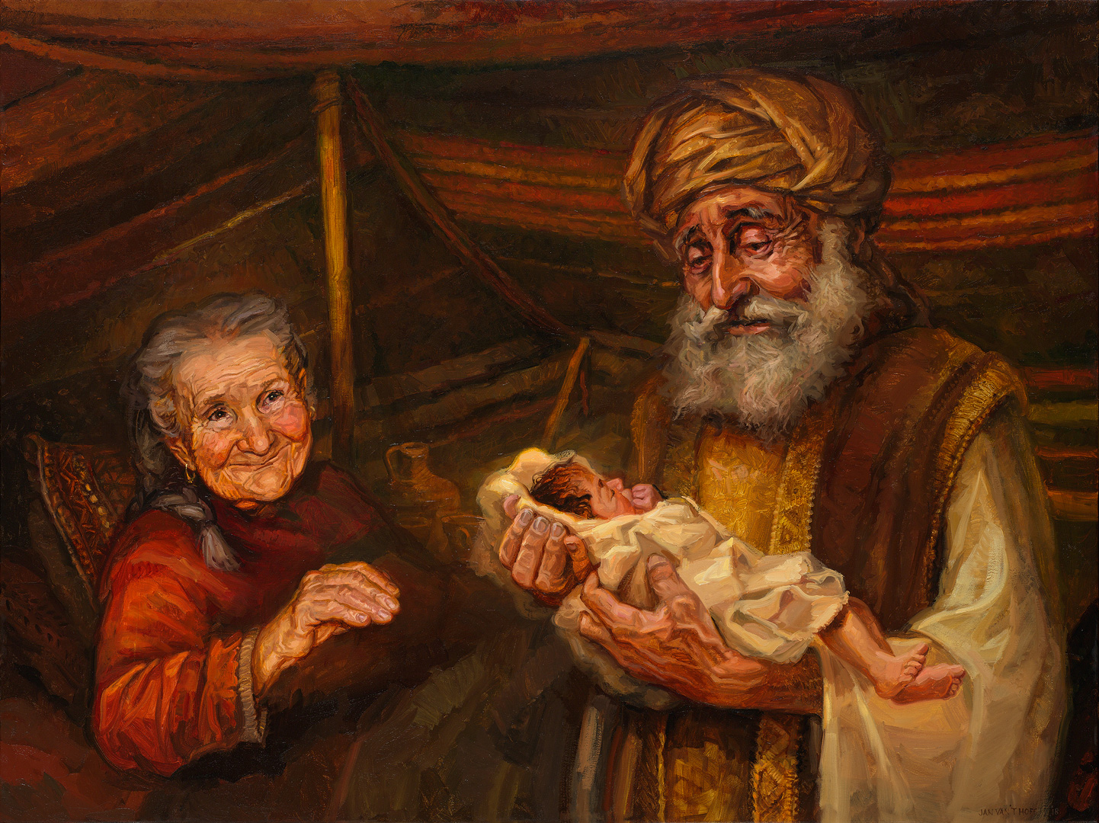
Romans 4:3 For what does the scripture say? “Abraham believed God, and it was credited to him as righteousness.”
Notes:
Image from: https://www.gospelimages.com/paintings/52/birth-of-isaac

Slide 5
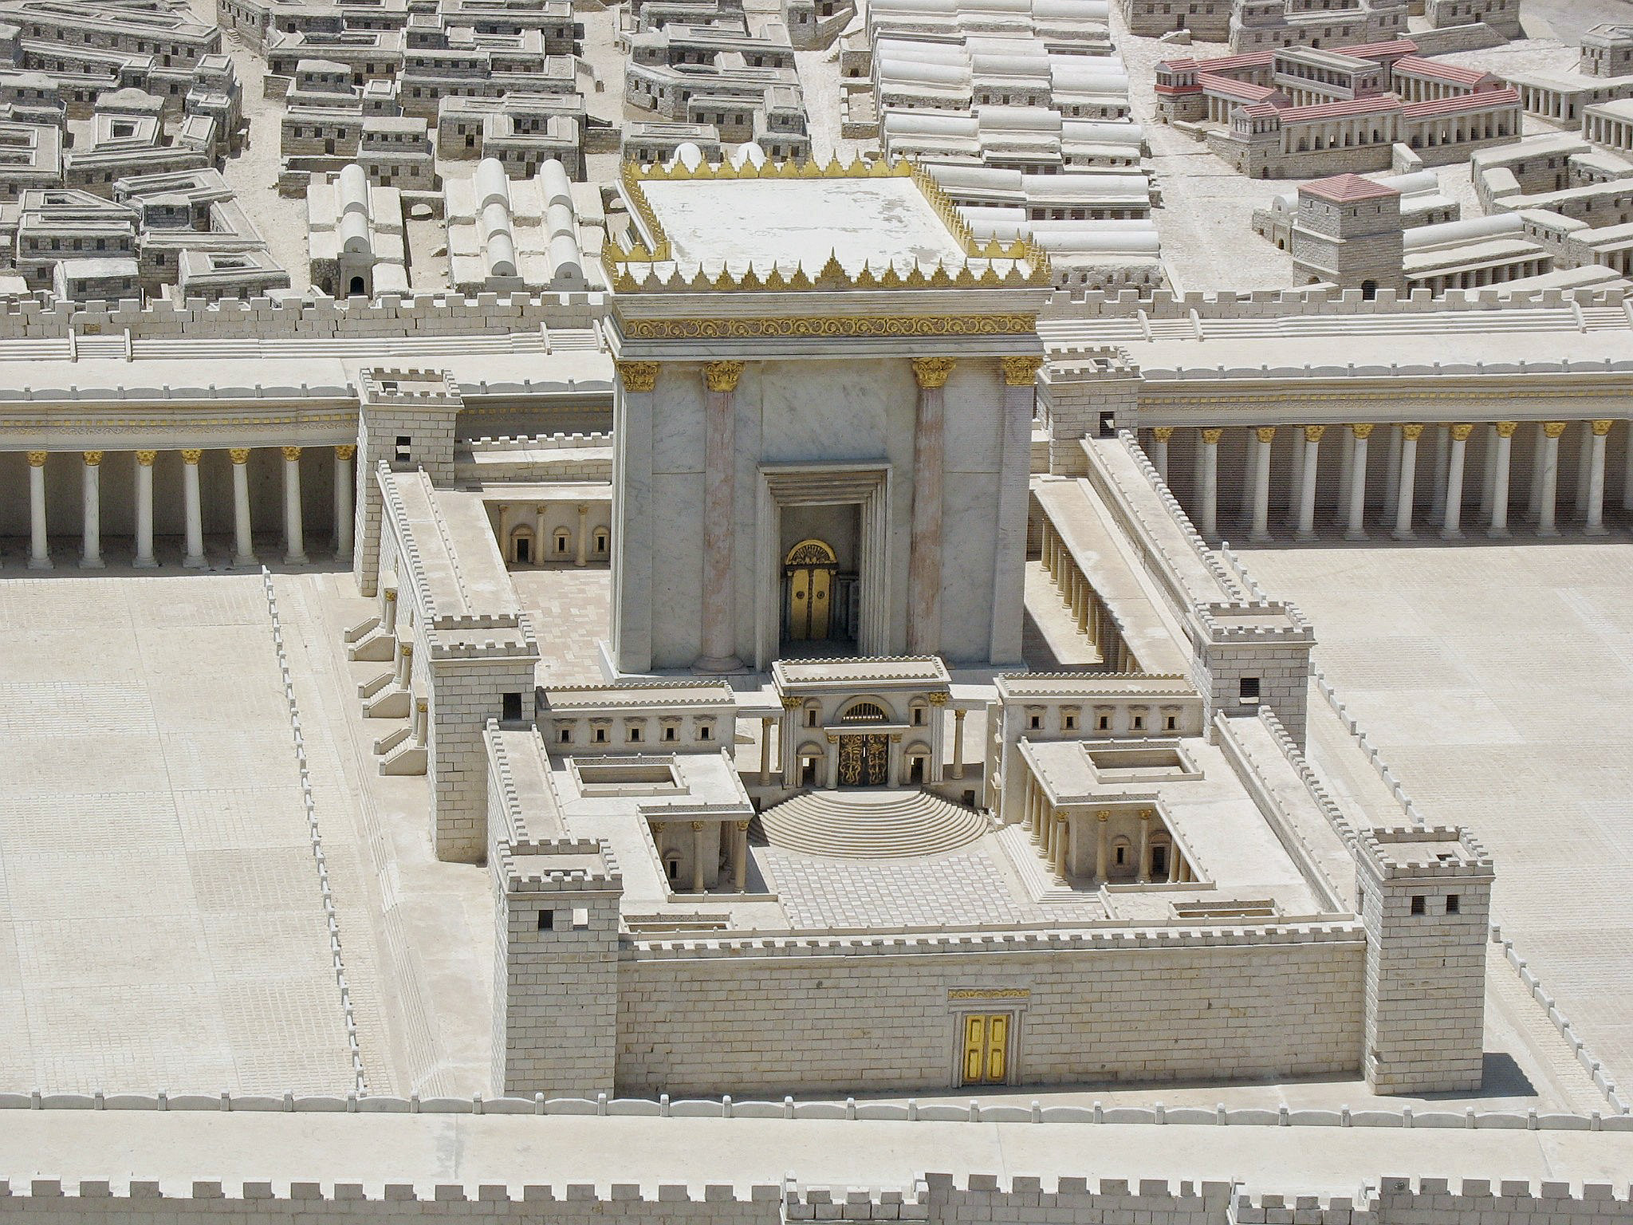
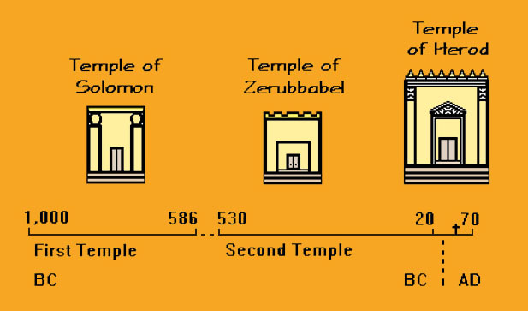
Matthew 5:20 “Unless your righteousness goes beyond that of the experts in the law and the Pharisees, you will never enter the kingdom of heaven.”
Notes:
Pharisees - Cultural Codes - God had stopped speaking to them and hadn't sent a prophet to them in about 400 years. So, they believed that if every Israelite were to perfectly observe all 613 commands in the Torah, then it would appease God and He would restore the Judean kingdom in Israel.
Cultural Identity – the Pharisees, the Sadducees – Developed Theological Systems – Drove Culture – Enforced Their Own Righteousness
The Levites (scribes and priests) were prohibited from owning their own land, so they depended on contributions for food and goods.
That also means they never had to work the land or do the manual labor needed to produce what they ate.
They were of a higher class in society and culture.
They were insulated from the consequences of their own teaching.
Jesus identifies this problem…
It’s easy to write a law that says “don’t pick heads of grain on the Sabbath because that’s work” when you yourself are never starving or hungry enough to consider doing that.
Matthew 23:4 : “They tie up heavy, cumbersome loads and put them on other people’s shoulders, but they themselves are not willing to life a finger to move them.”
Image from: https://commons.wikimedia.org

Slide 6
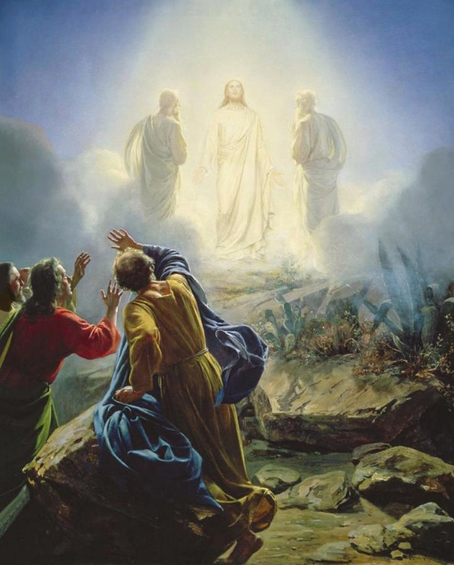
Daniel 7:14 To him was given ruling authority, honor, and sovereignty… His authority is eternal and will not pass away. His kingdom will not be destroyed.
2 Peter 1:16-18 …we were eyewitnesses of his grandeur. For he received honor and glory from God the Father, when that voice was conveyed to him by the Majestic Glory: “This is my dear Son, in whom I am delighted.” When this voice was conveyed from heaven, we ourselves heard it, for we were with him on the holy mountain.
Notes:
Luke 24 – Emmaus Road – Jesus had to “open their minds” to understanding.

Slide 7
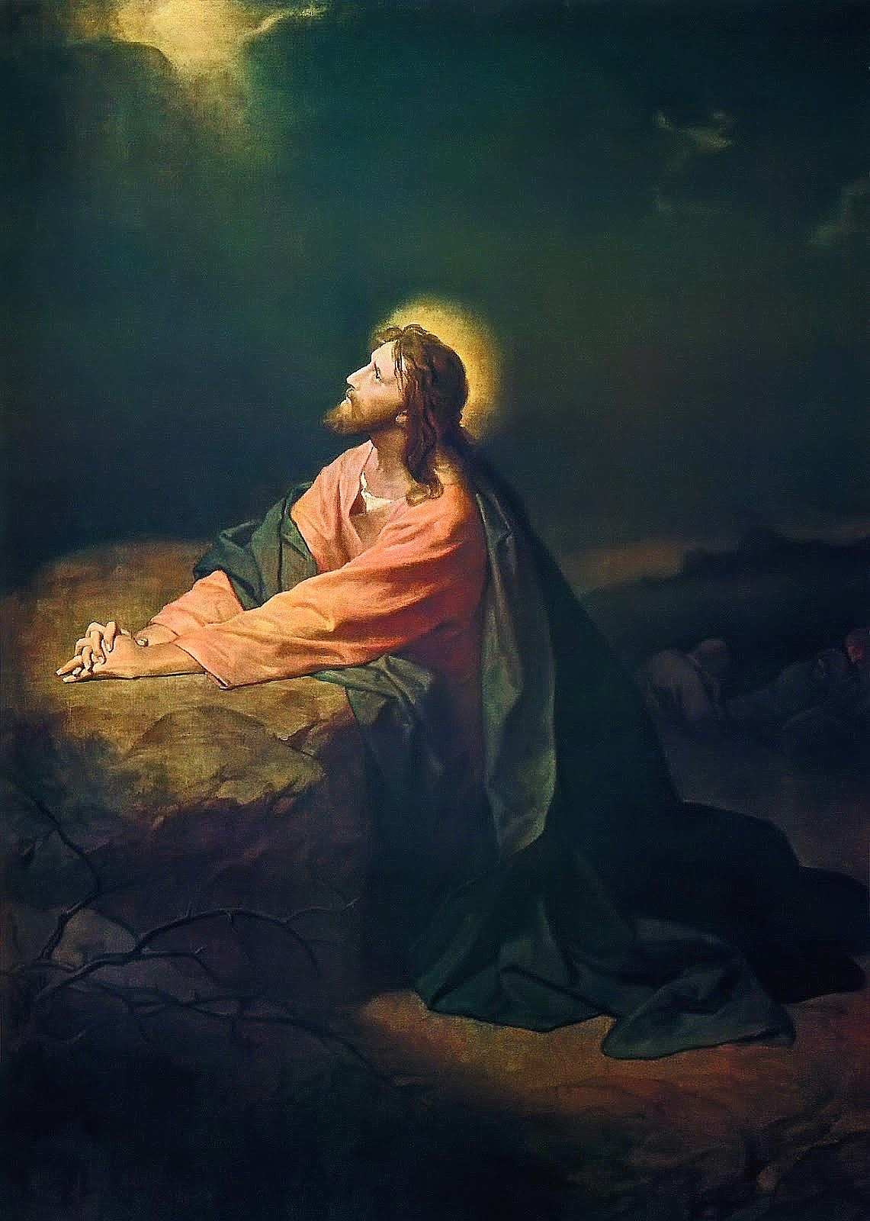
John 17:16-21 They do not belong to the world just as I do not belong to the world. Set them apart in the truth; your word is truth. Just as you sent me into the world, so I sent them into the world. And I set myself apart on their behalf, so that they too may be truly set apart. I am not praying only on their behalf, but also on behalf of those who believe in me through their testimony, that they will all be one, just as you, Father, are in me and I am in you. I pray that they will be in us, so that the world will believe that you sent me.

Slide 8
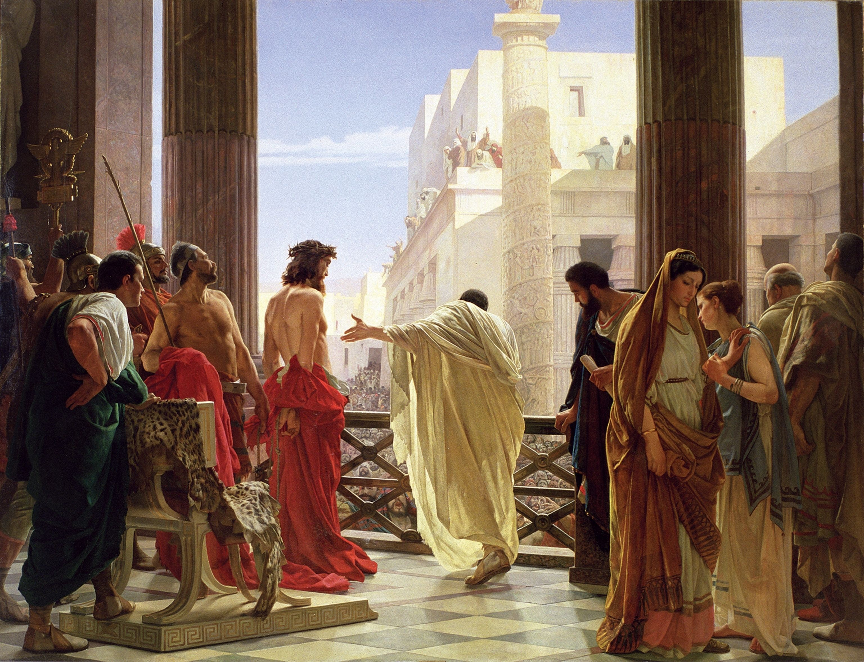
Jesus replied, “… For this reason I was born, and for this reason I came into the world – to testify to the truth. Everyone who belongs to the truth listens to my voice.

Slide 9
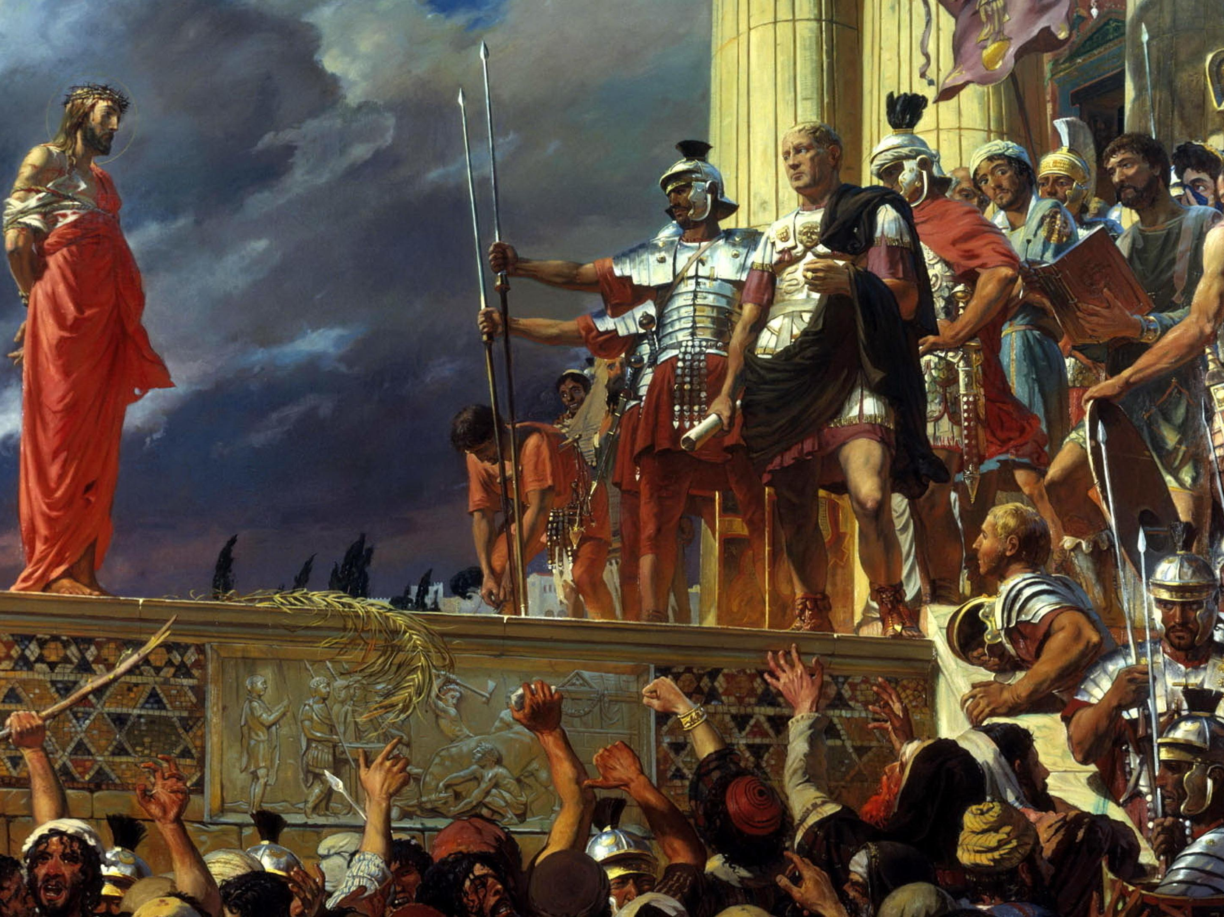
“None of the rulers of this age understood it. If they had known it, they would not have crucified the Lord of glory.” 1 Corinthians 2:8
Notes:
Ecce Homo (“Behold the Man”) by Antonio Ciseri, 1871
The title comes from John 19:5: “So Jesus came out, wearing the crown of thorns and the purple robe. Pilate said to them, ‘Look, here is the man!’”
John 19:4–6 : “Then Pilate went outside again and said to them, ‘Look, I am bringing him out to you, so that you may know that I find no reason for an accusation against him.’ So Jesus came out… When the chief priests and their officers saw him, they shouted out, ‘Crucify! Crucify!’”
This reflects Isaiah 53:7: “He was oppressed and afflicted, yet he did not open his mouth.”
Connection to this Study Theme
This image visually captures:
the righteousness of God standing silent
the righteousness of man expressed through law, crowd pressure, and political calculation
Pilate represents system-driven order.
The crowd represents fear-driven morality.
Jesus represents God’s righteousness without control.
John 18:36 : “My kingdom is not from this world.”
That contrast is the heart of the painting.

Slide 10
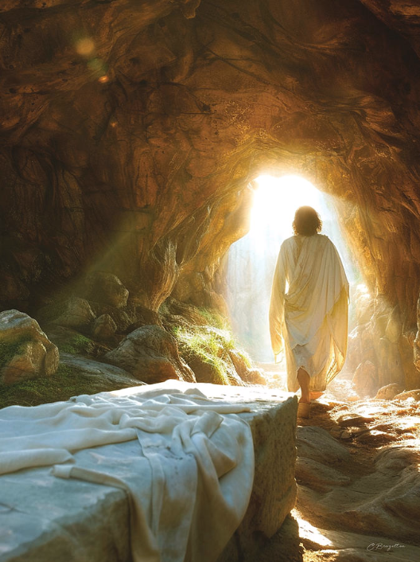
He has destroyed what was against us, a certificate of indebtedness expressed in decrees opposed to us. He has taken it away by nailing it to the cross. Disarming the rulers and authorities, he has made a public disgrace of them, triumphing over them by the cross. (Colossians 2:14-15)
Therefore, since the children share in flesh and blood, he likewise shared in their humanity, so that through death He could destroy the one who holds the power of death (that is, the devil) and set free those who were held in slavery all their lives by their fear of death. For surely his concern is not for angels, but He is concerned for Abraham’s descendants.
(Hebrews 2:14-16)
Notes:
Reclaim the Sacred Space
Matt 28:16-20 So the eleven disciples went to Galilee to the mountain Jesus had designated. (17) When they saw him, they worshiped him, but some doubted. (18) Then Jesus came up and said to them, “All authority in heaven and on earth has been given to me. (19) Therefore go and make disciples of all nations, baptizing them in the name of the Father and the Son and the Holy Spirit, (20) teaching them to obey everything I have commanded you. And remember, I am with you always, to the end of the age.”
The Temple is now represented by each Human Being. The sacred space. Take the Kingdom back one temple at a time.

Slide 11
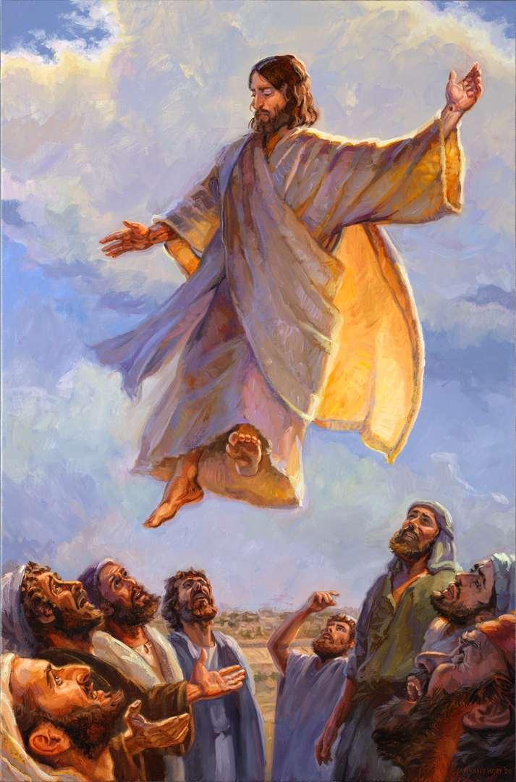
Go! Take Back All Nations
Matthew 28:18-20 Then Jesus came up and said to them, “All authority in heaven and on earth has been given to me. Therefore, go and make disciples of all nations, baptizing them in the name of the Father and the Son and the Holy Spirit, teaching them to obey everything I have commanded you. And remember, I am with you always, to the end of the age.”
Notes:
Reclaim the Sacred Space
Matt 28:16-20 So the eleven disciples went to Galilee to the mountain Jesus had designated. (17) When they saw him, they worshiped him, but some doubted. (18) Then Jesus came up and said to them, “All authority in heaven and on earth has been given to me. (19) Therefore go and make disciples of all nations, baptizing them in the name of the Father and the Son and the Holy Spirit, (20) teaching them to obey everything I have commanded you. And remember, I am with you always, to the end of the age.”
The Temple is now represented by each Human Being. The sacred space. Take the Kingdom back one temple at a time.

Slide 12
Christ Reveals the Righteousness of God
Revelation, Declaration, Regeneration, Transformation
2 Corinthians 5:21 God made the one who did not know sin to be sin for us, so that in him we would become the righteousness of God.
Romans 5:1 Therefore, since we have been declared righteous by faith, we have peace with God through our Lord Jesus Christ…
1 Peter 1:23 You have been born anew, not from perishable but from imperishable seed, through the living and enduring word of God.
Ephesians 4:22-24 You were taught with reference to your former way of life to lay aside the old man who is being corrupted in accordance with deceitful desires, to be renewed in the spirit of your mind, and to put on the new man who has been created in God’s image – in righteousness and holiness that comes from truth.
Notes:
God’s Plan to Restore His Human Family
The Gospel Narrative
Christ reveals God’s righteousness.
Justification receives God’s righteousness.
New birth implants God’s righteousness as new life.
Sanctification expresses God’s righteousness in character and conduct.
Key Contrasts
Not human achievement, but divine provision.
Not works as the basis, but faith as the means.
Not outward conformity alone, but inward transformation.
Not a one-time decision only, but a life continually shaped by grace.

