Slide 1
Projecting and Protecting Unity
Forgiveness, Peace, Gratitude
Clothe the Church in Love
Therefore, as the elect of God, holy and dearly loved, clothe yourselves with a heart of mercy, kindness, humility, gentleness, and patience, bearing with one another and forgiving one another, if someone happens to have a complaint against anyone else. Just as the Lord has forgiven you, so you also forgive others. And to all these virtues add love, which is the perfect bond. Let the peace of Christ be in control in your heart (for you were in fact called as one body to this peace) and be thankful. Let the word of Christ dwell in you richly, teaching and exhorting one another with all wisdom, singing psalms, hymns, and spiritual songs, all with grace in your hearts to God. And whatever you do in word or deed, do it all in the name of the Lord Jesus, giving thanks to God the Father through him. (Colossians 3:12-17)
https://tinyurl.com/Call2Unity
Notes:
Week 12: Projecting and Protecting Unity
Text: Colossians 3:12–17
Objective: Clothe the church in love.
Key Themes: Forgiveness, peace, gratitude.
Discussion:
What are the garments of unity?
How does the Word shape communal identity?
Application: Create a personal commitment plan to protect unity.
(Col 3:12-17) Therefore, as the elect of God, holy and dearly loved, clothe yourselves with a heart of mercy, kindness, humility, gentleness, and patience, (13) bearing with one another and forgiving one another, if someone happens to have a complaint against anyone else. Just as the Lord has forgiven you, so you also forgive others. (14) And to all these virtues add love, which is the perfect bond. (15) Let the peace of Christ be in control in your heart (for you were in fact called as one body to this peace), and be thankful. (16) Let the word of Christ dwell in you richly, teaching and exhorting one another with all wisdom, singing psalms, hymns, and spiritual songs, all with grace in your hearts to God. (17) And whatever you do in word or deed, do it all in the name of the Lord Jesus, giving thanks to God the Father through him.

Slide 2
Projecting and Protecting Unity Colossians 3:12-17
“as the elect of God, holy and dearly loved” (v.12): Paul roots unity in identity. Before we do, we must remember who we are—set apart by grace.
“Clothe yourselves…” (v.12): Clothing metaphor suggests intentional choice. Just as we daily choose garments, we must daily choose compassion, kindness, humility, gentleness, and patience.
“bearing with one another and forgiving one another” (v.13): Forgiveness is the safeguard against bitterness. The measure? “Forgive as the Lord forgave you.”
“And to all these virtues add love” (v.14): Love is the binding garment that integrates all virtues into a seamless unity.
“Let the peace of Christ be in control in your heart ” (v.15): The peace of Christ is not passive; it acts as an umpire, guiding decisions for the good of the body.
“Let the word of Christ dwell in you richly” (v.16): Unity is not sustained by sentiment alone, but by the Word shaping teaching, admonition, and worship.
“Do everything… in the name of the Lord Jesus” (v.17): Every action is done under the authority and reputation of Christ, projecting unity outward to the world.
Notes:
(Col 3:12-17) Therefore, as the elect of God, holy and dearly loved, clothe yourselves with a heart of mercy, kindness, humility, gentleness, and patience, (13) bearing with one another and forgiving one another, if someone happens to have a complaint against anyone else. Just as the Lord has forgiven you, so you also forgive others. (14) And to all these virtues add love, which is the perfect bond. (15) Let the peace of Christ be in control in your heart (for you were in fact called as one body to this peace), and be thankful. (16) Let the word of Christ dwell in you richly, teaching and exhorting one another with all wisdom, singing psalms, hymns, and spiritual songs, all with grace in your hearts to God. (17) And whatever you do in word or deed, do it all in the name of the Lord Jesus, giving thanks to God the Father through him.

Slide 3
The Garments of Unity The wardrobe that protects the church from envy, rivalry, and division.
Compassion – Seeing others’ pain.
Kindness – Acting for others’ good.
Humility – Self-forgetfulness.
Gratitude : Shifts focus from what divides to what unites. Paul repeatedly links thanksgiving to maturity (Col. 2:6-7; 4:2).
Gentleness – Strength under control.
Peace : Acts as the arbiter when conflicts arise; unity is preserved by following Christ’s peace, not our tempers.
Patience – Enduring hardship without resentment.
Forgiveness – Releasing debt.
Prevents grudges from festering into division (Matthew 18:21–35)
Love – The overcoat binding them all together.
Notes:
Mat 18:21-35 Then Peter came to him and said, “Lord, how many times must I forgive my brother who sins against me? As many as seven times?” (22) Jesus said to him, “Not seven times, I tell you, but seventy-seven times! (23) “For this reason, the kingdom of heaven is like a king who wanted to settle accounts with his slaves. (24) As he began settling his accounts, a man who owed ten thousand talents was brought to him. (25) Because he was not able to repay it, the lord ordered him to be sold, along with his wife, children, and whatever he possessed, and repayment to be made. (26) Then the slave threw himself to the ground before him, saying, ‘Be patient with me, and I will repay you everything.’ (27) The lord had compassion on that slave and released him, and forgave him the debt. (28) After he went out, that same slave found one of his fellow slaves who owed him one hundred silver coins. So he grabbed him by the throat and started to choke him, saying, ‘Pay back what you owe me!’ (29) Then his fellow slave threw himself down and begged him, ‘Be patient with me, and I will repay you.’ (30) But he refused. Instead, he went out and threw him in prison until he repaid the debt. (31) When his fellow slaves saw what had happened, they were very upset and went and told their lord everything that had taken place. (32) Then his lord called the first slave and said to him, ‘Evil slave! I forgave you all that debt because you begged me! (33) Should you not have shown mercy to your fellow slave, just as I showed it to you?’ (34) And in anger his lord turned him over to the prison guards to torture him until he repaid all he owed. (35) So also my heavenly Father will do to you, if each of you does not forgive your brother from your heart.”
Col 2:6-7 Therefore, just as you received Christ Jesus as Lord, continue to live your lives in him, (7) rooted and built up in him and firm in your faith just as you were taught, and overflowing with thankfulness.
Col 4:2 Be devoted to prayer, keeping alert in it with thanksgiving.
Discussion
What are the “garments” of unity, and which is hardest for you to “put on” daily?
How does Scripture shape not just individual faith, but communal identity?
Why is gratitude a vital ingredient in protecting unity?

Slide 4
Projecting Unity Not only inward – it must be project outward as witness.
To the world: “By this everyone will know you are my disciples, if you love one another” (John 13:35).
Through worship: Teaching and singing together (Col. 3:16) embody visible harmony
In mission: Shared gospel work (Acts 4:18-20) demonstrates authentic fellowship.
Notes:
Joh 13:34-35 “I give you a new commandment – to love one another. Just as I have loved you, you also are to love one another. (35) Everyone will know by this that you are my disciples – if you have love for one another.”
Col 3:16 Let the word of Christ dwell in you richly, teaching and exhorting one another with all wisdom, singing psalms, hymns, and spiritual songs, all with grace in your hearts to God.
Act 4:18-20 And they called them in and ordered them not to speak or teach at all in the name of Jesus. (19) But Peter and John replied, “Whether it is right before God to obey you rather than God, you decide, (20) for it is impossible for us not to speak about what we have seen and heard.”
Discussion:
Where might our church need to be more intentional in projecting unity outward?

Slide 5
Protecting Unity Not assuming unity is automatic; but maintaining it actively.
Guard against pride and factions (1 Cor. 1:10–13).
Handle offense quickly (Matt. 5:21–25).
Speak truth in love (Eph. 4:14-15).
Equip every member to serve (Eph. 4:11–13).
Protecting unity requires intentional vigilance (Eph. 4:3).
Notes:
1Co 1:10-13 I urge you, brothers and sisters, by the name of our Lord Jesus Christ, to agree together, to end your divisions, and to be united by the same mind and purpose. (11) For members of Chloe’s household have made it clear to me, my brothers and sisters, that there are quarrels among you. (12) Now I mean this, that each of you is saying, “I am with Paul,” or “I am with Apollos,” or “I am with Cephas,” or “I am with Christ.” (13) Is Christ divided? Paul wasn’t crucified for you, was he? Or were you in fact baptized in the name of Paul?
Mat 5:21-25 “You have heard that it was said to an older generation, ‘Do not murder,’ and ‘whoever murders will be subjected to judgment.’ (22) But I say to you that anyone who is angry with a brother will be subjected to judgment. And whoever insults a brother will be brought before the council, and whoever says ‘Fool’ will be sent to fiery hell. (23) So then, if you bring your gift to the altar and there you remember that your brother has something against you, (24) leave your gift there in front of the altar. First go and be reconciled to your brother and then come and present your gift. (25) Reach agreement quickly with your accuser while on the way to court, or he may hand you over to the judge, and the judge hand you over to the warden, and you will be thrown into prison.
Eph 4:14-15 So we are no longer to be children, tossed back and forth by waves and carried about by every wind of teaching by the trickery of people who craftily carry out their deceitful schemes. (15) But practicing the truth in love, we will in all things grow up into Christ, who is the head.
Eph 4:11-13 And he himself gave some as apostles, some as prophets, some as evangelists, and some as pastors and teachers, (12) to equip the saints for the work of ministry, that is, to build up the body of Christ, (13) until we all attain to the unity of the faith and of the knowledge of the Son of God – a mature person, attaining to the measure of Christ’s full stature.
Eph 4:1-3 I, therefore, the prisoner for the Lord, urge you to live worthily of the calling with which you have been called, (2) with all humility and gentleness, with patience, putting up with one another in love, (3) making every effort to keep the unity of the Spirit in the bond of peace.

Slide 6
Biblical Examples Learning from the first Christians
Jerusalem Church (Acts 2:42–47): Projected unity through shared worship and generosity.
Philippian Church (Phil. 2:1–4): Protected unity by putting others before self.
Paul’s Team (Col. 4:7–17): Diverse coworkers, united in mission.
John 17:3 "Now this is eternal life: that they know you, the only true God, and Jesus Christ, whom you have sent."
John 14:16-17 "And I will ask the Father, and he will give you another advocate to help you and be with you forever—the Spirit of truth. The world cannot accept Him, because it neither sees Him nor knows Him. But you know Him, for He lives with you and will be in you.“
2 Corinthians 5:17-18 "Therefore, if anyone is in Christ, the new creation has come: The old has gone, the new is here! All this is from God, who reconciled us to himself through Christ."
Notes:
Act 2:42-47 They were devoting themselves to the apostles’ teaching and to fellowship, to the breaking of bread and to prayer. (43) Reverential awe came over everyone, and many wonders and miraculous signs came about by the apostles. (44) All who believed were together and held everything in common, (45) and they began selling their property and possessions and distributing the proceeds to everyone, as anyone had need. (46) Every day they continued to gather together by common consent in the temple courts, breaking bread from house to house, sharing their food with glad and humble hearts, (47) praising God and having the good will of all the people. And the Lord was adding to their number every day those who were being saved.
Php 2:1-4 Therefore, if there is any encouragement in Christ, any comfort provided by love, any fellowship in the Spirit, any affection or mercy, (2) complete my joy and be of the same mind, by having the same love, being united in spirit, and having one purpose. (3) Instead of being motivated by selfish ambition or vanity, each of you should, in humility, be moved to treat one another as more important than yourself. (4) Each of you should be concerned not only about your own interests, but about the interests of others as well.
Col 4:7-17 Tychicus, a dear brother, faithful minister, and fellow slave in the Lord, will tell you all the news about me. (8) I sent him to you for this very purpose, that you may know how we are doing and that he may encourage your hearts. (9) I sent him with Onesimus, the faithful and dear brother, who is one of you. They will tell you about everything here. (10) Aristarchus, my fellow prisoner, sends you greetings, as does Mark, the cousin of Barnabas (about whom you received instructions; if he comes to you, welcome him). (11) And Jesus who is called Justus also sends greetings. In terms of Jewish converts, these are the only fellow workers for the kingdom of God, and they have been a comfort to me. (12) Epaphras, who is one of you and a slave of Christ, greets you. He is always struggling in prayer on your behalf, so that you may stand mature and fully assured in all the will of God. (13) For I can testify that he has worked hard for you and for those in Laodicea and Hierapolis. (14) Our dear friend Luke the physician and Demas greet you. (15) Give my greetings to the brothers and sisters who are in Laodicea and to Nympha and the church that meets in her house. (16) And after you have read this letter, have it read to the church of Laodicea. In turn, read the letter from Laodicea as well. (17) And tell Archippus, “See to it that you complete the ministry you received in the Lord.”
Personal Commitment Plan:
One person I will forgive or seek forgiveness from.
One habit of gratitude I will practice daily.
One way I will contribute to peace in my relationships.
Summary: Unity is not static—it must be clothed in Christlike virtues, safeguarded by forgiveness, peace, and gratitude, and projected outward as a witness to the world. To protect unity is to protect the church’s witness to Christ.

Slide 7
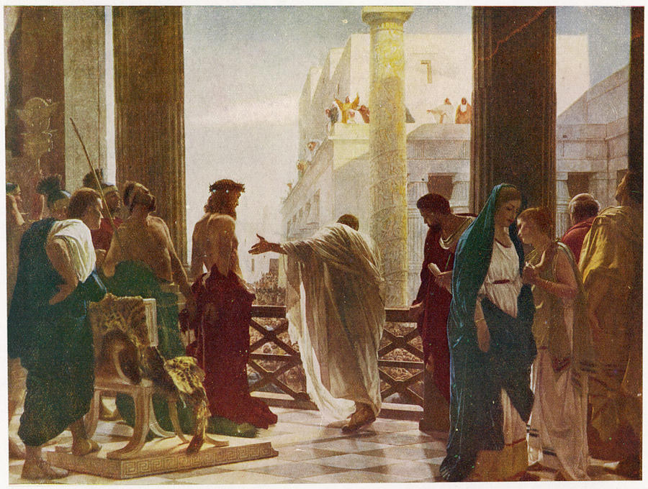
The Call to a Unifying Truth A Call to Whom? (John 18:37)
Notes:
1 Peter 1:22-23 Since you have purified your souls in obeying the truth through the Spirit in sincere love of the brethren, love one another fervently with a pure heart, having been born again, not of corruptible seed but incorruptible, through the word of God which lives and abides forever…
The Call to Unity
Text: 1 Peter 1:22–23
Focus: What does it mean to love one another earnestly?
Themes: Purified hearts, obedience to truth, love as the fruit of rebirth.
Application: Cultivating a church culture that values sincere love over superficial peace.
Joh 18:33-37
(33) So Pilate went back into the governor’s residence, summoned Jesus, and asked him, “Are you the king of the Jews?”
(34) Jesus replied, “Are you saying this on your own initiative, or have others told you about me?”
(35) Pilate answered, “I am not a Jew, am I? Your own people and your chief priests handed you over to me. What have you done?”
(36) Jesus replied, “My kingdom is not from this world. If my kingdom were from this world, my servants would be fighting to keep me from being handed over to the Jewish authorities. But as it is, my kingdom is not from here.”
(37) Then Pilate said, “So you are a king!” Jesus replied, “You say that I am a king. For this reason I was born, and for this reason I came into the world – to testify to the truth. Everyone who belongs to the truth listens to my voice.”
Joh 14:6
(6) Jesus replied, “I am the way, and the truth, and the life. No one comes to the Father except through me.
Joh 14:23
(23) Jesus replied, “If anyone loves me, he will obey my word, and my Father will love him, and we will come to him and take up residence with him.

