Slide 1
The Obedience of Faith
“All authority in heaven and on earth has been given to me. Therefore, go and make disciples of all nations, baptizing them in the name of the Father and the Son and the Holy Spirit, teaching them to obey everything I have commanded you. And remember, I am with you always, to the end of the age.” (Matthew 28:18–20)
http://TeachTheWord.Church

Slide 2
The Principle: The Obedience of Faith
“Paul, a bondservant of Jesus Christ, ... Through Him we have received grace and apostleship for obedience to the faith among all nations for His name, among whom you also are the called of Jesus Christ;” (Romans 1:1-6)
“There is therefore now no condemnation to those who are in Christ Jesus, who do not walk according to the flesh, but according to the Spirit.” (Romans 8:1)
“Now to Him who is able to establish you according to my gospel and the preaching of Jesus Christ, according to the revelation of the mystery kept secret since the world began but now made manifest, and by the prophetic Scriptures made known to all nations, according to the commandment of the everlasting God, for obedience to the faith — to God, alone wise, be glory through Jesus Christ forever. Amen.”
(Romans 16:25-27)

Slide 3
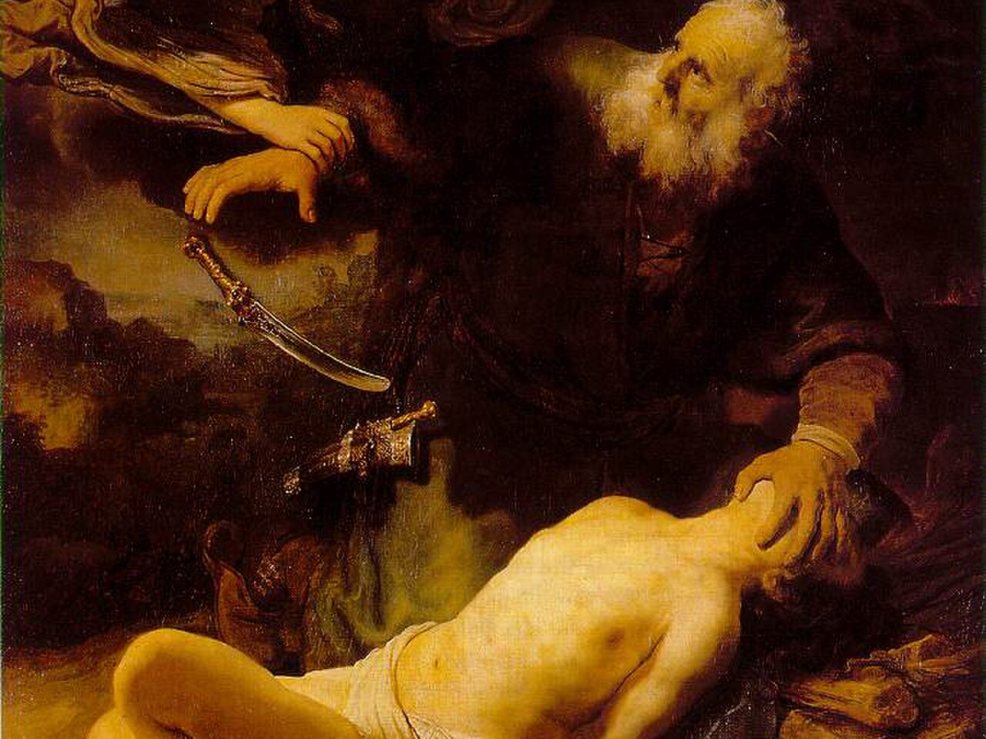
“By faith Abraham, when he was tested, offered up Isaac, and he who had received the promises offered up his only begotten son,” (Hebrews 11:17)

Slide 4
Four Concepts that Scripture Uses with Precision
4. Obedience of Faith
the SETTLED PATTERN (Romans 1:5; 16:26)
Obedience of Faith: The whole gospel stack aligned → a life reorganized around what it claims. Not one dramatic act.
3. Sacrifice
the COST → the disposition made visible
Sacrifice: “Take your son → your only son, whom you love” (Gen 22:2). Faith became visible at the raised knife (Heb 11:17–19).
2. Worship
the DISPOSITION → the heart aimed at God
Worship: “In spirit and truth” (John 4:23–24). But a disposition is invisible → even to its owner.
1. Religion
the FORM → observance, attendance, identity
Religion: James says a man can practice the form; deceive his heart → “futile”
(James 1:26). Alone, it proves nothing.

Slide 5
Obedience of Faith : Elements of Our Response
“I beseech you therefore, brethren, by the mercies of God, that you present your bodies a living sacrifice, holy, acceptable to God, which is your reasonable service. And do not be conformed to this world, but be transformed by the renewing of your mind, that you may prove what is that good and acceptable and perfect will of God.” (Romans 12:1-2)
God’s Sovereign Will (the will of decree, Ephesians 1:11)
God’s Moral Will (will of precept, or revealed will, 1 Thes 4:3)
God’s Will of Disposition (good pleasure, 2 Peter 3:9)
Notes:
SOVEREIGN WILL
“In Him also we have obtained an inheritance, being predestined according to the purpose of Him who works all things according to the counsel of His will,”
(Ephesians 1:11)
MORAL WILL
“For this is God’s will: that you become holy, that you keep away from sexual immorality” (1 Thessalonians 4:3).
DISPOSITION WILL
“The Lord is not slow concerning his promise… but is being patient toward you, because he does not wish for any to perish but for all to come to repentance” (2 Peter 3:9).

Slide 6
The Revealing Pattern of Sacrifice and Obedience
Jesus → Perfect Alignment with God’s Will and Purpose
“Sacrifice and offering you did not desire, but a body you prepared for me… Then I said, ‘Here I am; I have come → it is written of me in the scroll of the book → to do your will, O God.’” (Hebrews 10:5, 7)
Obedience of Faith : “I have come to do your will”
Aligned once by Jesus Himself, completely, in Him.
“By that will we have been made holy → once for all.” (Heb 10:10)
Your Obedience of Faith is a thank offering, not a payment. (Rom 12:1-2)
Sacrifice : the full cost, a body, nothing kept back
Worship : perfect heart
Religion : perfect form
Notes:
[CLICK] Heb 10:5,7 — Psalm 40 in the mouth of Christ.
[CLICK×4] Build the gold stack: form, heart, cost, obedience.
[CLICK] Aligned once, completely, in Him — mercy first, altar second, your living sacrifice

