Slide 1
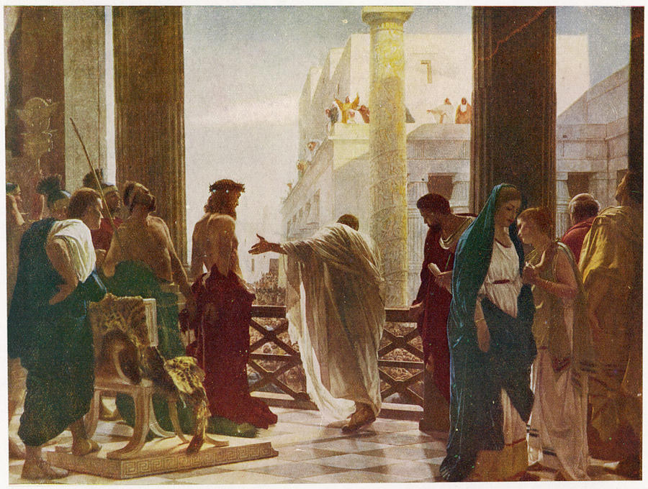
The Call to a Unifying Truth A Call to which Cohort? (John 18:37)
Notes:
Consider the “Cohorts” present at the Pilate inquiry.
Pharisees – lacked discernment (Matt 16 : able to predict weather, but not able to see the signs of the time). A time when both the Pharisees and Sadducees were unified.
Romans – “Might is Right” – reading the wrong signs – ignoring significance of situational context – “the end justifies the means”
Jesus – A cohort of 1 (Trinity?). Speaking to whom?
Joh 18:33-37
(33) So Pilate went back into the governor’s residence, summoned Jesus, and asked him, “Are you the king of the Jews?”
(34) Jesus replied, “Are you saying this on your own initiative, or have others told you about me?”
(35) Pilate answered, “I am not a Jew, am I? Your own people and your chief priests handed you over to me. What have you done?”
(36) Jesus replied, “My kingdom is not from this world. If my kingdom were from this world, my servants would be fighting to keep me from being handed over to the Jewish authorities. But as it is, my kingdom is not from here.”
(37) Then Pilate said, “So you are a king!” Jesus replied, “You say that I am a king. For this reason I was born, and for this reason I came into the world – to testify to the truth. Everyone who belongs to the truth listens to my voice.”
Joh 14:6
(6) Jesus replied, “I am the way, and the truth, and the life. No one comes to the Father except through me.
Joh 14:23
(23) Jesus replied, “If anyone loves me, he will obey my word, and my Father will love him, and we will come to him and take up residence with him.
I Cor. 2:13-16
“…but we have the mind of Christ”

Slide 2
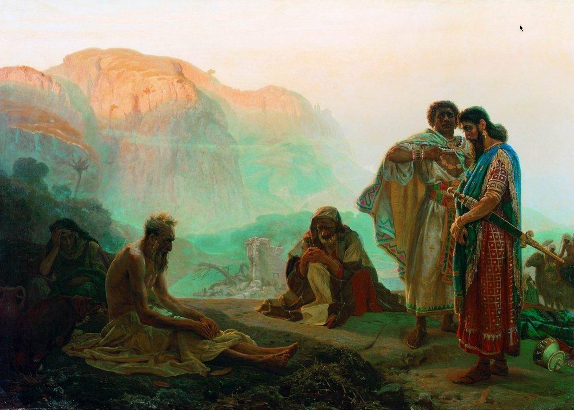
Job’s Friends Practice Discernment
Notes:
Job’s friends—Eliphaz, Bildad, Zophar, and Elihu—offer insight into how faulty presuppositions can damage relationships and cloud theological truth. Each speaks as if he fully understands the reason for Job’s suffering, but their shared assumptions are flawed.
Key Observations:
1. Job’s character reputation indicates that his friends would also have been people of high character. Each appears to “know God”.
2. The Satan (Accuser) appears to have overtaken Job’s friends. Each friend ultimately accuses Job of sin. They have become Delegated Accusers.
3. Ultimately, Job succumbs to the attack on his character (Job 42:3). But what was his sin? Where did Job’s sin originate (i.e. the Mind).

Slide 3
Presuppositional Thinking Faulty presuppositions damage relationships and cloud theological truth
Suffering is always the result of sin Assuming a direct correlation between personal sin and suffering, leaving no room for mystery or divine testing.
“Consider now: Who being innocent has ever perished?” – Eliphaz (Job 4:7)
God’s justice is immediate and visible Assuming God always rewards or punishes visibly and swiftly.
“Surely God does not reject one who is blameless…” – Bildad (Job 8:20)
Human wisdom can fully explain divine action Assuming an understanding of God’s ways through tradition or reason.
“Are God’s consolations not enough for you…?” – Eliphaz (Job 15:11)
Suffering may be preventative or instructive, not always punitive Presuming to speak with divine authority.
God does all these things to a person… to turn them back from the pit.” – Elihu (Job 33:29-30)
Confession and repentance will instantly fix the problem Assuming that doing so will immediately restore his fortunes.
“If you put away the sin that is in your hand… then you will lift up your face without shame.” – Zophar (Job 11:14–15)
Notes:
All four speakers operate from flawed presuppositions: that Job’s suffering must be deserved. They demonstrate how misapplication of truth, even when well-intended, leads to false counsel and further division. Their failure underscores the need for humility, context, and compassion in theological dialogue—directly applicable to preserving unity in the church.
What Is Presuppositional Thinking?
Presuppositional thinking involves starting with assumptions that shape how we interpret reality, truth, and Scripture. These assumptions are often unexamined but deeply rooted in our worldview—our overarching framework for making sense of life, meaning, morality, and destiny.
Example: If someone presupposes that "truth is relative," they will interpret Scripture selectively, potentially dismissing clear biblical commands as "contextual" or outdated.
How It Leads to Incorrect Assumptions
Confirmation Bias: We only accept interpretations that match what we already believe.
Cultural Filtering: We interpret eternal truths through the lens of modern trends or preferences (e.g. self-image or influencer dogmas).
Doctrinal Rigidity: We assume our denominational position is the only legitimate one without examining Scripture afresh.
These errors contribute to theological division, moral confusion, and church disunity—precisely the issues your course aims to resolve.

Slide 4
Presuppositional Thinking Faulty presuppositions damage relationships and cloud theological truth
Job’s Response and Divine Admonition: While Job rightly resists the flawed arguments of his friends and maintains his innocence, he eventually slips into self-righteousness and questions God's justice. In chapters 38–41, God responds not by explaining Job’s suffering but by humbling him with a series of rhetorical questions that reveal divine sovereignty and human limitation.
“Who is this that obscures my plans with words without knowledge?” – God to Job (Job 38:2)
Though Job never curses God, he does accuse God of injustice, and this presumption is what God corrects. Job’s error is not moral failure, but intellectual and theological presumption; assuming that God must explain Himself.
“Surely I spoke of things I did not understand, things too wonderful for me to know.” – Job (Job 42:3)
Insights: Even the righteous can err in trying to defend themselves or interpret God's will. The Friend’s assumptions demonstrate how sincere but shallow theology can lead to misjudgment and further pain. The story of Job reminds us to approach others with humility, listen well, and trust God’s sovereignty even when His purposes are hidden. We must practice discernment to avoid becoming delegated accusers like Job’s Friends. The pathway to restored understanding and unity is humble submission to divine wisdom.
Notes:
Discernment via Truth Tests
1. Correspondence Test
Truth must correspond to reality.
Example: If we say “God is love” (1 John 4:8), then our actions and church culture should reflect this.
Application: Church unity must correspond to the visible fruit of love, peace, and mutual care—not just doctrinal statements.
2. Correlation Test
Truth must cohere with other known truths.
Example: “Grace saves” and “Faith without works is dead” must correlate (Ephesians 2:8–10 + James 2:17).
Application: Interpret Scripture in context of the whole Bible to avoid false dichotomies (e.g., truth vs. love, grace vs. accountability).
When divisions arise in the church—doctrinal, relational, or practical—they often spring from presuppositions that haven’t been tested against objective truth.
Teaching mature Christians to:
Recognize their assumptions,
Test ideas against Scripture and observable fruit, and
Ensure coherence within the whole counsel of God can help resolve disagreements, strengthen unity, and promote humble discernment.

Slide 5
The Source of Unity
Unity as Divine Witness
What does Oneness in the Trinity Teach Us?
“I am not praying only on their behalf, but also on behalf of those who believe in me through their testimony, that they will all be one, just as you, Father, are in me and I am in you. I pray that they will be in us, so that the world will believe that you sent me. The glory you gave to me I have given to them, that they may be one just as we are one – I in them and you in me – that they may be completely one, so that the world will know that you sent me, and you have loved them just as you have loved me. (John 17:20-23)
Phil@UsefulEngines.com
https://tinyurl.com/sa846z8m
Notes:
“I am not praying only on their behalf, but also on behalf of those who believe in me through their testimony, that they will all be one, just as you, Father, are in me and I am in you. I pray that they will be in us, so that the world will believe that you sent me. The glory you gave to me I have given to them, that they may be one just as we are one – I in them and you in me – that they may be completely one, so that the world will know that you sent me, and you have loved them just as you have loved me. (John 17:20-23)

Slide 6
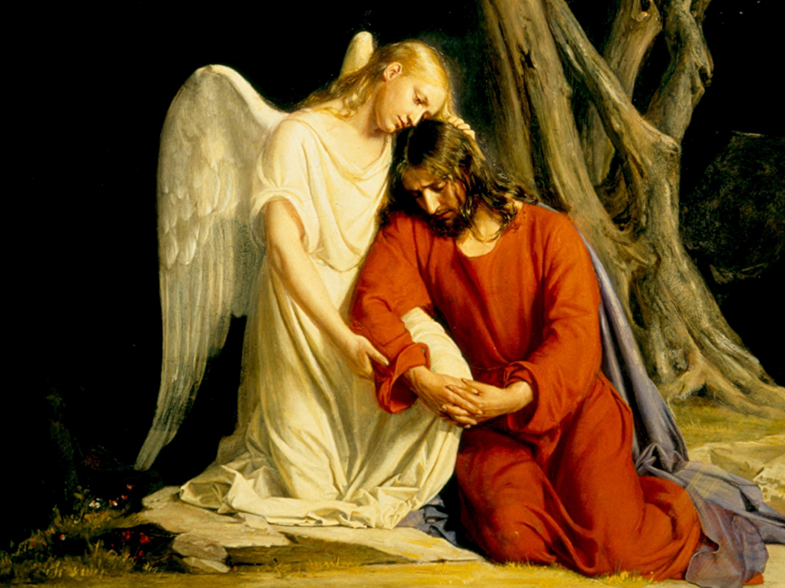
Notes:
John 17
17:16 Christians are not of the world, just as Christ was not of the world. We should remember this when tempted to engage in some worldly pastime or enter into worldly associations where the name of Jesus is unwelcome.
17:17 To sanctify means to set apart. The Word of God has a sanctifying effect on believers. As they read it and obey it, they are set apart as vessels suitable for the Master's use. That is exactly what the Lord Jesus was praying for here. He wanted a people who were set apart to God from the world, and usable by God. “Your word is truth,” Jesus said. He did not say, as so many do today, “Your word contains truth,” but “Your word IS truth.”
17:18 The Father sent the Lord Jesus into the world to reveal the character of God to men. As the Lord prayed, He realized that He would soon be going back to heaven. But future generations would still need some witness concerning God. This work must be done by believers, through the power of the Holy Spirit. Of course, Christians can never represent God as perfectly as Christ did because they can never be equal with God. But believers are here just the same to represent God to the world. It is for this reason Jesus sent them into the world.

Slide 7
Knowing God via the Social Order Relationships reflect His Character – “By Design”
“The LORD God said, ‘It is not good for the man to be alone.’” Genesis 2:18
Is this a qualitative statement? (i.e. “could be better”)
Is this an ethical statement? (i.e. “is not right; ought to be different”)
Against what standard does God refer to in the context of this statement?
Aloneness is bad in an ethical sense because it contradicts the nature of God, who is three-in-one: God Himself exists in community and relationship; man, who is made in His image, is supposed to do the same. This concept forms the basis of a true, God-centered understanding of the social order.
To go against God’s design is to deny His character.

Slide 8
The Triune Nature of God Unity, Relationships, Roles, Equality, Authority, Submission
The Father with the Son
“The Father and I are one.” John 10:30
“So Jesus said to them again, ‘Peace be with you. Just as the Father has sent me, I also send you.’” John 20:21
The Son with the Holy Spirit
“But I tell you the truth, it is to your advantage that I am going away. For if I do not go away, the Advocate will not come to you, but if I go, I will send Him to you. And when He comes, He will prove the world wrong concerning sin and righteousness and judgment…”
John 16:7-8
The Father, The Son, The Holy Spirit
“Therefore go and make disciples of all nations, baptizing them in the name of the Father and the Son and the Holy Spirit, teaching them to obey everything I have commanded you. And remember, I am with you always, to the end of the age.”
Matthew 28:19
The Father with the Holy Spirit
“But the Advocate, the Holy Spirit, whom the Father will send in my name, will teach you everything and will cause you to remember everything I said to you.”
John 14:26
Notes:
The Father, The Son, The Holy Spirit
“Therefore go and make disciples of all nations, baptizing them in the name of the Father and the Son and the Holy Spirit, teaching them to obey everything I have commanded you. And remember, I am with you always, to the end of the age.”
Matthew 28:19
The Father with the Holy Spirit
“But the Advocate, the Holy Spirit, whom the Father will send in my name, will teach you everything and will cause you to remember everything I said to you.”
John 14:26
The Father with the Son
“The Father and I are one.” John 10:30
“So Jesus said to them again, ‘Peace be with you. Just as the Father has sent me, I also send you.’” John 20:21
The Son with the Holy Spirit
“But I tell you the truth, it is to your advantage that I am going away. For if I do not go away, the Advocate will not come to you, but if I go, I will send Him to you. And when He comes, He will prove the world wrong concerning sin and righteousness and judgment…”
John 16:7-8

Slide 9
Who is God? What does He want? The God of Order and Relationships
“Dominion and awe belong to God; He establishes order in the heights of heaven.” Job 25:2
“For God is not a God of disorder…” 1 Corinthians 14:33
“He who has My commandments and keeps them, it is he who loves Me. And he who loves Me will be loved by My Father, and I will love him and manifest Myself to him.” John 14:21
“For whoever does the will of God is my brother and sister and mother.” Mark 3:35
“Let this mind be in you which was also in Christ Jesus…” Philippians 2:5-11
Social Disorder is a Human Pathology…
“For where you have envy and selfish ambition, there you find disorder and every evil practice.” James 3:16
Notes:
The Trinity as a Model
Unity and Diversity: The Father, Son, and Holy Spirit are distinct, yet fully one. This divine relationship is the pattern for all social and institutional life.
God’s Sovereignty: All spheres of life derive their structure and authority from God’s design, not from human invention.
The Six Spheres of Dominion
These represent domains where God’s authority is displayed and delegated to humans:
Family – Reflects intimacy and generational legacy.
Labor/Work – Stewardship of creation and productivity.
Church – Spiritual care and moral leadership.
State – Civil justice and protection of the innocent.
Community – Social interaction, culture, and charity.
God-Man Relationship – The heart of worship and truth.
Each of these should remain in their proper boundaries while working harmoniously—like the unity within the Trinity.

Slide 10
The Mind of Christ… What is True Religion?
“Love the Lord you God with all your heart, with all your soul, and with all your mind. This is the first and greatest commandment. The second is like it: Love your neighbor as yourself.” Matt. 22:37-39
“All authority has been given to Me in heaven and on earth. Go therefore and make disciples of all nations, baptizing them in the name of the Father and of the Son and of the Holy Spirit, teaching them to observe all things that I have commanded you; and lo, I am with you always, even to the end of the age.”
Matt. 28:18-20
Notes:
Reflecting on the way that God operates…
Thru 1 man, Adam, sin entered the World.
Thru 1 man, Noah, God resolved to renew this World and promised to overcome the effects of sin in it.
Thru 1 man, Abraham, God reached a family and promised to bless all families.
Thru 1 man, Moses, God reached a nation and promised to bless all nations.
Thru 1 man, Jesus, God reached the world and promises to be with each of us to the end of the World

Slide 11
Focusing on the King’s Perspective A mission from our King… (Matt. 22:37-40; 28:19-20)
1. Love the Lord with all your heart (Worship – Matt. 4:10).
2. Love your neighbor as yourself (Service - Eph. 4:12)
3. Go and make disciples (Evangelism – Acts 1:8).
4. Baptize them (Fellowship; Covenant Unity – Eph. 4:1-6)
5. Teach them to obey (Discipleship – Col. 1:28)
“I, therefore, the prisoner for the Lord, urge you to live worthily of the calling with which you have been called, will all humility and gentleness, with patience, putting up with one another in love, making every effort to keep the unity of the Spirit in the bond of peace. There is one body and one Spirit, just as you were called to the one hope of your calling, one Lord, one faith, one Baptism, one God and Father of all, who is over all and through all and in all.”
“But you will receive power when the Holy Spirit has come upon you, and you will be my witnesses in Jerusalem, and in all Judea and Samaria, and to the farthest parts of the earth.”
“We proclaim Him by instructing and teaching all people with all wisdom so that we may present every person mature in Christ.”
Colossians 1:28
“…For it is written: ‘You are to worship the Lord your God and serve only Him’.”
“And he himself gave some as apostles, some as prophets, some as evangelists, and some as pastors and teachers, to equip the saints for the work of the ministry, that is, to build up the body of Christ, until we all attain to the unity of the faith and of the knowledge of the Son of God – a mature person, attaining to the measure of Christ’s full stature.”

Slide 12
How the Early Church Responded
A foundational pattern for every church. Acts 2:40-47
“And they continued steadfastly in the apostles’ doctrine (DISCIPLESHIP) and fellowship (FELLOWSHIP), in the breaking of bread, and in prayers (WORSHIP).” v. 42
“Now all who believed were together, and had all things in common, and sold their possessions and goods, and divided them among all, as anyone had need (SERVICE).” v. 44-45
“For we are God’s fellow workers; you are God’s field, you are God’s building. According to the grace of God which was given to me, as a wise master builder I have laid the foundation, and another builds on it.” 1 Corinthians 3:9-10
We trust the Lord that you are putting into practice the things we taught you. 2 Thessalonians 3:4
“So continuing daily with one accord in the temple, and breaking bread from house to house, they ate their food with gladness and simplicity of heart, praising God and having favor with all the people. And the Lord added to the church daily those who were saved (COMMUNION, WORSHIP, EVANGELISM).” v. 46-47

Slide 13
The Heart of the Christian Gospel Restoration of a covenant relationship with God
John 17:3 "Now this is eternal life: that they know you, the only true God, and Jesus Christ, whom you have sent."
John 14:16-17 "And I will ask the Father, and he will give you another advocate to help you and be with you forever—the Spirit of truth. The world cannot accept Him, because it neither sees Him nor knows Him. But you know Him, for He lives with you and will be in you.“
2 Corinthians 5:17-18 "Therefore, if anyone is in Christ, the new creation has come: The old has gone, the new is here! All this is from God, who reconciled us to himself through Christ."
How to be Right with God…
“If anyone says ‘I love God’ and yet hates his fellow Christian, he is a liar because the one who does not love his fellow Christian whom he has seen cannot love God whom he has not seen. And the commandment we have from Him is this: that the one who loves God should love his fellow Christian too. Everyone who believes that Jesus is the Christ has been fathered by God, and everyone who loves the Father loves the child fathered by Him. By this we know that we love the children of God: whenever we love God and obey His commandments. For this is the love of God: that we keep His commandments. And His commandments do not weigh us down, because everyone who has been fathered by God overcomes the world.”
1 John 4:20 – 5:4
Notes:
The Gospel centers on the restoration of relationship with God, accomplished through Christ’s life, death, and resurrection.
- John 17:3 : "Now this is eternal life: that they know you, the only true God, and Jesus Christ, whom you have sent."
- Defines eternal life as knowing God personally and relationally.
- John 14:16-17 : "And I will ask the Father, and he will give you another advocate to help you and be with you forever—the Spirit of truth. The world cannot accept him, because it neither sees him nor knows him. But you know him, for he lives with you and will be in you."
- Speaks of the Holy Spirit’s indwelling presence, a vital part of the believer’s union with God.
- 2 Corinthians 5:17-18 : "Therefore, if anyone is in Christ, the new creation has come: The old has gone, the new is here! All this is from God, who reconciled us to himself through Christ."
- Highlights the transformative power of the Gospel, reconciling believers to God.
“If anyone says ‘I love God’ and yet hates his fellow Christian, he is a liar because the one who does not love his fellow Christian whom he has seen cannot love God whom he has not seen. And the commandment we have from Him is this: that the one who loves God should love his fellow Christian too. Everyone who believes that Jesus is the Christ has been fathered by God, and everyone who loves the Father loves the child fathered by Him. By this we know that we love the children of God: whenever we love God and obey His commandments. For this is the love of God: that we keep His commandments. And His commandments to not weigh us down, because everyone who has been fathered by God overcomes the world.” 1 John 4:20 – 5:4

