Slide 1
Romans
God’s Judgment of
Pagan Mankind
1:18-32
https://tinyurl.com/RomeGospel
Notes:
Review:
Truth is objective, knowable, and personified in Jesus of Nazareth. (John 14:6-11; John 18:37; Acts 2:22)
The Natural Man recognizes God’s creativity and intelligence in the created order; but suppresses the truth in unrighteousness. (Romans 1)
The Moral Man recognizes how things ought to be; but falls short of God’s goodness revealed via his own conscience and rationality. (Romans 2)
The Religious Man recognizes that God exists, and that God has expectations; but succumbs to selfish pride, artificial authority, arrogance, and hypocrisy. (Romans 3)
The Just Man relies upon God’s promise, lives by faith; and receives the blessing of imputed righteousness. (Romans 4)
Key Areas of Debate in Romans
1. Justification: Faith Alone vs Faith + Obedient Response
Main Protestant View (especially Reformed, Lutheran)
Justification is by faith alone (sola fide)
Faith = trust, not works of any kind
Obedience follows, but is not part of receiving justification
Romans 3:28 (NET)
“For we consider that a person is declared righteous by faith apart from the works of the law.”
Restoration Theology Emphasis
Justification is by grace through faith
but faith is not passive
it includes obedient response (repentance, baptism, submission)
Romans 1:5 (NET)
“to bring about the obedience of faith among all the Gentiles…”
Key Difference
Protestants: faith alone (often inward belief)
Restoration: faith that obeys (response to the gospel)
Many disagreements in Romans come down to one core issue:
What is the nature of saving faith?
Is it belief only?
Or belief that responds in obedience?
Paul ties them together:
Romans 1:5 (NET)
“the obedience of faith”
That phrase sits at the center of the discussion.

Slide 2
The Predicament of Mankind “The wrath of God is revealed…” “…For all have sinned…”
Romans 1 : The “Pagan Man”
Romans 2 : The “Moral Man”
Romans 3 : The “Religious Man”
“For I am not ashamed of the gospel of Christ, for it is the power of God to salvation for everyone who believes, for the Jew first and also for the Greek. For in it the righteousness of God is revealed from faith to faith; as it is written, ‘The just shall live by faith.””
Romans 1:16-17
Notes:
The first step in the revelation of the righteousness that God provides for people by faith is to set forth our need for it because we are under God’s judgment. We are born into a fallen race. The human race stands condemned before God and is helpless and hopeless apart from God’s grace.
Read the summary statement of the first three chapters... 3:23-26
They Became Fools…
Man’s refusal to acknowledge and glorify God leads to a downward path:
First, worthless thinking;
Next, moral insensitivity; and
Then, religious stupidity as seen in idol-worship!
And we become like the gods we worship (Ps 115:8, 135:15-18)
The Pagan Man
Naturalism – the belief that nature is all that there is.
The Empiricist looks to nature for truth; what he observes. God reveals Himself to men of this type via his creation.
Uniformity of Nature (e.g. the “Laws of Nature” being uniform across time & space) speak to the character of God. Such uniformity cannot be explained if the natural world were based upon mere randomness.
e.g. “Why is the universe discoverable? Understandable? Bound by natural laws? Comprising information?”
The universe reflects the unchanging character of God. We are made in his image and thus able to understand his creation.
God says…
Hebrews 1:1 “God, who are various times and in various ways spoke in time past to the fathers by the prophets, has in these last days spoken to us by His Son, whom He has appointed heir of all things, through whom also He made the worlds; who being the brightness of His glory and the express image of His person, and upholding all things by the word of His power, when He had by Himself purged our sins, sat down at the right hand of the Majesty on high,…”

Slide 3
The Substance of Truth A Spiritual Battleground – Freeing Captives of a Lie
“Jesus said to him, ‘I am the way, the truth, and the life. No one comes to the Father except through Me.’” John 14:6
“…Attaining to all riches of the full assurance of understanding, to the knowledge of the mystery of God, both of the Father and of Christ, in whom are hidden all the treasures of wisdom and knowledge … For in Him dwells all the fullness of the Godhead bodily …”
Colossians 2:2,3,9
“Do not think that I came to bring peace on earth. I did not come to bring peace but a sword.” Matthew 10:34
A servant of the Lord must not quarrel but be gentle to all, able to teach, patient, in humility correcting those who are in opposition, if God perhaps will grant them repentance, so that they may know the truth, and that they may come to their senses and escape the snare of the devil, having been taken captive by him to do his will.
2 Timothy 2:24-26
Notes:
The Substance of Truth:
Biblically speaking, Truth is both relational and propositional. It is at one and the same time a Person – Jesus Christ, God in the Flesh – and a set of verbally expressible, mentally comprehensible statements about that Person and the invisible God He reveals.
The Truth is consistent with reality; it matches the observable facts of the universe while simultaneously explaining realities we cannot see.
Truth and Faith:
“Now faith is the substance of things hoped for, the evidence of things not seen.” Hebrews 11:1
There is a tendency in our day to separate “reality” from “spirituality”. It’s part of the innate human propensity for compartmentalizing knowledge, belief, and behavior – in other words, for hypocrisy. Biblical Truth demands a total response. It elicits action as well as mental assent. If I believe that what I believe is really real, I will step out and act upon it. This is the meaning of the biblical word “faith”.
Truth and Division:
The light of Christ disperses the darkness of the devil’s lies. But in so doing, it splits human society and draws a line through the center of every human heart. In a fallen world – a world divided into warring camps – the Truth gains enemies simply by being true.
We must view those in opposition to truth as captives of a lie… (Isaiah 44:14-20, v20)

Slide 4
The Pagan Man (Natural Man) “…who suppress the truth…”
“For the wrath of God is revealed from heaven against all ungodliness and unrighteousness of men, who suppress the truth in unrighteousness, because what may be known of God is manifest in them, for God has shown it to them.
For since the creation of the world His invisible attributes are clearly seen, being understood by the things that are made, even His eternal power and Godhead, so that they are without excuse, because, although they knew God, they did not glorify Him as God, nor were thankful, but became futile in their thoughts, and their foolish hearts were darkened.
Professing to be wise, they became fools, and changed the glory of the incorruptible God into an image made like corruptible man – and birds and four-footed animals and creeping things.”
Romans 1:18-23
(Isaiah 44:14-20)
Notes:
Read 1:18-32 and then return to this section. Ask questions before next slide.
What are the basis stated for God’s judgment of the pagan world?
For Suppressing God’s Truth (v.18) (King James correctly translates this as “Holding” Truth but by implication suppressing it.)
For Ignoring God’s revelation (v.19-20)
For Perverting God’s glory (v.21-23)
How do men suppress the truth in unrighteousness?
Philosophies of Man (e.g. Humanism)
Lies, False Teaching, and Artificial Authority
Pride, Selfishness, and Hatred
Claiming Presuppositions
What are some secular presuppositions?
Naturalism – Nature is all that there is (e.g. It is now illegal to teach Biblical Creation in public schools).
Empiricism – “Science” is the authority
Relativism – There is no standard of Truth.
Neutrality – All religions are equal.
Bible is irrelevant to science – Exclusion of Faith from public discourse.
What are some Biblical presuppositions?
The Bible is true
Moral Absolutes
Laws of logic
Laws of morality
Uniformity and Induction

Slide 5
His Invisible Attributes Are Clearly Seen
“The heavens declare the glory of God;
And the firmament shows His handiwork.
Day unto day utters speech,
And night unto night reveals knowledge.
There is no speech nor language
Where their voice is not heard.
Their line has gone out through all the earth,
And their words to the end of the world.”
Psalm 19:1-4
Notes:
How can something that’s invisible testify to something that’s clearly seen?
Design – It was designed that way from the beginning of creation!
Example: DNA
DNA – 3 out of 4 error correcting digital code (could not have arisen from randomness)
Everywhere in the universe is evidence of design

Slide 6
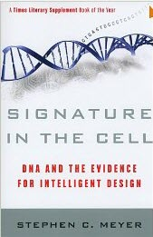
Evidence of His Handiwork Creative Design – Hierarchy of Information Systems
Open Loop Systems
Closed Loop Systems
Adaptive Systems
Intelligent Systems
Self-Modifying
Self-Programming
Self-Diagnosing
Self-Repairing
Self-Reproducing
Notes:
Natural Information Systems complexity is a clue to God’s creative design. Each higher level of complexity requires adding information to the system.

Slide 7
Evidence of His Handiwork Probability Reveals Knowledge
“Yes, but you must wager. There is no choice, you are already committed. Which will you choose then?
Let us see, since a choice must be made, let us see which offers you the least interest. You have two things to lose: the true and the good; and two things to stake: your reason and your will; and, your knowledge and your happiness.
Your nature has two things to avoid: error and wretchedness. Since you must necessarily choose, your reason is no more affronted by choosing one rather than the other. That is one point cleared up.
But your happiness? Let us weigh up the gain and the loss involved
in calling heads that God exists. Let us assess the two cases: if you win you win everything, if you lose you lose nothing. Do not hesitate then; wager that he does exist.”
Pascal’s Wager, Blaise Pascal, Pensées, 1670
Notes:
From a mathematical, probabilistic, risk analysis perspective:
Type I Error: Rejecting a true hypothesis.
Type II Error: Accepting a false hypothesis.

Slide 8
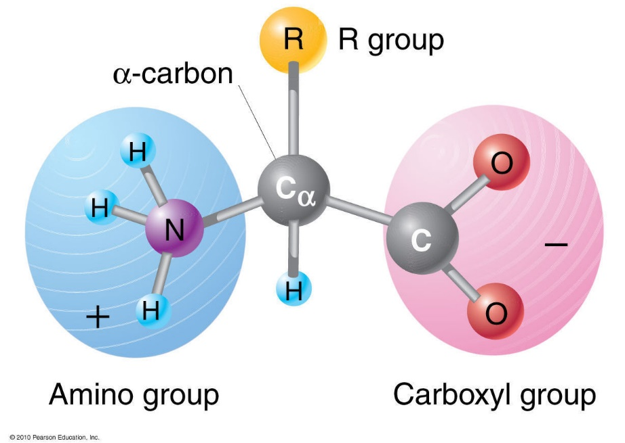
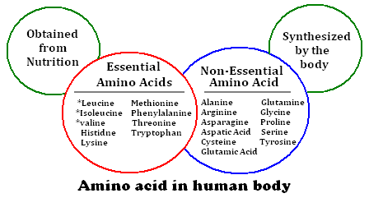
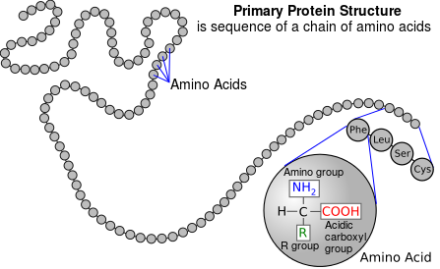
Evidence of His Handiwork Probability Reveals Knowledge
Notes:
Molecules: behave like groups of ball magnets
Amino Acids: Consider the 20 essential amino acids that make-up all proteins in living cells. 10 our bodies manufacturer; 10 we obtain from our food
All amino acids found in proteins have this basic structure, differing only in the structure of the R-group or the side chain.
Right-handed versus Left-handed?
What happens in presence of Oxygen?
Language of Protein Sequencing:
20 Symbols; 20 Essential Amino Acids
Arrange these in specific sequence to produce all proteins (i.e. to convey information)

Slide 9
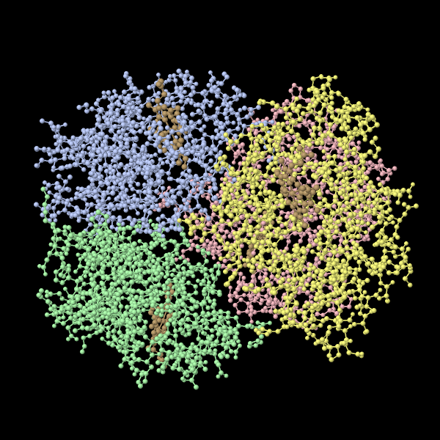
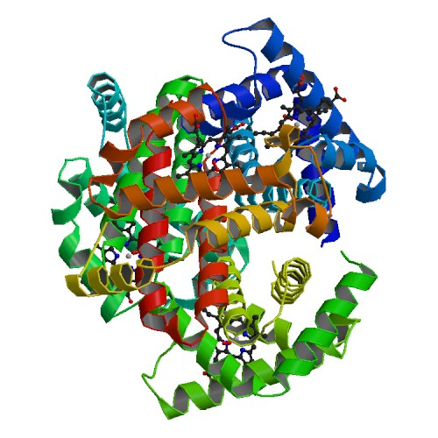
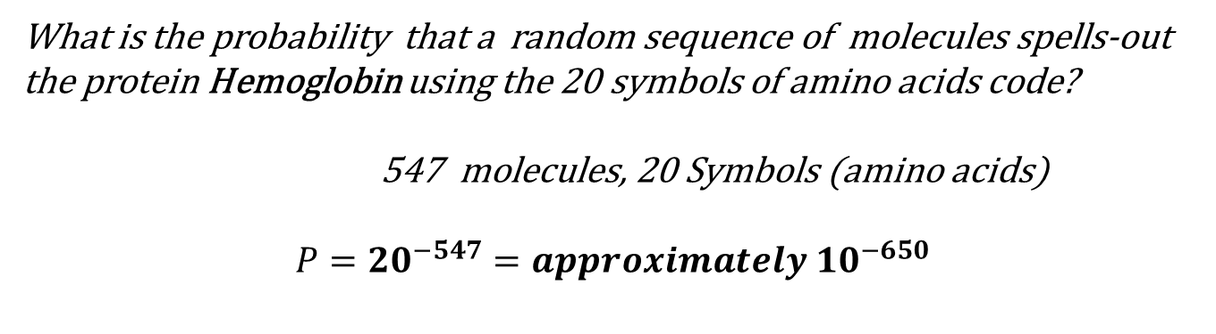
Evidence of His Handiwork Probability Reveals Knowledge
What is the probability that a random sequence of molecules spells-out the protein Hemoglobin using the 20 symbols of amino acids code?
547 molecules, 20 Symbols (amino acids)
$$P={20}^{−547}=approximately {10}^{−650}$$
Notes:
Chemical Composition:
Hemoglobin; about 96% of red blood cell (dry weight) is the protein molecule Hemoglobin; binds and transports Oxygen and other gases to/from cells.
Specificity : Formula for linear arrangements: N=n!/(p! x q! x r! …)
There are 10^650 permutations possible; only one of them is hemoglobin (change just one of them? = Hemoglobin Opathy).
Far beyond “chance”.
The Elements of Language:
Syntactic
Symantec
Absurd?
$$P={10}^{−50} is generally regarded as impossible$$
$${10}^{18} seconds since beginning of a 15 billion year universe$$
$${10}^{66} atoms within the entire MilkyWay galaxy$$
Chance is too inefficient in both time and material. Absurd?
$$P={10}^{−50} is generally regarded as impossible$$
$${10}^{18} seconds since beginning of a 15 billion year universe$$
$${10}^{66} atoms within the entire MilkyWay galaxy$$
Chance is too inefficient in both time and material.

Slide 10
Judgment with Cause Three bases for His judgment of the Pagan world…
For Suppressing God’s Truth (v.18)
For Ignoring God’s Revelation (v.19-20)
For Perverting God’s Glory (v.21-23)
The witness to God in nature is so clear and so constant that ignoring it is indefensible.
The pagan man’s condemnation is based not on their rejecting Christ of whom they have not heard,
But sinning against the Light that they do have.
Notes:
Psalm 19
For Suppressing God’s Truth (v.18)
For Ignoring God’s revelation (v.19-20)
For Perverting God’s glory (v.21-23)
How do we reach the pagan man with the Gospel?
Argument from Design
All Designs imply a s Designer
There is great design in the universe
Therefore, there must be a Great designer of the Universe
Argument from Creation
The Universe had a beginning
Anything that has a beginning must have been caused by something else
Therefore, the universe was caused by something else, and this cause was God
Examples:
Pharaoh, Exodus 10:16
Philistines, 1 Samuel 4:7,8; 5:7,8,11
King of Nineveh, Jonah 3:7-9

Slide 11
Origins (Where do we come from?) Acknowledging God as Creator
Psalm 8:3-4 When I consider Your heavens, the work of Your fingers, The moon and the stars, which You have ordained, What is man that You are mindful of him, And the son of man that You visit him?
Psalm 19:1-2 The heavens declare the glory of God; And the firmament shows His handiwork. Day unto day utters speech, And night unto night reveals knowledge.
Psalm 24:1-2 The earth is the LORD's, and all its fullness, The world and those who dwell therein. For He has founded it upon the seas and established it upon the waters.
Psalm 33:6-9 By the word of the LORD the heavens were made, And all the host of them by the breath of His mouth. He gathers the waters of the sea together as a heap; He lays up the deep in storehouses. Let all the earth fear the LORD; Let all the inhabitants of the world stand in awe of Him. For He spoke, and it was done; He commanded, and it stood fast.
Psalm 90:2 Before the mountains were brought forth, Or ever You had formed the earth and the world, Even from everlasting to everlasting, You are God.
Notes:
PSALMS
Key worldview categories—origins, meaning, morality, and destiny. While these selections are not exhaustive, they provide starting points for exploring how the Psalms address fundamental questions about life and existence.
Origins (Where did we come from?)
Psalm 8:3–4: Reflects on the wonder of the night sky and God’s creative role, prompting awe that the Creator cares for humanity.
Psalm 19:1–2: Declares that the heavens and the sky reveal God’s handiwork, pointing to Him as the source of all that exists.
Psalm 24:1–2: Proclaims that the earth and all its inhabitants belong to the LORD, who established it upon the waters.
Psalm 33:6–9: Emphasizes that God created the heavens and the earth by His word, underscoring His authority as the originator of all things.
Psalm 90:2: Acknowledges God’s eternal nature and presence before the creation of the mountains and the formation of the earth.

Slide 12
Origins (Where do we come from?) Acknowledging God as Creator
Mark 10:6-8 But from the beginning of the creation, God 'MADE THEM MALE AND FEMALE.' 'FOR THIS REASON A MAN SHALL LEAVE HIS FATHER AND MOTHER AND BE JOINED TO HIS WIFE, AND THE TWO SHALL BECOME ONE FLESH'; so then they are no longer two, but one flesh.
John 5:17-18 But Jesus answered them, "My Father has been working until now, and I have been working.“ …
John 1:1-3 In the beginning was the Word, and the Word was with God, and the Word was God. He was in the beginning with God. All things were made through Him, and without Him nothing was made that was made.
Acts 17:24-26 God, who made the world and everything in it, since He is Lord of heaven and earth, does not dwell in temples made with hands. Nor is He worshiped with men's hands, as though He needed anything, since He gives to all life, breath, and all things.
Colossians 1:16-17 For by Him all things were created that are in heaven and that are on earth, visible and invisible, whether thrones or dominions or principalities or powers. All things were created through Him and for Him. And He is before all things, and in Him all things consist.
Notes:
NT
Origins (Where did we come from?)
- Matthew 19:4–6 ; Mark 10:6 : Jesus refers back to the creation account, stating that “at the beginning” God made humanity male and female. This acknowledgment situates human existence within God’s creative work from the start.
- John 5:17–18 , John 8:58 Jesus affirms His divine origin and relationship with the Father throughout John’s Gospel
- John 1:1–3 : Establishes that all things were made through the Word (Christ), affirming God as the Creator of all existence.
- Acts 17:24–26 : Paul’s sermon at the Areopagus proclaims that God made the world and everything in it, creating all nations from one ancestor.
- Colossians 1:16–17 : States that all things, visible and invisible, were created through and for Christ, who holds all creation together.

