Slide 1
Christ in the Psalms
Elements of a World View
Psalm 19
https://tinyurl.com/3zj9ne34

Slide 2
The Substance of Truth A Spiritual Battleground – Freeing Captives of a Lie
“Jesus said to him, ‘I am the way, the truth, and the life. No one comes to the Father except through Me.’” John 14:6
“…Attaining to all riches of the full assurance of understanding, to the knowledge of the mystery of God, both of the Father and of Christ, in whom are hidden all the treasures of wisdom and knowledge … For in Him dwells all the fullness of the Godhead bodily …”
Colossians 2:2,3,9
“Do not think that I came to bring peace on earth. I did not come to bring peace but a sword.” Matthew 10:34
A servant of the Lord must not quarrel but be gentle to all, able to teach, patient, in humility correcting those who are in opposition, if God perhaps will grant them repentance, so that they may know the truth, and that they may come to their senses and escape the snare of the devil, having been taken captive by him to do his will.
2 Timothy 2:24-26
Notes:
The Substance of Truth:
Biblically speaking, Truth is both relational and propositional. It is at one and the same time a Person – Jesus Christ, God in the Flesh – and a set of verbally expressible, mentally comprehensible statements about that Person and the invisible God He reveals.
The Truth is consistent with reality; it matches the observable facts of the universe while simultaneously explaining realities we cannot see.
Truth and Faith:
“Now faith is the substance of things hoped for, the evidence of things not seen.” Hebrews 11:1
There is a tendency in our day to separate “reality” from “spirituality”. It’s part of the innate human propensity for compartmentalizing knowledge, belief, and behavior – in other words, for hypocrisy. Biblical Truth demands a total response. It elicits action as well as mental assent. If I believe that what I believe is really real, I will step out and act upon it. This is the meaning of the biblical word “faith”.
Truth and Division:
The light of Christ disperses the darkness of the devil’s lies. But in so doing, it splits human society and draws a line through the center of every human heart. In a fallen world – a world divided into warring camps – the Truth gains enemies simply by being true.
We must view those in opposition to truth as captives of a lie… (Isaiah 44:14-20, v20)

Slide 3
What is meant by ‘Knowing God’? Jeremiah 31:31-34 God’s perspective is…
“You search the Scriptures, for in them you think you have eternal life; and these are they which testify of Me.” John 5:39
“You say that I am a king. For this reason, I was born, and for this reason I came into the world – to testify to the truth. Everyone who belongs to the truth listens to my voice.” v. 37, John 18:24-38
“If you abide in My word, you are My disciples indeed. And you shall know the truth, and the truth shall make you free.” John 8:31
“Let this mind be in you which was also in Christ Jesus…” Phil. 2:5-11
“For who has known the mind of the LORD that he may instruct Him? But we have the mind of Christ.” 1 Corinthians 2:16
“And this is eternal life, that they may know You, the only true God, and Jesus Christ whom you have sent.” John 17:3
Notes:
It is the scriptures that testify of Jesus.
v.39… “What is truth?” Pilate doesn’t seem to have grasped the importance of his ironic question. Without the plumb line of Truth, we can know neither life, goodness, righteousness, nor justice. We can’t even know ourselves. This is why Jesus, the King of all creation, came into the world to serve and bear witness to the Truth.
What does it mean to live in a world without Truth?
Isaiah 59:14, 15 “Justice is turned back, and righteousness stands afar off; for truth is fallen in the street, and equity cannot enter. So truth fails, and he who departs from evil makes himself a prey.”
“For the wrath of God is revealed from heaven against all ungodliness and unrighteousness of men, who suppress the truth in unrighteousness…”
Romans 1:18
What is God’s perspective on all things? Origins? Meaning? Morality? Destiny?

Slide 4
The Predicament of Mankind “The wrath of God is revealed…” “…For all have sinned…”
Romans 1 : The “Natural Man”
Romans 2 : The “Moral Man”
Romans 3 : The “Religious Man”
Notes:
The first step in the revelation of the righteousness that God provides for people by faith is to set forth our need for it because we are under God’s judgment. We are born into a fallen race. The human race stands condemned before God and is helpless and hopeless apart from God’s grace.
Read the summary statement of the first three chapters... 3:23-26
They Became Fools…
Man’s refusal to acknowledge and glorify God leads to a downward path:
First, worthless thinking;
Next, moral insensitivity; and
Then, religious stupidity as seen in idol-worship!
And we become like the gods we worship (Ps 115:8, 135:15-18)
The Natural Man - the Pagan
Naturalism – the belief that nature is all that there is.
The Empiricist looks to nature for truth; what he observes. God reveals Himself to men of this type via his creation.
Uniformity of Nature (e.g. the “Laws of Nature” being uniform across time & space) speak to the character of God. Such uniformity cannot be explained if the natural world were based upon mere randomness.
e.g. “Why is the universe discoverable? Understandable? Bound by natural laws? Comprising information?”
The universe reflects the unchanging character of God. We are made in his image and thus able to understand his creation.
The Moral Man – The Philosopher
The Moral Man looks inward for truth; what he reasons (i.e. Logic)
God has reveals Himself to this type of man within the concepts of right and wrong.
Morals reflect the character of God. We are made in His image and thus able to reason using logic of which he is the source.
The Religious Man - Spiritual Man
One who recognizes the Sin Nature of Man. He seeks to “work” his way to a “right” relationship with his god.
The Religious Man looks to religion for truth; what he believes. A “heart” centric conditioned response.
God reveals Himself to men of this type via his special revelation of sin under the law (e.g. via the prototypical Jew) and redemption by grace within Christ.
Man says…
Humanism – man is the measure of all things.
Atheism – god doesn’t exist.
Pantheism – creation itself is the measure of all things.
God says…
Hebrews 1:1 “God, who are various times and in various ways spoke in time past to the fathers by the prophets, has in these last days spoken to us by His Son, whom He has appointed heir of all things, through whom also He made the worlds; who being the brightness of His glory and the express image of His person, and upholding all things by the word of His power, when He had by Himself purged our sins, sat down at the right hand of the Majesty on high,…”

Slide 5
The Natural Man “…who suppress the truth…”
“For the wrath of God is revealed from heaven against all ungodliness and unrighteousness of men, who suppress the truth in unrighteousness, because what may be known of God is manifest in them, for God has shown it to them.
For since the creation of the world His invisible attributes are clearly seen, being understood by the things that are made, even His eternal power and Godhead, so that they are without excuse, because, although they knew God, they did not glorify Him as God, nor were thankful, but became futile in their thoughts, and their foolish hearts were darkened.
Professing to be wise, they became fools, and changed the glory of the incorruptible God into an image made like corruptible man – and birds and four-footed animals and creeping things.”
Romans 1:18-23
(Isaiah 44:14-20)
Notes:
Read 1:18-32 and then return to this section. Ask questions before next slide.
What are the basis stated for God’s judgment of the pagan world?
For Suppressing God’s Truth (v.18) (King James correctly translates this as “Holding” Truth but by implication suppressing it.)
For Ignoring God’s revelation (v.19-20)
For Perverting God’s glory (v.21-23)
How do men suppress the truth in unrighteousness?
Philosophies of Man (e.g. Humanism)
Lies, False Teaching, and Artificial Authority
Pride, Selfishness, and Hatred
Claiming Presuppositions
What are some secular presuppositions?
Naturalism – Nature is all that there is (e.g. It is now illegal to teach Biblical Creation in public schools).
Empiricism – “Science” is the authority
Relativism – There is no standard of Truth.
Neutrality – All religions are equal.
Bible is irrelevant to science – Exclusion of Faith from public discourse.
What are some Biblical presuppositions?
The Bible is true
Moral Absolutes
Laws of logic
Laws of morality
Uniformity and Induction

Slide 6
His Invisible Attributes Are Clearly Seen
“The heavens declare the glory of God;
And the firmament shows His handiwork.
Day unto day utters speech,
And night unto night reveals knowledge.
There is no speech nor language
Where their voice is not heard.
Their line has gone out through all the earth,
And their words to the end of the world.”
Psalm 19:1-4
What would you accept as evidence?
Notes:
How can something that’s invisible testify to something that’s clearly seen?
Design – It was designed that way from the beginning of creation!
Example: DNA
DNA – 3 out of 4 error correcting digital code (could not have arisen from randomness)
Everywhere in the universe is evidence of design

Slide 7

Evidence of His Handiwork Creative Design – Complex Information Systems
Intelligent Systems
Self-Modifying
Self-Programming
Self-Diagnosing
Self-Repairing
Self-Reproducing
Notes:
Natural Information Systems complexity is a clue to God’s creative design.

Slide 8
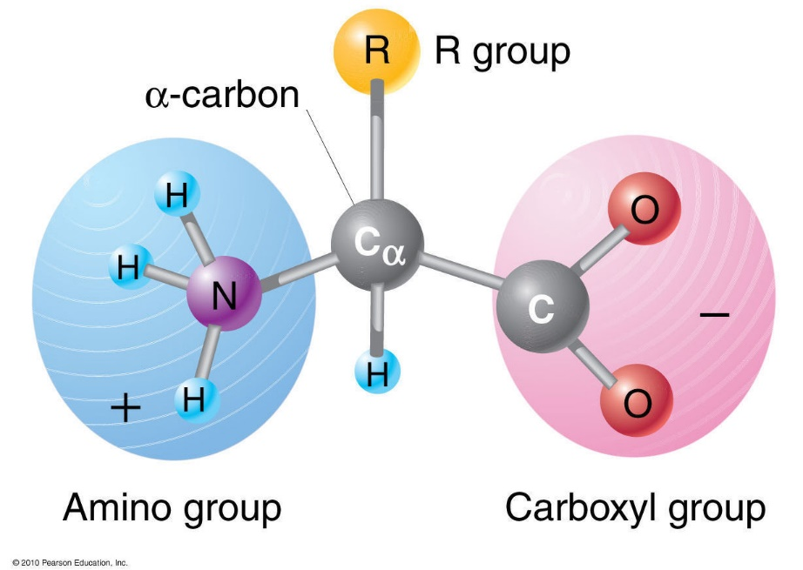
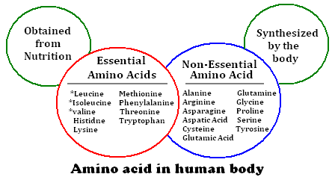
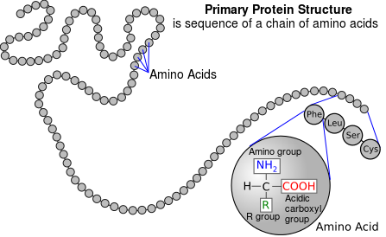
Evidence of His Handiwork Probability Reveals Knowledge
Notes:
Molecules: behave like groups of ball magnets
Amino Acids: Consider the 20 essential amino acids that make-up all proteins in living cells. 10 our bodies manufacturer; 10 we obtain from our food
All amino acids found in proteins have this basic structure, differing only in the structure of the R-group or the side chain.
Right-handed versus Left-handed?
What happens in presence of Oxygen?
Language of Protein Sequencing:
20 Symbols; 20 Essential Amino Acids
Arrange these in specific sequence to produce all proteins (i.e. to convey information)

Slide 9
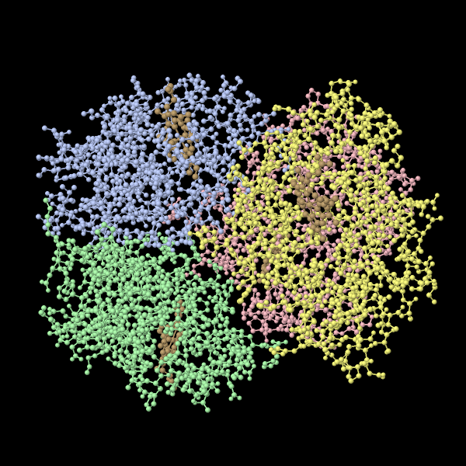
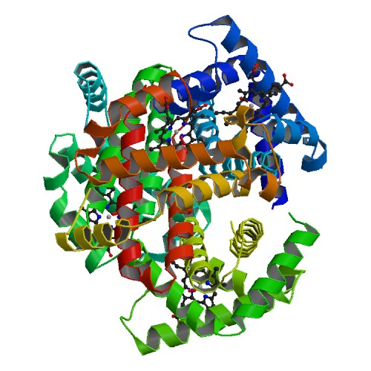
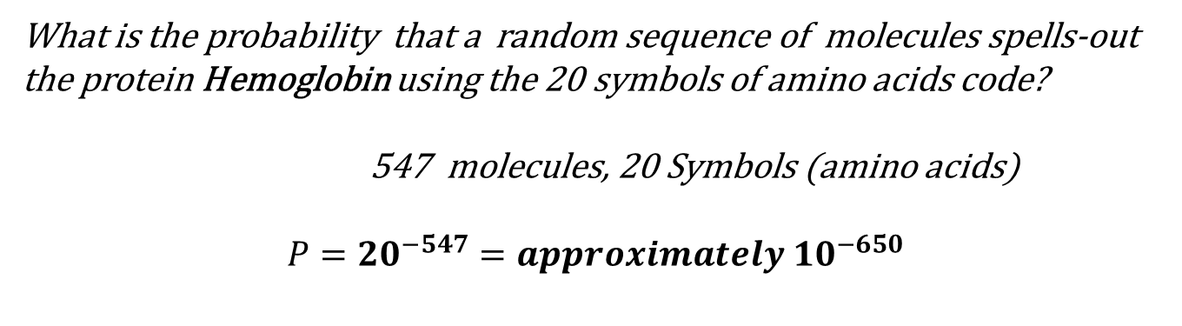
Evidence of His Handiwork Probability Reveals Knowledge
What is the probability that a random sequence of molecules spells-out the protein Hemoglobin using the 20 symbols of amino acids code?
547 molecules, 20 Symbols (amino acids)
$$P={20}^{−547}=approximately {10}^{−650}$$
Notes:
Chemical Composition:
Hemoglobin; about 96% of red blood cell (dry weight) is the protein molecule Hemoglobin; binds and transports Oxygen and other gases to/from cells.
Specificity : Formula for linear arrangements: N=n!/(p! x q! x r! …)
There are 10^650 permutations possible; only one of them is hemoglobin (change just one of them? = Hemoglobin Opathy).
Far beyond “chance”.
The Elements of Language:
Syntactic
Symantec
The most advanced computers could not have “broken” Paul Revere’s
code.
Both semantics (“One if by land; two if by sea”) and syntax (“The
Old North Church…”) are required. Was it random accident (chance)?
Or coordinated planning (design)?

Slide 10
Judgment with Cause Three basis for His judgment of the Natural Man…
For Suppressing God’s Truth (v.18)
For Ignoring God’s Revelation (v.19-20)
For Perverting God’s Glory (v.21-23)
Notes:
Psalm 19
For Suppressing God’s Truth (v.18)
For Ignoring God’s revelation (v.19-20)
For Perverting God’s glory (v.21-23)

Slide 11
The Predicament of Mankind “The wrath of God is revealed…” “…For all have sinned…”
Romans 1 : The “Natural Man”
Romans 2 : The “Moral Man”
Romans 3 : The “Religious Man”
Notes:
The first step in the revelation of the righteousness that God provides for people by faith is to set forth our need for it because we are under God’s judgment. We are born into a fallen race. The human race stands condemned before God and is helpless and hopeless apart from God’s grace.
Read the summary statement of the first three chapters... 3:23-26
They Became Fools…
Man’s refusal to acknowledge and glorify God leads to a downward path:
First, worthless thinking;
Next, moral insensitivity; and
Then, religious stupidity as seen in idol-worship!
And we become like the gods we worship (Ps 115:8, 135:15-18)
The Natural Man - the Pagan
Naturalism – the belief that nature is all that there is.
The Empiricist looks to nature for truth; what he observes. God reveals Himself to men of this type via his creation.
Uniformity of Nature (e.g. the “Laws of Nature” being uniform across time & space) speak to the character of God. Such uniformity cannot be explained if the natural world were based upon mere randomness.
e.g. “Why is the universe discoverable? Understandable? Bound by natural laws? Comprising information?”
The universe reflects the unchanging character of God. We are made in his image and thus able to understand his creation.
The Moral Man – The Philosopher
The Moral Man looks inward for truth; what he reasons (i.e. Logic)
God has reveals Himself to this type of man within the concepts of right and wrong.
Morals reflect the character of God. We are made in His image and thus able to reason using logic of which he is the source.
The Religious Man - Spiritual Man
One who recognizes the Sin Nature of Man. He seeks to “work” his way to a “right” relationship with his god.
The Religious Man looks to religion for truth; what he believes. A “heart” centric conditioned response.
God reveals Himself to men of this type via his special revelation of sin under the law (e.g. via the prototypical Jew) and redemption by grace within Christ.
Man says…
Humanism – man is the measure of all things.
Atheism – god doesn’t exist.
Pantheism – creation itself is the measure of all things.
God says…
Hebrews 1:1 “God, who are various times and in various ways spoke in time past to the fathers by the prophets, has in these last days spoken to us by His Son, whom He has appointed heir of all things, through whom also He made the worlds; who being the brightness of His glory and the express image of His person, and upholding all things by the word of His power, when He had by Himself purged our sins, sat down at the right hand of the Majesty on high,…”

Slide 12
The Moral Man Are you a good person? How do you know?
“It may be that the deity can forgive sins, but I do not see how.”
Socrates, to Plato, 469-399 BC
“They will say that the just man who is thought unjust will be scourged, racked, bound, will have his eyes burnt out, and, at last, after suffering every kind of evil, he will be impaled; and thus, men will learn that not to be, but to seem, just is what we ought to desire.”
Plato, Republic, Book II
“Blessed is he whose transgression is forgiven,
whose sin is covered,
Blessed is the man to whom
the LORD does not impute iniquity,
And in whose spirit, there is no deceit.”
Psalm 32:1-2; Romans 4:7-8
Notes:
FIRST - Read Romans 3:21-26
THE QUESTION:
How can a perfectly just God forgive sins?
How can sinful man find favor with a righteous God?
THE ANALOGY:
God (the Son) presides as the Judge of mankind (pagan, moral, and spiritual men). John 5:22
The Son steps down from the Judgment seat and assumes the seat of the plaintiff (mankind). Isaiah 53:11
The Son himself assumes the just penalty of sin for all of sinful mankind.
The Father is satisfied with the just payment for sin.
The Father demonstrates mercy by extending the righteousness of one man to cover many. 2 Cor. 5:21
God demonstrates His perfect justice at the same time that he demonstrates His perfect mercy… in the act of delivering justice, he also justifies.
Eph. 2:8 “For by grace you have been saved through faith, and that not of yourselves; it is the gift of God, not of works, lest anyone should boast.
Hallelujah! What a Savior!
In **Plato's *Republic***, Book II, there is a passage where Glaucon (Plato's brother) describes the perfectly righteous man and contrasts him with the perfectly unjust man. Glaucon challenges Socrates by describing how the truly righteous man will be perceived and treated by society. Even though this man is perfectly just, he will be misunderstood and mistreated by others as if he were a criminal.
The passage is this:
"They will say that the just man who is thought unjust will be scourged, racked, bound, will have his eyes burnt out, and, at last, after suffering every kind of evil, he will be impaled; and thus, men will learn that not to be, but to seem, just is what we ought to desire.
(Republic, Book II, 361e-362a)
In this thought experiment, Plato, through Glaucon, explores the consequences of living a truly just life in a world that does not recognize or value true righteousness. The just man is portrayed as suffering immensely, being treated like a monster by those around him, while the unjust man who maintains the appearance of righteousness is rewarded. This passage highlights the tension between reality and appearance, a key theme in Plato's philosophy.

Slide 13
The Moral Man Are you a good person? How do you know?
”The law of the LORD is perfect, converting the soul; the testimony of the LORD is sure, making wise the simple;
The statutes of the LORD are right, rejoicing the heart; the commandment of the LORD is pure, enlightening the eyes;
The fear of the LORD is clean, enduring forever; the judgements of the LORD are true and righteous altogether.
More to be desired are they than gold, Yea, than much fine gold; Sweeter also than honey and the honeycomb.
Moreover, by them Your servant is warned, And in keeping them there is great reward.
Who can understand his errors? Cleanse me from secret faults.”
Psalm 19:7-12
Notes:
FIRST - Read Romans 3:21-26
THE QUESTION:
How can a perfectly just God forgive sins?
How can sinful man find favor with a righteous God?
THE ANALOGY:
God (the Son) presides as the Judge of mankind (pagan, moral, and spiritual men). John 5:22
The Son steps down from the Judgment seat and assumes the seat of the plaintiff (mankind). Isaiah 53:11
The Son himself assumes the just penalty of sin for all of sinful mankind.
The Father is satisfied with the just payment for sin.
The Father demonstrates mercy by extending the righteousness of one man to cover many. 2 Cor. 5:21
God demonstrates His perfect justice at the same time that he demonstrates His perfect mercy… in the act of delivering justice, he also justifies.
Eph. 2:8 “For by grace you have been saved through faith, and that not of yourselves; it is the gift of God, not of works, lest anyone should boast.
Hallelujah! What a Savior!

Slide 14
The Moral Man Seven Principles of God’s Righteous Judgment
According to Truth
“But we know that the judgment of God is according to truth against those who practice such things.” v.2
Self-righteousness
Condemnation before investigation
The only barrier to receiving the Truth is the assumption that you already have it. (pride vs. “ask, seek, knock” humility)
(2) According to Accumulated Guilt
“…treasuring up for yourself wrath…” v.5
Not until the last evil result of a life of sin can the final condemnation of the sinner be known.
Unless… John 5:24; Romans 8:1; (The Good News!)
Notes:
What is the greatest thought that ever entered the mind of Man?
“My responsibility to my Maker!” Daniel Webster
How does God deal with Man individually? Ezekiel 18…? Mankind Corporately?
According to Truth…
In this court-room, we are privileged to be wear (as jurists) the glasses of God’s Truth… to see the evidence with the Mind of Christ (1 Cor 2:15).
Emphatically! We MUST always wear these when doing Kingdom work (in humility, planting, watering, answering, with compassion).
Seven principles dealing with how God will decide and respond to mankind.
According to Truth
Do you think that you will escape judgment – You? Self righteousness is a death sentence that we all share in. (Ezekiel 16:48-50)
The principle that keeps us in ignorance is condemnation (coming to a conclusion) before investigation.
v4, Not only do we feel ourselves innocent, but the riches of God should be leading us to repentance.
Note God’s progressive degrees – goodness, forbearance, and longsuffering – in responding to our ingratitude.
(2) According to Accumulated Guilt
The First Law of Holes… stop digging.
Ezekiel 16:49-50 – Example Sodom and Gomorrah – pride; more than homosexuality
Luke 17:28-30
Prosperity always feeds pride; it’s easy to be humble when you are poor.

Slide 15
The Moral Man Seven Principles of God’s Righteous Judgment
(3) According to Works
“Who will render to each one according to his deeds:” v.6
Revelation 20:13-15
Not a revelation of the way of salvation, but a general description of the character of the saved.
“Doing good” demonstrates a heart that is right with God.
(4) Without Respect of Persons
“For there is no respect of persons with God.” v.11
Just recompense by God is without regard to:
Ethnic background or any other consideration,
Except what each person has done.
Law – specific and general (according to the Light given)

Slide 16
The Moral Man Seven Principles of God’s Righteous Judgment
(5) According to Obedience
“…for not the hearers of the law are just in the sight of God, but the doers of the law will be justified;…” v.13
Addresses the false comfort or false peace (i.e. false teaching) of justification by merely “knowing God’s Truth”.
Gospel speaks of the “obedience of faith”.
Habitual conduct reveals one’s heart.
(6) According to Secrets of the Heart
“In the day when God will judge the secrets of men by Jesus Christ, according to my gospel.” v.16
In accord with theme of verses 2:5-13
Judgment will deal with men’s secrets. 1 Cor. 4:5

Slide 17
The Moral Man Seven Principles of God’s Judgment
(7) According to Reality
Romans 2:17-29
Specifically addressing the Jew; exemplar of the religious person; who is proud of the law, but not keeping it.
Religion – man’s attempt to cover himself.
Basis of Jewish Pride
Being called a Jew
Relied on the Law
Boasting of God
Knowing God’s Will
Being instructed of the Law
“For ‘the name of God is blasphemed among the Gentiles because of you’…” Isaiah 52:5; Ezekiel 36:22
Reality counts with God… the true “Jew” exemplar is one who is circumcised in heart; one who seeks to walk in accordance with the revealed will of God.

Slide 18
The Moral Man Conscience, v. 14-15
Conscience is an important part of human nature…
But, not an absolutely trustworthy indicator of what is right.
Romans 2:14,15 are an explanation of verses 2:12,13
One’s conscience can be…
“good” - Acts 23:1; 1 Timothy 1:5,19
“clear” - Acts 24:16; 1 Timothy 3:9; 2 Timothy 1:3; Hebrews 13:18
But, it can also be…
“guilty” - Hebrews 10:22
“corrupted” - Titus 1:15
“weak” - 1 Corinthians 8:7,10,12
“seared” - 1 Timothy 4:2
By way of the blood of Jesus Christ, our conscience may be…
“cleansed” - Hebrews 9:14

Slide 19
The Predicament of Mankind “The wrath of God is revealed…” “…For all have sinned…”
Romans 1 : The “Natural Man”
Romans 2 : The “Moral Man”
Romans 3 : The “Religious Man”
Notes:
The first step in the revelation of the righteousness that God provides for people by faith is to set forth our need for it because we are under God’s judgment. We are born into a fallen race. The human race stands condemned before God and is helpless and hopeless apart from God’s grace.
Read the summary statement of the first three chapters... 3:23-26
They Became Fools…
Man’s refusal to acknowledge and glorify God leads to a downward path:
First, worthless thinking;
Next, moral insensitivity; and
Then, religious stupidity as seen in idol-worship!
And we become like the gods we worship (Ps 115:8, 135:15-18)
The Natural Man - the Pagan
Naturalism – the belief that nature is all that there is.
The Empiricist looks to nature for truth; what he observes. God reveals Himself to men of this type via his creation.
Uniformity of Nature (e.g. the “Laws of Nature” being uniform across time & space) speak to the character of God. Such uniformity cannot be explained if the natural world were based upon mere randomness.
e.g. “Why is the universe discoverable? Understandable? Bound by natural laws? Comprising information?”
The universe reflects the unchanging character of God. We are made in his image and thus able to understand his creation.
The Moral Man – The Philosopher
The Moral Man looks inward for truth; what he reasons (i.e. Logic)
God has reveals Himself to this type of man within the concepts of right and wrong.
Morals reflect the character of God. We are made in His image and thus able to reason using logic of which he is the source.
The Religious Man - Spiritual Man
One who recognizes the Sin Nature of Man. He seeks to “work” his way to a “right” relationship with his god.
The Religious Man looks to religion for truth; what he believes. A “heart” centric conditioned response.
God reveals Himself to men of this type via his special revelation of sin under the law (e.g. via the prototypical Jew) and redemption by grace within Christ.
Man says…
Humanism – man is the measure of all things.
Atheism – god doesn’t exist.
Pantheism – creation itself is the measure of all things.
God says…
Hebrews 1:1 “God, who are various times and in various ways spoke in time past to the fathers by the prophets, has in these last days spoken to us by His Son, whom He has appointed heir of all things, through whom also He made the worlds; who being the brightness of His glory and the express image of His person, and upholding all things by the word of His power, when He had by Himself purged our sins, sat down at the right hand of the Majesty on high,…”

Slide 20
The Spiritual/Religious Man How can a sinful man find favor with a righteous God?
”Keep back Your servant also from presumptuous sins; Let them not have dominion over me. Then I shall be blameless, And I shall be innocent of great transgression.
Let the words of my mouth and the meditation of my heart be acceptable in Your sight, O LORD, my strength and my Redeemer.”
Psalm 19:13-14
Notes:
FIRST - Read Romans 3:21-26
THE QUESTION:
How can a perfectly just God forgive sins?
How can sinful man find favor with a righteous God?
THE ANALOGY:
God (the Son) presides as the Judge of mankind (pagan, moral, and spiritual men). John 5:22
The Son steps down from the Judgment seat and assumes the seat of the plaintiff (mankind). Isaiah 53:11
The Son himself assumes the just penalty of sin for all of sinful mankind.
The Father is satisfied with the just payment for sin.
The Father demonstrates mercy by extending the righteousness of one man to cover many. 2 Cor. 5:21
God demonstrates His perfect justice at the same time that he demonstrates His perfect mercy… in the act of delivering justice, he also justifies.
Eph. 2:8 “For by grace you have been saved through faith, and that not of yourselves; it is the gift of God, not of works, lest anyone should boast.
Hallelujah! What a Savior!

Slide 21
The Spiritual/Religious Man Man’s Attempt to Cover Himself
Romans 2:17-29; 3:1-8
Specifically addressing the Jew; exemplar of the religious person; who is proud of the law, but not keeping it.
Basis of Jewish Pride
Being called a Jew (v. 17)
Relied on the Law, “rest” (v. 17)
Boasting of God (superior attitude, v.19)
Knowing God’s Will (v. 20)
Being instructors of the Law (v. 21)
But, all men could see their self-righteous hypocrisy
“For ‘the name of God is blasphemed among the Gentiles because of you’…” Isaiah 52:5; Ezekiel 36:22
Reality counts with God…!
“…but he is a Jew who is one inwardly; and circumcision is that of the heart, in the Spirit, not in the letter...” (v. 2:29) (Deut. 10:16-17)
Notes:
Read 2:17 thru 3:8
Were the Jewish people “better” (e.g. culturally) than others?
Arguably “yes”… compare OT laws about health and living systems vs. others (e.g. hygiene, food restrictions, “keepers of God’s Laws”)
Jews had set aside the “hope of the Messiah” as the Light (even unto Gentiles) and assumed themselves to be the Light.
i.e. arrogant conceit
They had the “form of the Law”, an adaptation of the “original Law”
Paul uses the very Law the Jew trusts in to “root him out”….
Note: Historically, the Church had begun in the Jewish community; most of the early Christians (in the years after pentecost) were Jews. But, here we are 30-40 years since then and the Church had largely become a Gentile phenomenon. Paul (as he traveled and preached in the synagogues) undoubtedly faced a hostile, taunting, perhaps demeaning audience of Jews. Hence, his focus on a Jewish centered argument from that perspective.
Sub-argument (circumcision is of the heart – Deut 10:16):
The Jew (being circumcised under the law) would not receive covering under the law without obedience…
And, the Gentile (not being circumcised under the law) could receive covering under the law with obedience (argument from v. 2:13)…
Therefore, the Jew would argue (tauntingly)… Romans 3:1-8
What advantage is there in being a Jew…? If we are made right with God by His Grace alone, then…
Isn’t it the case then that our unrighteousness further increase God’s glory…?
Discuss Job 38:1-3; Job 40:2; Job 40:8
Discuss Psalm 51:4
(similar argument today – is baptism really necessary then? )
The Starting Place of Faith (God’s Truth is not determined by our assessment of it…):
3:3 “Let God be true and every man a liar…”
We all know about truth because we all comprehend what a lie is… (the negative reveals the positive)
3:4 Men are judging God…! (Psalm 51:4) Man says… “God doesn’t have the right to judge me..! I am as he has made me…” Discuss Job 40:8
3:5-9 Paul assents to their argument and then demonstrates how the argument can’t be true because it contradicts God’s own nature… (How can a perfectly just God not apply justice?)
Sin is born of motivation….! Who is really good?

Slide 22
The Spiritual/Religious Man The Law Reveals our Condition
“Would you indeed annul My judgment? Would you condemn Me that you may be justified?” Job 40:8
“There is none righteous, no, not one;
There is none who understands;
There is none who seeks after God.” Romans 3:10-11
“Hear my prayer, O LORD, Give ear to my supplications! In Your faithfulness answer me. And in Your righteousness. Do not enter into judgment with Your servant, For in Your sight no one living is righteous.” Psalm 143:1-2
“Now we know that whatever the law says, it says to those who are under the law, that every mouth may be stopped, and all the world may become guilty before God. Therefore, by the deeds of the law no flesh will be justified in His sight, for by the law is the knowledge of sin.”
Romans 3:19-20
Notes:
Romans, chapter 3, illustrates that even the Religious Man is impoverished… none can keep the theoretical sanctification of the Law.
The Religious Man looks to the practice of religion for justification. He recognizes the Sin Nature of Man and seeks to “work” his way to a “right” relationship with his god.
The Law (i.e. religion – even the best corporate attempt) offers a theoretical promise of Justification…
2:6-7 “...who will render to each one according to his deeds: eternal life to those who by patient continuance in doing good seek for glory, honor, and immortality…”
2:13 “…for not the hearers of the law are just in the sight of God, but the doers of the law will be justified…”
The Law will offer salvation to you… but it will simply draw you out… to the realization of sin… and it will lead you to condemnation… to give up your excuses… and accept your condition in humility… your realization of guilt… v20
We thus see that Religion (even that of the righteous Law) thus reveals the failure of man’s best corporate effort to attain to God’s righteousness..!
Read 3:9
Transition Point – Paul again turns the argument onto the Jury (i.e. you and I)… He has baited us again!
3:9… “What then?” another transition point in Paul’s theological argument. He has entrapped us again!
The Law (i.e. religion – even the best corporate attempt) offers a theoretical promise of Justification…
2:6-7 “...who will render to each one according to his deeds: eternal life to those who by patient continuance in doing good seek for glory, honor, and immortality…”
2:13 “…for not the hearers of the law are just in the sight of God, but the doers of the law will be justified…”
We all here recognize and agree that our best attempts to attain self-righteousness do not attain to God’s Truth… our motivations bely our sin condition!
Paul intends to convict his audience… to enable them to realize that they themselves are under the judgment of sin…
He proved the pagan man to be under sin…
He proved the moral man cannot overcome sin…
He proved that the religious (self-righteous) man is condemned by the Law…
Sin is born of motivation…! Who is really good? Man seeks glory… and ends with selfish pride and self-righteousness.

Slide 23
The Predicament of Mankind “The wrath of God is revealed…” “…For all have sinned…”
Romans 1 : The “Natural Man”
For Suppressing God’s Truth (v.18)
For Ignoring God’s Revelation (v.19-20)
For Perverting God’s Glory (v.21-23)
Romans 2 : The “Moral Man”
According to Truth (v. 2)
According to Accumulated Guilt (v. 5)
According to Works (v. 6)
Without Respect of Persons (v. 11)
According to Obedience (v. 13)
According to Secrets of the Heart (v. 16)
According to Reality (v. 17-29)
Romans 3 : The “Religious Man”
Our Conscience is an Indicator of a Need for Righteousness and a basis for Religion (v. 2:14-15)
God recognizes Obedience from the Heart (v. 2:29)
Notes:
The Pagan Man - They Became Fools…
Man’s refusal to acknowledge and glorify God leads to a downward path:
First, worthless thinking;
Next, moral insensitivity; and
Then, religious stupidity as seen in idol-worship!
The witness to God in nature is so clear and so constant that ignoring it is indefensible.
The pagan man’s condemnation is based not on their rejecting Christ of whom they have not heard,
But sinning against the Light that they do have. 2 Corinthians 8:12
NOTE: God’s prior judgments of mankind (i.e. condemnations) reveal that He judged them apart from the Law and according to the eternal principles of His Revealed Truth (e.g. Sodom and Gomorrah, Noah’s Flood).
The Moral Man – Seven Principles of God’s Righteous Judgment
**** The First Law of Holes… stop digging! ****
Let us not confuse Romans 2 with Revelation 20… at Judgment Day, there will be no reasoning nor preaching; only condemnation; based upon the Principles of God’s Judgment.
The Agent of divine judgment is Jesus Christ. John 5:22, 27; Acts 17:31
Judgment
The Same Measuring Stick (we all know and use the same stick):
Romans 2:1-2
Matthew 7:1-2 (passing judgment should give us pause…)
Does not imply “do not pass judgment – i.e. discernment”
1 Corinthians 2:14-16 – the spiritual man makes judgment about all things
Different judgments
Examples of prior Judgments (with condemnation) by God: Ezekiel 16:48-50 (Sodom and Gomorrah – pride and sexual perversion; see also Luke 17:28-30)
At the end: Revelation 20:13-15 (“…treasuring up for yourself wrath…” Romans 2:5)
Even the Christian: 1 Cor. 3:11-15 (but not condemned…! John 5:24; Romans 8:1)

Slide 24
The Righteousness of God Revealed How the LORD delights in keeping his promises…!
“’Behold, the days are coming,’ says the LORD, ‘That I will raise to David a Branch of righteousness; A King shall reign and prosper, And execute judgment and righteousness in the earth. In His days Judah will be saved. And Israel will dwell safely; Now this is His name by which He will be called: THE LORD OUR RIGHTEOUSNESS. ‘” Jeremiah 23:5-6
“He shall see the labor of His soul, and be satisfied. By His knowledge My righteous Servant shall justify many, For He shall bear their iniquities.” Isaiah 53:11
“For He made Him who knew no sin to be sin for us, that we might become the righteousness of God in Him.” 2 Corinthians 5:21
“…that He might be just and the justifier of the one who has faith in Jesus.” Romans 3:26
Notes:
FIRST, Read Galatians 3:19-29
The Promises of GOD are the currency upon which man-kind’s ultimate hope and destiny rest. Discuss how GOD made promises to Abraham, Moses and the Israelites, and to us (Jer 31:31).
What should our response be?
Needs Analysis: Mankind NEEDS a Savior!

Slide 25
What difference should that make…? How now ought we live?
“Love the Lord you God with all your heart, with all your soul, and with all your mind. This is the first and greatest commandment. The second is like it: Love your neighbor as yourself.” Matt. 22:37-39
“All authority has been given to Me in heaven and on earth. Go therefore and make disciples of all nations, baptizing them in the name of the Father and of the Son and of the Holy Spirit, teaching them to observe all things that I have commanded you; and lo, I am with you always, even to the end of the age.”
Matt. 28:18-20
Notes:
Reflecting on the way that God operates…
Thru 1 man, Adam, sin entered the World.
Thru 1 man, Noah, God resolved to renew this World and promised to overcome the effects of sin in it.
Thru 1 man, Abraham, God reached a family and promised to bless all families.
Thru 1 man, Moses, God reached a nation and promised to bless all nations.
Thru 1 man, Jesus, God reached the world and promises to be with each of us to the end of the World

