Slide 1
Christ in the Psalms
Total Truth
Correspondence and Correlation Throughout Scripture
Phil@UsefulEngines.com
https://tinyurl.com/zadnvuca
Notes:
Luke 24
Jesus himself gives the divine authorization for reading all of the Old Testament (including the Psalms) in reference to Him.

Slide 2
The Call to Unity
A Divine Mandate
Correspondence and Correlation Throughout Scripture
Phil@UsefulEngines.com
https:
Notes:
Luke 24
Jesus himself gives the divine authorization for reading all of the Old Testament (including the Psalms) in reference to Him.

Slide 3
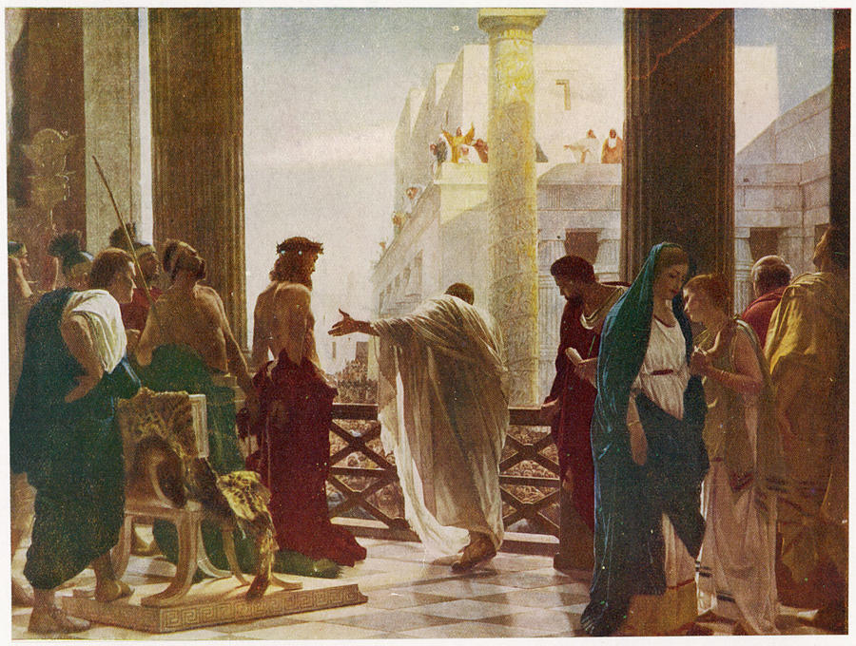
The Call to Unity Which Cohort?
Notes:
Joh 18:33-37
(33) So Pilate went back into the governor’s residence, summoned Jesus, and asked him, “Are you the king of the Jews?”
(34) Jesus replied, “Are you saying this on your own initiative, or have others told you about me?”
(35) Pilate answered, “I am not a Jew, am I? Your own people and your chief priests handed you over to me. What have you done?”
(36) Jesus replied, “My kingdom is not from this world. If my kingdom were from this world, my servants would be fighting to keep me from being handed over to the Jewish authorities. But as it is, my kingdom is not from here.”
(37) Then Pilate said, “So you are a king!” Jesus replied, “You say that I am a king. For this reason I was born, and for this reason I came into the world – to testify to the truth. Everyone who belongs to the truth listens to my voice.”
Joh 14:6
(6) Jesus replied, “I am the way, and the truth, and the life. No one comes to the Father except through me.

Slide 4
Psalm 37 – The Heritage of the Righteous Wisdom for responding to the success of the wicked
Psalm 37 offers wisdom for responding to the success of the wicked by encouraging patience, trust in God, and commitment to righteousness.
Key Verses:
Psalm 37:1-3 Do not fret because of evildoers, Nor be envious of the workers of iniquity. For they shall soon be cut down like the grass, And wither as the green herb. Trust in the LORD, and do good; Dwell in the land, and feed on His faithfulness.
Psalm 37:34 Wait on the LORD, And keep His way, And He shall exalt you to inherit the land; When the wicked are cut off, you shall see it.
Key Themes:
This psalm advises patience, trust, and commitment to God’s ways as responses to societal wickedness. Highlights the intimate connection between God and individuals.
Believers are encouraged to maintain their focus on God’s word, avoid the path of the wicked, and find hope in God’s steadfast love and justice.

Slide 5
Origins (Where do we come from?) Acknowledging God as Creator
Psalm 8:3-4 When I consider Your heavens, the work of Your fingers, The moon and the stars, which You have ordained, What is man that You are mindful of him, And the son of man that You visit him?
Psalm 19:1-2 The heavens declare the glory of God; And the firmament shows His handiwork. Day unto day utters speech, And night unto night reveals knowledge.
Psalm 24:1-2 The earth is the LORD's, and all its fullness, The world and those who dwell therein. For He has founded it upon the seas and established it upon the waters.
Psalm 33:6-9 By the word of the LORD the heavens were made, And all the host of them by the breath of His mouth. He gathers the waters of the sea together as a heap; He lays up the deep in storehouses. Let all the earth fear the LORD; Let all the inhabitants of the world stand in awe of Him. For He spoke, and it was done; He commanded, and it stood fast.
Psalm 90:2 Before the mountains were brought forth, Or ever You had formed the earth and the world, Even from everlasting to everlasting, You are God.
Notes:
PSALMS
Key worldview categories—origins, meaning, morality, and destiny. While these selections are not exhaustive, they provide starting points for exploring how the Psalms address fundamental questions about life and existence.
Origins (Where did we come from?)
Psalm 8:3–4: Reflects on the wonder of the night sky and God’s creative role, prompting awe that the Creator cares for humanity.
Psalm 19:1–2: Declares that the heavens and the sky reveal God’s handiwork, pointing to Him as the source of all that exists.
Psalm 24:1–2: Proclaims that the earth and all its inhabitants belong to the LORD, who established it upon the waters.
Psalm 33:6–9: Emphasizes that God created the heavens and the earth by His word, underscoring His authority as the originator of all things.
Psalm 90:2: Acknowledges God’s eternal nature and presence before the creation of the mountains and the formation of the earth.

Slide 6
Origins (Where do we come from?) Acknowledging God as Creator
Mark 10:6-8 But from the beginning of the creation, God 'MADE THEM MALE AND FEMALE.' 'FOR THIS REASON A MAN SHALL LEAVE HIS FATHER AND MOTHER AND BE JOINED TO HIS WIFE, AND THE TWO SHALL BECOME ONE FLESH'; so then they are no longer two, but one flesh.
John 5:17-18 But Jesus answered them, "My Father has been working until now, and I have been working.“ …
John 1:1-3 In the beginning was the Word, and the Word was with God, and the Word was God. He was in the beginning with God. All things were made through Him, and without Him nothing was made that was made.
Acts 17:24-26 God, who made the world and everything in it, since He is Lord of heaven and earth, does not dwell in temples made with hands. Nor is He worshiped with men's hands, as though He needed anything, since He gives to all life, breath, and all things.
Colossians 1:16-17 For by Him all things were created that are in heaven and that are on earth, visible and invisible, whether thrones or dominions or principalities or powers. All things were created through Him and for Him. And He is before all things, and in Him all things consist.
Notes:
NT
Origins (Where did we come from?)
- Matthew 19:4–6 ; Mark 10:6 : Jesus refers back to the creation account, stating that “at the beginning” God made humanity male and female. This acknowledgment situates human existence within God’s creative work from the start.
- John 5:17–18 , John 8:58 Jesus affirms His divine origin and relationship with the Father throughout John’s Gospel
- John 1:1–3 : Establishes that all things were made through the Word (Christ), affirming God as the Creator of all existence.
- Acts 17:24–26 : Paul’s sermon at the Areopagus proclaims that God made the world and everything in it, creating all nations from one ancestor.
- Colossians 1:16–17 : States that all things, visible and invisible, were created through and for Christ, who holds all creation together.

Slide 7
Meaning (Why are we here?) Revealing Human Life as Purposeful and Precious
Psalm 8:4-6 What is man that You are mindful of him, And the son of man that You visit him? For You have made him a little lower than the angels, And You have crowned him with glory and honor. You have made him to have dominion over the works of Your hands; You have put all things under his feet…
Psalm 16:11 You will show me the path of life; In Your presence is fullness of joy; At Your right hand are pleasures forevermore.
Psalm 139:13-16 For You formed my inward parts; You covered me in my mother's womb. I will praise You, for I am fearfully and wonderfully made; Marvelous are Your works, And that my soul knows very well. My frame was not hidden from You, When I was made in secret, And skillfully wrought in the lowest parts of the earth. Your eyes saw my substance, being yet unformed. And in Your book they all were written, The days fashioned for me, When as yet there were none of them.
Psalm 73:23-26 Nevertheless I am continually with You; You hold me by my right hand. You will guide me with Your counsel, And afterward receive me to glory. Whom have I in heaven but You? And there is none upon earth that I desire besides You. My flesh and my heart fail; But God is the strength of my heart and my portion forever.
Notes:
PSALMS
Meaning (Why are we here?)
Psalm 8:4–6: Questions the significance of humanity and reveals that humans, though seemingly insignificant, are given honor and responsibility by God.
Psalm 16:11: Expresses that true meaning and fullness of life come from God’s presence, as He reveals the path of life.
Psalm 57:2: Affirms that God fulfills His purpose for the individual, suggesting our lives have meaning aligned with divine intention.
Psalm 139:13–16: Highlights that God intentionally formed each person, with days ordained and recorded, showing purpose and design.
Psalm 73:23–26: Finds meaning in relationship with God, stating that even when everything else fails, God Himself is our ultimate purpose and strength.

Slide 8
Meaning (Why are we here?) Revealing Human Life as Purposeful and Precious
Matthew 5:13-16 You are the salt of the earth; but if the salt loses its flavor, how shall it be seasoned? It is then good for nothing but to be thrown out and trampled underfoot by men. You are the light of the world. A city that is set on a hill cannot be hidden. Nor do they light a lamp and put it under a basket, but on a lampstand, and it gives light to all who are in the house. Let your light so shine before men, that they may see your good works and glorify your Father in heaven.
John 10:10 The thief does not come except to steal, and to kill, and to destroy. I have come that they may have life, and that they may have it more abundantly.
Ephesians 2:10 For we are His workmanship, created in Christ Jesus for good works, which God prepared beforehand that we should walk in them.
John 15:4-5 Abide in Me, and I in you. As the branch cannot bear fruit of itself, unless it abides in the vine, neither can you, unless you abide in Me. "I am the vine, you are the branches. He who abides in Me, and I in him, bears much fruit; for without Me you can do nothing. … By this My Father is glorified, that you bear much fruit; so you will be My disciples.
Philippians 1:21 For to me, to live is Christ, and to die is gain.
Notes:
NT
Meaning (Why are we here?)
- Matthew 5:13–16 : Jesus tells His disciples they are “the salt of the earth” and “the light of the world,” giving them a sense of purpose: to preserve goodness, illuminate truth, and lead others to glorify God.
- John 10:10 : Jesus says He came so that people “may have life, and have it abundantly.” This suggests that meaningful existence is found in Him, defined by a fullness of life rather than mere survival.
John 15:1–11 : Using the vine and branches metaphor, Jesus explains that abiding in Him leads to fruitful living. This indicates that human purpose is fulfilled in relationship with Christ, resulting in spiritual growth and joy.
- Ephesians 2:10 : Declares believers are God’s workmanship, created in Christ for good works—implying a purposeful existence rooted in God’s design.
- John 15:4–5, 8 : The vine and branches analogy shows life’s meaning is found in abiding in Christ, bearing fruit that glorifies God.
- Philippians 1:21 : Paul finds life’s meaning in Christ, stating, “To live is Christ,” which suggests our ultimate purpose involves knowing and serving Him.

Slide 9
Morality (How should we live?) Upholding Divine Law as the Moral Guide
Psalm 1:1-3 Blessed is the man Who walks not in the counsel of the ungodly, Nor stands in the path of sinners, Nor sits in the seat of the scornful; But his delight is in the law of the LORD, And in His law he meditates day and night. He shall be like a tree Planted by the rivers of water, That brings forth its fruit in its season, Whose leaf also shall not wither; And whatever he does shall prosper.
Psalm 15:1-5 LORD, who may abide in Your tabernacle? Who may dwell in Your holy hill? He who walks uprightly, And works righteousness, And speaks the truth in his heart; ... He who does these things shall never be moved.
Psalm 19:11 Moreover by them Your servant is warned, And in keeping them there is great reward.
Psalm 24:3-4 Who may ascend into the hill of the LORD? Or who may stand in His holy place? He who has clean hands and a pure heart, Who has not lifted up his soul to an idol, Nor sworn deceitfully.
Psalm 51:10 Create in me a clean heart, O God, And renew a steadfast spirit within me.
Psalm 119:105 Your word is a lamp to my feet And a light to my path.
Notes:
PSALMS
Morality (How should we live?)
Psalm 1:1–3: Contrasts the life of the righteous—those who delight in God’s law—with the life of the wicked, setting a moral path for blessed living.
Psalm 15:1–5: Describes the qualities of a person who may dwell in God’s presence—integrity, righteousness, honesty—defining moral character.
Psalm 19:7–11: Celebrates God’s law as perfect, trustworthy, and enlightening, underscoring that moral direction comes from divine instruction.
Psalm 24:3–4: Speaks of moral purity (clean hands and pure heart) as a prerequisite for approaching God’s holy presence.
Psalm 51:10: Seeks God’s transformation of the heart, “Create in me a clean heart, O God,” showing morality rooted in inner renewal.
Psalm 119 (entire chapter, e.g. v. 9, 105): Extensively upholds God’s commandments as the true guide for living rightly and morally.

Slide 10
Morality (How should we live?) Upholding Divine Law as the Moral Guide
Matthew 5-7 (Sermon on the Mount : Jesus’ most comprehensive moral instruction; teaching on humility, righteousness, love for enemies, purity, integrity, and trusting God – provides an ethical framework that goes beyond conformity to internal transformation.)
Mark 12:30-31 And the second, like it, is this: 'YOU SHALL LOVE YOUR NEIGHBOR AS YOURSELF.' There is no other commandment greater than these."
Luke 10:25-37 (Parable of the Good Samaritan : Jesus uses this parable to redefine who our “neighbor” is and exhorts compassionate, sacrificial love as the highest moral responsibility.)
John 13:34-35 A new commandment I give to you, that you love one another; as I have loved you, that you also love one another. By this all will know that you are My disciples, if you have love for one another.
Romans 12:1-2 I beseech you therefore, brethren, by the mercies of God, that you present your bodies a living sacrifice, holy, acceptable to God, which is your reasonable service. And do not be conformed to this world, but be transformed by the renewing of your mind, that you may prove what is that good and acceptable and perfect will of God.
Notes:
NT
Morality (How should we live?)
- Matthew 5–7 (Sermon on the Mount) : Jesus’ most comprehensive moral instruction—teaching on humility, righteousness, love for enemies, purity, integrity, and trusting God—provides an ethical framework that goes beyond external conformity to internal transformation.
- Mark 12:30–31 : Jesus summarizes the Law by instructing His followers to love God with their whole being and to love their neighbors as themselves. This dual command shapes moral priorities and principles for living.
- Luke 10:25–37 (Parable of the Good Samaritan) : Jesus uses a parable to redefine who our “neighbor” is and exhorts compassionate, sacrificial love as the highest moral responsibility.
John 13:34–35 : Jesus commands His disciples to love one another as He has loved them, making self-giving love the defining mark of Christian morality.
- Matthew 5–7 (Sermon on the Mount) : Jesus provides ethical teachings that set the moral standard for His followers, emphasizing inner transformation, love for enemies, and righteousness exceeding that of religious formalism.
- Romans 12:1–2 : Encourages believers to present themselves as living sacrifices, be transformed by renewing their minds, and thereby discern God’s will—moral living through spiritual renewal.
- Galatians 5:22–23 : Lists the Fruit of the Spirit, virtues like love, joy, peace, and self-control that form the moral character of a Christian.
- James 1:22–27 : Urges action, not just hearing the Word, and highlights caring for orphans and widows as a hallmark of true religion.

Slide 11
Destiny (Where are we going?) Faithfulness to GOD Leads to a Hopeful Eternal Future
Psalm 16:9-11 Therefore my heart is glad, and my glory rejoices; My flesh also will rest in hope. For You will not leave my soul in Sheol, Nor will You allow Your Holy One to see corruption. You will show me the path of life; In Your presence is fullness of joy; At Your right hand are pleasures forevermore.
Psalm 23:6 Surely goodness and mercy shall follow me All the days of my life; And I will dwell in the house of the LORD Forever.
Psalm 37:37-38 Mark the blameless man, and observe the upright; For the future of that man is peace. But the transgressors shall be destroyed together; The future of the wicked shall be cut off.
Psalm 49:15 But God will redeem my soul from the power of the grave, For He shall receive me.
Psalm 73:24 You will guide me with Your counsel, And afterward receive me to glory.
Notes:
PSALMS
Destiny (Where are we going?)
Psalm 16:9–11: Expresses confidence that God will not abandon His faithful ones to the grave and promises eternal joy in God’s presence.
Psalm 23:6: Ends with the assurance of dwelling in the house of the LORD forever, hinting at a blessed eternal destiny.
Psalm 37:37–38: Contrasts the peaceful future of the righteous with the tragic end of the wicked, indicating that moral choices affect one’s ultimate outcome.
Psalm 49:15: Declares that God will redeem the faithful from the realm of the dead, offering hope beyond physical death.
Psalm 73:24: Confidently states that God will guide believers on earth and ultimately receive them into glory, pointing to a future with Him.

Slide 12
Destiny (Where are we going?) Faithfulness to GOD Leads to a Hopeful Eternal Future
Matthew 25:31-46 (Parable of the Sheep and the Goats : Jesus teaches about a future judgement where people’s eternal destinies are determined by their response to Him and how they treated others.)
Luke 23:43 And Jesus said to him, "Assuredly, I say to you, today you will be with Me in Paradise."
John 14:1-3 Let not your heart be troubled; you believe in God, believe also in Me. In My Father's house are many mansions; if it were not so, I would have told you. I go to prepare a place for you. And if I go and prepare a place for you, I will come again and receive you to Myself; that where I am, there you may be also.
1 Corinthians 15:20-22, 51-58 (Paul discusses the resurrection of the dead the imperishable body believers will inherit, affirming eternal life beyond death.)
Philippians 3:20-21 For our citizenship is in heaven, from which we also eagerly wait for the Savior, the Lord Jesus Christ, who will transform our lowly body that it may be conformed to His glorious body, according to the working by which He is able even to subdue all things to Himself.
Revelation 21-22 (Foresees a new heaven and new earth for God’s people.)
Notes:
NT
Destiny (Where are we going?)
- Matthew 25:31–46 (Parable of the Sheep and the Goats) : Jesus teaches about a future judgment where people’s eternal destinies are determined by their response to Him and how they treated others.
- Luke 23:43 : In conversation with the repentant thief on the cross, Jesus promises, “Today you will be with me in Paradise,” indicating a future beyond earthly life for those who turn to Him.
John 14:1–3 : Jesus comforts His disciples by saying He will prepare a place for them in His Father’s house, assuring them of an eternal home and hope beyond death.
- 1 Corinthians 15:20–22, 51–58 : Discusses the resurrection of the dead and the imperishable body believers will inherit, affirming eternal life beyond death.
- Philippians 3:20–21 : Reminds believers that their true citizenship is in heaven, where Christ will transform their bodies to be like His glorious body.
- Revelation 21–22 : Foresees a new heaven and new earth where God’s people live forever in His presence, free from death, mourning, and pain.

