Slide 1
The Obedience of Faith — Week 6 · Unit II: Discernment
Love, Compassion, and Truth
Biblical love is never separated from truth
“Love… is not glad about injustice, but rejoices in the truth.”
(1 Corinthians 13:6)
https://tinyurl.com/TeachTheWord
Notes:
[0:00] TONE-SET, and it matters more this week than any other. Say up front: “This is not a lesson against compassion. Compassion is commanded. It is a lesson about what happens when compassion is cut loose from truth — and it starts, of all places, in Eden.” If the room hears “he’s against being kind,” the hour is lost. Lead warm.

Slide 2
The Fall as Displacement
Genesis 3 — the serpent’s method was reframing, not force
The serpent never grabs the fruit or forces a hand. His whole attack is on one thing — the authority of God’s word.
“Is it really true that God said, ‘You must not eat from any tree of the orchard’?” (Genesis 3:1)
Step one: “Did God really say?” Not “God is wrong” — just enough doubt to reopen a settled question.
Then the reframe:
• God is withholding something good — “God knows that when you eat… you will be like God” (3:5)
• The fruit is beneficial — “good for food… pleasing to the eye… desirable for making one wise” (3:6)
• Your judgment is the better standard — so Eve evaluated God’s command by the creature’s claim.
The core failure was not appetite. It was a change of authority.
The question shifted from “What did God say?” to “What seems good, desirable, and reasonable to me?” Once feeling and perception outranked the word, the fruit was already as good as eaten. Every temptation since runs the same play (2 Cor 11:3).
Notes:
[0:00–12:00]
[CLICK] The method — no force, ever. Persuasion. The target is the WORD’s authority, which ties straight to Weeks 3 and 5.
[CLICK] “Did God really say?” — the oldest question. Just enough doubt to reopen what God had closed.
[CLICK] The three-part reframe — God as withholder, the forbidden as beneficial, self as the standard. Note: the fruit really WAS pleasant; the lie wasn’t about the fruit’s qualities, it was about who decides.
[CLICK] The core: a change of AUTHORITY, not merely a bad craving. “What did God say” vs. “What seems good to me.” This is the whole week in one line — and it is why a lesson on compassion begins at the Fall: compassion cut loose from the word makes ME the judge of good, exactly as in Eden. Transition: “Hold that — now watch it happen with a virtue we all prize.”

Slide 3
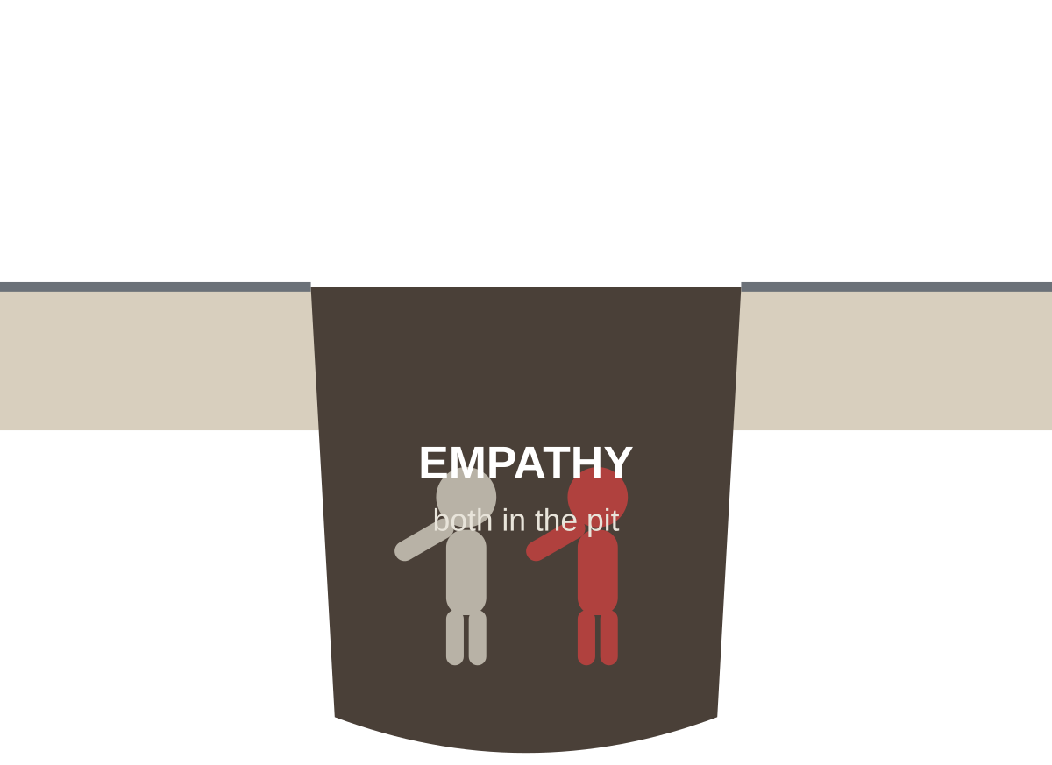
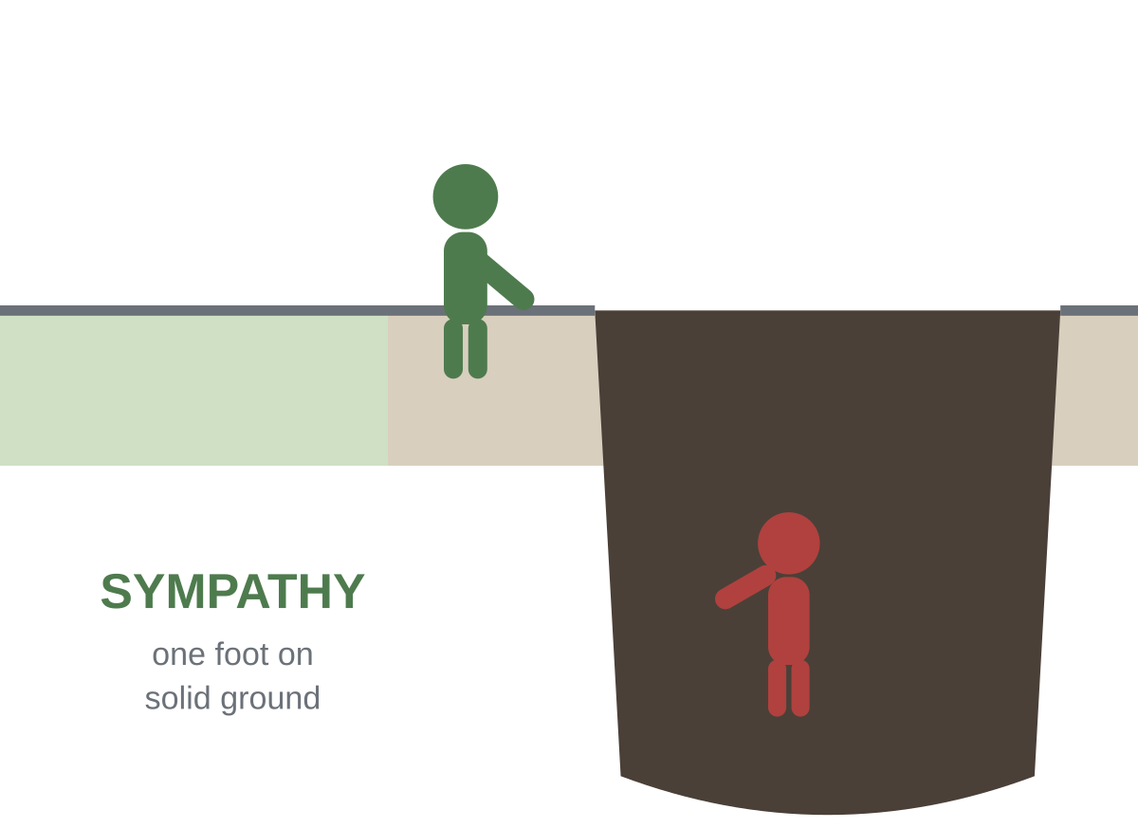
Love vs. Indiscriminate Empathy
1 Cor 13 — love and truth are never rivals
“Love… is not glad about injustice, but rejoices in the truth. It bears all things, believes all things, hopes all things, endures all things.” (1 Corinthians 13:6–7)
Biblical love is never separated from truth. It seeks a person’s ultimate good — not merely their immediate comfort. Those are often the same. Sometimes they are opposites.
Empathy can mean climbing into the pit — feeling exactly what they feel, losing the ground to stand on. Sympathy / love keeps one foot on solid ground to pull the other person out. Christ sympathizes fully — yet without sin (Heb 4:15).
Notes:
[12:00–25:00]
[CLICK] 1 Cor 13:6–7 — the definition. Love REJOICES IN TRUTH. A love that celebrates a comforting falsehood is, by this verse, not love. Read it slowly.
[CLICK] Ultimate good vs. immediate comfort — a parent, a doctor, a good friend all know these can diverge. Love aims at the former.
[CLICK] The pit images. Careful definitional note: people use “empathy” and “sympathy” loosely and interchangeably — do NOT let this become a vocabulary fight or an attack on the word “empathy.” The POINT is the posture: to help someone out of a hole you cannot be in the hole with them. Feeling-with is good; being-swept-away is not. Heb 4:15: Christ is the model — he understands our weakness completely (fully feels-with) YET without sin (never swept from the truth). Perfect sympathy, solid ground. Transition: “Here is where it turns dangerous.”

Slide 4
When Compassion Is Weaponized
Feelings made the final authority — Eden’s move, repeated
The pattern: “If you really cared about me, you would enable my choice.”
The discussion is moved off what is right and onto what causes the least emotional discomfort. Guilt becomes the lever; feeling becomes the final court.
Notice it is Eden’s move exactly: the standard shifts from “What did God say?” to “What will make the pain stop?” Compassion, cut from truth, becomes a tool of control — and often the one applying pressure sincerely believes it is love.
But the God of all compassion is not like this:
• He is “compassionate and gracious, slow to anger” (Ex 34:6) — and
• He disciplines the son he loves (Heb 12:6)
• He calls to repentance precisely because he is patient (2 Pet 3:9; Rom 2:4)
Real compassion sometimes says the hard thing. The surgeon who refuses to operate because the patient fears the knife is not kind. A love that will not risk the other person’s displeasure has already stopped seeking their good.
Notes:
[25:00–35:00]
[CLICK] The pattern sentence — say it in the voice it’s usually said in: wounded, sincere. This is not always cynical manipulation; often the person genuinely conflates love with agreement. Name it without contempt.
[CLICK] The Eden link — same authority-swap. “What did God say” → “what stops the pain.” And crucially: the one pressuring often BELIEVES it’s love. That charity keeps the room from hearing this as “people who disagree with me are manipulators.”
[CLICK] God’s own compassion — the AND is the hinge. Compassionate AND disciplines AND calls to repentance. A god who only ever soothes is not the God of Scripture; he’s an idol made of our comfort.
[CLICK] The surgeon image — land it gently. Withholding a hard truth to avoid displeasure is not love. Transition: “So are we forced to choose — truth or compassion?”

Slide 5
Never a Choice Between Them
Compassion firmly anchored in truth
The false choice to reject: “either be truthful, or be loving.”
Scripture never offers that menu. The believer is not asked to pick a side; he is asked to hold both — with truth as the anchor and love as the manner.
“speaking the truth in love, we will in all things grow up into Christ, who is the head.” (Ephesians 4:15)
Truth is what is spoken; love is how. Neither word is optional; neither is a hostage.
Emotion is a good servant — and a catastrophic master.
As a servant, feeling fuels compassion, softens the hard word, moves us toward the hurting.
As a master, feeling overrules the word of God — which is precisely the sin of Eden. The cure is not less compassion. It is compassion put back under its King.
And remember whose order this is: grace first. God’s kindness leads us to repentance (Rom 2:4). Mercy first, altar second — the truth we speak rests on a love already proven at the cross.
Notes:
[35:00–45:00]
[CLICK] Kill the false binary explicitly — many in the room feel forced to choose and will be relieved to be told they never had to. Truth = content; love = manner.
[CLICK] Eph 4:15 — the whole formula in four words: truth IN love. Note the goal is maturity/growth, tying back to Heb 5:14 — the mature hold both.
[CLICK] The servant/master line — the memorable takeaway. Say it twice. Feeling is not the enemy; misplaced feeling is.
[CLICK] Unpack both roles. The cure for bad compassion is never coldness — it is rightly-ordered compassion.
[CLICK] Grace-first anchor (the Week 4/7/9/12 refrain) — the truth we speak is not cold correction; it rests on the cross. Straight to discussion.

Slide 6
Discussion
Ten minutes — this is the week’s practice
1. Where is the line between compassion and enabling? How can you tell, in a real situation, which one you’re doing?
2. How do you speak truth without weaponizing it — and love without surrendering it? Which failure is yours?
Handle with care: people in this room are carrying real relationships — a wandering child, a hard marriage. Keep it about the principle, and be gentle.
Notes:
[45:00–55:00]
This is the most personally loaded discussion in the course so far. Many will have a specific person in mind — an adult child making destructive choices, a friend, a spouse. Move slowly.
Q1: The line is the person’s ULTIMATE GOOD vs. their immediate comfort AND your own comfort (enabling is often self-protective — we cave to end OUR discomfort). Test: am I helping them toward what’s good, or just making the tension stop?
Q2: Two failure modes, like the Berean two halves. Truth-weaponizers need the “in love”; love-surrenderers need the “truth.” Ask them to name their own — gently. Do NOT let this become naming other people’s sins in absentia.
[CLICK] Read the care-note aloud if the room drifts toward venting about a specific person.

Slide 7
Read Like a Berean
For next week — and a unit turns
For next week, read:
• Deuteronomy 8:1–10 — why did God lead Israel through the wilderness? Find the word “test” and note what it was testing.
• Genesis 22:1–2 — the first time Scripture calls something a “test.” Who is tested, and what is asked?
Next week begins Unit III — Testing: Faith Tests Across the Covenants. In every era, God tests faith — and the tests always sit on the far side of grace.
Carry this week in one sentence:
Compassion anchored in truth. Emotion — a good servant, a catastrophic master.
“Speaking the truth in love, we will… grow up into Christ.” (Ephesians 4:15)
https://tinyurl.com/TeachTheWord
Notes:
[55:00 close, ~2 min]
[CLICK] Next week’s reading — the pivot into Unit III. Flag both “test” words; the class arrives already having found them.
[CLICK] Preview Unit III — and reassure: after the grace of Week 4, tests are not a return to earning. Far side of grace.
[CLICK] Carry sentence — say it together.
[CLICK] Close on Eph 4:15 — send them out toward maturity, not toward a fight. Dismiss on time.

