Slide 1
The Obedience of Faith — Week 9 · Unit III: Testing
The Altar Today
Living Sacrifice, Royal Priesthood — do Christians offer sacrifices?
“present your bodies as a sacrifice — alive, holy, and pleasing to God — which is your reasonable service.”
(Romans 12:1)
https://tinyurl.com/TeachTheWord
Notes:
[0:00] Ask the question straight, and let it hang: “Do Christians offer sacrifices? Most of us would say no — that ended at the cross. Half of that is exactly right. The other half will surprise you.” This week closes Unit III and brings the sacrifice thread from Week 2 full circle. Point at Rom 12:1 — the answer is on the screen: you, alive.

Slide 2
First, the Guard
The atoning sacrifice is finished — once for all
“And by his will we have been made holy through the offering of the body of Jesus Christ once for all… For by one offering he has perfected for all time those who are made holy.” (Hebrews 10:10, 14)
Once for all. The atoning work is complete, finished, unrepeatable. No altar you build, no sacrifice you offer, adds a single thing to it. It cannot be improved, only received.
Hebrews drives it home by contrast: the old priests stood daily, offering the same sacrifices that could never take away sins (10:11). Christ offered one sacrifice and “sat down” (10:12) — the posture of finished work.
Hold this guard the whole hour: nothing we say next reopens the cross. Never let anyone — including yourself — put you back under a system of earning. And yet… the New Testament keeps using sacrifice language for us. Why?
Notes:
[0:00–8:00]
[CLICK] Heb 10:10,14 — read both. ONCE FOR ALL (ephapax) is the hinge word of Hebrews. Perfected FOR ALL TIME.
[CLICK] Land “once for all.” This is the guard that keeps the whole week from sounding like works-salvation — the very thing Week 4 warned against. The atonement is not a project we contribute to.
[CLICK] The contrast — old priests STOOD (work never done); Christ SAT DOWN (work finished). A seated priest is a stunning image; no Levite ever sat in the sanctuary.
[CLICK] State the tension the rest of the hour resolves: atonement is finished, YET the NT still calls us to offer sacrifices. Not a contradiction — a change of material. Transition: “Here is the turn.”

Slide 3
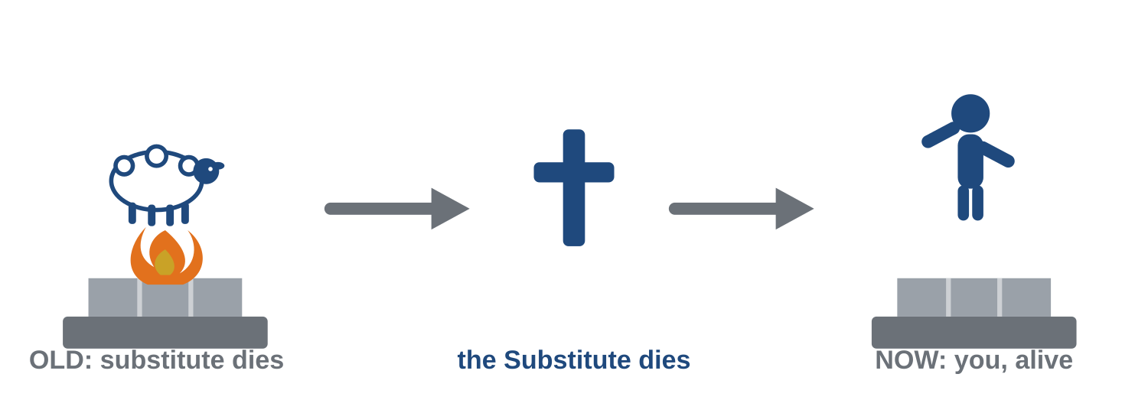
The Turn: Sacrifice Didn’t End — It Changed Material
Romans 12:1 — the Substitute has died, so now YOU go on the altar
Under the old covenant a substitute died in your place — you brought the lamb, and it went on the altar instead of you. Now the true Substitute has died, once for all. So what goes on the altar? You do — alive.
“present your bodies as a sacrifice — alive, holy, and pleasing to God — which is your reasonable service.” (Romans 12:1)
The symbol has given way to the reality it always pointed toward: a whole life laid down, and kept alive to keep laying down.
The New Covenant sacrifices, named plainly:
▪ Praise — “a sacrifice of praise… the fruit of lips that confess his name” (Heb 13:15)
▪ Good done & possessions shared — “with such sacrifices God is pleased” (Heb 13:16)
▪ Your very self — “a holy priesthood, to offer spiritual sacrifices” (1 Pet 2:5)
Notes:
[8:00–20:00]
[CLICK] Walk the graphic left to right. OLD: the lamb dies INSTEAD of you. CENTER: at the cross, the true Substitute dies once for all (Week-8 territory). NOW: the altar has no fire — because the sacrifice is meant to stay ALIVE. That empty-of-flame altar is the whole point of Rom 12:1.
[CLICK] Say the hinge: “Sacrifice didn’t end. It changed material.” Pause both sides of it. The substitute has died, so the worshiper himself is now the offering — living.
[CLICK] Rom 12:1 — “alive” is the shocking word. Every prior sacrifice was dead; this one breathes. Recall Week 2’s NET note: living sacrifices keep crawling off the altar — which is why it must be daily.
[CLICK] The three named sacrifices — praise, good/generosity, the self. These are concrete; the class can DO them this week. Transition: “And notice what Peter just called you — a priest.”

Slide 4
You Are the Priest
Malachi’s question arrives with no middleman
“you are… a royal priesthood… a holy priesthood, to offer spiritual sacrifices acceptable to God through Jesus Christ.” (1 Pet 2:5, 9)
Feel the weight of that. Malachi was written to priests — about the quality of what they brought. Peter just made you the priest. So Malachi’s rebuke now arrives at your door with no one standing in between.
“When you present blind animals for sacrifice, is that not wrong? … Try presenting them to your governor! Would he be pleased with you?” (Malachi 1:8)
God’s point: you would not hand your employer, your commanding officer, the leftover you hand Me. The blind, the lame, the leftover — offered because it cost you nothing.
And the standard crossed every covenant untouched — the best, the whole, the unblemished:
“I will not offer to the LORD my God burnt sacrifices that cost me nothing.” (2 Samuel 24:24)
David’s twelve words are the whole doctrine of cost. A sacrifice that costs nothing sacrifices nothing.
Notes:
[20:00–32:00]
[CLICK] 1 Pet 2:5,9 — the priesthood of ALL believers. Not clergy alone; everyone in the room is a priest with an offering to bring.
[CLICK] The transfer — this is the convicting pivot. Malachi’s complaint was to PRIESTS. You are now the priest. No middleman means no hiding behind “the professionals handle worship.”
[CLICK] Mal 1:8 — deliver “offer it to your governor!” as the dry, pointed sarcasm it is. Don’t raise your voice; the verse is already sharp. The image: you’d never give your boss the garbage you routinely give God.
[CLICK] 2 Sam 24:24 — the cleanest quotable in the course. “That cost me nothing.” If they remember one sentence, this. Sets up the discussion question directly. Transition: “So the offering is now yourself. But Paul said TWO things go on the altar.”

Slide 5
Body AND Mind
Romans 12:1–2 is Hebrews 5:14 — one paragraph
“present your bodies as a sacrifice… (2) Do not be conformed to this present world, but be transformed by the renewing of your mind, so that you may test and approve what is the will of God — what is good and well-pleasing and perfect.” (Romans 12:1–2)
Verse 1 puts the body on the altar. Verse 2 puts the mind. And look WHY the mind is renewed: “so that you may test and approve… what is good.”
That is Hebrews 5:14 in Paul’s handwriting. The renewed mind exists to discern the Good — the exact faculty the whole course has been training (Week 5). The living sacrifice and trained discernment are not two subjects. They are verses one and two of the same paragraph.
So daily renewal in the Word is not preparation for your sacrifice. It IS your sacrifice — the daily portion of it. The mind laid on the altar every morning is the offering, not the warm-up.
Mercy first, altar second — a thank offering, not a payment.
Notes:
[32:00–45:00]
[CLICK] Read Rom 12:1–2 as ONE unit — most people stop at verse 1. The purpose clause in v.2 is the payoff of the entire course.
[CLICK] Body AND mind. The mind is renewed FOR something: to test and approve the good. Invite them to open Romans 12 and see it — checkable, not asserted.
[CLICK] The great convergence: Rom 12:2 = Heb 5:14. Discernment (Unit II) and sacrifice (Units I & III) turn out to be the same paragraph. This is the intellectual peak of the course — let it land.
[CLICK] The reframe: daily Bible reading is not prep for worship; it IS the offering — the daily portion of the living sacrifice. This dignifies the ordinary morning chapter as an altar act.
[CLICK] The banner — the grace guardrail one more time. Rom 12:1 begins “by the mercies of God.” Thank offering, not payment. To discussion.

Slide 6
Discussion
Ten minutes — this is the week’s practice
1. If your time this week were an animal brought to Malachi’s altar, what condition would it be in — the best of the flock, or the blind and lame?
2. What are the “first minutes” of your day currently given to? What would change if they went on the altar?
Gentle, first-person: this is a mirror, not a measuring stick — grace already holds you; the question is what you’re bringing in return.
Notes:
[45:00–55:00]
Q1: The Malachi image made personal — and searching. Most of us give God the exhausted, distracted leftover of our time. Name it first-person (“I’ve brought that lamb”). Do NOT let it curdle into guilt; the frame is grace — what would a FIRSTFRUITS offering of time look like? Concrete, not condemning.
Q2: The practical companion. “First minutes” = phone, news, email, worry — vs. the Word, prayer. Not legalism about a specific hour; the principle of firstfruits vs. leftovers applied to attention. Seed: “What gets your mind before God does?”
[CLICK] Read the mirror-not-measuring-stick line — keeps grace in the room.

Slide 7
Read Like a Berean
For next week — and a unit turns
For next week, read:
• 1 Corinthians 14:26–40 — Paul orders public worship. What governs who may do what — and what does v.37 claim?
• Jude 3 — “the faith once for all entrusted to the saints.” What does “entrusted” imply about where authority comes from?
Next week begins Unit IV — God’s House: Apostolic Appointment — where does teaching authority in the church come from? Two weeks of careful, contested ground.
Carry this week in one sentence:
Sacrifice didn’t end — it changed material. You are the priest, and you are the offering, alive.
“I will not offer… sacrifices that cost me nothing.” (2 Samuel 24:24)
https://tinyurl.com/TeachTheWord
Notes:
[55:00 close, ~2 min]
[CLICK] Next week’s reading — the pivot into Unit IV (church order). Both flags (v.37 “Lord’s command”; “entrusted”) preview the apostolic-appointment argument. Give the class a heads-up: the next two weeks handle genuinely contested ground, and we’ll do it as Bereans — eager AND examining.
[CLICK] Preview Unit IV.
[CLICK] Carry sentence — say it together.
[CLICK] Close on 2 Sam 24:24. Dismiss on time.

