Slide 1
The Call to Unity
A Divine Mandate
What does it mean to “purify your soul”?
Since you have purified your souls in obeying the truth through the Spirit in sincere love of the brethren, love one another fervently with a pure heart, having been born again, not of corruptible seed but incorruptible, through the word of God which lives and abides forever…
(1 Peter 1:22-23)
https://tinyurl.com/Call2Unity

Slide 2
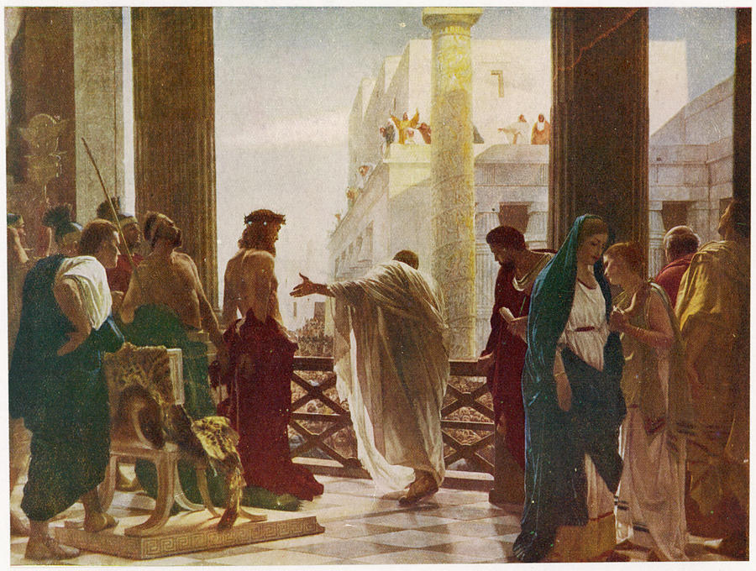
The Call to a Unifying Truth A Call to Whom? (John 18:37)
Notes:
Consider the “Cohorts” present at the Pilate inquiry.
Pharisees – lacked discernment (Matt 16 : able to predict weather, but not able to see the signs of the time). A time when both the Pharisees and Sadducees were unified.
Romans – “Might is Right” – reading the wrong signs – ignoring significance of situational context – “the end justifies the means”
Jesus – A cohort of 1 (Trinity?). Speaking to whom?
Joh 18:33-37
(33) So Pilate went back into the governor’s residence, summoned Jesus, and asked him, “Are you the king of the Jews?”
(34) Jesus replied, “Are you saying this on your own initiative, or have others told you about me?”
(35) Pilate answered, “I am not a Jew, am I? Your own people and your chief priests handed you over to me. What have you done?”
(36) Jesus replied, “My kingdom is not from this world. If my kingdom were from this world, my servants would be fighting to keep me from being handed over to the Jewish authorities. But as it is, my kingdom is not from here.”
(37) Then Pilate said, “So you are a king!” Jesus replied, “You say that I am a king. For this reason I was born, and for this reason I came into the world – to testify to the truth. Everyone who belongs to the truth listens to my voice.”
Joh 14:6
(6) Jesus replied, “I am the way, and the truth, and the life. No one comes to the Father except through me.
Joh 14:23
(23) Jesus replied, “If anyone loves me, he will obey my word, and my Father will love him, and we will come to him and take up residence with him.
I Cor. 2:13-16
“…but we have the mind of Christ”

Slide 3
How to Know Truth?
The LORD says, ‘Wise people should not boast that they are wise, Powerful people should not boast that they are powerful. Rich people should not boast that they are rich. If people want to boast, they should boast about this: They should boast that they understand and know me. They should boast that they know and understand that I, the LORD, act out of faithfulness, fairness, and justice in the earth and that I desire people to do these things…’ Jeremiah 9:23-24
“Now we do speak wisdom among the mature, but not a wisdom of this age or of the rulers of this age… Instead we speak the wisdom of God… Things that no eye has seen, or ear heard, or mind imagined, are the things God has prepared for those who love Him. God has revealed these to us by the Spirit…
And we speak these things, not with words taught us by human wisdom, but with those taught by the Spirit, explaining spiritual things to spiritual people… For who has known the mind of the Lord, so as to advise Him? But we have the mind of Christ.”
I Corinthians 2:6-16
Perspective is understanding something because you are seeing it from a larger frame of reference. It is the ability to perceive how things are interrelated and then judge their comparative importance. In a spiritual sense, it means seeing life from God’s point of view. In the Bible, the words understanding, wisdom, and discernment all have to do with perspective. The opposite of perspective is hardness of heart, blindness, and cognitive dissonance.
“…Jesus answered, ‘You say rightly that I am a king. For this cause I was born, and for this cause I have come into the world, that I should bear witness to the truth. Everyone who is of the truth hears My voice.’” John 18:37
Notes:
Are you “of the truth”….?
----------------------------------------------------------------------------
**** This moment was also one that divided Humanity forevermore. ****
Not just a Call to Unity… Also, a Call to Separate! From Whom or What? Why?
----------------------------------------------------------------------------
Joh 14:6
(6) Jesus replied, “I am the way, and the truth, and the life. No one comes to the Father except through me.
Joh 17:14-21 I have given them your word, and the world has hated them, because they do not belong to the world, just as I do not belong to the world. (15) I am not asking you to take them out of the world, but that you keep them safe from the evil one. (16) They do not belong to the world just as I do not belong to the world. (17) Set them apart in the truth; your word is truth. (18) Just as you sent me into the world, so I sent them into the world. (19) And I set myself apart on their behalf, so that they too may be truly set apart. (20) “I am not praying only on their behalf, but also on behalf of those who believe in me through their testimony, (21) that they will all be one, just as you, Father, are in me and I am in you. I pray that they will be in us, so that the world will believe that you sent me.
----------------------------------------------------------------------------
Joh 14:23 Jesus replied, “If anyone loves me, he will obey my word, and my Father will love him, and we will come to him and take up residence with him.
I Cor. 2:13-16 “…but we have the mind of Christ”
----------------------------------------------------------------------------
There is a world of chaos and confusion. The system in which we live is pitted against the Truth of God.
When divisions arise in the church - doctrinal, relational, or practical - they often spring from presuppositions that haven’t been tested against objective truth.
Know the Truth. Have Discernment.
God has given you Himself (Jesus) who is Truth, The Holy Spirit that you may know Truth, His Word that you may test Truth. How terrible that you may ignore these and yet be deceived.
Don’t spend time thinking about what “they” think versus what “He” thinks.“ “…but we have the mind of Christ” (1 Cor. 2).
--------------------------------------------------------------------------
It’s essential to be able to say “that’s right” and “that’s wrong”. There is often an unwillingness to disagree.
There has to be constant and healthy debate about Truth in the Church. Be Opinionated… Declare “that’s wrong” and “that’s right”. Don’t be subjective…
Jay Adams wrote… “From the garden of Eden with its two trees – one allowed, one forbidden – to the eternal destiny of the human being in heaven or in hell, the Bible sets forth two and only two ways: God’s way and all others. Accordingly, people are either saved or lost. They belong to God’s people or the world. There is Gerizim, the mount of blessing, and Ebal, the mount of cursing. There is the narrow way and the wide way. One leads to eternal life, the other to eternal destruction.
“There are those who are against and those who are with us. There are those within the kingdom and those outside the kingdom. There is life and death, truth and falsehood, good and bad, light and darkness, the kingdom of God and the kingdom of Satan, love and hatred, spiritual wisdom and the wisdom of the world. And Christ is said to be the way, the truth, and the life; and no one may come to the Father but by Him. He is the only name under the sky by which one may be saved.”
And that is exactly the way the Bible presents itself. It presents truth and error, God’s way and everybody else’s way. There’s a right way, there’s a wrong way. There’s a right interpretation of a passage, and every other interpretation is the wrong one. There’s a right theology, and anything that disagrees with it is a wrong theology. There is a right way to understand God, Christ, the Holy Spirit, and salvation, and a wrong way. This is on every page of the Bible, from the beginning to the end of Scripture. This antithetical kind of thinking is everywhere.

Slide 4
A Call to Discernment A Key Capability of the Divine Truth Cohort
Matthew 16:1-4
Religious elite able to “discern the weather” but not the “prophetic signs”.
2 Corinthians 11:1-4
[False Doctrine]…”you will put up with it!” Illustrates a Lack of Discernment.
2 Thessalonians 5:16-22
“Do not despise Revelation (i.e. preaching).” Scripture, discernment, testing.
2 Timothy 2:15-17
Practice doctrinal precision. Avoid the dogmas of self-image and self-worth influencers.
1 Timothy 6:3-5 ; 11-16
Guard the Truth. Gain skills for distinguishing truth from falsehood and from half-truth.
1 John 2:20-29
Constant conflict – The Truth vs. Lies. Abide in Him and His Teaching.
Notes:
There are two things that are in constant conflict – The Truth and The Lies
Knowledge is only valuable if it becomes the driving force in the choices we make. The right choices requires knowledge. A pattern of right choices suggests Wisdom.
What is the greatest need in the Church today? The biggest problem? (A lack of discernment) (Accepting the wrong choices) (Failing to recognize the signs)
Eclectic Theology – a quilted collection of patterns that makes no sense. No discernment, no discrimination. No rhyme nor reason. Indiscriminate. Contemporary Christian scene exhibits no discriminating judgements about any theological ideas. How dare you question any viewpoint?
Biblical Christianity is fighting for its life. This growing lack of Spiritual Discrimination out-strips any other problem we now see in the Church.
We are warned against teachers “who tickle our ears” with certain messages, warned against false teachers, demonic forces, perverse teachings, commandments of men, ideas that are deceitful, empty philosophies, traditions of men, corrupters of the Word of God, false prophets, agents of Satan.
There is a world of chaos and confusion. The system in which we live is pitted against the Truth of God.
Know the Truth. Have Discernment.
God has given you Himself (Jesus) who is Truth, The Holy Spirit that you may know Truth, His Word that you may test Truth. How terrible that you may ignore these and yet be deceived.
Scriptural Interpretation with Precision is warranted. Amateur versus Professional. Knowing Sound Doctrine. Lack of Doctrinal Clarity and Conviction.
Don’t spend time thinking about what “they” think versus what “He” thinks.“ “…but we have the mind of Christ” (1 Cor. 2).
It’s essential to be able to say “that’s right” and “that’s wrong”. There is often an unwillingness to disagree.
There has to be constant and healthy debate about Truth in the Church. Be Opinionated… Declare “that’s wrong” and “that’s right”. Don’t be subjective…
Jay Adams wrote… “From the garden of Eden with its two trees – one allowed, one forbidden – to the eternal destiny of the human being in heaven or in hell, the Bible sets forth two and only two ways: God’s way and all others. Accordingly, people are either saved or lost. They belong to God’s people or the world. There is Gerizim, the mount of blessing, and Ebal, the mount of cursing. There is the narrow way and the wide way. One leads to eternal life, the other to eternal destruction.
“There are those who are against and those who are with us. There are those within the kingdom and those outside the kingdom. There is life and death, truth and falsehood, good and bad, light and darkness, the kingdom of God and the kingdom of Satan, love and hatred, spiritual wisdom and the wisdom of the world. And Christ is said to be the way, the truth, and the life; and no one may come to the Father but by Him. He is the only name under the sky by which one may be saved.”
And that is exactly the way the Bible presents itself. It presents truth and error, God’s way and everybody else’s way. There’s a right way, there’s a wrong way. There’s a right interpretation of a passage, and every other interpretation is the wrong one. There’s a right theology, and anything that disagrees with it is a wrong theology. There is a right way to understand God, Christ, the Holy Spirit, and salvation, and a wrong way. This is on every page of the Bible, from the beginning to the end of Scripture. This antithetical kind of thinking is everywhere.

Slide 5
How to Discern Truth A Biblical Call to Discernment
1 Thessalonians 5:21–22 “Test everything; hold fast what is good. Abstain from every form of evil.” → Paul calls believers to actively evaluate teachings and influences rather than accept them blindly.
1 John 4:1 “Beloved, do not believe every spirit, but test the spirits to see whether they are from God.” → A direct command to discern between truth and deception, especially spiritual and doctrinal influences.
Hebrews 5:14 “But solid food is for the mature, for those who have their powers of discernment trained by constant practice to distinguish good from evil.” → Discernment develops through spiritual maturity and disciplined practice.
Matthew 7:15–20 “By their fruit you will recognize them.” → Jesus teaches discernment by evidence - truth is recognized by the fruit it produces.
Notes:
Discerning truth is essential for unity in the church. Without spiritual discernment, believers may fall into error, deception, or harmful division. Scripture calls God’s people not only to know the truth, but to test, examine, and uphold it.
Discernment defends unity by:
Preventing division over false or misapplied doctrine.
Protecting the flock from spiritual manipulation.
Promoting maturity, which leads to clarity, humility, and shared understanding.
Practice:
Measure claims by Scripture (e.g. Bereans in Acts 17:11).
Assess outcomes through spiritual fruit (Galatians 5:22–23).
Encourage thoughtful dialogue rooted in love and truth (Ephesians 4:15).
Php 1:9-11 And I pray this, that your love may abound even more and more in knowledge and every kind of insight (10) so that you can decide what is best, and thus be sincere and blameless for the day of Christ, (11) filled with the fruit of righteousness that comes through Jesus Christ to the glory and praise of God.
Act 17:11 These Jews were more open-minded than those in Thessalonica, for they eagerly received the message, examining the scriptures carefully every day to see if these things were so.

Slide 6
The Art of Deception in Spiritual Warfare Discernment counters Deception
“All warfare is based on deception.” Sun Tzu, The Art of War
Church Application: Misunderstanding and deception, intentional or not, are strategic tools of spiritual warfare. Division in the church often begins when truth is distorted or obscured.
“The first casualty of war is truth.” U.S. Senator Hiram Johnson (1917)
Church Application: In times of tension or disagreement, truth is often compromised by fear, pride, or presupposition, undermining unity.
“In war, truth is so precious that she should always be attended by a bodyguard of lies.” Winston Churchill
Church Application: When believers begin to guard their positions or reputations with rhetorical smokescreens rather than honest dialogue, relational breakdown is inevitable.
Notes:
Here are three insightful quotes that associate war with deception, useful for exploring how misinterpretation, false assumptions, or divisiveness can function like warfare within a community or church.
1. “All warfare is based on deception.”
— Sun Tzu, The Art of War
Context: This foundational quote sets the tone for Sun Tzu’s philosophy, emphasizing that misleading the enemy is a strategic necessity.
Church Application: Misunderstanding and deception—intentional or not—are strategic tools of spiritual warfare. Division in the church often begins when truth is distorted or obscured.
2. “The first casualty of war is truth.”
— Attributed to U.S. Senator Hiram Johnson (1917)
Context: This saying reflects how propaganda, misinformation, and emotional manipulation quickly overshadow objective facts in any conflict.
Church Application: In times of tension or disagreement, truth is often compromised by fear, pride, or presupposition—undermining unity.
3. “In war, truth is so precious that she should always be attended by a bodyguard of lies.”
— Winston Churchill
Context: Churchill used this line during WWII to justify the necessity of military deception in protecting national security.
Church Application: When believers begin to guard their positions or reputations with rhetorical smokescreens rather than honest dialogue, relational breakdown is inevitable.

Slide 7
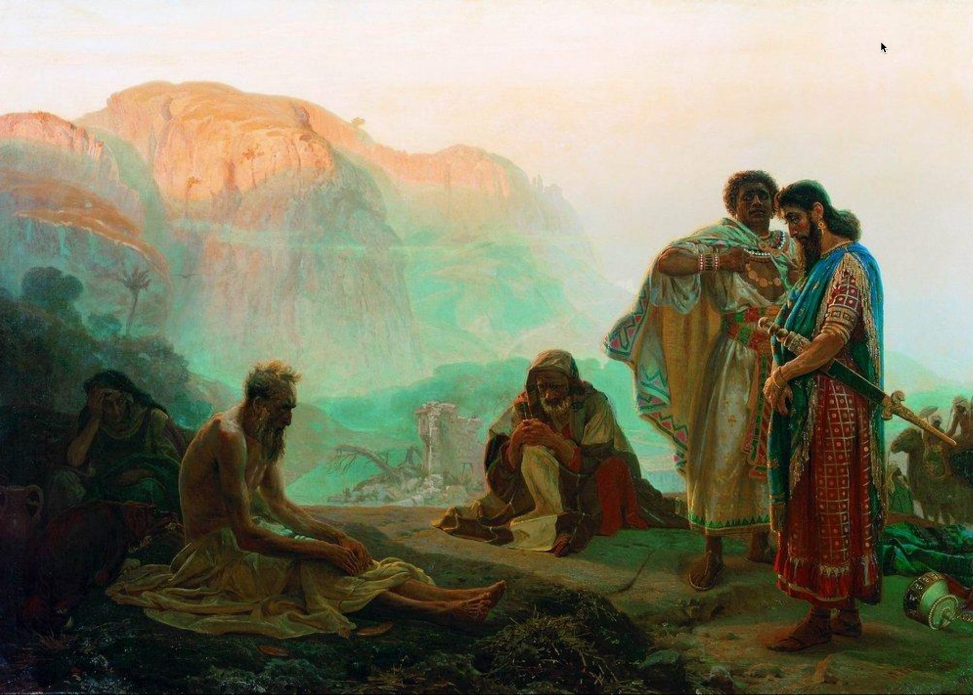
Job’s Friends Practice Discernment
Notes:
Job’s friends—Eliphaz, Bildad, Zophar, and Elihu—offer insight into how faulty presuppositions can damage relationships and cloud theological truth. Each speaks as if he fully understands the reason for Job’s suffering, but their shared assumptions are flawed.
Key Observations:
1. Job’s character reputation indicates that his friends would also have been people of high character. Each appears to “know God”.
2. The Satan (Accuser) appears to have overtaken Job’s friends. Each friend ultimately accuses Job of sin. They have become Delegated Accusers.
3. Ultimately, Job succumbs to the attack on his character (Job 42:3). But what was his sin? Where did Job’s sin originate (i.e. the Mind).

Slide 8
Presuppositional Thinking Faulty presuppositions damage relationships & cloud theological truth
Suffering is always the result of sin Assuming a direct correlation between personal sin and suffering, leaving no room for mystery or divine testing.
“Consider now: Who being innocent has ever perished?” – Eliphaz (Job 4:7)
God’s justice is immediate and visible Assuming God always rewards or punishes visibly and swiftly.
“Surely God does not reject one who is blameless…” – Bildad (Job 8:20)
Human wisdom can fully explain divine action Assuming an understanding of God’s ways through tradition or reason.
“Are God’s consolations not enough for you…?” – Eliphaz (Job 15:11)
Suffering may be preventative or instructive, not always punitive Presuming to speak with divine authority.
God does all these things to a person… to turn them back from the pit.” – Elihu (Job 33:29-30)
Confession and repentance will instantly fix the problem Assuming that doing so will immediately restore his fortunes.
“If you put away the sin that is in your hand… then you will lift up your face without shame.” – Zophar (Job 11:14–15)
Notes:
All four speakers operate from flawed presuppositions: that Job’s suffering must be deserved. They demonstrate how misapplication of truth, even when well-intended, leads to false counsel and further division. Their failure underscores the need for humility, context, and compassion in theological dialogue—directly applicable to preserving unity in the church.
What Is Presuppositional Thinking?
Presuppositional thinking involves starting with assumptions that shape how we interpret reality, truth, and Scripture. These assumptions are often unexamined but deeply rooted in our worldview—our overarching framework for making sense of life, meaning, morality, and destiny.
Example: If someone presupposes that "truth is relative," they will interpret Scripture selectively, potentially dismissing clear biblical commands as "contextual" or outdated.
How It Leads to Incorrect Assumptions
Confirmation Bias: We only accept interpretations that match what we already believe.
Cultural Filtering: We interpret eternal truths through the lens of modern trends or preferences (e.g. self-image or influencer dogmas).
Doctrinal Rigidity: We assume our denominational position is the only legitimate one without examining Scripture afresh.
These errors contribute to theological division, moral confusion, and church disunity—precisely the issues your course aims to resolve.

Slide 9
Presuppositional Thinking Faulty presuppositions damage relationships & cloud theological truth
Job’s Response and Divine Admonition: While Job rightly resists the flawed arguments of his friends and maintains his innocence, he eventually slips into self-righteousness and questions God's justice. In chapters 38–41, God responds not by explaining Job’s suffering but by humbling him with a series of rhetorical questions that reveal divine sovereignty and human limitation.
“Who is this that obscures my plans with words without knowledge?” – God to Job (Job 38:2)
Though Job never curses God, he does accuse God of injustice, and this presumption is what God corrects. Job’s error is not moral failure, but intellectual and theological presumption; assuming that God must explain Himself.
“Surely I spoke of things I did not understand, things too wonderful for me to know.” – Job (Job 42:3)
Insights: Even the righteous can err in trying to defend themselves or interpret God's will. The Friend’s assumptions demonstrate how sincere but shallow theology can lead to misjudgment and further pain. The story of Job reminds us to approach others with humility, listen well, and trust God’s sovereignty even when His purposes are hidden. We must practice discernment to avoid becoming delegated accusers like Job’s Friends. The pathway to restored understanding and unity is humble submission to divine wisdom.
Notes:
Discernment via Truth Tests
1. Correspondence Test
Truth must correspond to reality.
Example: If we say “God is love” (1 John 4:8), then our actions and church culture should reflect this.
Application: Church unity must correspond to the visible fruit of love, peace, and mutual care—not just doctrinal statements.
2. Correlation Test
Truth must cohere with other known truths.
Example: “Grace saves” and “Faith without works is dead” must correlate (Ephesians 2:8–10 + James 2:17).
Application: Interpret Scripture in context of the whole Bible to avoid false dichotomies (e.g., truth vs. love, grace vs. accountability).
When divisions arise in the church - doctrinal, relational, or practical - they often spring from presuppositions that haven’t been tested against objective truth.
Teaching mature Christians to:
Recognize their assumptions,
Test ideas against Scripture and observable fruit, and
Ensure coherence within the whole counsel of God can help resolve disagreements, strengthen unity, and promote humble discernment.

Slide 10
The Heart of the Christian Gospel Restoration of a covenant relationship with God
John 17:3 "Now this is eternal life: that they know you, the only true God, and Jesus Christ, whom you have sent."
John 14:16-17 "And I will ask the Father, and he will give you another advocate to help you and be with you forever—the Spirit of truth. The world cannot accept Him, because it neither sees Him nor knows Him. But you know Him, for He lives with you and will be in you.“
2 Corinthians 5:17-18 "Therefore, if anyone is in Christ, the new creation has come: The old has gone, the new is here! All this is from God, who reconciled us to himself through Christ."
How to be Right with God…
“If anyone says ‘I love God’ and yet hates his fellow Christian, he is a liar because the one who does not love his fellow Christian whom he has seen cannot love God whom he has not seen. And the commandment we have from Him is this: that the one who loves God should love his fellow Christian too. Everyone who believes that Jesus is the Christ has been fathered by God, and everyone who loves the Father loves the child fathered by Him. By this we know that we love the children of God: whenever we love God and obey His commandments. For this is the love of God: that we keep His commandments. And His commandments do not weigh us down, because everyone who has been fathered by God overcomes the world.” 1 John 4:20 – 5:4
Notes:
The Gospel centers on the restoration of relationship with God, accomplished through Christ’s life, death, and resurrection.
- John 17:3 : "Now this is eternal life: that they know you, the only true God, and Jesus Christ, whom you have sent."
- Defines eternal life as knowing God personally and relationally.
- John 14:16-17 : "And I will ask the Father, and he will give you another advocate to help you and be with you forever—the Spirit of truth. The world cannot accept him, because it neither sees him nor knows him. But you know him, for he lives with you and will be in you."
- Speaks of the Holy Spirit’s indwelling presence, a vital part of the believer’s union with God.
- 2 Corinthians 5:17-18 : "Therefore, if anyone is in Christ, the new creation has come: The old has gone, the new is here! All this is from God, who reconciled us to himself through Christ."
- Highlights the transformative power of the Gospel, reconciling believers to God.
“If anyone says ‘I love God’ and yet hates his fellow Christian, he is a liar because the one who does not love his fellow Christian whom he has seen cannot love God whom he has not seen. And the commandment we have from Him is this: that the one who loves God should love his fellow Christian too. Everyone who believes that Jesus is the Christ has been fathered by God, and everyone who loves the Father loves the child fathered by Him. By this we know that we love the children of God: whenever we love God and obey His commandments. For this is the love of God: that we keep His commandments. And His commandments to not weigh us down, because everyone who has been fathered by God overcomes the world.” 1 John 4:20 – 5:4

