Slide 1


eTraffic Police

Slide 2

Introduction
“eTraffic Police” is an application developed by the Sri Lankan Traffic Police which allows the public to report traffic violations by uploading images or videos taken through the application as evidence which is sent to the database in the traffic HQ in real time with the location, and the user can also choose to add a description/comment regrading the violation. All this information is received by the police IT division and traffic HQ where the operations team can initiate whatever the action that is required. And once the case is resolved, the user will be notified with the status of the action
The application has no functionality to upload media that is already available in the gallery since users should be restricted from uploading edited images/videos. Which is subjected to the Motor Traffic (Amendment) Act (No. 40 of 1984) and Evidence (Special Provisions) Act. No. 14 of 1995.

Slide 3


Technology

Slide 4
Group Details
Registration number | Name
IT19014296 | Jayaweera N.C.S.
IT19032252 | Pitawala W.W.S.P.
IT19011912 | Fernando W.A.D.S.
IT19064932 | Hameed M.S.

Slide 5
Individual work allocation

Slide 6
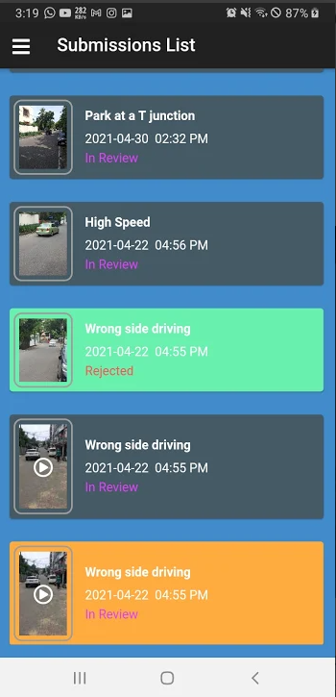
IT19014296-Jayaweera N.C.S.
Submission's list UI
Create new UI for View submissions-delete /edit (when submission is in submitted state)

Slide 7
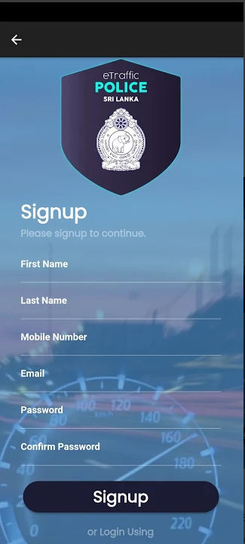
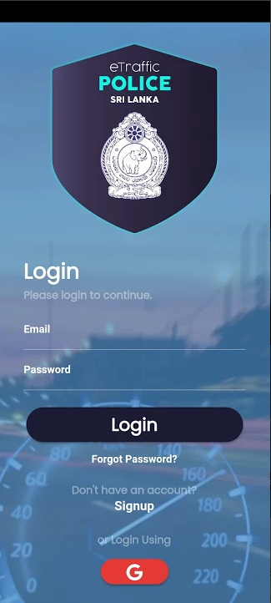

IT19032252-Pitawala W.W.S.P
Register / login/ change password

Slide 8
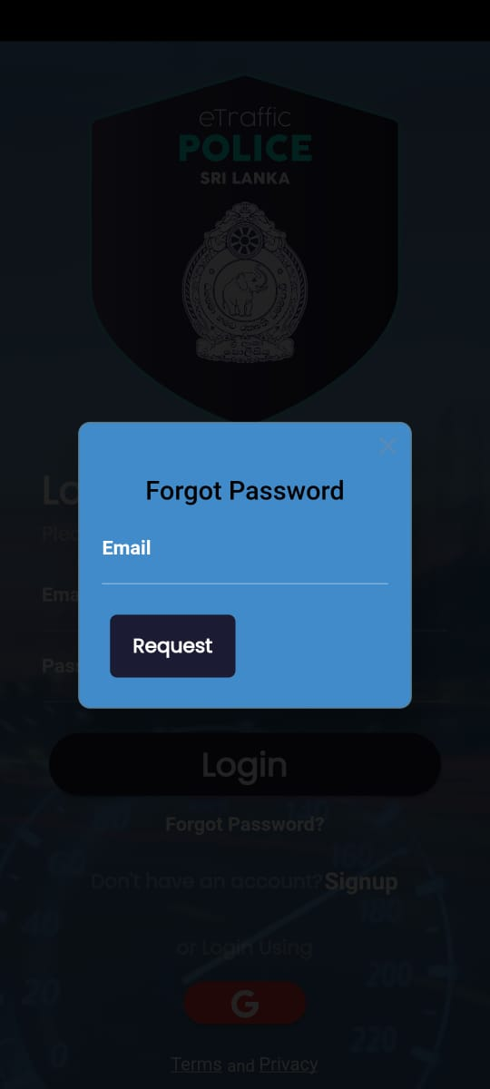
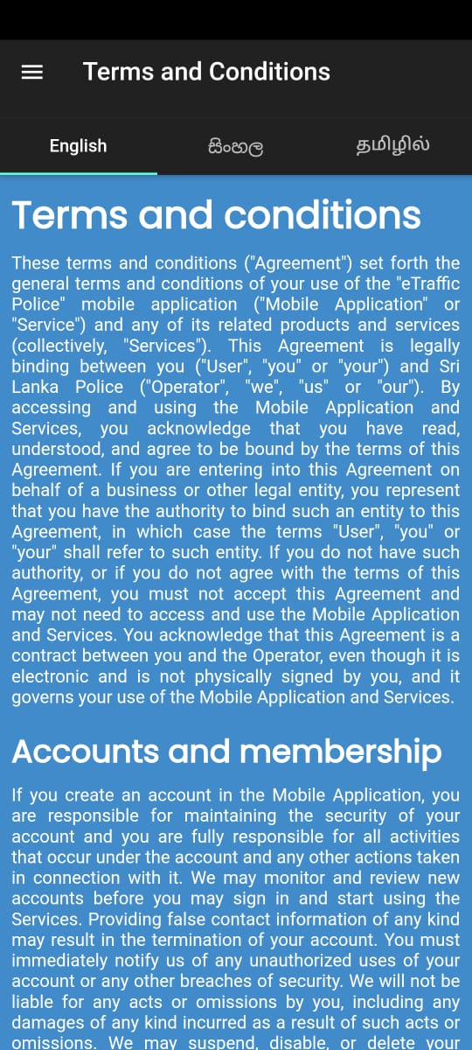
IT19011912-W.A.D.S.Fernando
forgot password
privacy policy
Terms and conditions(add/delete as an admin)

Slide 9
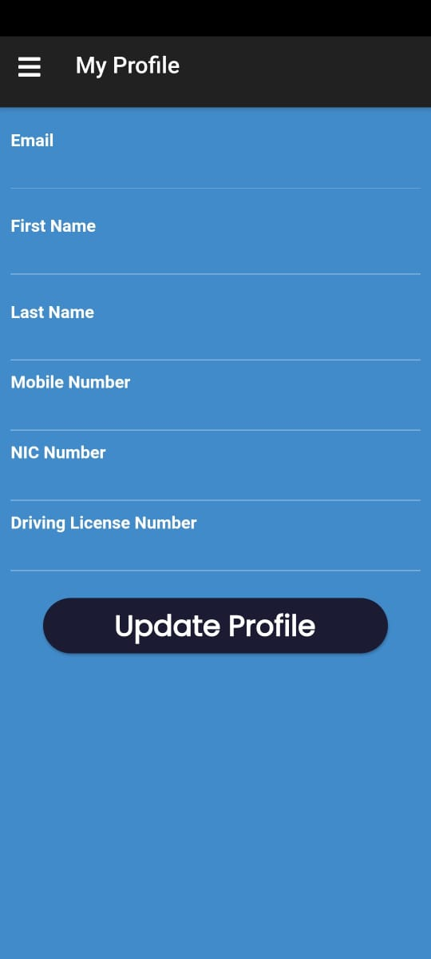


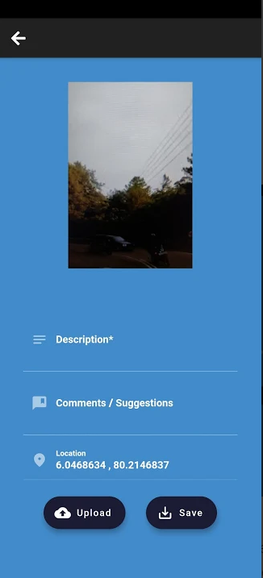
IT19064932-Hameed M.S
Profile handling
upload videos and photos

Slide 10
Thank You!

