Slide 1

USER_DATA DEFINE APP
ADVANCED JAVASCRIPT

Slide 2
Make React App
App Name : Data Finding
Documentation
Data Implement With
User Guide
FAQs
Contact INFO
Release Notes
Tutorial
Features
Search functionality
Data vizualization
Contact management
Export functionality
Integrations
Customization
Notifications
Analytics &
Security
React Js
BS 5.2
API code

Slide 3
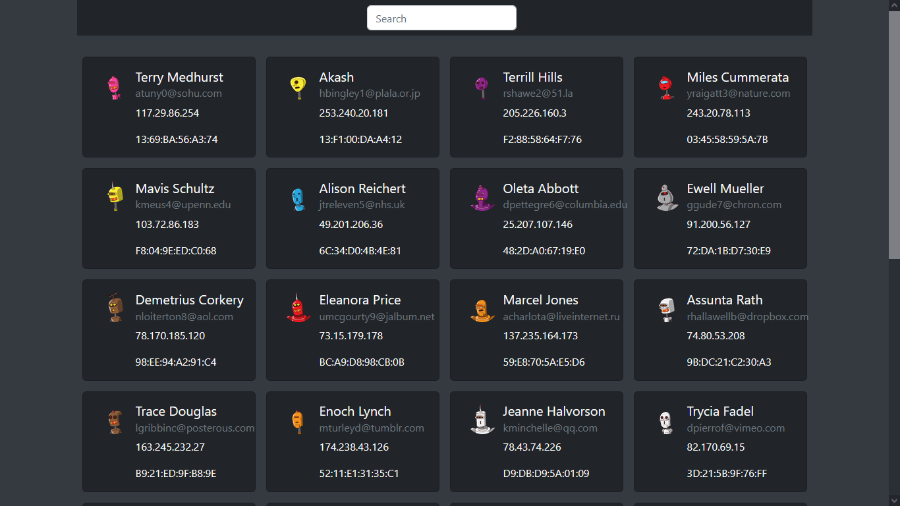
Make React App
This program is made to extract user's data. The program
is made with React JS. By doing this, all the structures of
the program are completely fixed.
I have made two parts in this project. The first part is the
searchbar or input type and the other is the number of cards
in a container

Slide 4
The program will work to find users. It will have more features later.
It uses React's functions, hooks, props, maps and APIs.

