Slide 1
Determining best part of Toronto to migrate to
HARJIT GAKHAL

Slide 2
Purpose of analyzing neighborhoods
Determine which factors are most influential to area value
Determine what factors people look for when buying houses
Determine the best value for money
Track changes over time

Slide 3
Data acquisition and cleaning
Toronto crime rate data obtained from the Toronto crime portal
Rest of data such as Education, sourced from the Toronto Open Data Catalogue
I had 140 rows and 23 columns in my dataset, and 22 features as one of the columns was the list of neighborhoods.
Similar columns were dropped, and rates are in regard to population so accurate representations.

Slide 4
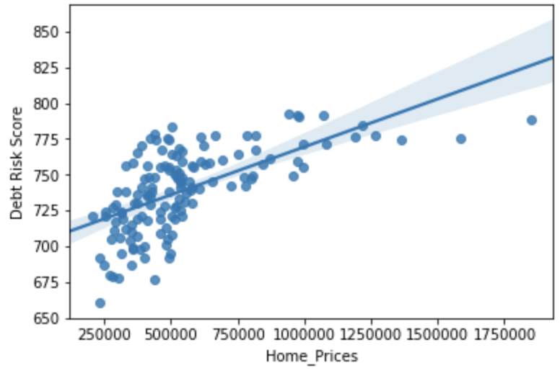
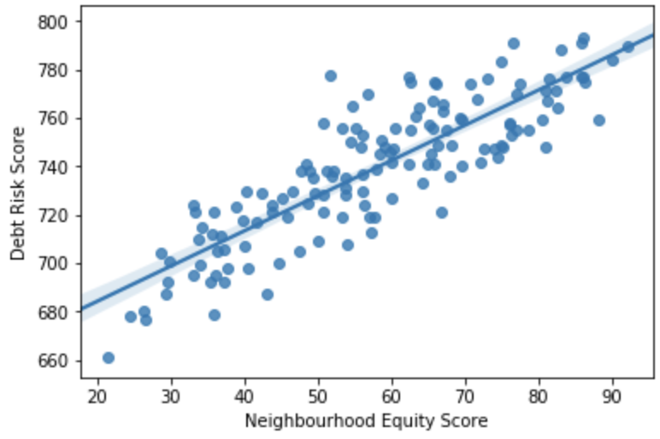
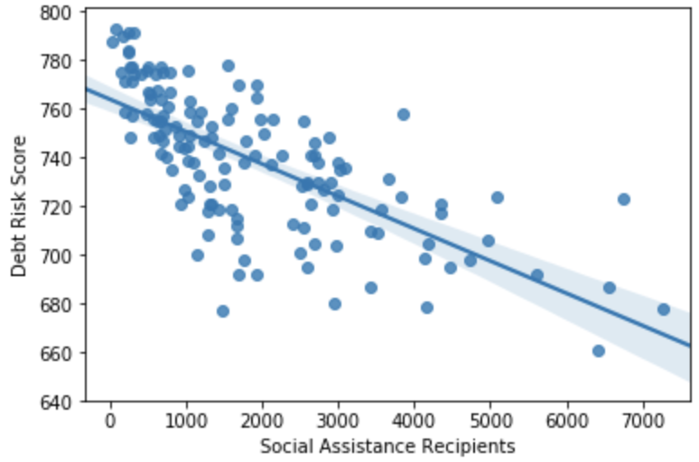
Used Regression plots to visualize patterns
We see a strong positive correlation between Neighborhood Equity Score and Debt risk score and a strong negative correlation between Debt risk score and Social assistance recipients.

Slide 5
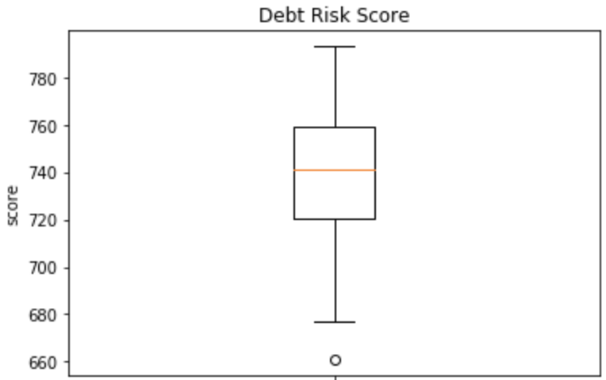
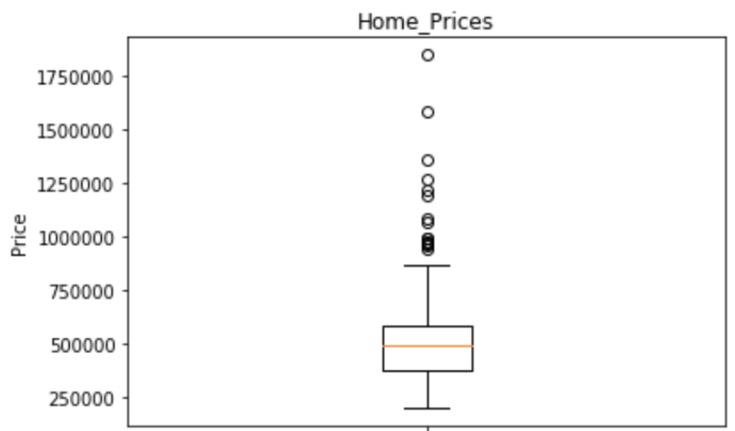
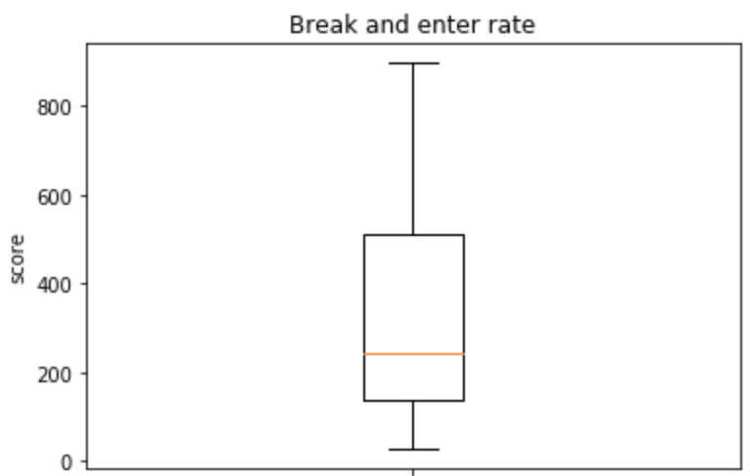
Using Box Plots to look at spread of data
Here we can see that majority of neighborhoods have a Debt Risk score of 700 + which is considered good, and we also see the break and enter rate is positively skewed indicating crime rates are only very high in some neighborhoods.

Slide 6
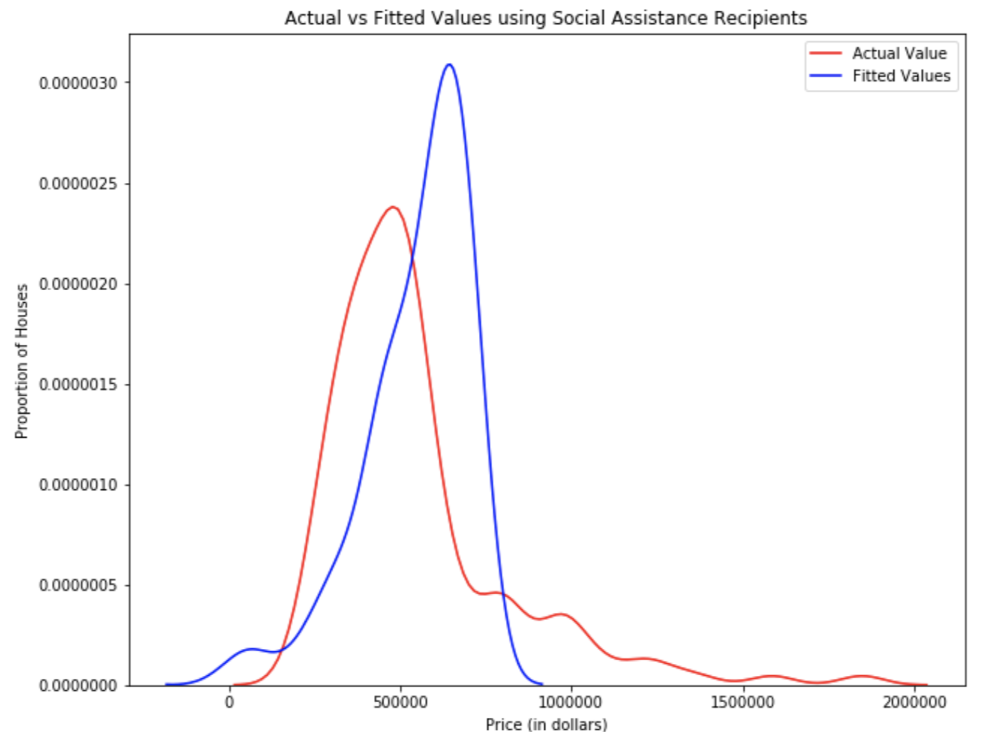
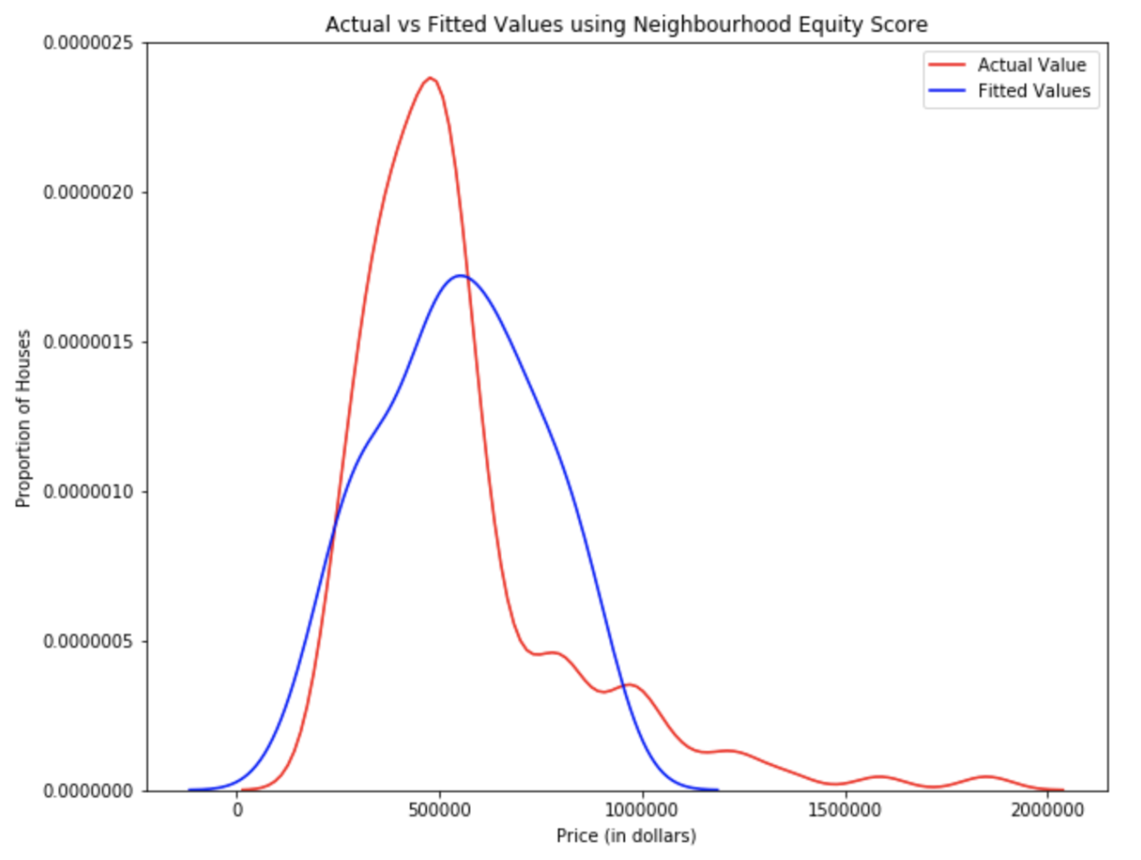
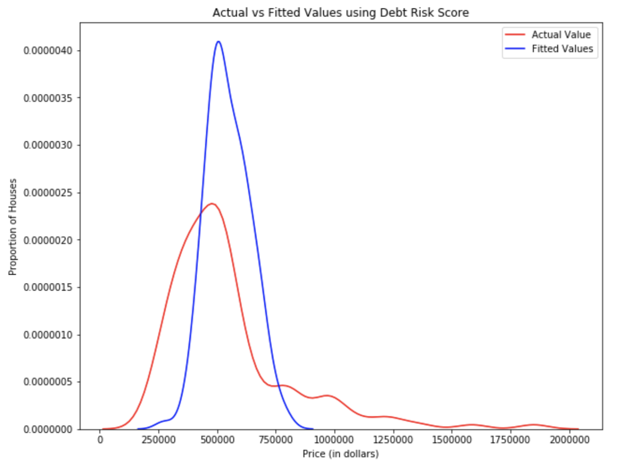
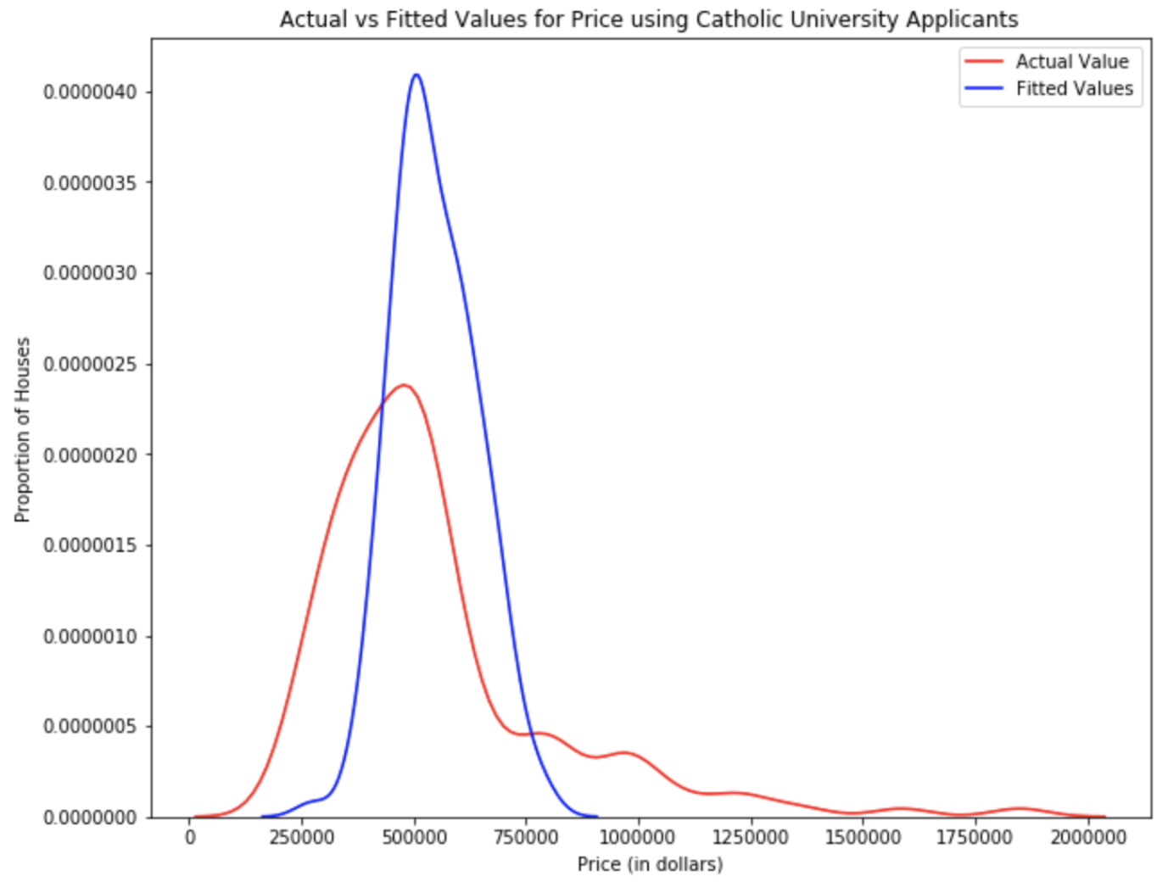
Linear regression models using single features
We can see that the Single feature linear models are not very accurate at predicting house prices

Slide 7
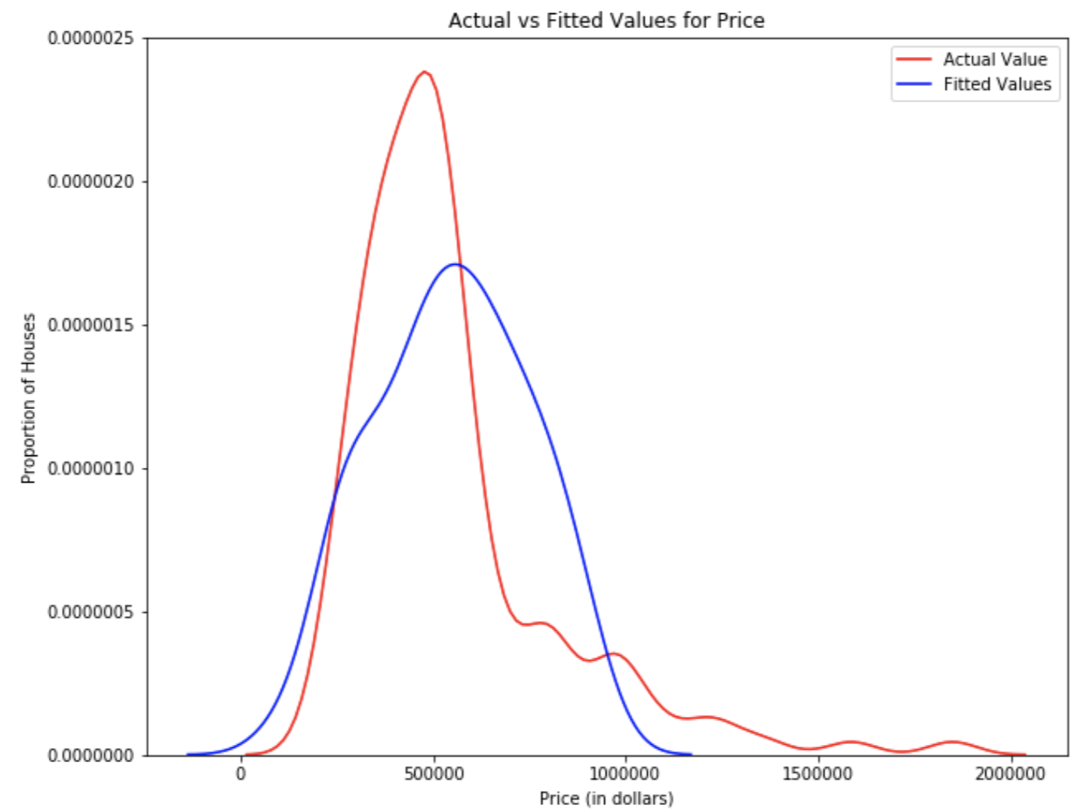
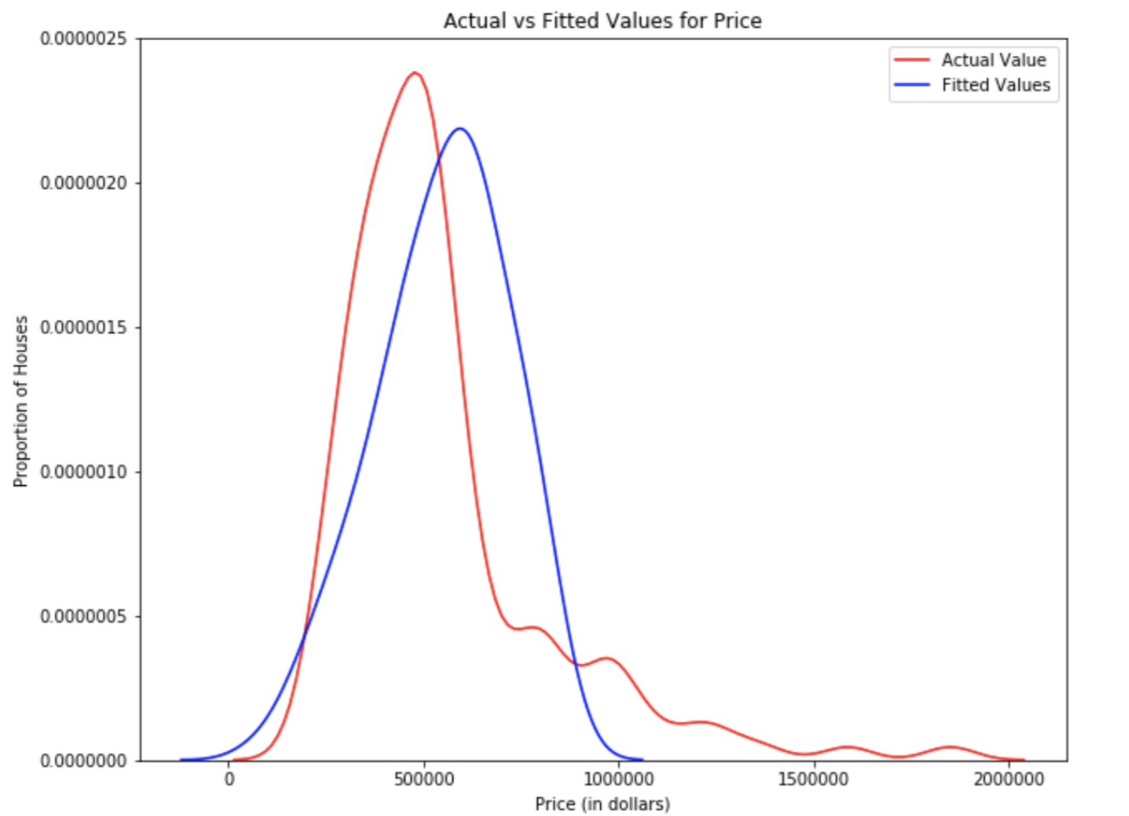
Linear regression using multiple features
The graph on the left uses the 4 features College applicants, Debt risk score, Neighborhood Equity score, and social assistance recipients. The graph on the right only used University applicants and Debt risk score.

Slide 8
Results
Models not accurate so decided to look manually and pay attention to features, and make recommendations based on these.
Split data up based on house prices
Up to $400,000
$400,000 - $500,000
$500,000 - $600,000
$600,000 - $900,000
$900,000 - $1,200,000
$1,200,000 +

Slide 9
Final results
 | Neighbourhood | Average Crime Rate | University Applicants Score | Neighbourhood Equity Score | Price
Up to $400 k | Milliken | 345.625 | 52.67 | 52.85 | $387,879
$400k - $500k | Waterfall Communities The island | 86.55 | 54.55 | 80.99 | $416,759
$500k - $600k | Willowdale east | 49.175 | 62.50 | 69.97 | $540,911
$600k - $900k | Banbury-Don Mills | 47.925 | 61.67 | 73.13 | $613,647
$900k - $1.2 M | Yonge-Eglinton | 96 | 42.86 | 88.11 | $975,449
$1.2 M + | Rosedale Moore Park | 127.875 | 46.15 | 83.78 | $1,265,389

Slide 10
Conclusion
Models were not as accurate as I would’ve liked
Opportunity to improve model with no features, e.g Transit Score
Crime rates are common in all areas and not as significant on house prices as previously imagined.

