Slide 1
Agenda
Toastmasters International (TMI)
District Website | d112tm.org.nz
FreeToastHost (FTH)
TI dashboard | https://dashboards.toastmasters.org/

Slide 2
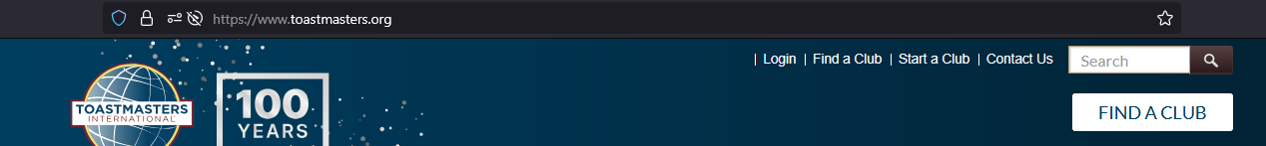
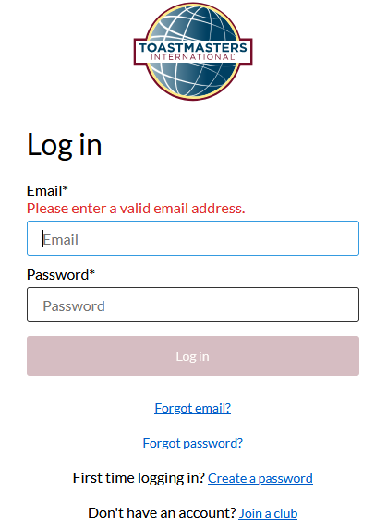
Toastmasters International | TMI
URL: Toastmasters.org

Slide 3
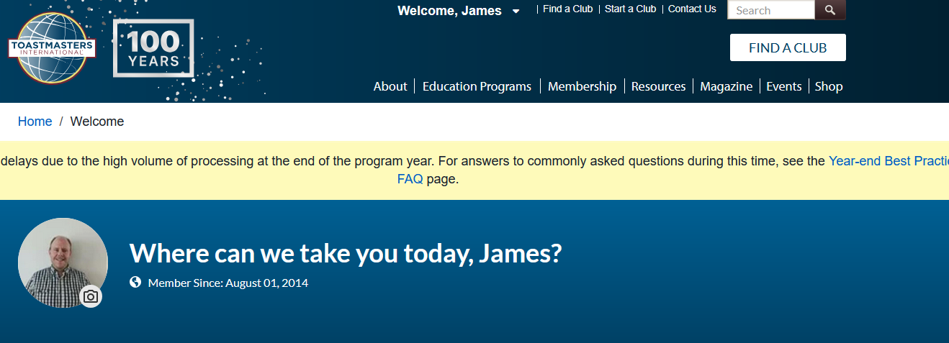
TMI | Logged-in

Slide 4
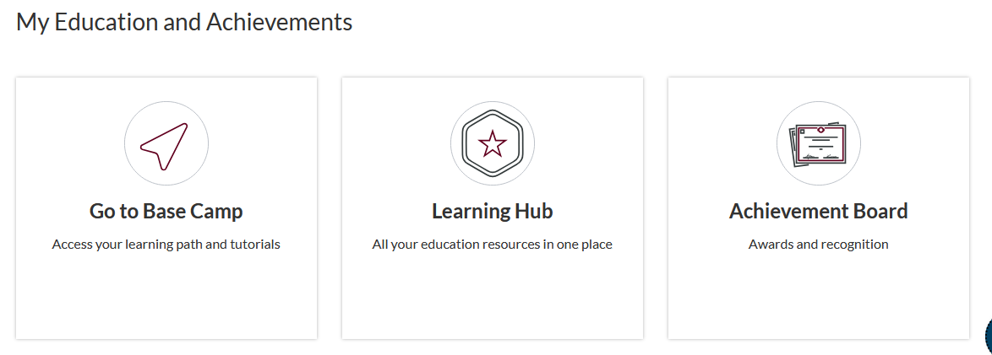
TMI | Pathways

Slide 5
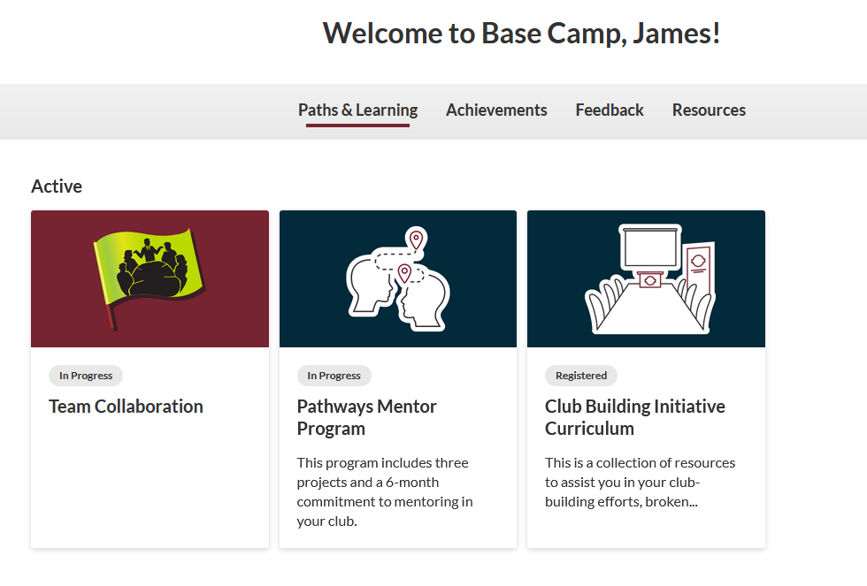
TMI | Pathways | Path Selection

Slide 6
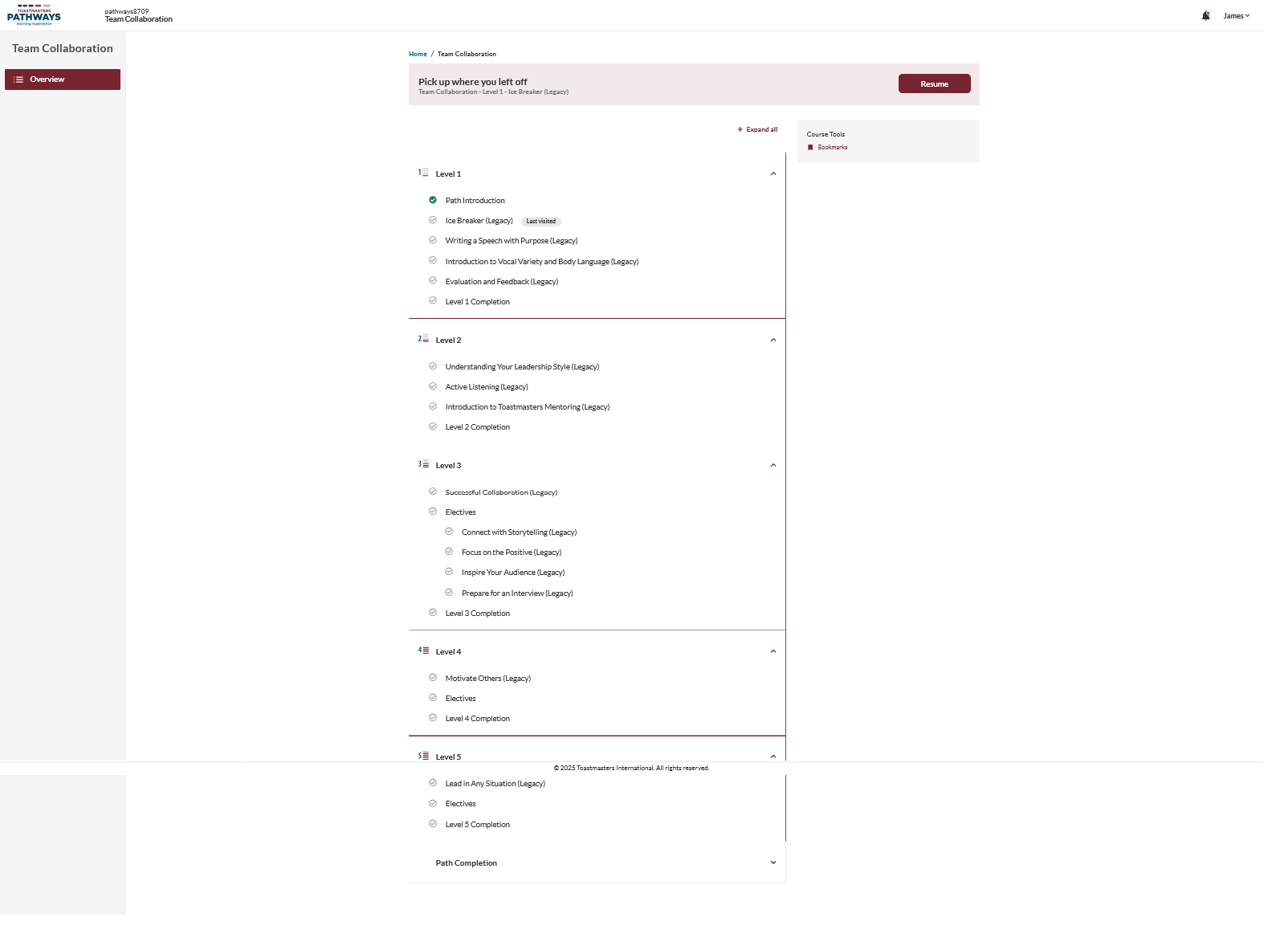
TMI | Pathways | Path overview

Slide 7
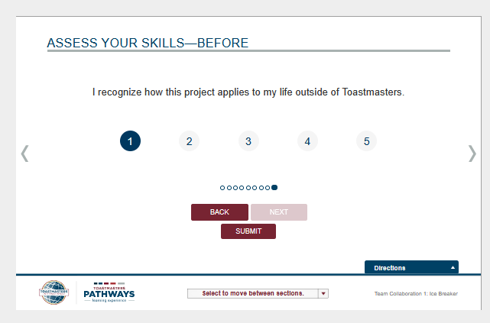
TMI | Pathways | Completing a project
TIP: Make sure to complete both skill assesements (paying particular attention to answering each question prior to selecting Next, otherwise the SUBMIT buttom will NOT appear) else it will NOT be counted.

Slide 8
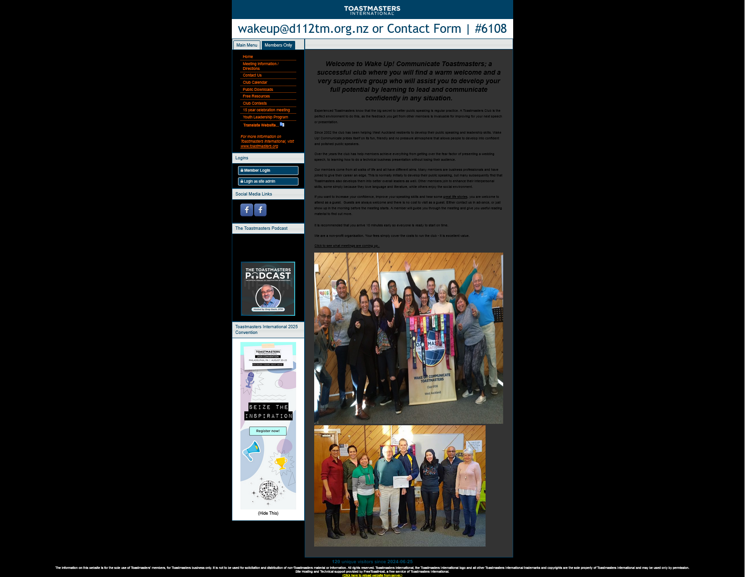
FreeToastHost (FTH)
TIP: Use the club number (less any leading zeros e.g 6108) rather than the club name. e.g. https://6108.toastmastersclubs.org/

Slide 9
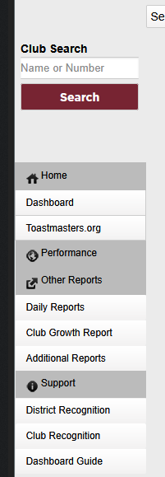
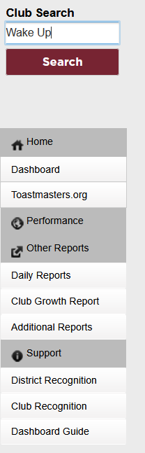
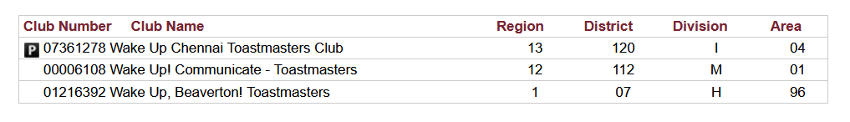
TI dashboard | https://dashboards.toastmasters.org/

