Slide 1

Automated Route Testing –MapQuest Mock API
Team Info – Aayush Humagain, Maria Akter, Carl Jomen

Slide 2

Project Overview & Purpose
Goal: Build a lightweight, offline route calculator for NSW.
Purpose: Simulate MapQuest with distance and travel time estimation.
Constraints: No API keys, no internet, mock data only.
Outcome: Fast, cost-free, and functional offline route testing tool.

Slide 3
System Design & Logic
How It Works:
User enters start and destination.
Program checks NSW dataset for valid route.
If route exists → calculates:
Travel Time = Distance / 80 km/h
Displays Distance & Estimated Time.
Technical Features:
Written in Python
Works fully offline
Uses mock dataset (dictionary lookup)
No dependency on Map APIs

Slide 4
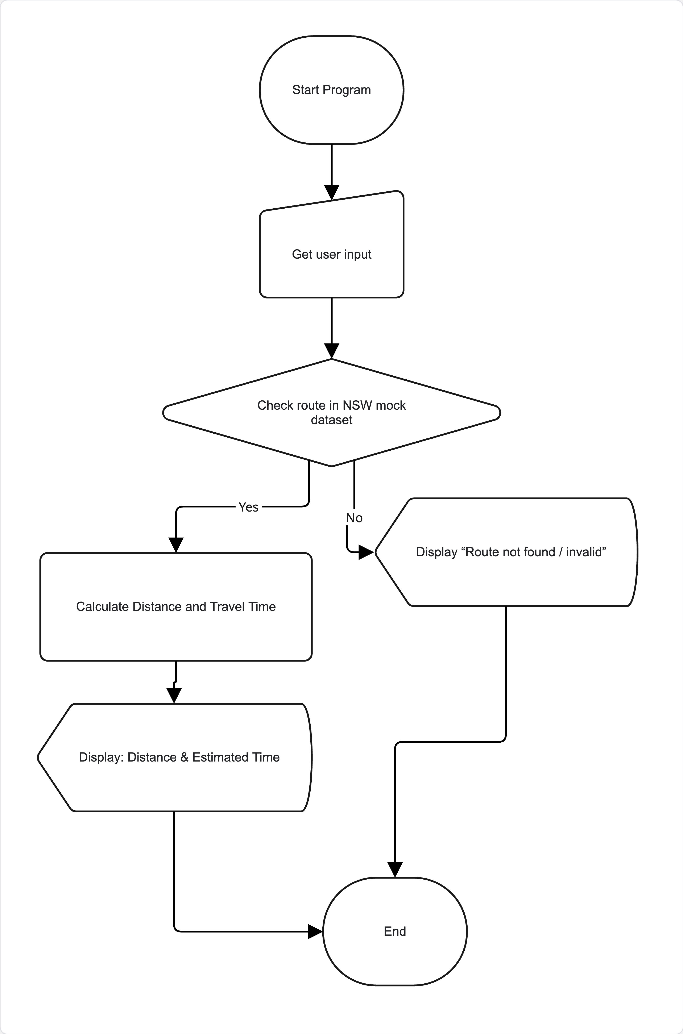
System Design & Logic (Cont.)

Slide 5

Technical Reflection
Developed strong understanding of data validation and input handling.
Enhanced skills in problem solving with limited resources.
Gained hands-on experience in GitHub version control and code reviews.

Slide 6
Automated Testing Overview
Framework: Python’s unittest
Objective: Ensure accuracy and reliability of distance logic.
Three Test Cases:
Valid Route → Sydney → Newcastle
Invalid Route → Nonexistent Path
Unknown Route → Empty Input

Slide 7
Test Results & Validation
Test Type | Input | Expected Output | Result
Valid Route | Sydney → Newcastle | 160 km, 2 hrs | ✅ Passed
Invalid Route | TownA → TownB | Error message | ✅ Passed
Empty Input | None | “Invalid Input” | ✅ Passed

Slide 8
Test Results & Validation (Cont.)
All tests passed successfully, confirming:
Reliable logic
Correct data handling
Error-free input management

Slide 9
Challenges & Problem Solving
Handling missing or malformed routes.
Managing testing paths in a mock dataset.
Ensuring all test cases run automatically with consistent results.
Reflection: Gained confidence in debugging, QA testing, and code analysis.

Slide 10
Program Demonstration
Demo Example:
  Input → Sydney → Newcastle
Output:
  Distance: 160 km
  Estimated Time: 2 hours
Offline Execution:
Instant processing
No API key / No internet
Reproducible results

Slide 11
Team Collaboration & Communication
Tools Used:
GitHub: Version control and issue tracking
Google Meet / Slack: Communication
Python: Shared code and testing
Team Reflection:
Aayush → Core logic & repository setup
Maria → Unit testing & debugging
Carl → Demo integration & presentation preparation

Slide 12
Team Collaboration & Communication (Cont.)
Collaboration Outcomes:
Improved teamwork and time management
Balanced workload
Learned agile coordination for academic projects

Slide 13

Future Enhancements & Reflection
Integrate real map API (OpenStreetMap).
Add GUI (Tkinter or PyQt).
Implement auto-suggest for place names.
Introduce real-time data like traffic conditions.
Future academic scope: expand dataset and use AI for route optimization.

Slide 14
Academic Impact
Demonstrates knowledge of:
  Software development lifecycle (SDLC)
  Testing methodologies
  Collaboration & documentation
Aligns with capstone outcomes:
  Critical thinking
  Communication
  Technical competency

Slide 15
Closing & Acknowledgment
GitHub: https://github.com/UserJomen/MapQuest-Enhancement-TeamInfo.git

Slide 16

Thank You
Question?

