Slide 1
Design and Evaluation of an Agentic AI-Driven Decision Support System for Explainable Early Disease Risk Detection in Companion Animals
Second Progress Review
Presented by: MTE Ranasinghe
Student ID: D/BIT/23/0025
Degree Programme: BSc (Hons) in Information Technology
Supervisor: Dr. (Mrs) N Wedasinghe
Co-Supervisor: Mr. BGL Balasuriya
Department: Department of Information Technology
University: General Sir John Kotelawala Defence University
Date: [ add presentation date ]
Notes:
Good morning. I am Tharushi Ranasinghe. This is my second progress review for my final year project on an agentic AI system that helps pet owners spot disease risk early. I will cover what I planned, what I have built, what the results show, and what is left.

Slide 2
Project Overview
Background · Problem · Aim · Objectives
02
• Background
– Pets cannot tell us what is wrong.
– Early signs are small and easy to miss.
• Problem
– Owners often notice too late.
– Late treatment costs more and hurts welfare.
– Existing apps only remind, they do not reason.
• Aim
– Build and evaluate an agentic AI system that finds
– early disease risk and explains its reasoning.
• Objectives
– 1. Find risk from owner-reported symptoms.
– 2. Train ML models for disease and risk level.
– 3. Add an agentic AI layer that reasons and acts.
– 4. Explain results: confidence and key symptoms.
– 5. Find nearby clinics and book appointments.
– 6. Track vaccinations and send reminders.
Notes:
The problem is simple. Pets hide illness. Owners see the signs late. Apps today only send reminders. My aim is a system that reasons on its own, explains why, and then helps the owner take action. The six objectives are unchanged from PR1 and all six are now built.

Slide 3
Literature Review Summary
Key findings and the gap
03
Area | What the literature shows | What is missing
AI in animal disease prediction | AI improves early detection | Built for surveillance, not owners
ML in animal healthcare | ML raises prediction accuracy | Mostly theory, no real mobile system
Veterinary decision support | AI can support vet decisions | Clinical only, not preventive
Chatbots in pet health | Chatbots help owner interaction | No autonomous reasoning
Sensor-based monitoring | Behaviour signals show health | Needs hardware; no symptom input
Dog health score systems | Scores agree with vet diagnosis | No reasoning or action guidance
• Research gap
– No owner-facing system that reasons on its own, explains why, and acts on the result.
– Nothing built for Sri Lanka or available in Sinhala and Tamil.
Notes:
I reviewed twelve studies. They agree AI works in animal health. But almost all of them are for vets, for livestock, or need sensors. None give the owner an explanation they can act on, and none work in Sinhala or Tamil. That is my gap.

Slide 4
Research Methodology
Approach · Design · Data · Tools
04
• Approach
– Design Science Research — build an artefact, then evaluate it.
• Development
– Agile, in short cycles. Each feature built and tested.
• Data collection
– Primary: 31 pet owner responses (symptom survey).
– Secondary: two public pet symptom datasets.
• Data analysis
– Accuracy, macro F1 and per-class F1.
– AI result compared with the vet's confirmed diagnosis.
• Tools and technologies
– React + TypeScript front end (installable web app).
– Node.js services and Python FastAPI for AI.
– MongoDB for data, Neo4j for the disease ontology.
– Docker Compose to run everything together.
Notes:
I follow Design Science Research: I build the system, then measure it. Development is agile. For data I used two public symptom datasets plus a survey of thirty one pet owners. I measure the models with accuracy and F1, and I also record what the vet actually diagnosed so I can compare AI against real outcomes.

Slide 5
System Analysis and Design
Requirements
05
• Functional requirements
– Register and log in securely.
– Create and manage pet profiles.
– Predict disease risk from symptoms.
– Agentic AI gives advice and urgency.
– Explain the result in plain words.
– Find clinics, surgeons and free time slots.
– Book, reschedule and cancel appointments.
– Track vaccinations and send reminders.
– Keep health history and notifications.
• Non-functional requirements
– Security — JWT login, role-based access.
– Privacy — a vet sees a pet only with a valid link.
– Usability — three languages: English, Sinhala, Tamil.
– Reliability — services recover on their own.
– Performance — result in a few seconds.
– Maintainability — separate services, shared types.
• Important rule
– Every result shows a decision-support disclaimer.
– The system supports decisions. It does not diagnose.
Notes:
Nine functional requirements, all implemented. On the non-functional side the two I want to highlight are privacy and the disclaimer. A vet cannot open a pet's records unless there is a real link — an appointment or the owner's consent. And every result carries a disclaimer, because this is decision support, not diagnosis.

Slide 6
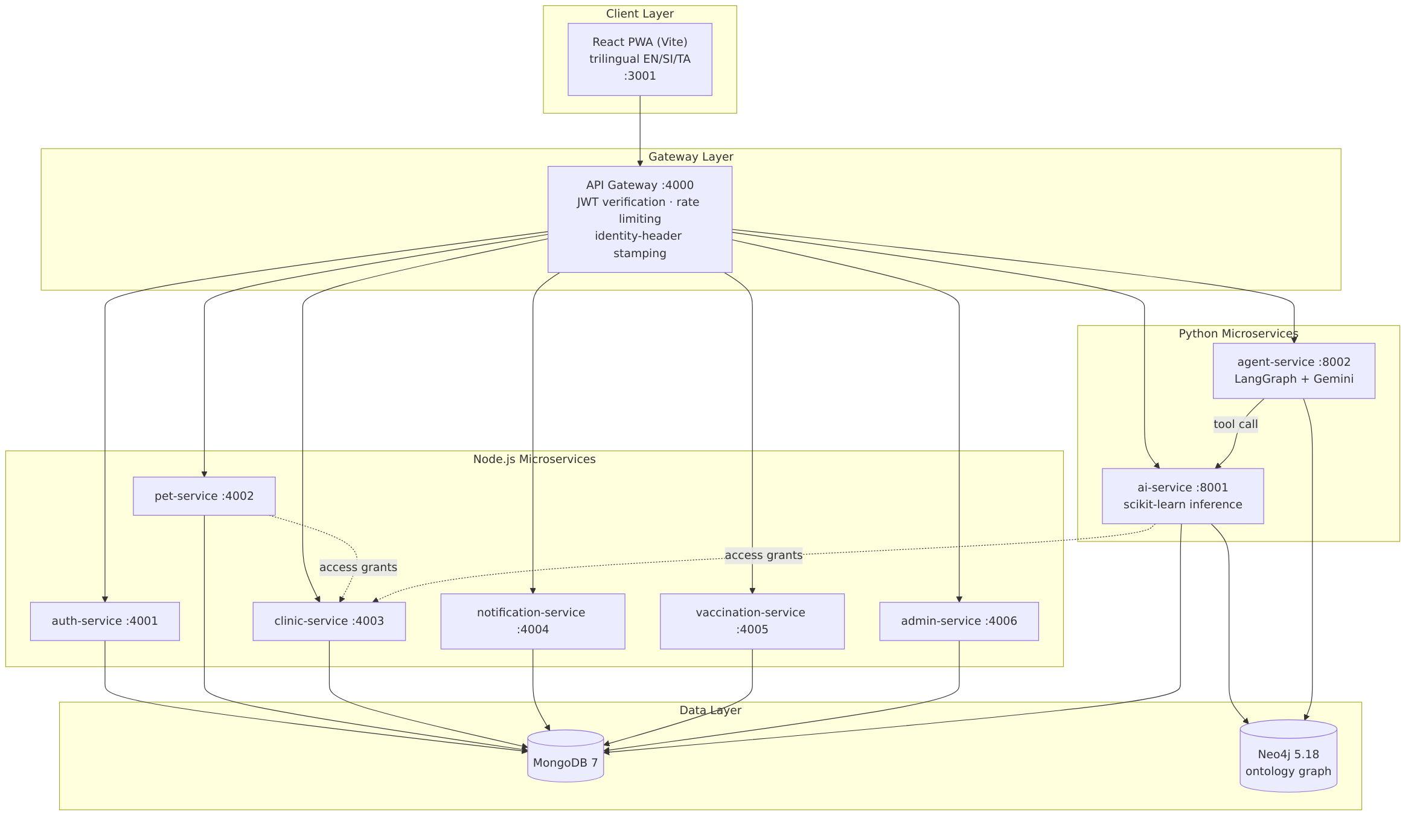
System Architecture
Micro-services behind one API gateway
06
Notes:
The front end talks to one API gateway. The gateway checks the login token and passes the request on. Node services handle users, pets, clinics, vaccinations and admin. Two Python services do the AI work. MongoDB stores the data and Neo4j stores the disease knowledge graph. Everything runs in Docker — thirteen containers.

Slide 7
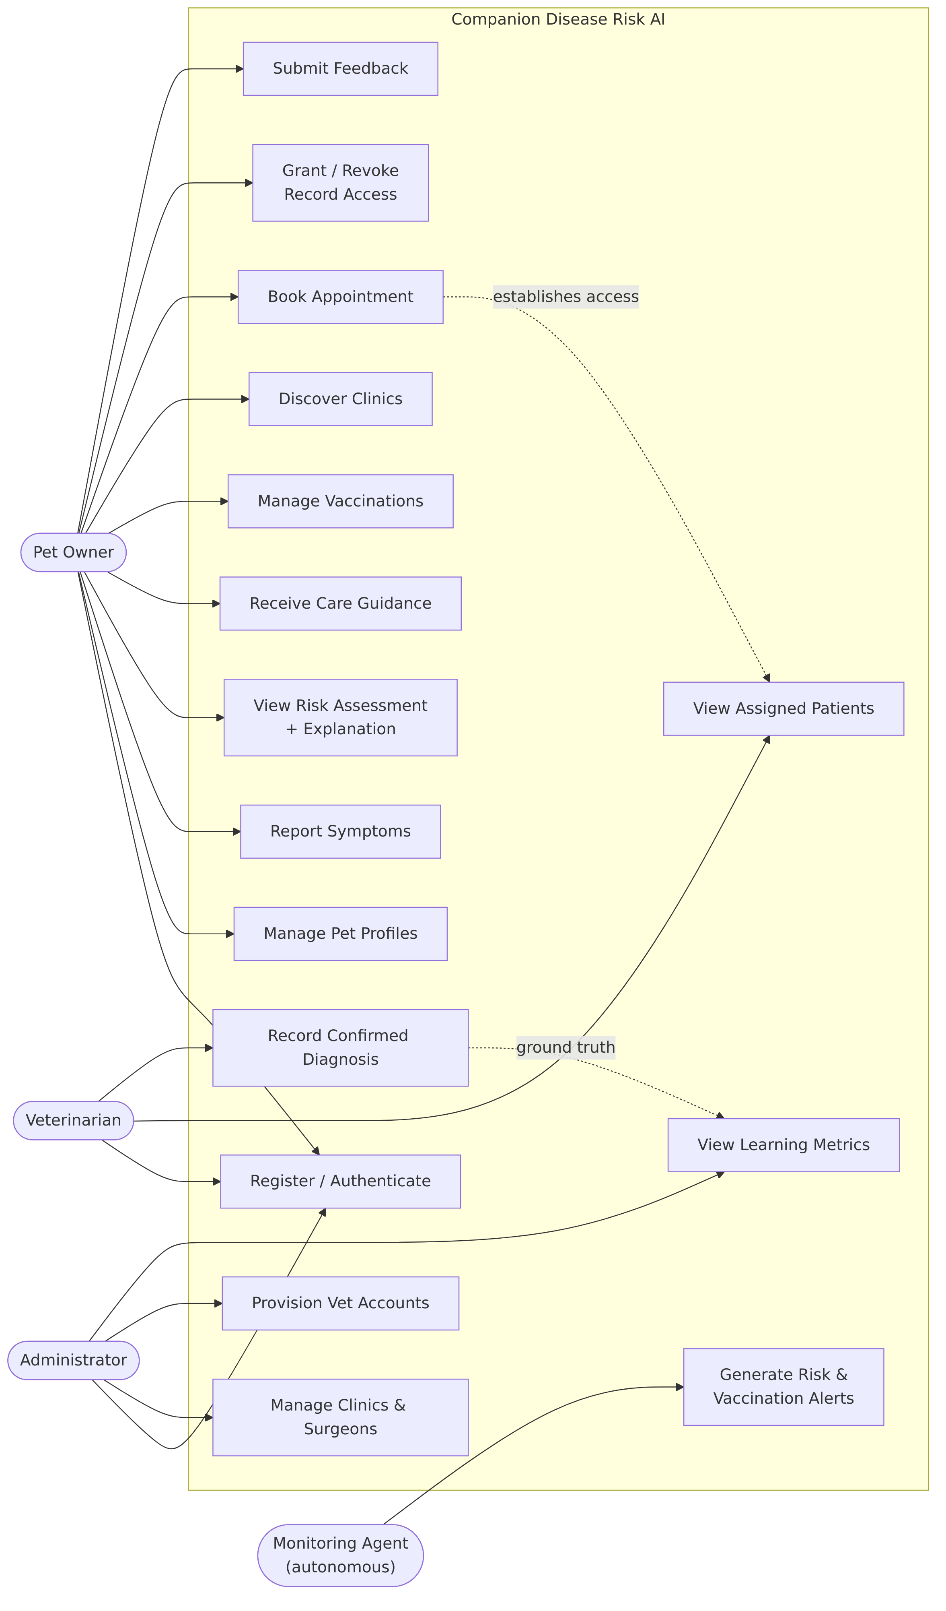
Use Case Diagram
Three roles: pet owner, veterinarian, administrator
07
Notes:
Three actors. The owner reports symptoms, sees the risk, books and tracks vaccinations. The vet sees patients they are linked to and confirms the real diagnosis. The admin manages clinics, vet accounts and approvals.

Slide 8
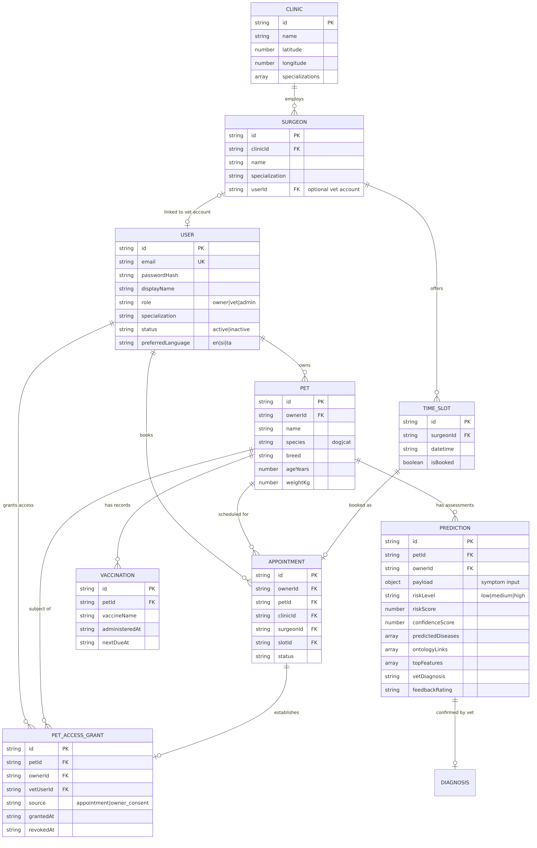
ER Diagram and Database Design
MongoDB collections and their links
08
Notes:
The main entities are User, Pet, Prediction, Appointment, Vaccination and Clinic. One extra table matters: the access grant, which records which vet may see which pet, and when that access started and ended.

Slide 9
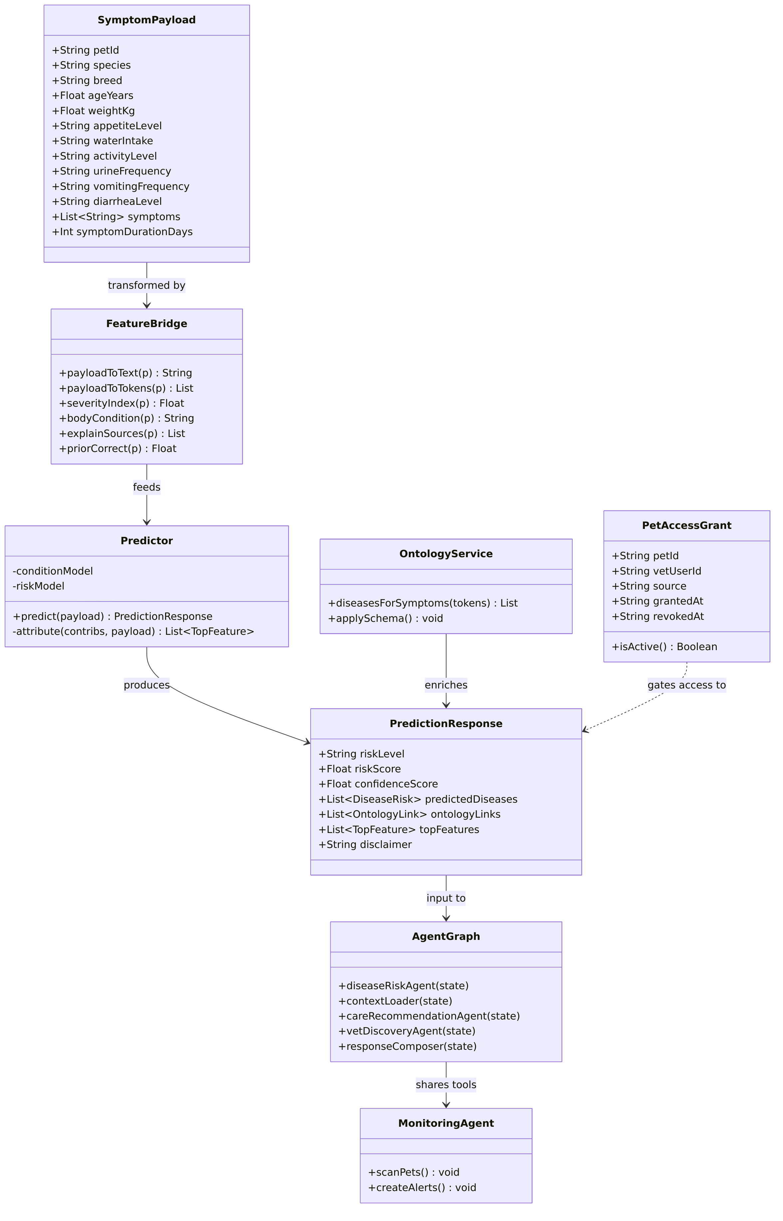
Class Diagram
Main classes and services
09
Notes:
This shows the main classes and how the services are organised in code.

Slide 10
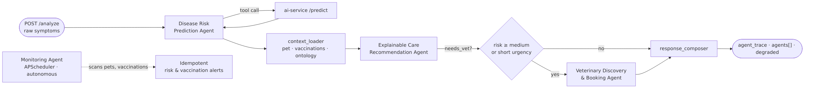
Agentic AI Pipeline
Four agents working together
10
Notes:
This is the agentic part. The first agent predicts the risk by calling the ML model. The second agent explains it and gives care advice. If the case needs a vet, a third agent finds and ranks clinics. A fourth agent runs in the background on a timer and creates alerts without anyone asking. The route through the graph is decided by the result, not fixed.

Slide 11
Development Progress
What is built and working
11
13
Docker containers
9
back-end services
3
role dashboards
3
languages (EN/SI/TA)
20 / 24
diseases / symptoms in ontology
• Modules completed
– Login, registration, role-based access.
– Pet profiles and health history.
– Symptom form and risk prediction.
– Explanation of every result.
– Clinic map, booking, cancel and reschedule.
– Vaccination tracking and reminders.
– Owner–vet inquiry messaging.
– Admin approvals, tickets and audit log.
• Technologies used
– React, TypeScript, Tailwind, installable PWA.
– Node.js + Express micro-services.
– Python FastAPI, scikit-learn, LangGraph, Gemini.
– MongoDB, Neo4j, Docker Compose.
• Version control
– Git and GitHub, committed after each feature.
Notes:
All nine functional requirements are built and running. The whole stack starts with one docker compose command — thirteen containers. Everything is in Git and pushed to GitHub after each feature.

Slide 12
Prototype — How the System Works
One journey, start to finish
12
1. Owner adds pet
2. Answers symptom form
3. ML predicts risk
4. Agents explain + advise
5. Clinic suggested
6. Book appointment
7. Reminders continue
PASTE SCREENSHOTS HERE Suggested: (1) symptom form (2) risk result with explanation (3) clinic map and booking
Notes:
This is the full journey. The owner adds a pet, answers a short form about appetite, water, activity and symptoms. The model predicts. The agents explain it and say how urgent it is. If a vet is needed, a clinic is suggested with a free slot, and the owner books. After that, reminders keep going. I will now show this live.

Slide 13
Explainability
The owner can see why
13
• What the owner sees
– The risk level and a confidence score.
– Top 3 possible conditions with probabilities.
– Which answers pushed the result up or down.
– Known symptom-to-disease links from the ontology.
• Why this matters
– An owner will not act on a number they do not trust.
– A vet can check the reasoning, not just the answer.
PASTE SCREENSHOT HERE The 'What led to this result' panel
Notes:
Explainability was a specific objective. The system shows the confidence, the top three conditions, and which of the owner's answers mattered most. Early on this showed raw word fragments like 'has' and 'less', which confused people, so I changed it to show whole form answers such as 'water intake: increased'.

Slide 14
Current Results — Model Performance
Measured, not estimated
14
90.3%
Model A accuracy
0.907
Model A macro F1
11
conditions predicted
4,160/1,040
train / test rows
0.964
Model B ROC-AUC
Condition | F1 | Data source
Skin Irritations | 0.77 | Real dataset
Parasites | 0.80 | Real dataset
Ear Infections | 0.80 | Real dataset
Mobility Problems | 0.81 | Real dataset
Digestive Issues | 0.87 | Real dataset
Diabetes, Heart, Liver, Pancreatitis | 1.00 | Knowledge-generated
Cancer, Chronic Kidney Disease | 0.97 | Knowledge-generated
Notes:
Model A reaches ninety point three percent accuracy over eleven conditions. But I want to be honest about that number. The six chronic classes score near one because their training rows were generated from veterinary knowledge, not collected. The five classes from the real dataset sit between zero point seven seven and zero point eight seven, and they confuse with each other. So I quote the per-class numbers, not just the headline.

Slide 15
Current Results — Testing
Manual and automated
15
123
manual test cases
82
passed
2
failed
97.6%
pass rate (executed)
53
automated tests pass
• How I tested
– A test workbook of 123 cases across every module.
– Each case has steps, expected result and actual result.
– 39 cases are still to run.
– Automated: 19 AI-service, 27 agent-service, 7 gateway.
• What testing found
– Vaccination records could not be edited — fixed.
– Booking confirmed with no confirmation step — fixed.
– Vet reply saved no message — fixed.
– Any vet could read any inquiry — fixed.
• Feedback loop is live
– Vets confirm the real diagnosis in the system.
– AI-vs-vet agreement is shown on the admin panel.
Notes:
I wrote a test workbook of one hundred and twenty three cases and I am working through it by hand. Eighty two pass, two fail, thirty nine still to run. Testing found real defects and I fixed each one. There are also fifty three automated tests, and all of them pass.

Slide 16
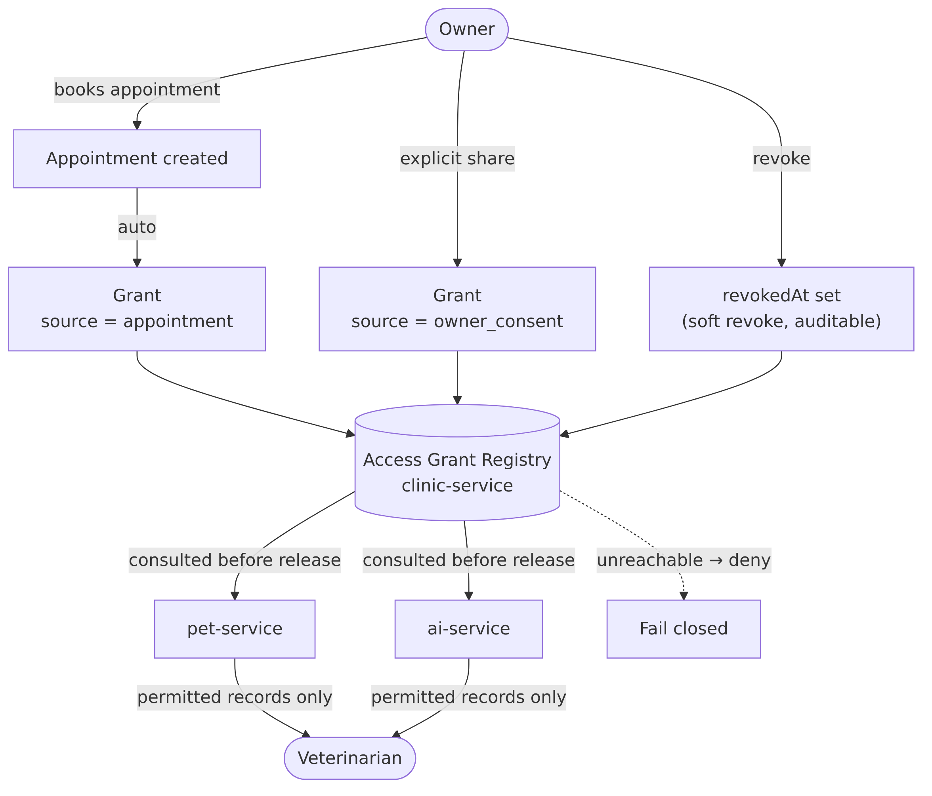
Privacy — Relationship-Based Access Control
A vet sees a pet only when there is a real link
16
• Access comes from an appointment or the owner's consent. The owner can withdraw it at any time.
– Checks are in the services, not the screen. If the check cannot run, access is refused.
Notes:
This was the biggest security fix of this stage. Before, any vet could open any pet's records. Now a vet needs a real relationship: either the owner booked with them, or the owner shared the records. The owner can take that back. And the check happens in the back end, not the screen, so hiding a button is not what protects the data.

Slide 17
Challenges and Solutions
Technical and research
17
Challenge | What I did
The disease graph loaded before the database was ready, so it was empty. | Added a health check and a background retry until it connects.
Explanations showed word pieces like 'has' and 'less'. Users were confused. | Grouped them into whole form answers, e.g. 'water intake: increased'.
Any veterinarian could open any pet's health records. | Built relationship-based access control that fails closed.
The risk dataset is 97.7% 'dangerous', so a label would always say dangerous. | Used it as a calibrated probability only, never a yes/no label. Stated as a limitation.
Planned Vertex AI, Google Maps and Firebase messaging needed paid billing. | Used Gemini API, OpenStreetMap and in-app notifications instead.
• Lesson learned: test the boring paths. Most defects were in restart, delete and cancel — not in the AI.
Notes:
Five real challenges. The one I would highlight is the risk dataset. Almost ninety eight percent of its rows are labelled dangerous, so a model trained on it would just say dangerous every time. Rather than hide that, I use it only as a probability and I state it openly as a limitation. The lesson overall: most of my defects were not in the AI, they were in restart, delete and cancel.

Slide 18
Remaining Work
What is left before submission
18
• Features to complete
– Run the remaining 39 test cases.
– Close the deactivated-vet login gap.
– Archive old risk assessments instead of deleting.
– Final accessibility and mobile polish.
• Testing and validation
– User testing with real pet owners.
– Collect vet-confirmed diagnoses for AI-vs-vet agreement.
• Documentation
– Final dissertation chapters.
– Updated diagrams and test evidence.
– User manual and deployment guide.
• Final steps
– Full system evaluation against the objectives.
– Viva preparation.
Notes:
What is left is mainly evaluation and writing. Thirty nine test cases still to run, user testing with real owners, and collecting enough vet-confirmed diagnoses to report the AI-versus-vet agreement rate properly. Then the dissertation.

Slide 19
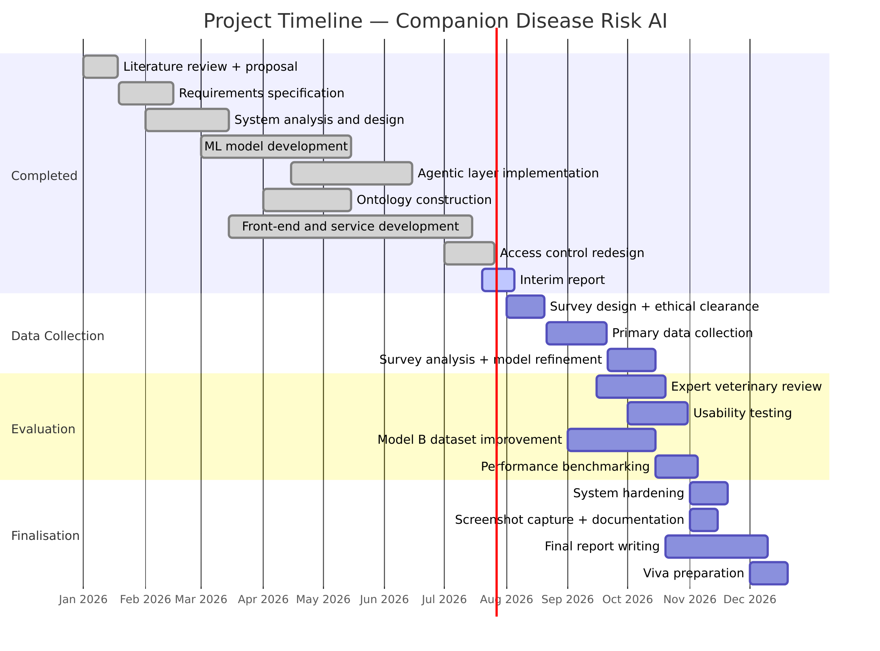
Project Timeline
Milestones completed and remaining schedule
19
• Completed: proposal, literature review, requirements, design, full implementation, interim report, PR2 testing.
– Remaining: user testing, evaluation, dissertation, viva.
Notes:
I am on schedule. Proposal, literature, design and implementation are done, the interim report is submitted, and I am now in the testing and evaluation phase.

Slide 20
Conclusion
Summary of progress
20
• All six objectives are implemented and running end to end.
– Model A predicts 11 conditions at 90.3% accuracy; per-class results are reported honestly.
– The agentic layer reasons, explains, recommends and monitors on its own.
– Explanations are in plain words, in three languages.
– Privacy is enforced by real relationships, not by hiding buttons.
• Tested: 82 of 84 executed manual cases pass, plus 53 automated tests.
• The system supports decisions. It never claims to diagnose.
• Expected completion: final dissertation and viva at the end of the academic year.
Notes:
To summarise: all six objectives are built and working. The models are measured and I report their weaknesses as well as their strengths. The agentic layer reasons and acts on its own. And throughout, the system is decision support — it never claims to diagnose. Thank you.

Slide 21
References
IEEE style
21
[1] S. C. Kim and S. Kim, "Development of a Dog Health Score Using an Artificial Intelligence Disease Prediction Algorithm Based on Multifaceted Data," Animals, vol. 14, no. 2, Jan. 2024.
[2] D. Szlosek et al., "Development and validation of a machine learning model for clinical wellness visit classification in cats and dogs," Front. Vet. Sci., vol. 11, 2024.
[3] S. Das, R. K. Roy, and T. Bezboruah, "Machine Learning in Animal Healthcare: A Comprehensive Review," Int. J. Recent Eng. Sci., vol. 11, no. 3, pp. 89–93, Jun. 2024.
[4] M. Jokar, A. Abdous, and V. Rahmanian, "AI chatbots in pet health care: Opportunities and challenges for owners," Vet. Med. Sci., May 2024.
[5] C. A. Aguilar-Lazcano et al., "Machine Learning-Based Sensor Data Fusion for Animal Monitoring: Scoping Review," Sensors, vol. 23, no. 12, Jun. 2023.
[6] J. Imada et al., "Comparison of Machine Learning Tree-Based Algorithms to Predict Future Paratuberculosis ELISA Results Using Repeat Milk Tests," Animals, vol. 14, no. 7, Apr. 2024.
[7] S. Eman et al., "Technologies in Biomarker Discovery for Animal Diseases," Animals, vol. 15, no. 21, Nov. 2025.
[8] J. Rathi and A. Sumathi, "Animal Health Prediction Using Hybrid KNN Based Vector Neighbor Classification Model," J. Comput. Sci., vol. 21, no. 9, pp. 2088–2095, Sep. 2025.
[9] F. Bouchemla et al., "Artificial intelligence feasibility in veterinary medicine: A systematic review," Vet. World, vol. 16, no. 10, pp. 2143–2149, 2023.
[10] A. AP, "PAWPAL: AI-Based Pet Health Assistance System Using Image-based Disease Detection and NLP Symptom Analysis," Int. J. Res. Appl. Sci. Eng. Technol., vol. 13, no. 12, pp. 2065–2072, Dec. 2025.
Notes:
These are the key references, in IEEE style. The full list is in the interim report.

Slide 22
Thank You
Questions?
Notes:
Thank you for your time. I am happy to take questions.
Likely questions and short answers:
• Why is accuracy so high? Six of the eleven classes use knowledge-generated rows. The five real-data classes sit at 0.77 to 0.87, and I report both.
• Is this a diagnosis? No. Every result carries a decision-support disclaimer.
• What makes it agentic? The route through the pipeline is decided by the result, and a fourth agent runs on a timer with no user request.
• How is privacy handled? A vet needs an appointment or the owner's consent, checked in the back end, and it fails closed.

