Slide 1

Road Damage Detection using Yolo v7 Object Detection Technique
DEPARTMENT OF INFORMATION TECHNOLOGY AND COMPUTER APPLICATIONS,ANDHRA UNIVERSITY,VISAKHAPATNAM
Presented by
K. Siva Durga Prasad
2/2 M.Sc(Computer Science)
Regd no: 421206421022
Guided by
Dr. Kondapalli Venkata Ramana

Slide 2
CONTENT
Abstract
Introduction
Necessity
Understanding The Problem
Object Detecion
What is YOLO?
What’s new with YOLO V7?
Limitations of YOLO V7
Custom Training with YOLOv7
Assemble Our Dataset
Training Custom pretrained YOLOv7 model
Project Methodology
Flow chart of system
Architecture of the Model
Results

Slide 3
ABSTRACT
The goal of our project is to design a pothole detection system which assists the driver in avoiding potholes on the roads, by giving him prior warnings. Due to weather conditions , improper construction and overloading of vehicles the roads are getting damaged. The scope of the project lies , where the irregularity of the road affects public people. This can be used in 4 wheelers, especially for ambulance drivers so that they could save many lives in time.Road damage poses significant safety risks and maintenance costs to transportation systems worldwide. Timely and accurate detection of road defects is crucial for effective infrastructure management and ensuring the safety of road users. In recent years, deep learning techniques have shown promising results in computer vision tasks, including object detection, making them suitable for road damage detection. This paper presents a novel approach for road damage detection using YOLOv7, an advanced version of the popular You Only Look Once (YOLO) object detection framework.

Slide 4
INTRODUCTION
Roads are the dominant means of transportation in India today
01
Pothole is a type of disruptions or disturbance in the surface of road way where a portion of the road material as broken away, leaving a hole
02
Also defined as cavity in a road surface having diameter of 150mm or more depth of 25mm and more
03
Heavy rains and movement of vehicles are the main reason for the formation of potholes etc...
04

Slide 5
NECESSITY
classification | Total accidents | Pothole related | Rate%
The number of compensation | 3625 | 1760 | 70.15%
According to the survey report "Road accidents in India, 2022", 15645 crashes and 4500 people died in accidents due to potholes
Table Accidents for 6 years (2017-2022)

Slide 6
UNDERSTANDING THE PROBLEM
Friction between the vehicles tires and the road surface heats up and causes the road to expand. This expansion results in the formation of cracks in the roadway surface over time. This allows water to seep through the cracks, and causes pothole.
Potholes make a ride bumpy that can be risky. Potholes can generate damage such as flat tire and wheel damage, impact and damage of lower vehicle, vehicle collision, cause wheel alignment issues, and causes major accidents.

Slide 7
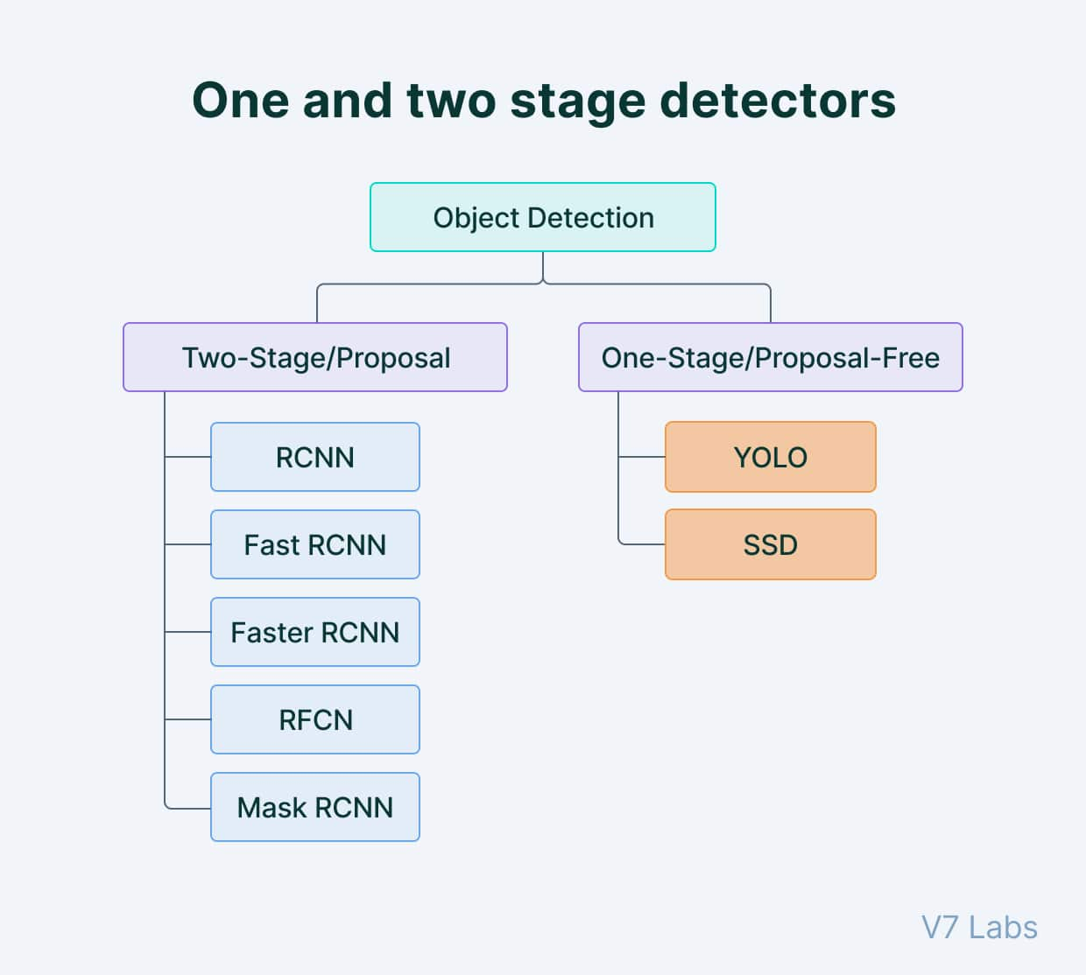
OBJECT DETECTION
Object detection is a key technology behind advanced driver assistance systems (ADAS) that enable cars to detect driving lanes or perform pedestrian detection to improve road safety. Object detection is also useful in applications such as video surveillance or image retrieval systems.
You can use a variety of techniques to perform object detection. Popular deep learning–based approaches using convolutional neural networks (CNNs), such as R-CNN and YOLO v2, automatically learn to detect objects within images.

Slide 8
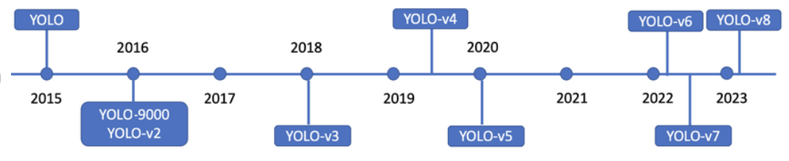
WHAT IS YOLO?
You Only Look Once (YOLO) proposes using an end-to-end neural network that makes predictions of bounding boxes and class probabilities all at once.
It differs from the approach taken by previous object detection algorithms, which repurposed classifiers to perform detection.
The YOLO algorithm takes an image as input and then uses a simple deep convolutional neural network to detect objects in the image.

Slide 9
WHAT’S NEW WITH YOLO V7?
YOLO v7, the latest version of YOLO, has several improvements over the previous versions. One of the main improvements is the use of anchor boxes.
Anchor boxes are a set of predefined boxes with different aspect ratios that are used to detect objects of different shapes. YOLO v7 uses nine anchor boxes, which allows it to detect a wider range of object shapes and sizes compared to previous versions, thus helping to reduce the number of false positives.
One of the main advantages of YOLO v7 is its speed. It can process images at a rate of 155 frames per second, much faster than other state-of-the-art object detection algorithms. Even the original baseline YOLO model was capable of processing at a maximum rate of 45 frames per second.

Slide 10
LIMITATIONS OF YOLO V7
YOLO v7, like many object detection algorithms, struggles to detect small objects. It might fail to accurately detecting objects in crowded scenes or when objects are far away from the camera.
YOLO v7 is also not perfect at detecting objects at different scales. This can make it difficult to detect objects that are either very large or very small compared to the other objects in the scene.
YOLO v7 can be sensitive to changes in lighting or other environmental conditions
YOLO v7 can be computationally intensive, which can make it difficult to run in real-time on resource-constrained devices like smartphones or other edge devices.

Slide 11
Custom Training with YOLOv7 In this Notebook, I have processed the images with RoboFlow because in Road formatted dataset was having different dimensions of image and Also data set was not splitted into different Format. To train a custom YOLOv7 model we need to recognize the objects in the dataset. To do so I have taken the following steps:
Export
Export the dataset to YOLOv7
Train
Train YOLOv7 to recognize the objects in our dataset
Evaluate
Evaluate our YOLOv7 model's performance
Run
Run test inference to view performance of YOLOv7 model at work

Slide 12

Assemble Our Dataset
In order to train our custom model, we need to assemble a dataset of representative images with bounding box annotations around the objects that we want to detect. And we need our dataset to be in YOLOv7 format.
In Roboflow, We can choose between two paths:
Convert an existing Road dataset to YOLOv7 format. In Roboflow it supports over 30 formats object detection formats for conversion.
Uploading only these raw images and annotate them in Roboflow with Roboflow Annotate

Slide 13
Training Custom pretrained YOLOv7 model
Here, I am able to pass a number of arguments:
batch: determine batch size
cfg: define input Config File into YOLOv7
epochs: define the number of training epochs. (Note: often, 3000+ are common here nut since I am using free GPU of kaggle I will be only defining it to 30!)
data: Our dataset locaiton is saved in the ./yolov7/Custom-Yolov7-on-Kaggle-on-Custom-Dataset-2 folder.
weights: specifying a path to weights to start transfer learning from. Here I have choosen a generic Road pretrained checkpoint.
device: Setting GPU for faster training

Slide 14
Project Methodology
We used a dataset of 3000+ road damage images which contains the bounding box of each class for the eight types of road damage. Furthermore, we showed that the type of damage from among the eight types can be identified with high accuracy. To build a model using YOLO according to our requirement.
Steps given below were followed to make our project
Step 1: Installation of pandas,os,wandb and numpy
Step 2: Selecting the Desired Algorithm i.e. Tiny YOLO
Step 3: Collecting data and annotations
Step 4: Modifying Model
Step 5: Running and deploying the model

Slide 15
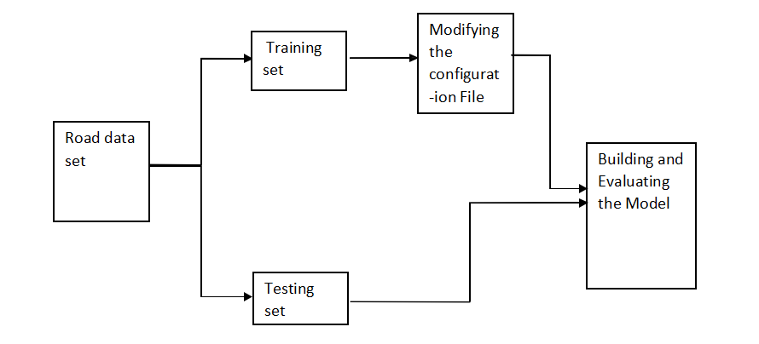
Flow chart of system

Slide 16
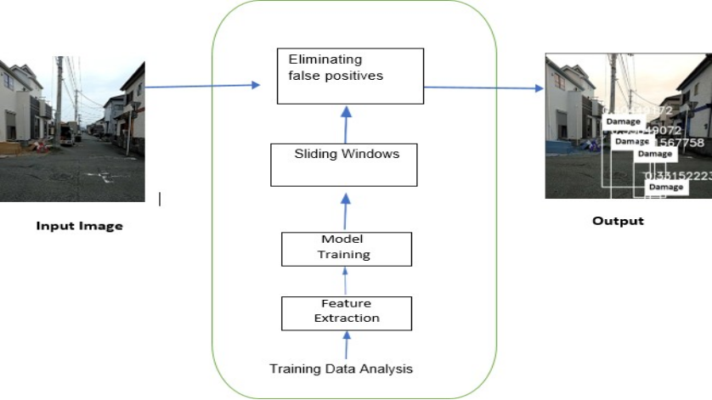
Architecture of the Model

Slide 17
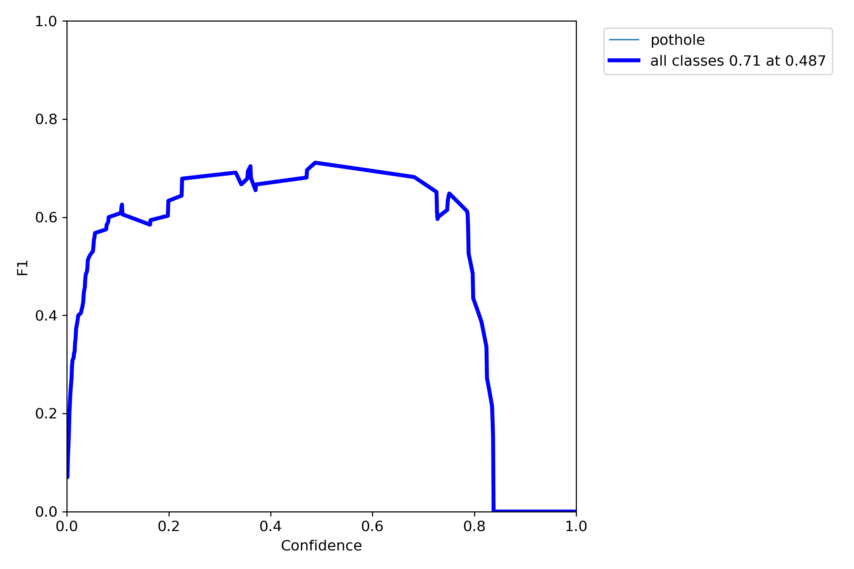
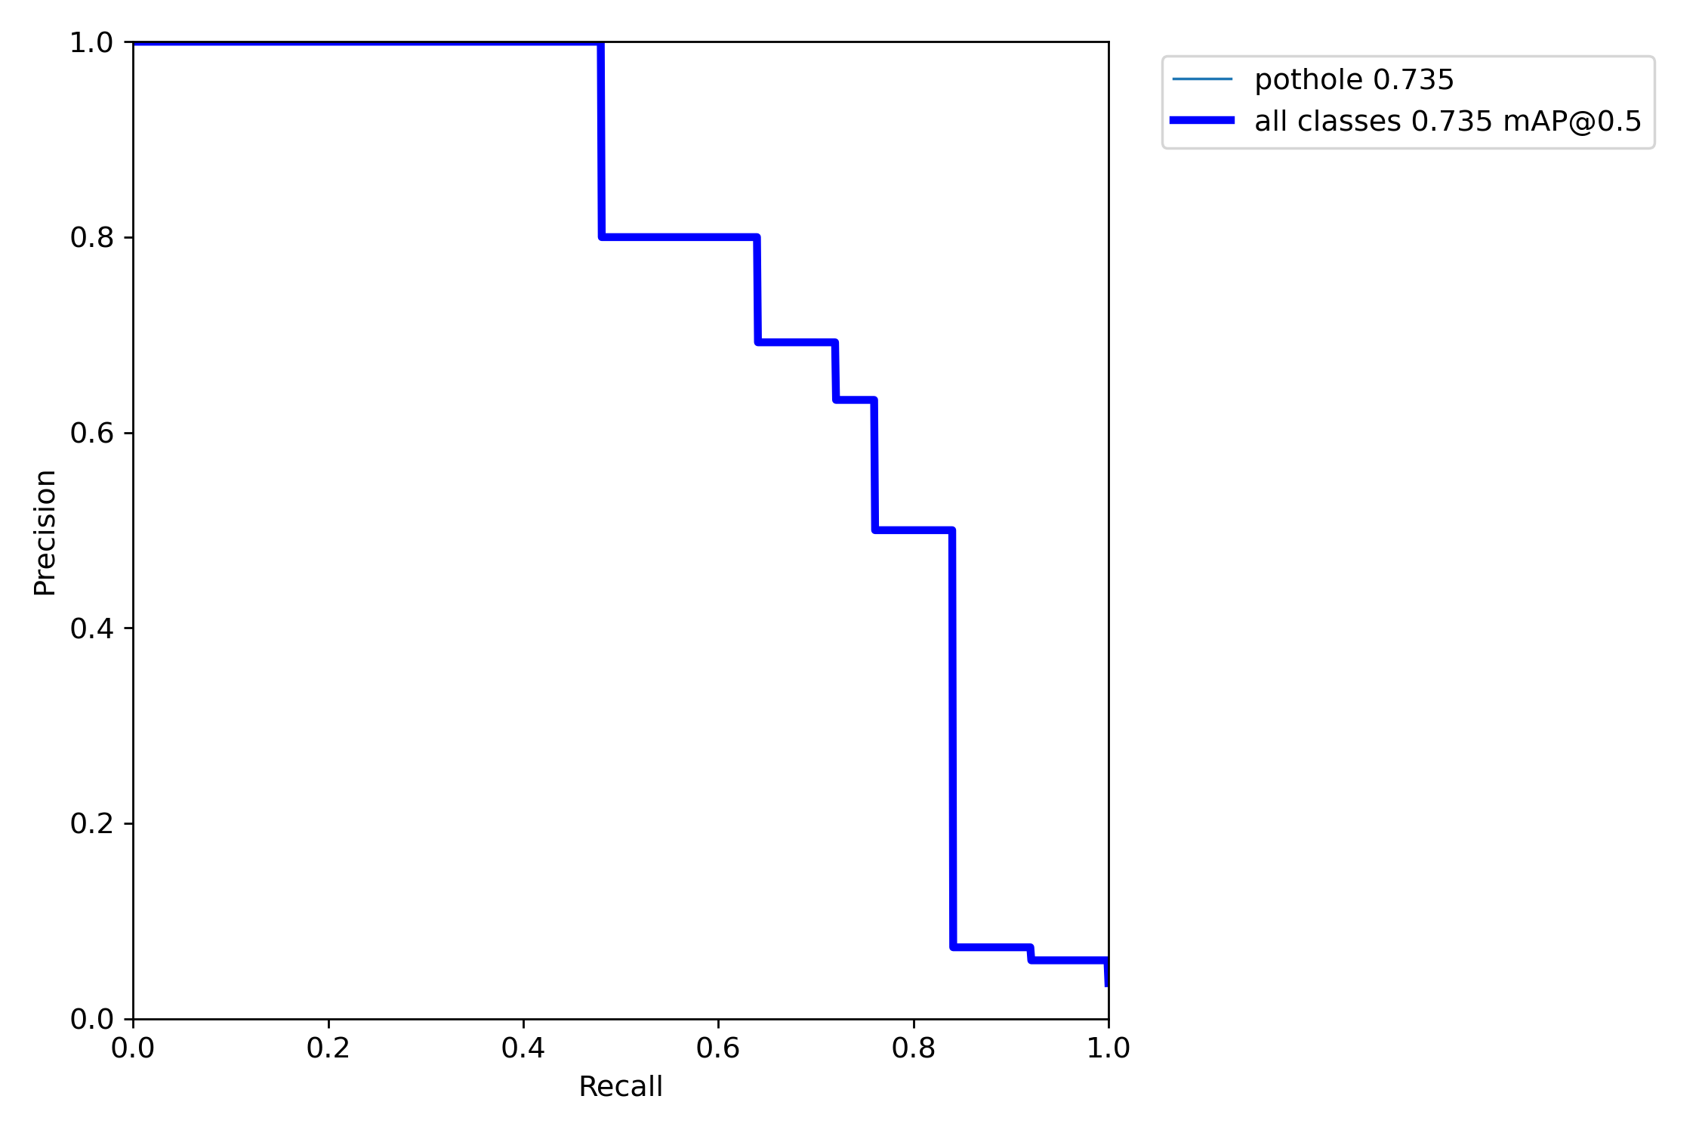
Results
F1 curve in a road damage detection project helps in understanding the model's performance across different classification levels
Precision-recall curve—This is a plot of precision (y-axis) and recall (x-axis), and it serves as an evaluation of the performance of an object detection model. The model is considered a good predictive model if the precision stays high as the recall increases.
F1 curve
PR curve

Slide 18
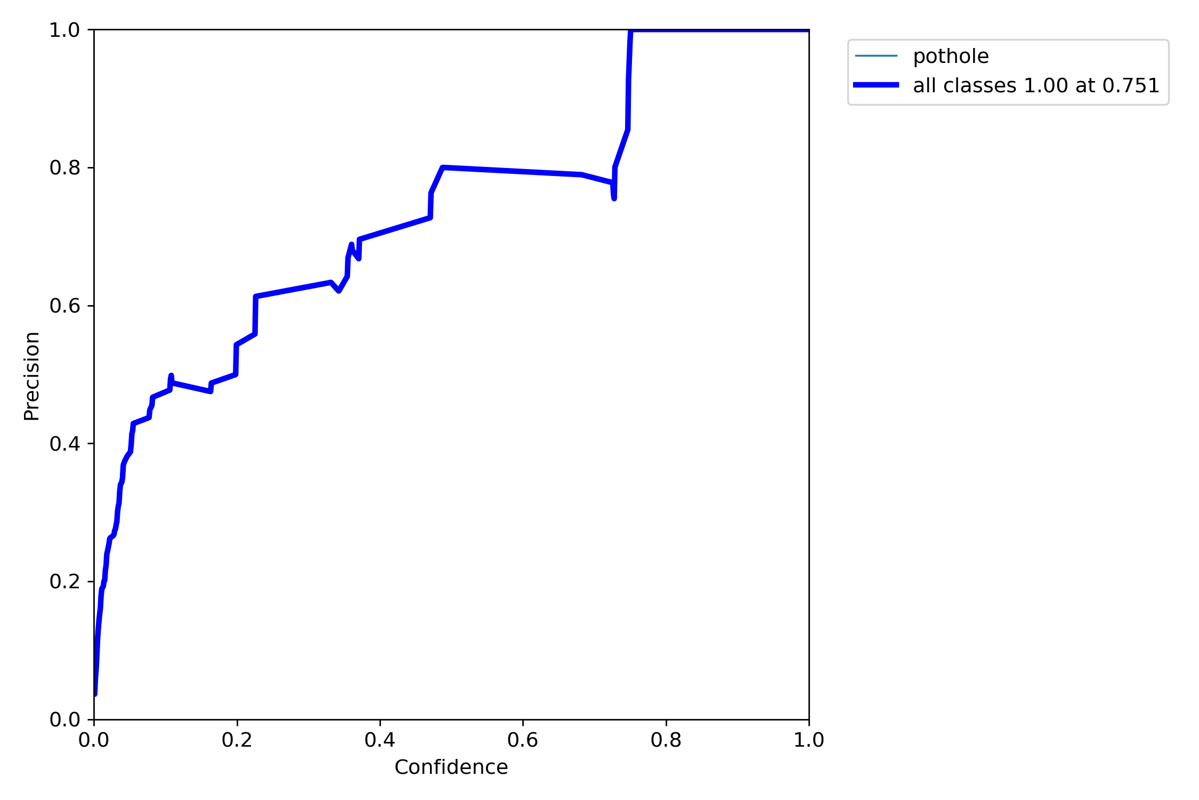
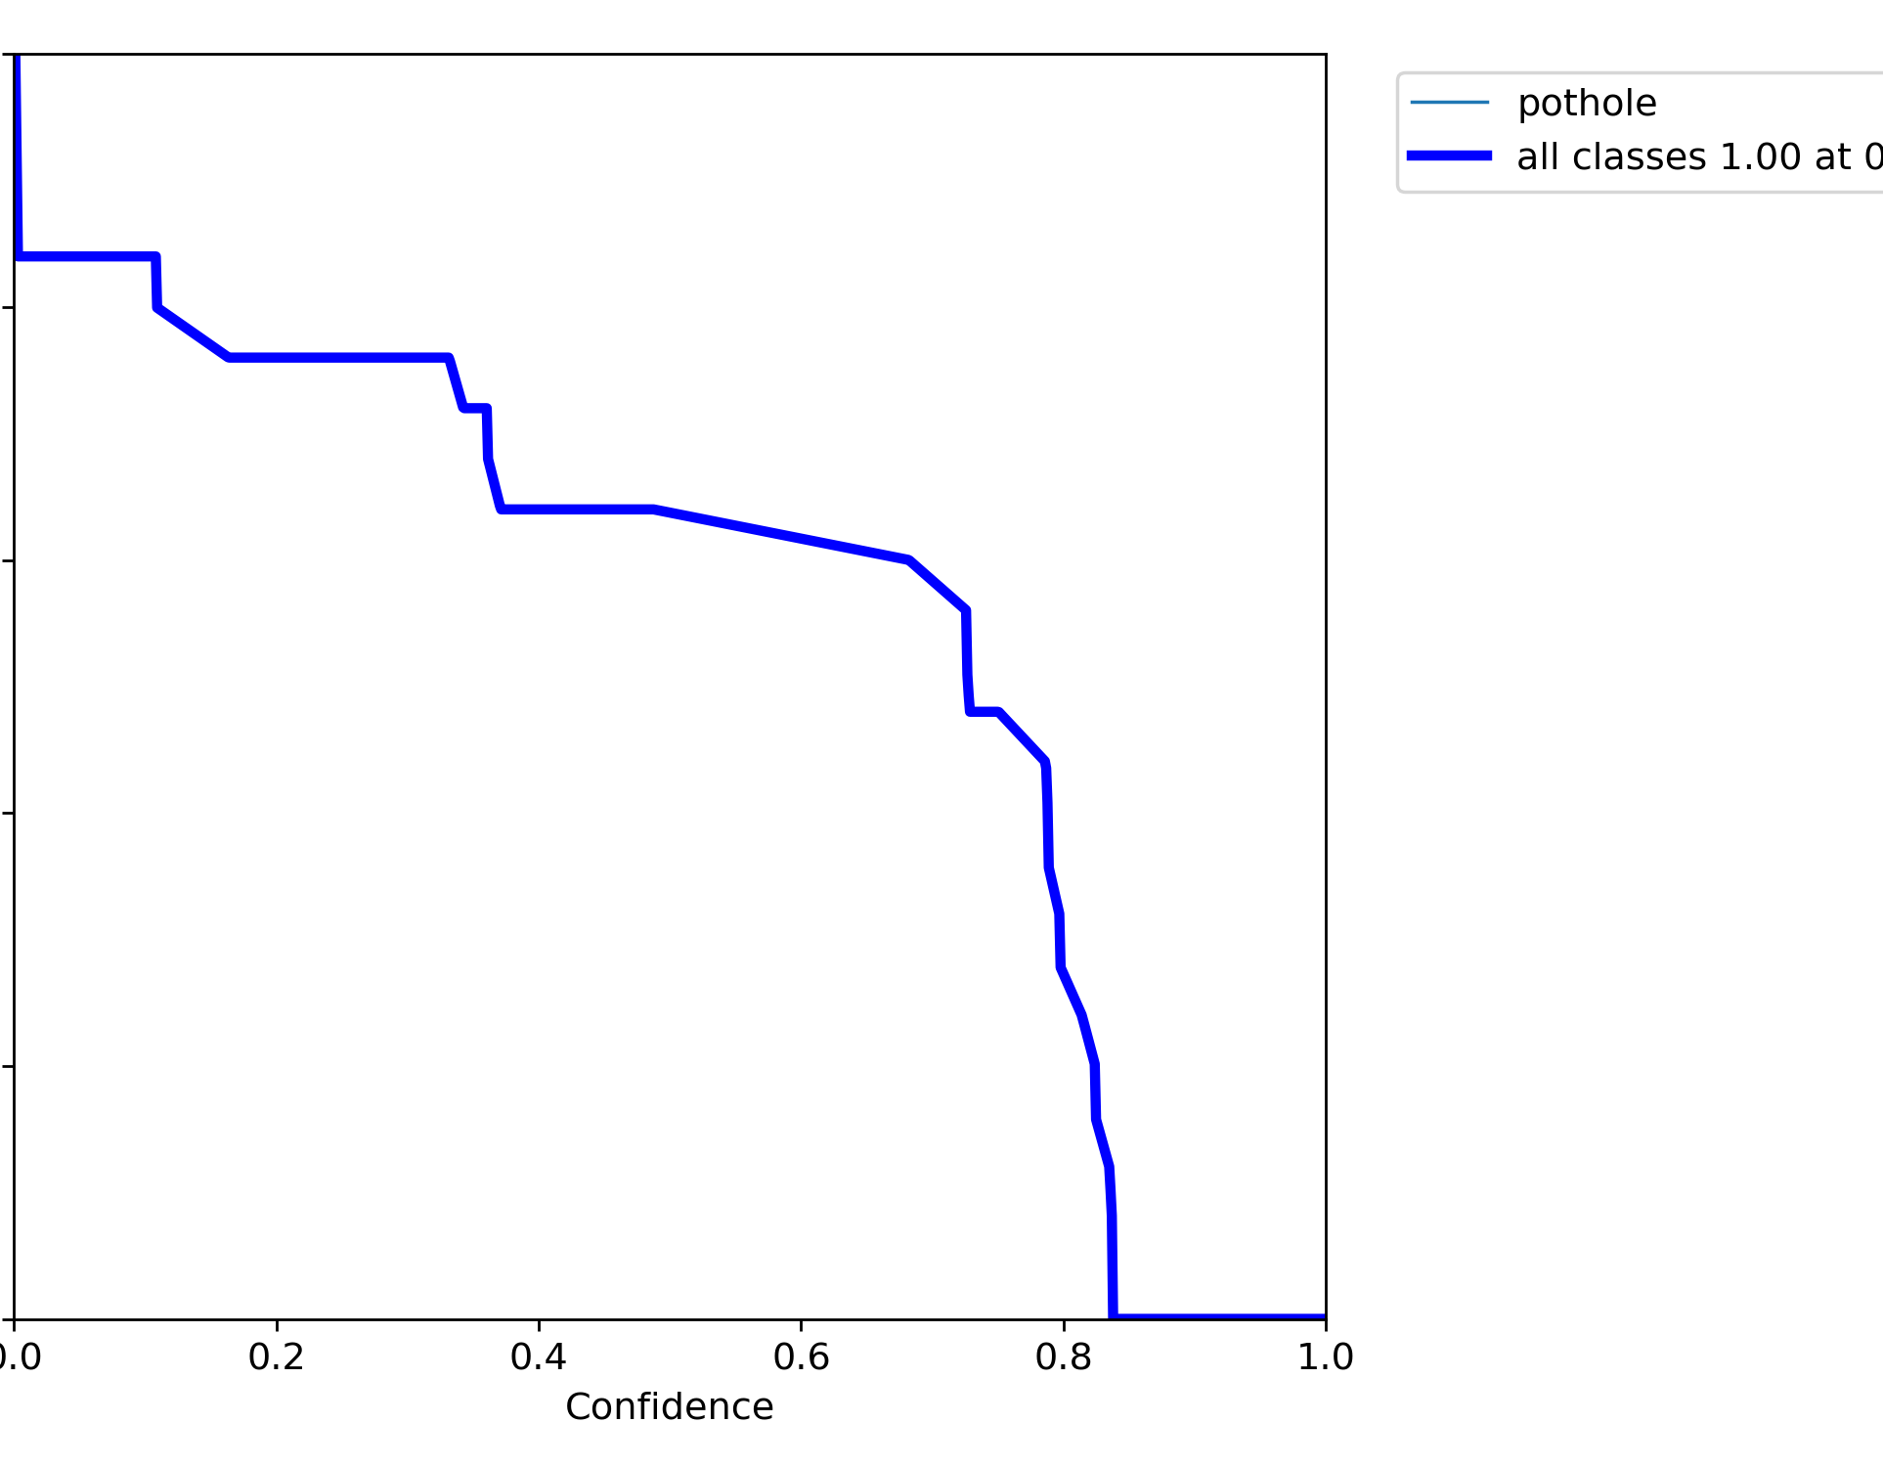
"confidence" refers to the level of certainty or probability assigned by the model to its predictions. It indicates how confident the model is in classifying an object in the image as a road damage.
confidence scores range from 0 to 1, with higher values indicating higher confidence. A confidence score of 1 would indicate that the model is very confident in its prediction, while a score close to 0 would suggest low confidence.
P curve
R curve

Slide 19
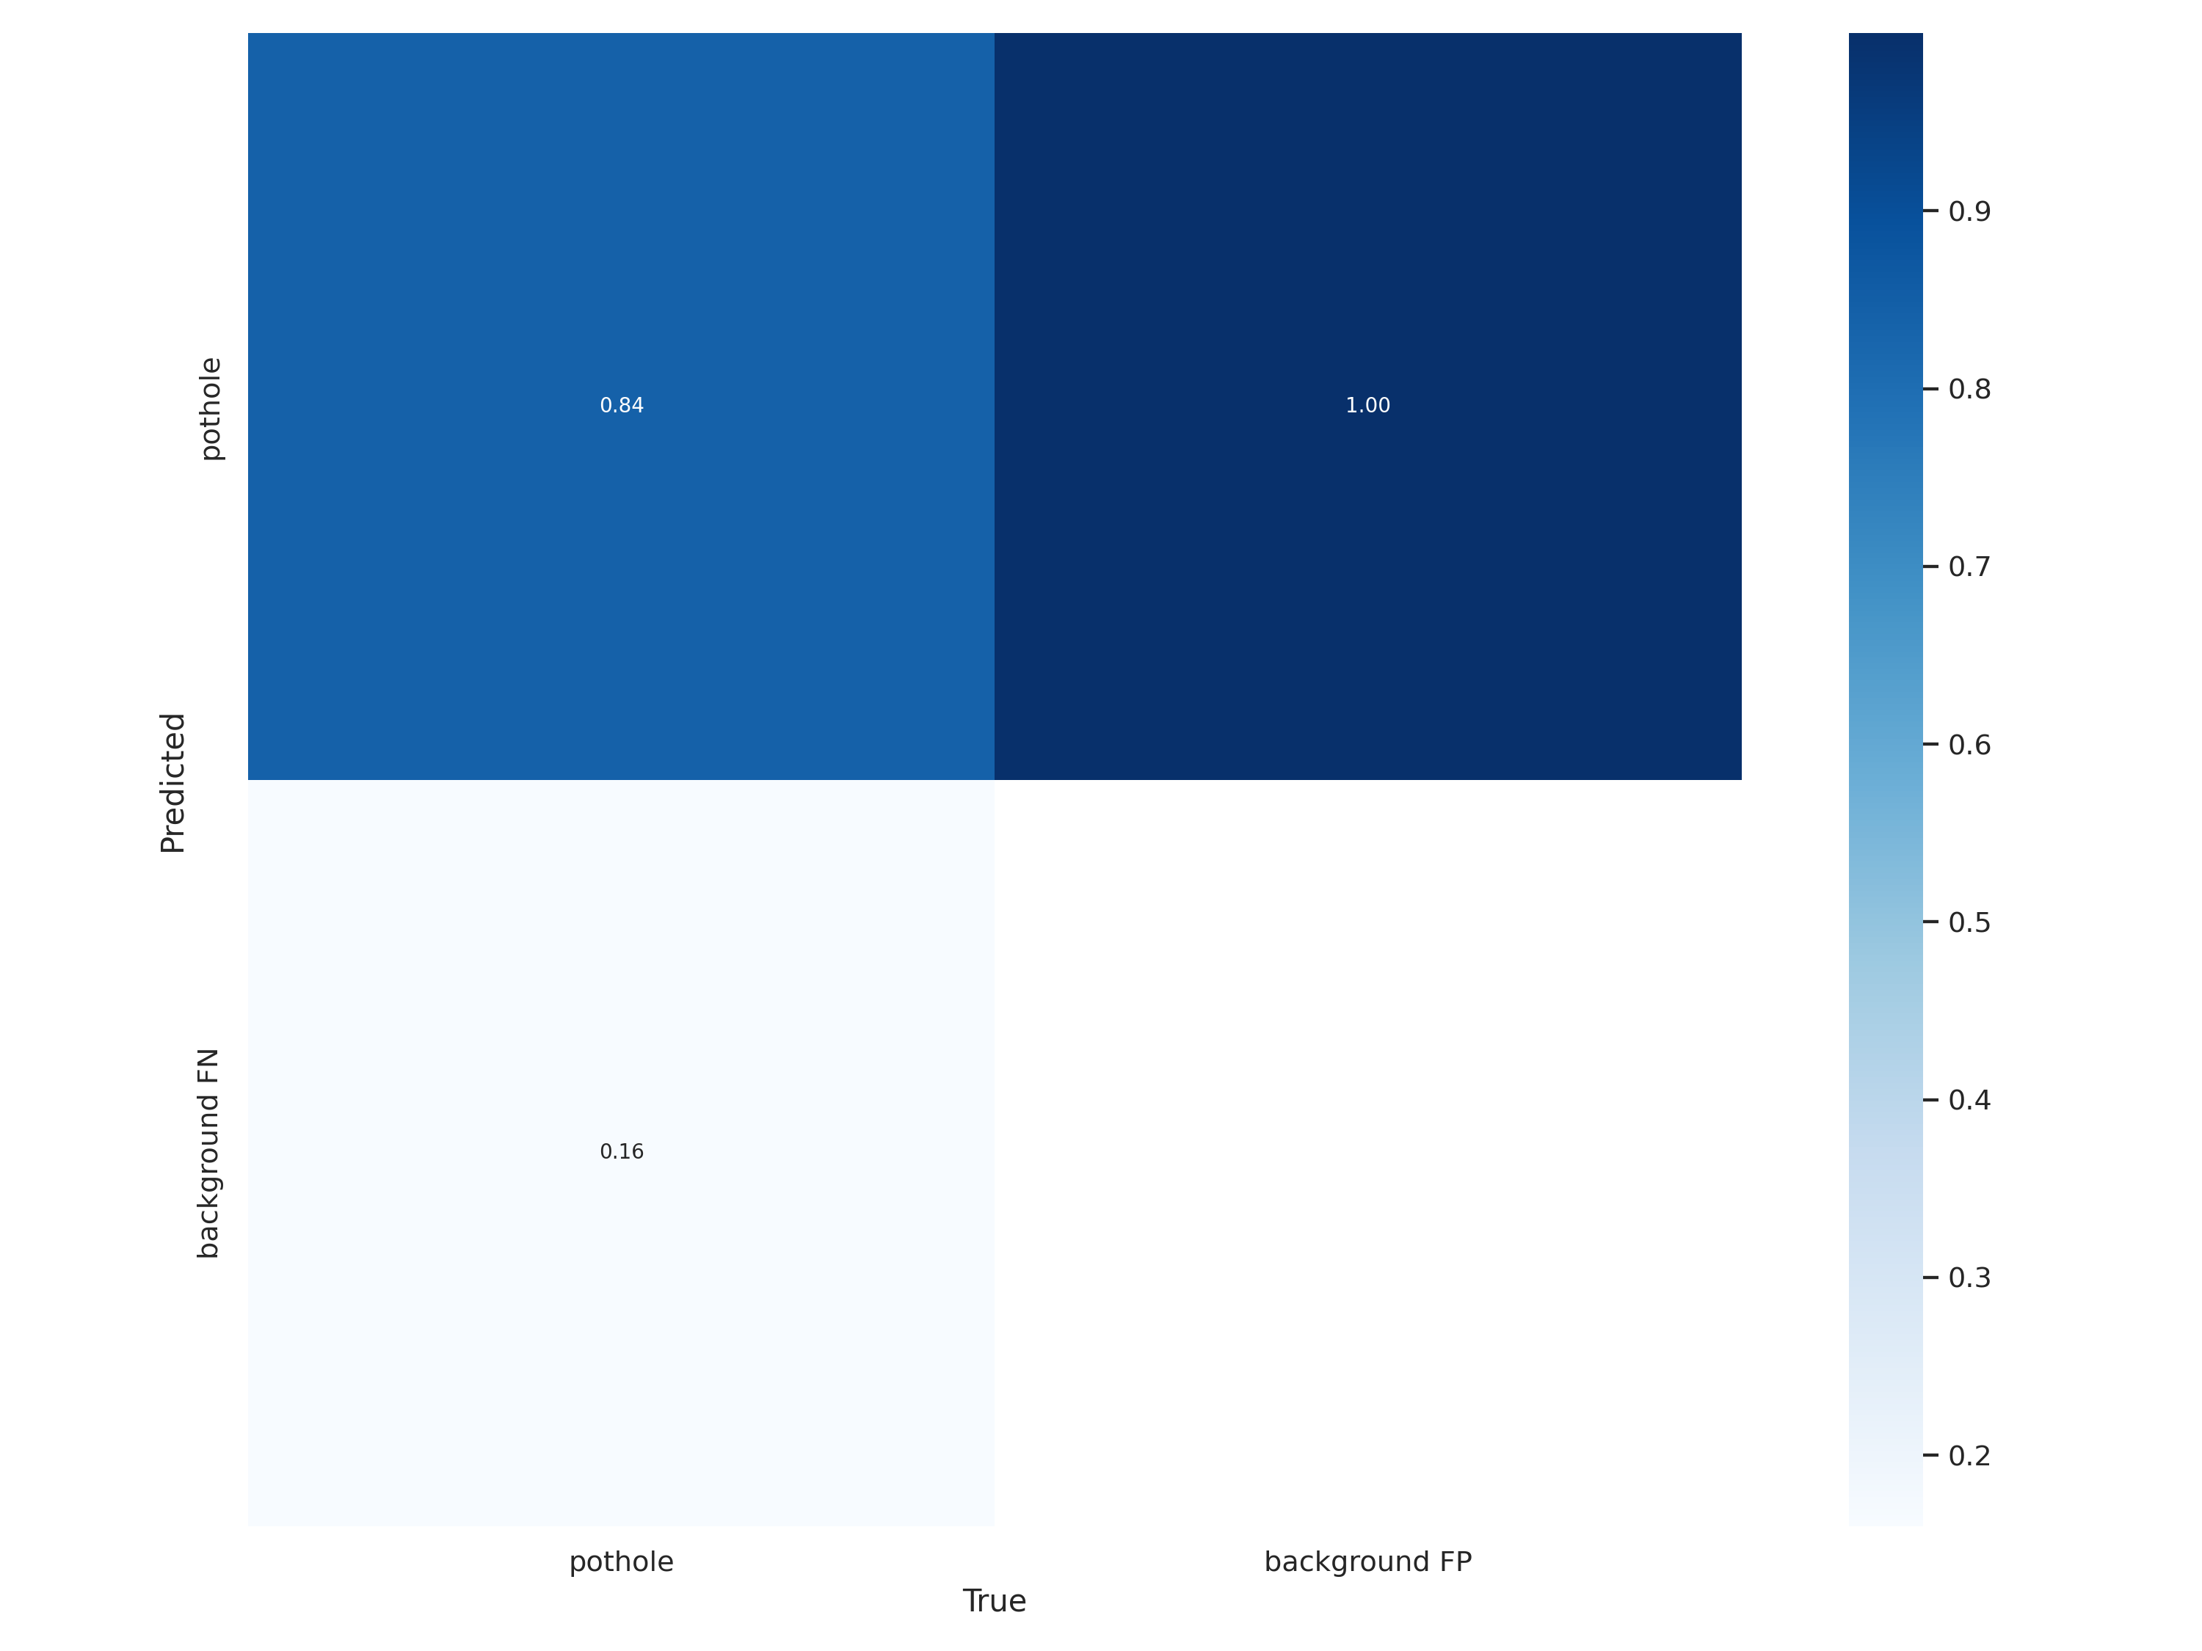
Accuracy: It measures the overall correctness of the model's predictions and is calculated as (TP + TN) / (TP + TN + FP + FN).
Precision: It measures the proportion of correctly predicted road damages out of all predicted road damages and is calculated as TP / (TP + FP).
Recall (Sensitivity or True Positive Rate): It measures the proportion of correctly predicted road damages out of all actual road damages and is calculated as TP / (TP + FN).
Specificity (True Negative Rate): It measures the proportion of correctly predicted non-road damages out of all actual non-road damages and is calculated as TN / (TN + FP).
Confusion matrix

Slide 20
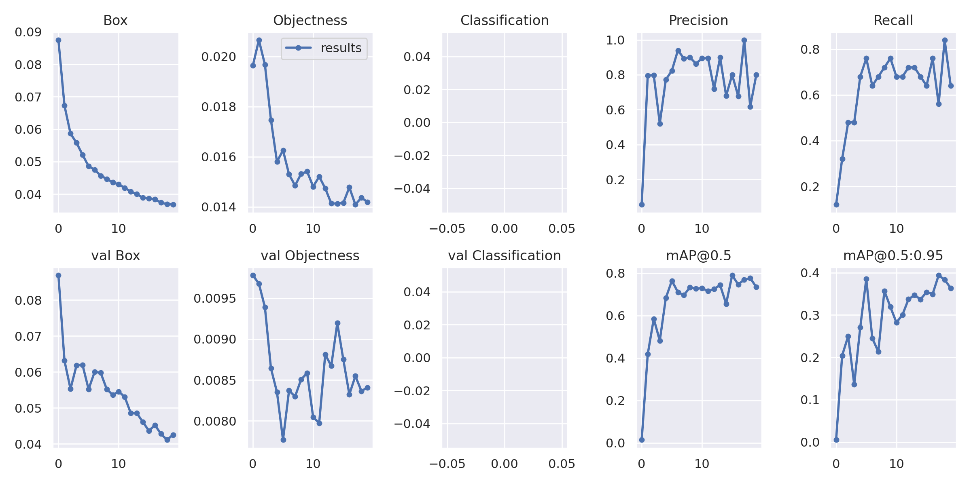

Slide 21
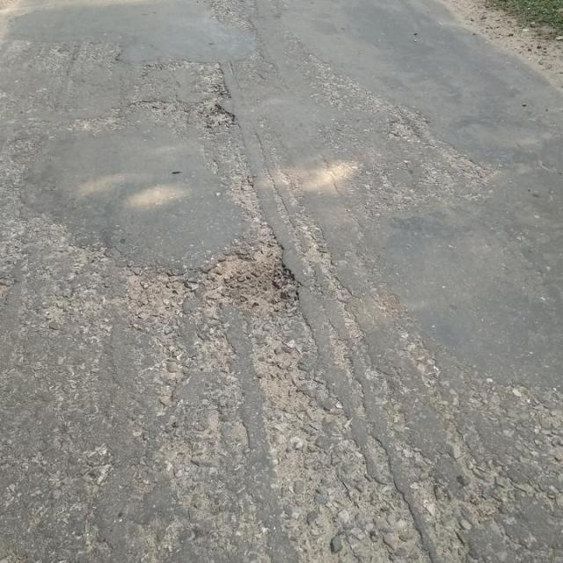
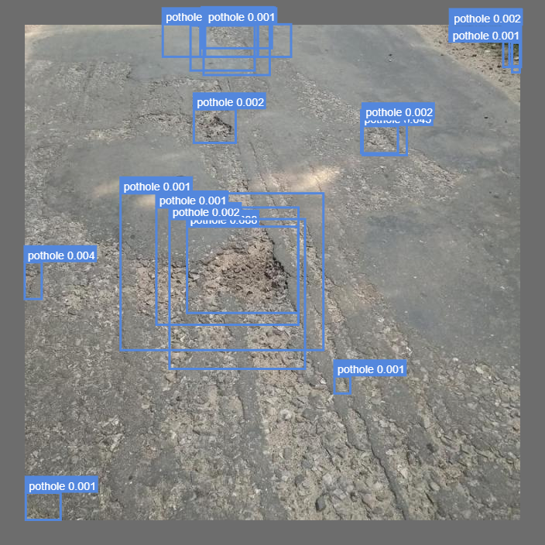
Input:
Output:

Slide 22
Thank you

