Slide 1
Finite Volume Method for Euler Equation
Zejian You
Columbia University

Slide 2
Introduction to Euler Equation

Slide 3
System of Hyperbolic Equation

Slide 4
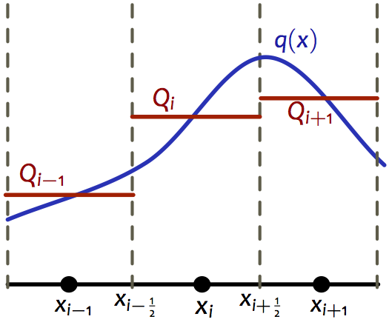
Riemann-based Finite Volume Method

Slide 5
Jacobian Matrix of Euler Flux

Slide 7
Approximate Riemann Solver and Roe Flux

Slide 8
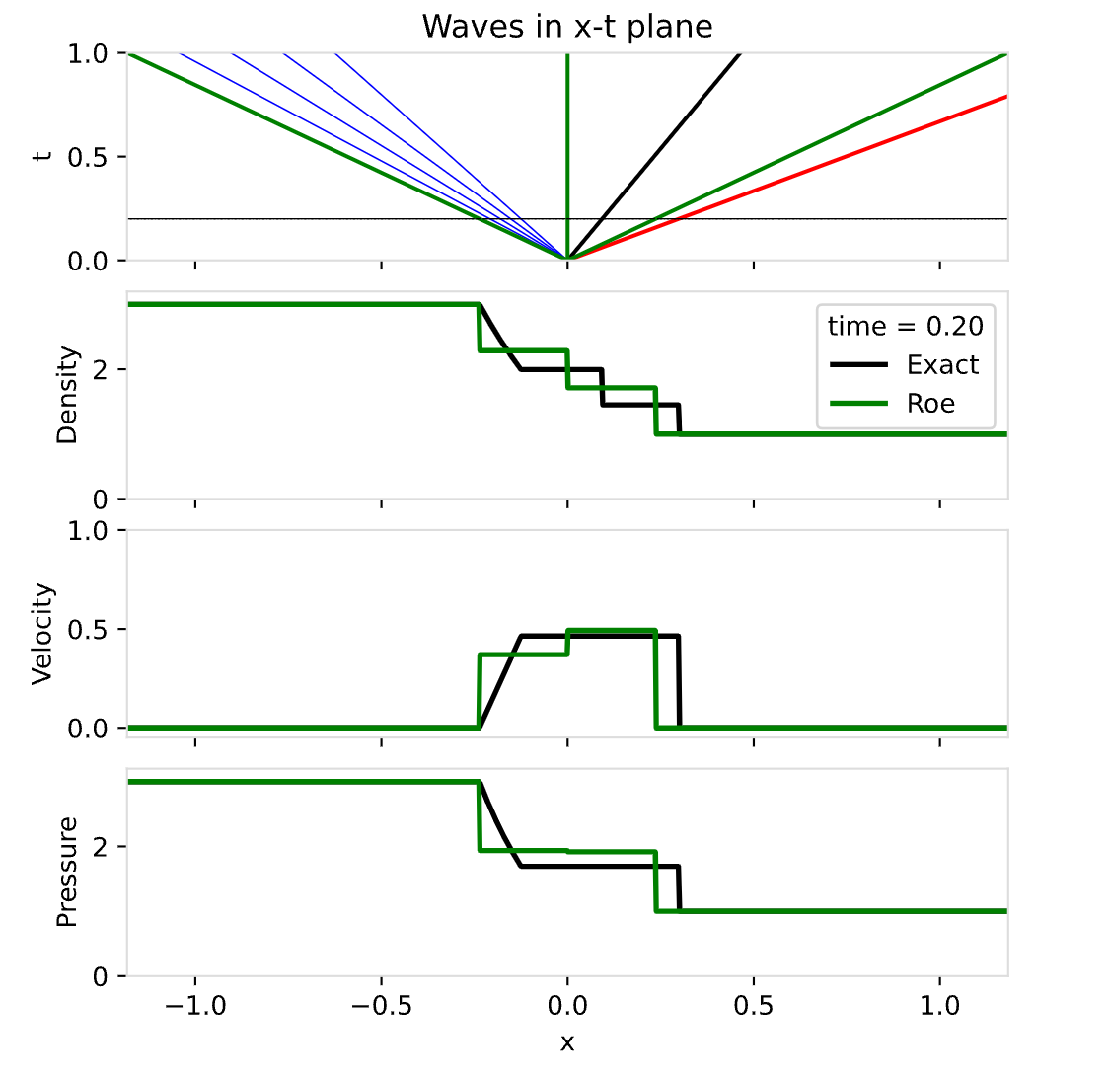

Slide 9
Example-Sod Shock Tube

Slide 10
Newton Iteration

Slide 11
Reference

Slide 12
Thank you!

