Slide 2
QuickWin: Learn a little bit of GO
microservice basics
Jochen Grün (ISO)

Slide 3
Agenda
Microserv
Inhalt
Unterpunkt
Unterpunkt
Inhalt
Unterpunkt
Unterpunkt
Inhalt

Slide 4
Go Introduction (30m)
Micro Service Coding (2h)

Slide 5
Introducing to you: “Go”
Wikipedia:
“Go is a statically typed, compiled programming language designed at Google by Robert Griesemer, Rob Pike, and Ken Thompson. Go is syntactically similar to C, but with memory safety, garbage collection, structural typing, and CSP-style concurrency. The language is often referred to as Golang because of its domain name, golang.org, but the proper name is Go.”
(CSP = communicating sequential processes)
Go has some unique features that sets it apart from e.g. .NET and Java
compiles into native binaries, no JVM or JIT needed
very small CPU/RAM footprint
single binary compilation is very convenient for building docker images
excellent integration in kubernetes ecosystem

Slide 6
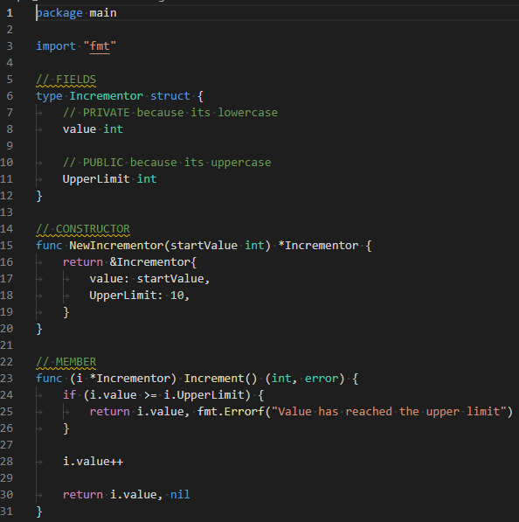
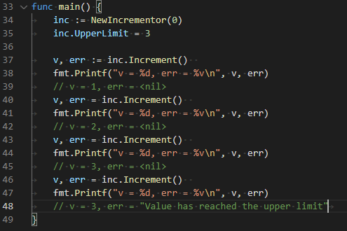
Write a „class“ in Go

Slide 7
Go code structure
Elements of code structure
module: each git repository can represent a Go module
package/imports: define package in a folder and import in different package of same module or across modules
struct/interface: represent data structures and functional interfaces for data structures
func: functions that can be either static or have a struct/interface receiver
main func: static function that serves entrypoint into a Go app (always located in a main package)

Slide 8
Go Modules
similar to packages in other languages
each repository can be a Go module, declared via a go.mod file
modules in Go are distributed „directly“ via the VCS, mainly git
to compile a Go binary the go compiler needs to download all modules source code onto the compiling machine

Slide 9
Go Structs
lowercase starting letter makes a property package internal (reflection will not work, e.g. on tags)
uppercase starting letter makes property visible outside package
a struct is very similar to a C struct: memory block of fixed size with named fields

Slide 10
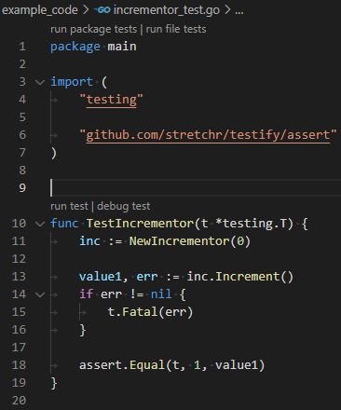
Go Unit Testing
test files are placed side-by-side with code files
simple naming convention
all files matching *_test.go are regarded as test files
all functions starting with Test… are regarded as test cases
each test case function receives a test context as parameter
test context can be used for logging or writing asserts
test code is not compiled into executable binaries

Slide 11
Whats a microservice anyhow?
Hard to say, some citations:
„…In a microservices architecture, services are fine-grained and the protocols are lightweight…”
„…Services are small in size, messaging-enabled…”
„ … It is common for microservices architectures to be adopted for cloud-native applications, serverless computing, and applications using lightweight container deployment…”
„… because of the large number of services, decentralized continuous delivery and DevOps with holistic service monitoring are necessary to effectively develop, maintain, and operate such applications…”

Slide 12
Microservice tech guidelines
Technical take aways:
fine-grained, small in size, large number of service: each service needs to be CPU/memory efficient, because inefficiencies add up on the large number of microservices
lightweight protocols: best protocols are those for which you do not need a special framework/library and adhere to official standards like HTTP
cloud-native/serverless, container deployment: only deploy using docker containers, there is no viable alternative at the moment
DevOps/continuous delivery: deployment must be easily automatable, kubernetes does that job
holistic service monitoring: monitoring must be build in and it should be easy to integrate
messaging enabled: easier to get your service landscape resilient, as messaging systems are built to be highly available and fast

Slide 13
Microservice Features
Implement a REST service with
docker image
helm chart for deploying it with kubernetes
health endpoint so kubernetes can restart a failed pod
metrics endpoint for monitoring with prometheus
logging
SQL database integration

Slide 14
Setup Dev Environment
Install WSL2
Install Docker for Windows and configure WSL2 backend/Kubernetes cluster
Install Helm
Install Kubernetes services
nginx ingress
postgres
prometheus
extend hosts file
WSL2 Linux VM
docker
docker build
VSCode
Terminal
use local
docker images
helm install
kubernetes

Slide 15
Implement service
basic app with health endpoint
dockerfile
helm chart with ingress and service
run chart in kubernetes
integrate metrics and service monitor
setup database
connection
migrations
repo functions
REST API

Slide 18

Erklärung der Textebenen, Segoe UI, 20pt, blau
Kapitelüberschrift, Segoe UI, 12pt, grau
Erste Textebene für Fließtext: Segoe UI, 14pt
Zweite Textebene für Bulletpoints: Segoe UI, 14pt
Dritte Textebene für Bulletpoints zweiter ebene: Segoe UI, 14pt
Vierte Textebene für Bulletpoints dritter Ebene: Segoe UI, 12pt
Fünfte Textebene für Aufzählungen: Segoe UI, 14pt
Sechste Textebene für Aufzählungen in zweiter Ebene: Segoe UI, 14pt
Siebte Textebene für Quellenangaben/Anmerkungen: Segoe UI, 12pt, hellgrau
Information Um die Textebenen zu nutzen, verwenden Sie die „Listenebene erhöhen“ oder „Listenebene verringern“ Schaltflächen in der Startleiste:
oder Ihre Tastatur: ALT+Shift+Links oder Rechts.
Achtung Um ein Aufzählungszeichen zu generieren, verwenden Sie bitte ausschließlich die vordefinierten Listenebenen und kreieren Sie diese nicht manuell über die Symbolleiste.

Slide 19
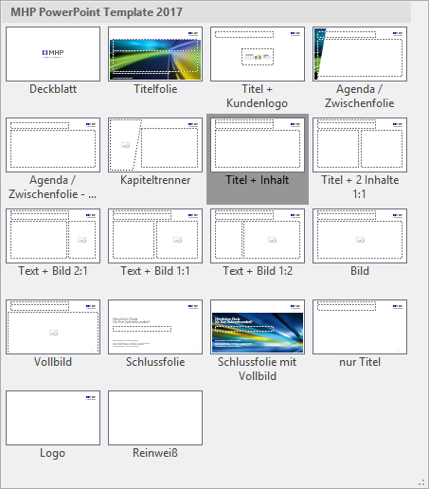
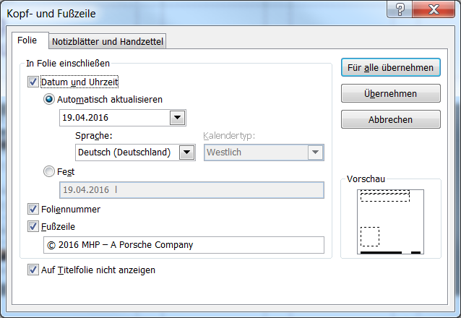
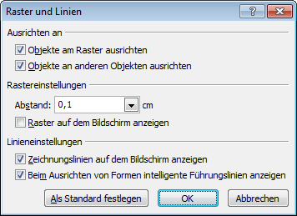

Erklärung der Layouts
Erklärungsfolien
Layouts
Sie können zwischen 18 verschiedenen Layouts wählen.
Zum Ändern gehen Sie auf Start > Layout > und wählen das gewünschte aus.
Kopf und Fußzeile
Zum Ändern der Fußzeile: Einfügen > Kopf- und Fußzeile
Führungslinien anzeigen
Aktivieren Sie die Zeichnungslinien über das Menü „Ansicht“ > Anzeigen > Führungslinien. An den Zeichnungslinien lassen sich Objekte einfacher ausrichten. Optimieren Sie die Einstellungen (wie im Beispiel zu sehen) über Klick auf das Auswahlmenü.

Slide 20
Erklärung des Rasters
Bereich für Titel, Logo und Kapitel
Erklärungsfolien
Bereich für Inhalte
Bereich für Datum, Fußzeile und Foliennummer

