Slide 1
An Integrated Distributed Log Management System with Metadata for Network Operation 2013 Seventh
International Conference on Complex, Intelligent, and Software Intensive Systems
Minoru Ikebe
Department of Computer Science and Intelligence Systems, Faculty of Engineering, Oita University
Oita, Japan minoru@oita-u.ac.jp
Kazuyuki Yoshida
Centre for Academic Information and Library Services, Information Technology Centre, Oita University
Oita, Japan yoshida@oita-u.ac.jp
Achievements:
An integrated client-server based management system was designed for different sensors which had various properties of collecting log-data, encompassed with a search function along with cross-sectional search which would be helpful to the network administrators.
To provide uniformity in rendering data, in rendering information , a centralized server copies all the log-file data to secondary servers.
It was a schema-less log-data management system which helped in the detection of malicious attacks and anomalous calls , using TCP connection states and mirroring packets .
The prototype of the system was also implemented.
The log collector was designed to handle an Apache combined log, bind9 queries log, and the pcap file.
Takeaway:
Understanding that the integrated system would solve the problem of distributed log files to the maximum extent.
Exposure that various criminal activities can be detected and in some ways would be helpful in recovering from loss of data using this prototype.
Administrators would be able to understand the network operations using all the log-data information gathered by the log collector.
A good approach of copying the log data into the centralized server using the cron schedule(rsync or scp) which could help in gathering the data but doesn’t provide timely access to it , hence servers promising file mounting with NFS protocol would be helpful.
A major OS process , the syslog daemon helps to transfer log-messages from one server to another (2 implementations of syslog , Rsyslog and syslog-ng).
Distributed hash table is an appropriate data-structure to maintain and access log-files in a system.

Slide 2
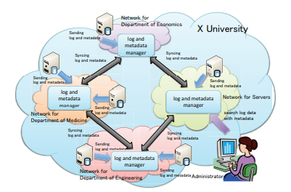
There wouldn’t be any loss of data as such as multiple copies are held on secondary servers.
Schema-less facility provided to the administrators taking care of the entire schema thing on log management side would reduce the burden on the managers.
Knowledge of the Integrated management system for regulating the log data , cross-processing of log files , collection and management of log-data in the campus networks, and understand network operations
Keywords: Server log , sensors(network devices),network operations ,distributed system ,metadata
Along with log-data information the IP address as well as the service which rendered it could be easily known.
FluentD is a flexible , open source ,lightweight log collector which is suitable for collecting and storing log-files on a local area network, the FluentD daemon then forwards the JSON data to the central FluentD server.
As a log manager MongoDB would suffice as it is a NoSQL database in which data can be stored as documents in terms of key-value pairs , and is most reliable in-terms of ACID properties.
Challenges:
Effectiveness of this system has to be tested taking into concern various measures.
This model handles logfiles in the printf-style format string , which is the most common and usable structure of log-files , the same model can be extended to work on log-files having different formats.(i.e., CloudStack, OpenStack, Eucalyptus, Sendmail, bind9, and the system logs of the OS)
A search function with a query interface can be implemented which will be implemented as a shell script language or an interpreter language

