Slide 1

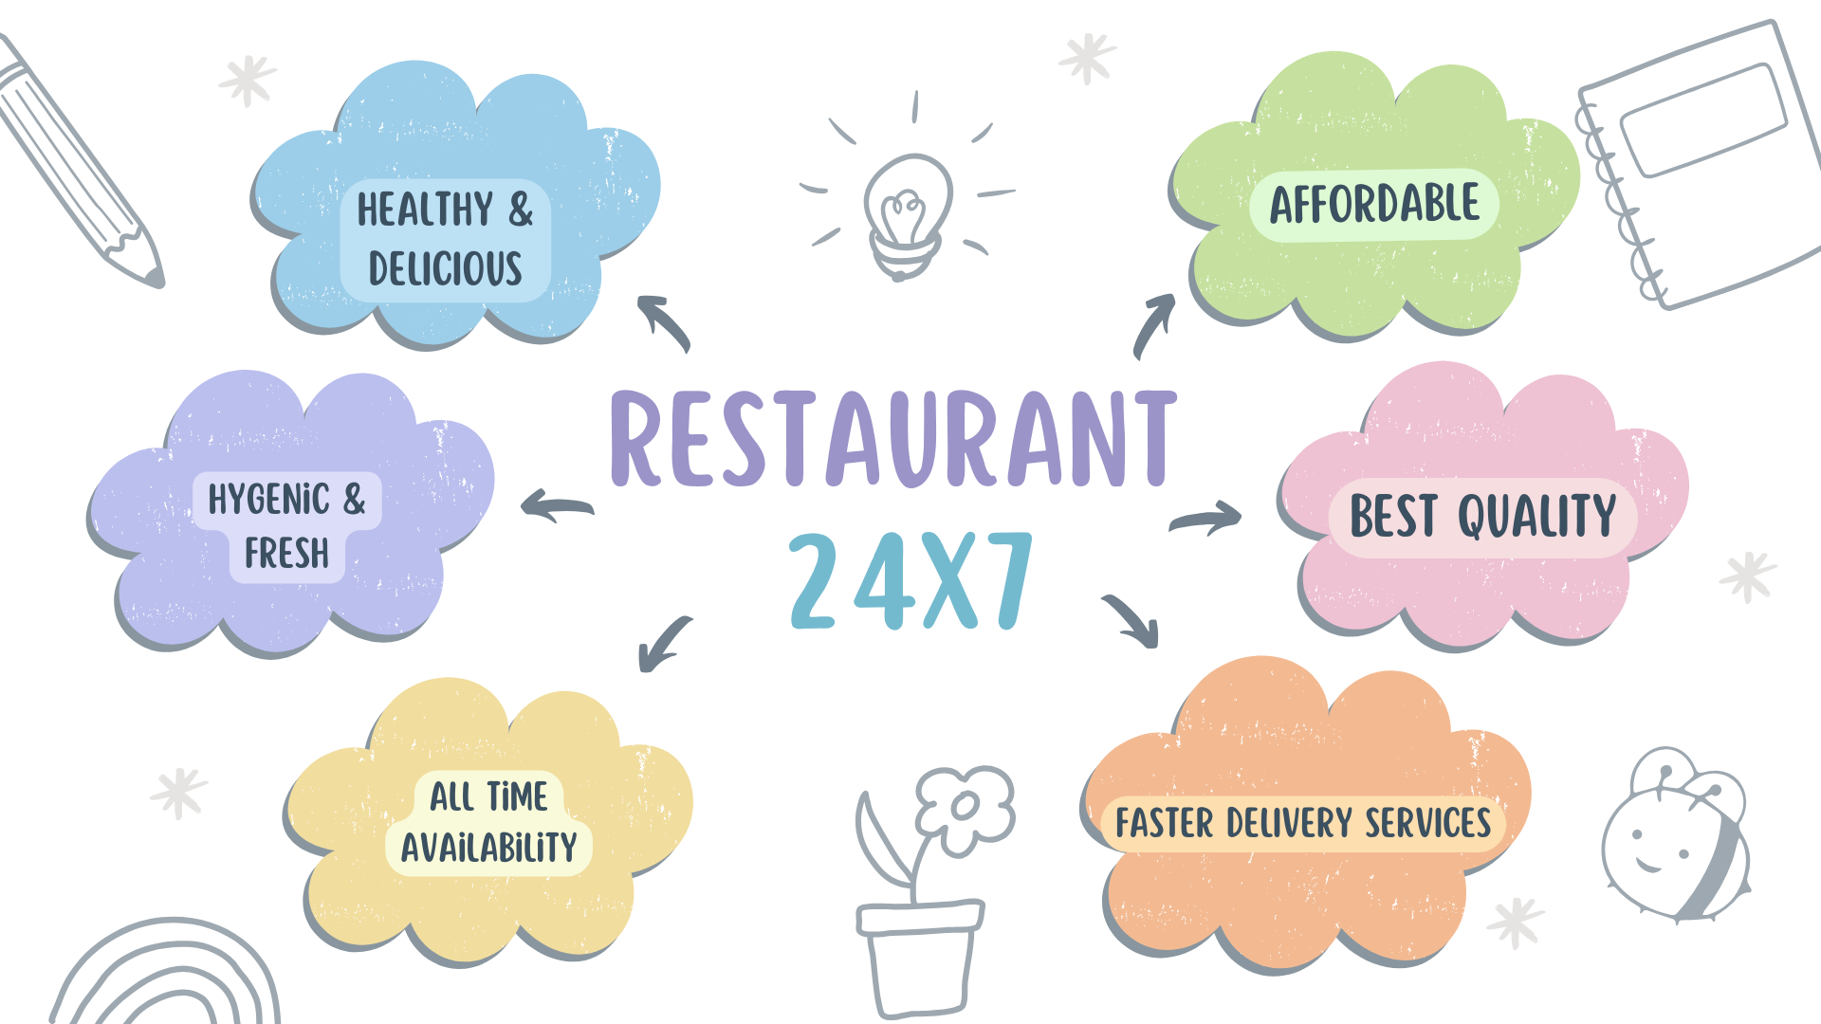
Designed By:
Usha Assudani, Harshita Harwani, Minal Sharma
FOODIE: RESTAURANT 24X7
Language Used: HTML, CSS, Java Script ,Bootstrap

