Slide 1

AMCAT Data Analysis

Slide 2
About me
My name is Ushamasani Rajkumar, and I graduated with a degree in Computer Science and Engineering(2007 - 2011). I have four years of experience working as an SAP Technical Consultant. After taking a career break of nearly nine years, I am eager to re-enter the workforce as a Data Analyst. My enthusiasm for data and its influence on decision-making drives my desire to pursue this career path.
Linkedin URL: https://www.linkedin.com/in/ushamasani/
GitHub URL: https://github.com/Ushamasani

Slide 3
Objective
The project aims to explore how various factors influence salary.
Analyse inputs like education, college, demographic details, Big Five personality traits, and areas of specialization.
The target variable is salary, and the goal is to understand which of these factors have the strongest impact on earnings.

Slide 4
Summary of data
The AMCAT data project focuses on understanding the relationship between various factors and salary. Key inputs include:
Education: The level, field of education, college tier attained by individuals.
Demographics: Personal details such as age, gender, and location.
Big Five Personality Traits: Characteristics like openness, conscientiousness, extraversion, agreeableness, and neuroticism.
Specialization: The specific area of expertise or field of study.
The target variable is salary, and the project aims to identify which of these factors most significantly influence salary levels among individuals. Through this analysis, we hope to gain insights that can guide career decisions and improve understanding of salary determinants in the job market.

Slide 5


Data Pre-processing
Understanding the Data
Imported required libraries
Read the data
Removed the unwanted columns
Renamed the column names

Slide 6
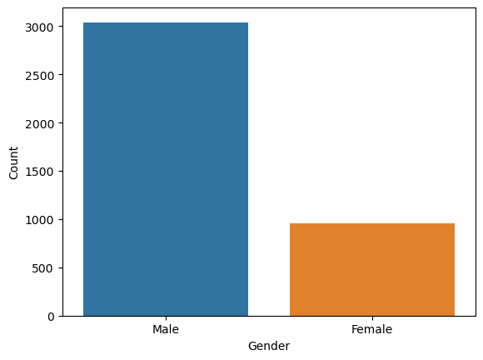
Univariate Analysis
Non-Visual Analysis
Performed nonvisual analysis('count', 'nunique', 'unique’) for discrete variables.
Performed nonvisual analysis ('min', 'max', 'mean', 'median', 'std’) for continuous variables.
Visual Analysis
Gender Distribution

Slide 7
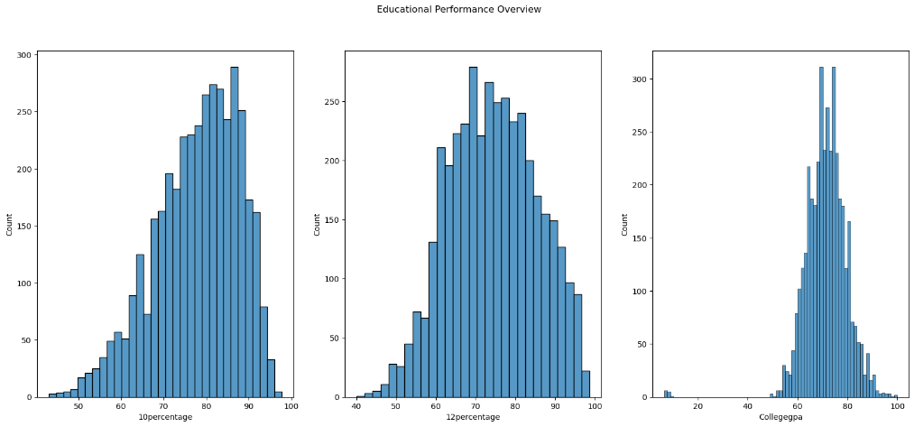
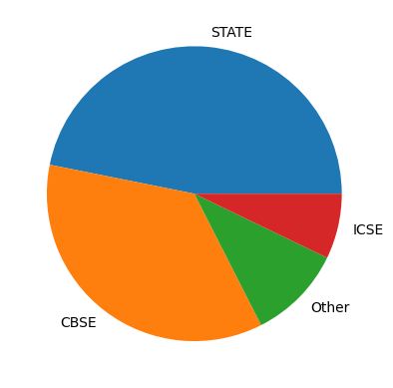
Education Performance Overview
Most of the aspirants got 50 to 100 percentages in 10th, 12th and College but there are some students who failed in class 10 and college.
Most of the students are from State and CBSE board in class 10.

Slide 8
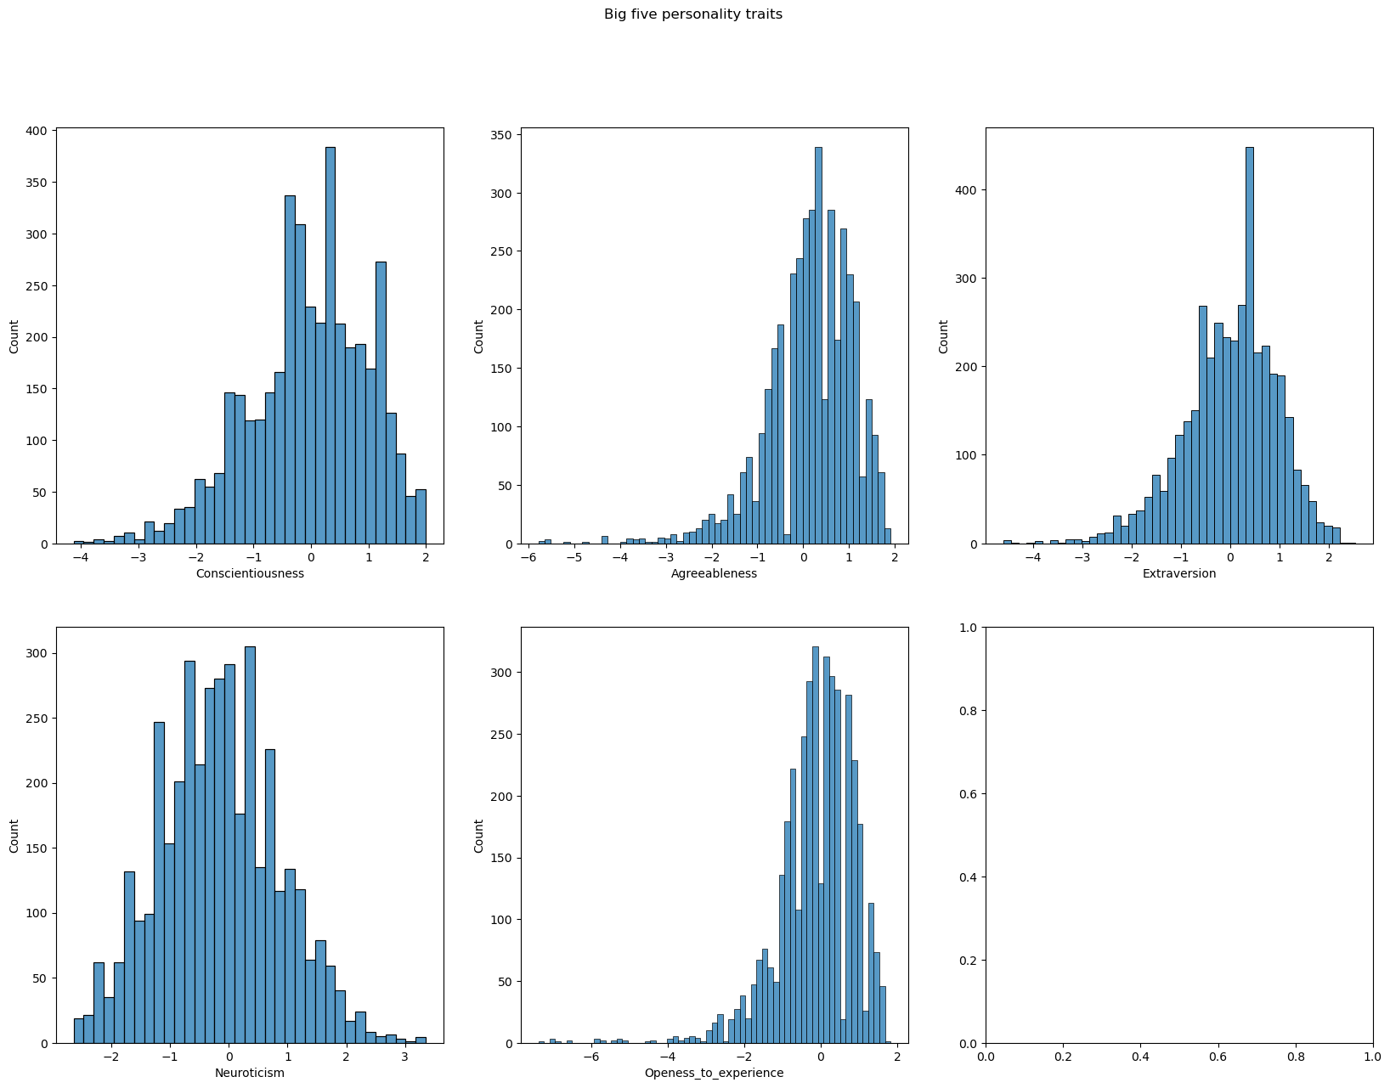
Personality Test Scores Distribution
The personality test scores are mostly left skewed which means that most people score higher on these traits, with a smaller number of individuals showing lower scores.
Neuroticism scores follow normal distribution which means that most individuals have an average level of neuroticism, with only a smaller proportion showing very high or very low neuroticism traits.

Slide 9
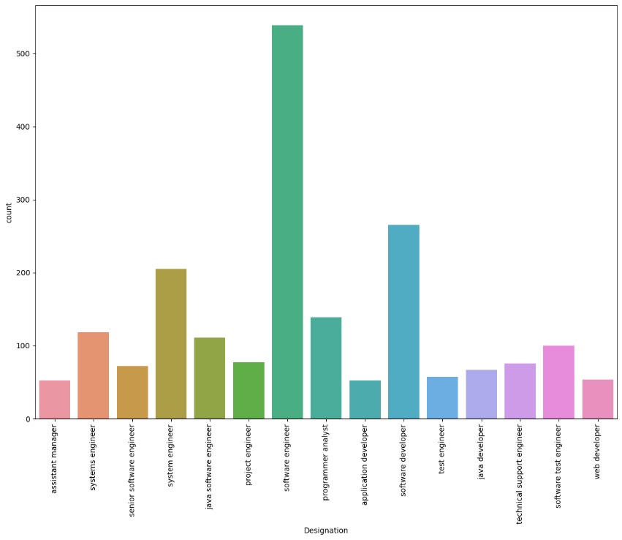
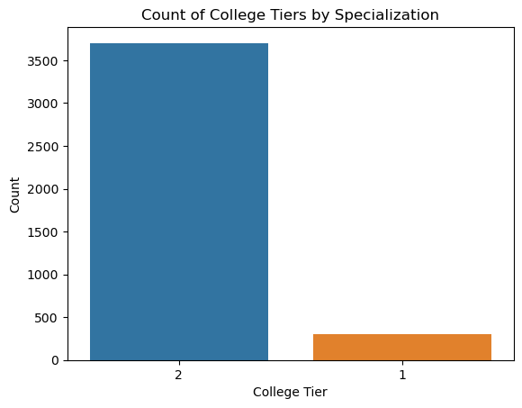
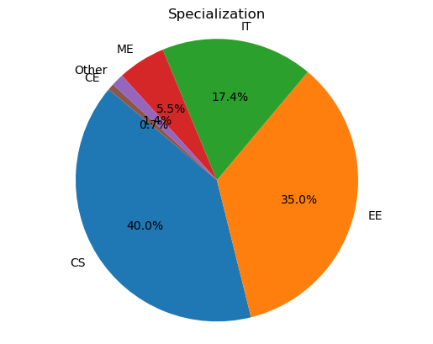
College Tier, Designation and Specialization Distribution
Tier 2 has more colleges.
CS and EE are more popular courses.
Software Engineer is the most popular designation

Slide 10
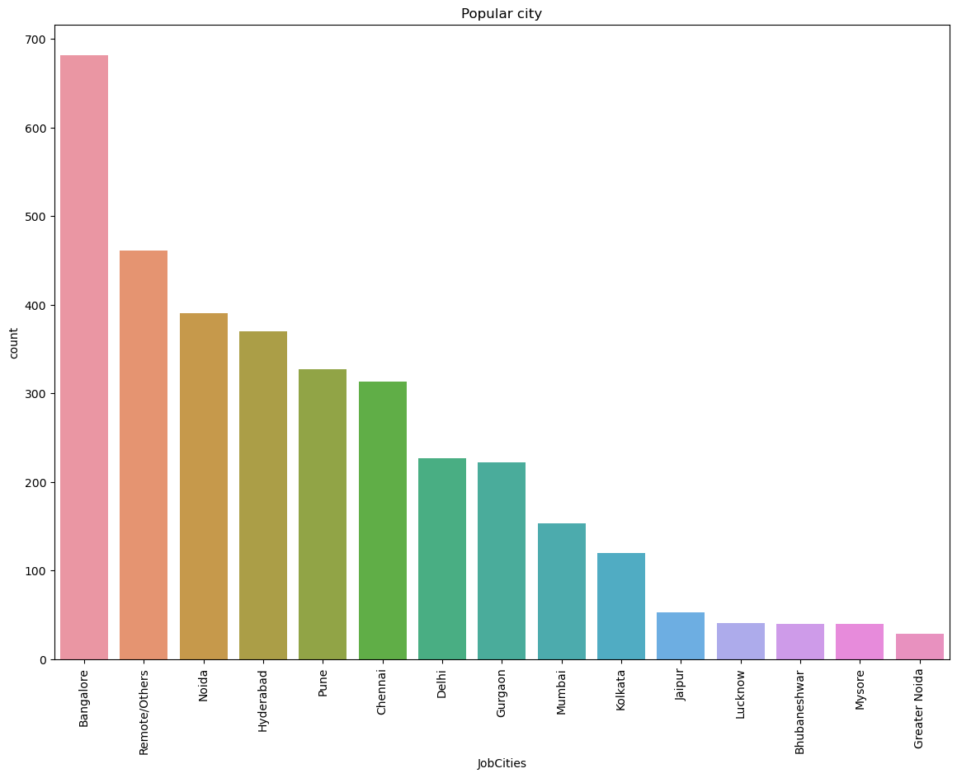
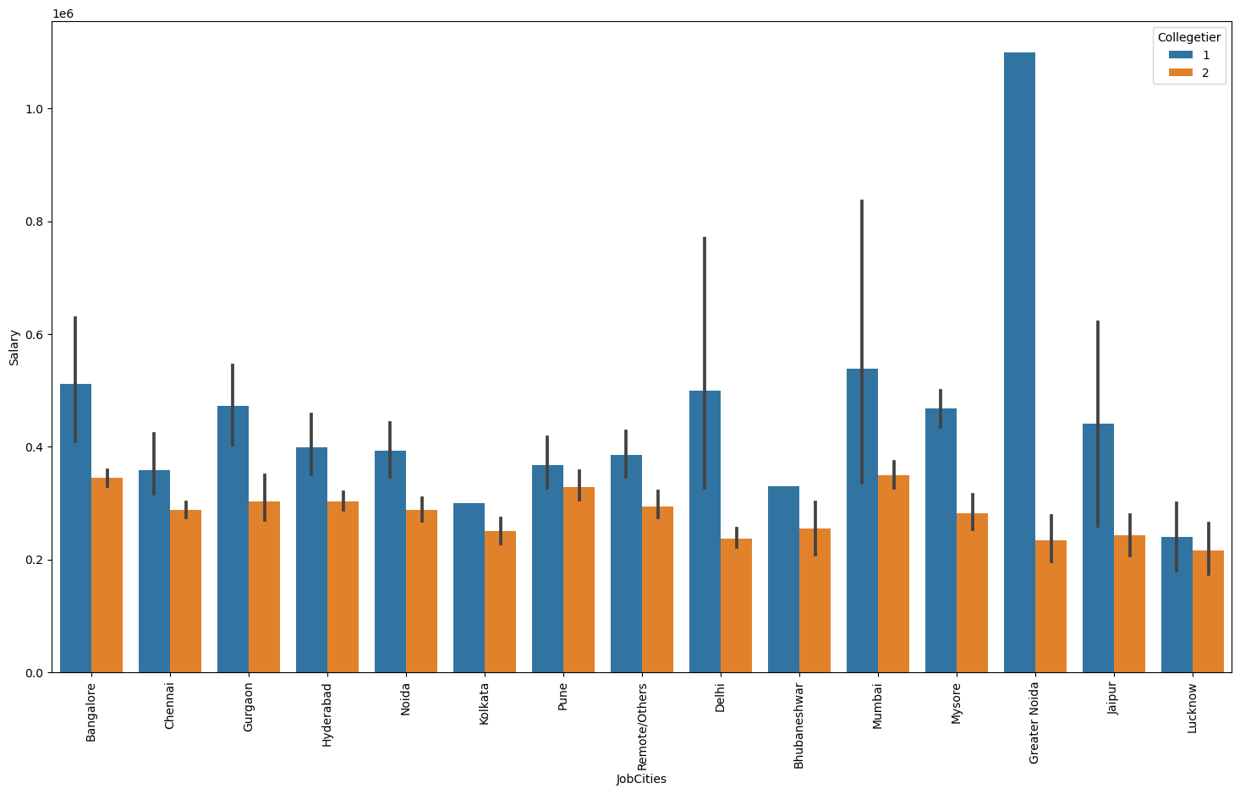
Job City Distribution
Most popular city to work is Bangalore followed by Noida.
Tier 1 college students were working in Greater Noida and earning more salary than others.

Slide 11
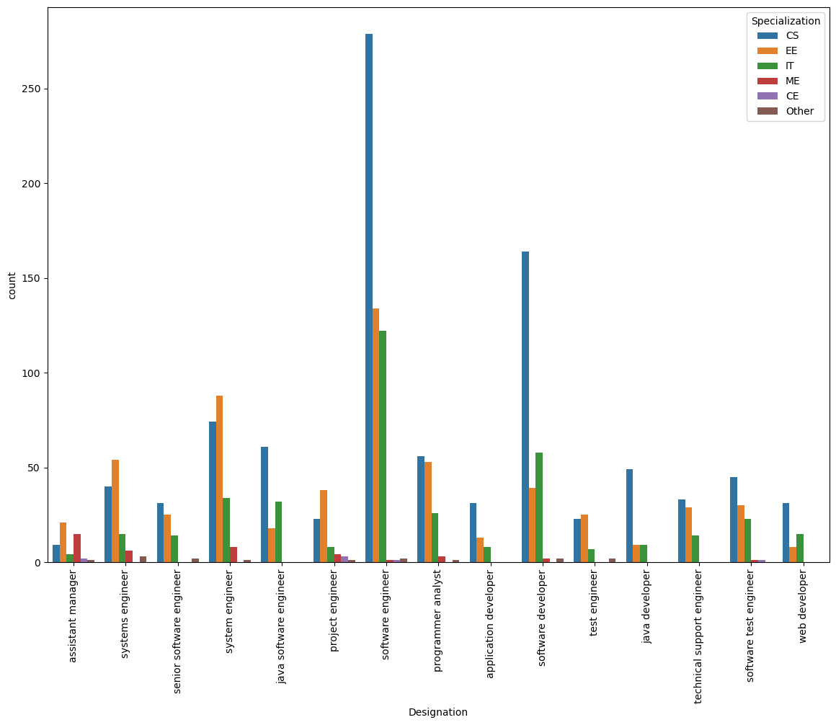
Designation w.r.t to Specialization
Students from CS and IT background are predominantly working as Software Engineer, Software Developer, System Engineer.

Slide 12
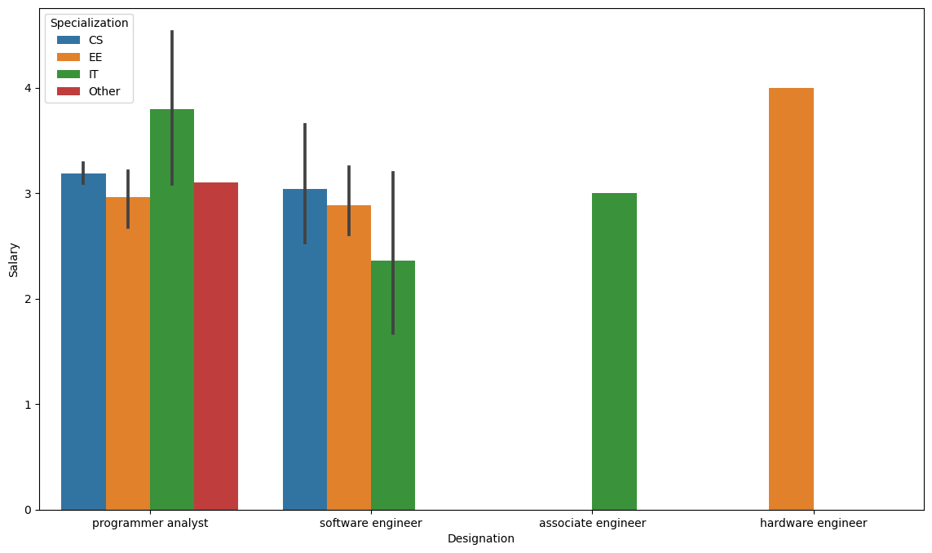
Research Questions
Performed ANOVA test to test the hypothesis.
ANOVA F-Statistic: 0.3961182733079398
P-Value: 0.7560320329849151
Performed ANOVA test for Designation w.r.t Specialization and salary
sum_sq df F PR(>F)
Designation 4.163065e+10 3.0 0.485788 0.692829
Specialization 3.369809e+10 3.0 0.393223 0.758112
Residual 3.227928e+12 113.0 NaN NaN
Result
The above made claim is true irrespective of the specialization.
Designation and Specialization does not have statistically significant effect on salary.
Claim-1 :
Times of India article dated Jan 18, 2019 states that “After doing your Computer Science Engineering if you take up jobs as a Programming Analyst, Software Engineer, Hardware Engineer and Associate Engineer you can earn up to 2.5-3 lakhs as a fresh graduate.”

Slide 13
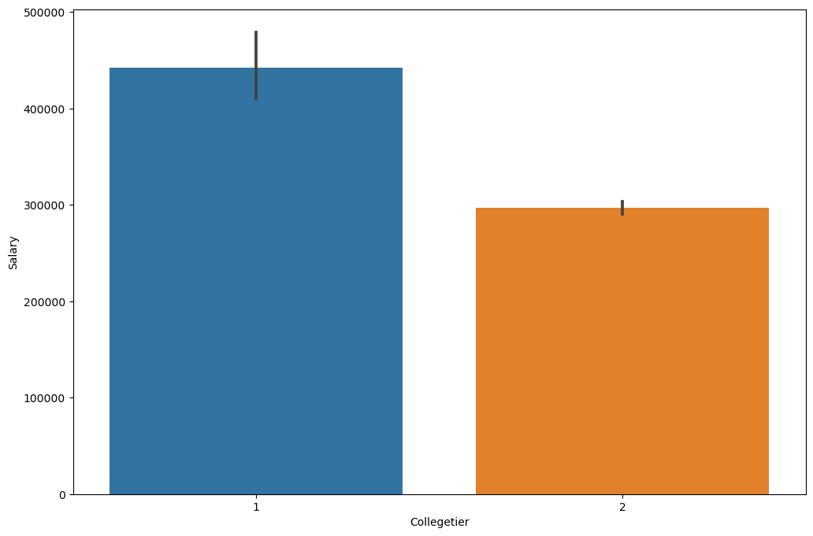
Claim-2:
Tier-1 college students tend to get higher salary packages compared to Tier-2 College students.
Performed T-Test to test the hypothesis
p-value: 3.0182471444274503e-30
Result
Reject the null hypothesis. There is a statistically significant difference in the average salary between Tier 1 and Tier 2 college students.

Slide 14
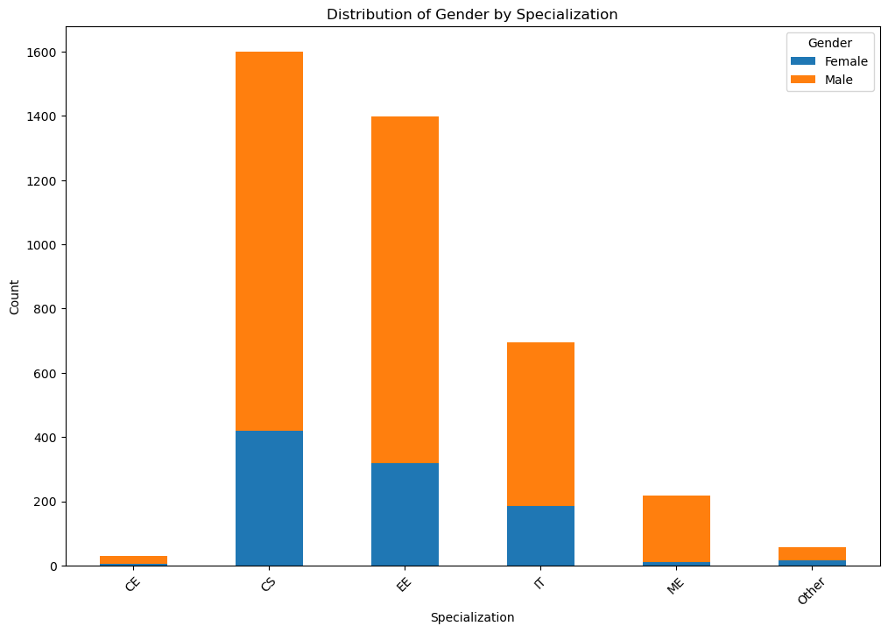
Claim-3: Is there a relationship between gender and specialization?
Performed Chi-Square test to perform the test
Contingency Table:
Specialization CE CS EE IT ME Other
Gender
Female 6 420 320 184 12 15
Male 23 1179 1079 511 207 42
Chi-Square Statistic: 49.415941726117246
P-Value: 1.8246242604380306e-09
Result
There is a significant relationship between 'Gender' and 'Specialization'.
Most females prefer CS, EE and IT specializations.

Slide 15
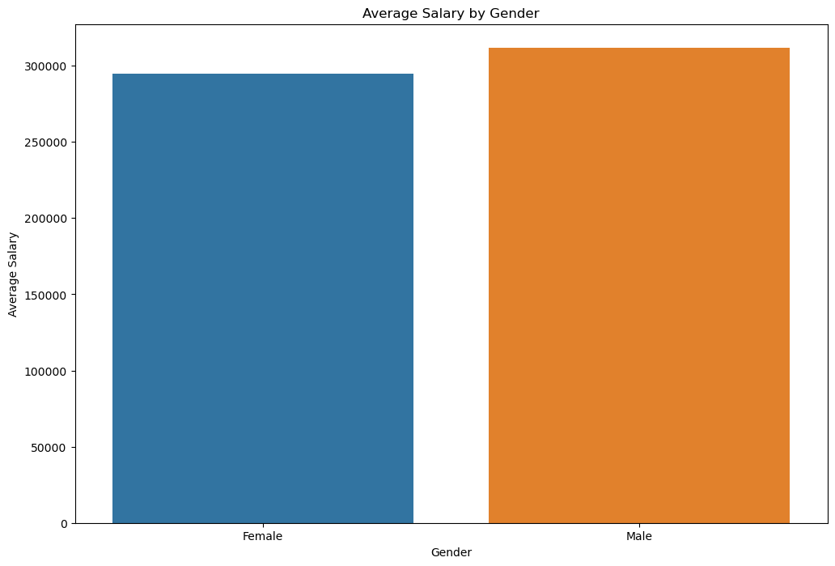
Claim-4: "On average, women in software engineering roles earn less than their male counterparts"
Performed T-Test to test the hypothesis
p-value: 0.03332394177012777
Result
Reject the null hypothesis. There is a statistically significant difference in the average salary between male and female.

Slide 16
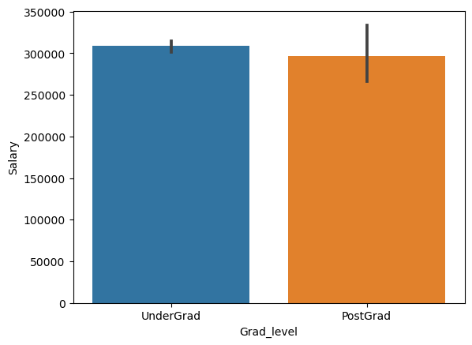
Claim-5: According to U.S Bureau of Labor Statistics "Learn more, earn more: Education leads to higher wages, lower unemployment"
Performed T-Test to test the hypothesis
p-value: 0.33385580824584704
Result
Fail to reject the null hypothesis. There is no statistically significant difference in the average salary between undergraduates and postgraduates.

Slide 17
Conclusion
The analysis reveals distinct patterns among job aspirants from different gender and educational backgrounds.
The majority of male aspirants hail from Computer Science (CS) and Electrical Engineering (EE) departments, particularly from Tier-1 colleges. They predominantly pursue careers in the IT domain, primarily in Mumbai and Bangalore, with an average salary of 3 LPA and a maximum salary reaching 40 LPA.
Female aspirants tend to favor CS, EE, and IT departments over traditional engineering fields like Mechanical and Civil. They also seek employment in the IT sector, primarily in Mumbai and Pune, earning an average salary of 2.9 LPA and a maximum around 36-37 LPA.
While Bangalore remains the most desired city for employment, many students from Tier-1 colleges are opting to work in Greater Noida instead.
The analysis highlights that Software Engineer and Software Developer positions are the most common among aspirants. In contrast, Senior Software Engineer and Assistant Manager roles offer the highest salary packages, indicating a lucrative career progression for those advancing in their respective fields.
Overall, the findings underscore the significance of college tier and specialization in shaping career opportunities and salary prospects, particularly in the dynamic IT landscape.

Slide 18

THANK YOU

