Slide 1
Store Management System
ITP-2019-MLB-G10-09

Slide 2
Our Team
Student Id Number | Name | Assigned Functions
IT18061130 | W.S.K Mendis | Salary Management
IT18023206 | T.D.I Dissanayake | Employee Management/Employee access levels Management.
IT18012620 | V.Y. Samarasiri | Attendance Management/Leave Management
IT18027884 | G.U.S Fernando | Inventory and Purchase Management
IT18022902 | S.P.M.K.W Illukkumbure | Supplier Management
IT18027716 | G.H.T. Wijeyawardhane | Finance Management

Slide 3
Introduction

Slide 4
Client
Nisha Enterprises is a store which has been initiated on 2011.
Which sells electronic equipment.
The company currently has 20 employees.
Company is located near Koswatte.

Slide 5
Problems and difficulties
Complexity due to maintenance of ledger files.
Time consuming due to traditional practices.
Difficulty to restrict sensitive data.
Hard to make changes in records.
Files can be misplaced.
Incapability of scaling

Slide 6
Solution
Developing a store managing desktop application which can handle all the departments of the company.

Slide 7
Benefits
Hand written data records are computerized.
Employee attendance/ leaving is tracked using a RFID reader.
Easier to check the inventory from the UI.
Employee salaries are created from the system.
Generating reports from the system.
Notifying the responsible users whenever stocks the are reduced.
System does not limit for certain number of employees.

Slide 8
System Overview

Slide 9
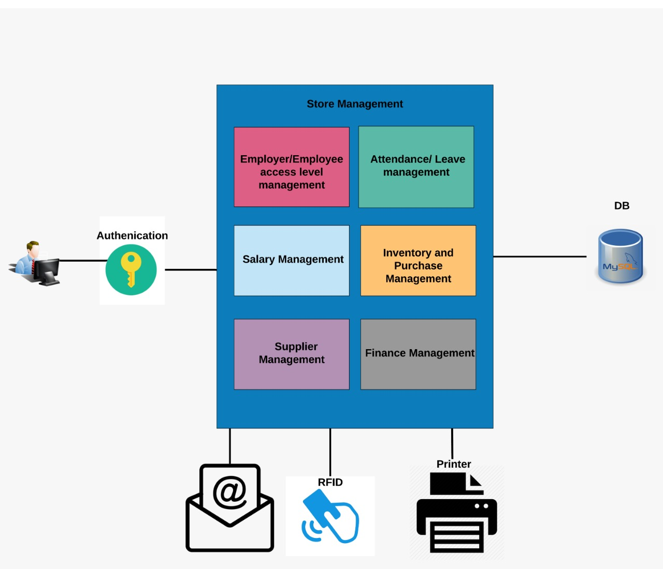
System Overview

Slide 10
Functions in Detail

Slide 11
Salary Management
Salary calculations
Calculating overtime payments to the salary.
Updating the working hours of the month.
Calculating monthly end salary .
Calculating year end bonus.
Generating reports
Monthly end salary reports.
Pay sheets of employees.

Slide 12
Salary Management
Request functionalities
Send requests to finance management.
Cancel requests.

Slide 13
Employee/Employee access Level Management
Manage Employee
Add new employee.
Edit employee profiles.
Delete existing profile.
Generate total employee summary reports.

Slide 14
Employee/Employee access Level Management
Manage access levels.
Providing user access levels to responsible individual.
Manage user credentials.

Slide 15
Employee Attendance Management
Manage attendance using RFID.
Track arriving time.
Track leaving time .
Calculate working hours.
Calculate time off from work.
Short leave.
Full day.
Overtime hours.

Slide 16
Employee Attendance Management
Generating reports for salary calculations
Generate monthly attendance reports

Slide 17
Inventory and purchase Management
Manage Products
Add new products .
Edit existing products.
Delete existing products.
Manage Product Categories and Product Brands
Add new categories and brands.
Edit existing categories and brands.
Delete existing categories and brands.

Slide 18
Inventory and purchase Management
Manage all Product Sales.
Process customer orders.
Calculate payments.
Generate bills to the customers.
Notify supplier manager and admin when stocks reached to a critical level.

Slide 19
Supplier Management
Manage Suppliers
Add new suppliers.
Edit existing supplier details.
Delete existing suppliers.
Manage Orders
Place new orders.
Update existing orders status.
Show ETA on orders (Estimate Time of Arrival).

Slide 20
Supplier Management
Generate Reports of orders & suppliers, monthly & weekly.
Received order monthly & weekly.
Pending order monthly & weekly.
Supplier details reports.
Payment due status.

Slide 21
Finance Management
Manage Financial processes in the company
Handle payments to suppliers
Handle employee salaries
Handle sales income
Handle other expenditures that are recorded
Record details systematically
insert, update, delete functions

Slide 22
Finance Management
Generate monthly financial reports
Inventory and Purchase management reports
Salary management reports
Supplier management reports
Approve transaction requests

Slide 23
Tools and Technologies

Slide 24
Technologies
JAVA for programming
JAVA Fx for GUI modeling
MySQL for database modeling

Slide 25
Tools
Intellij IDEA 2019.1 as the development environment.
GitHub for version control.
Discord for communication.
Adobe Photoshop to design UI elements.
Arduino IDE.

Slide 26
Gantt Chart

Slide 27
