Slide 1


Social Buzz
Data Analysis

Slide 2


Today's agenda
Project recap
Problem
The Analytics team
Process
Insights
Summary

Slide 3

Social media & content creation
There are 3 main reasons why they are now looking at bringing in external expertise:
They are looking to complete an IPO by the end of next year.
2) They are still a small company and do not have the resources to manage the scale that they are currently at.
3) They want to learn data best practices from a large corporation
Project Recap

Slide 4

Problem
Every day over 100,000 pieces of content.
Data is highly unstructured and requires extremely sophisticated and expensive technology to manage and maintain.
250 people working at Social Buzz, 200 of them are technical staff working on maintaining this highly complex technology.

Slide 5



Myself –
Data Analyst
The Analytics team
Marruo Desoza
Senior Data Analyst
Andrew Flammingo
Chief Architecture

Slide 6
Process
1
Gathering Data Together and understanding.
2
Analyzing and Cleaning Data
3
Data Modelling.
4
Data Analysis.
5
Conclude business insights.

Slide 7
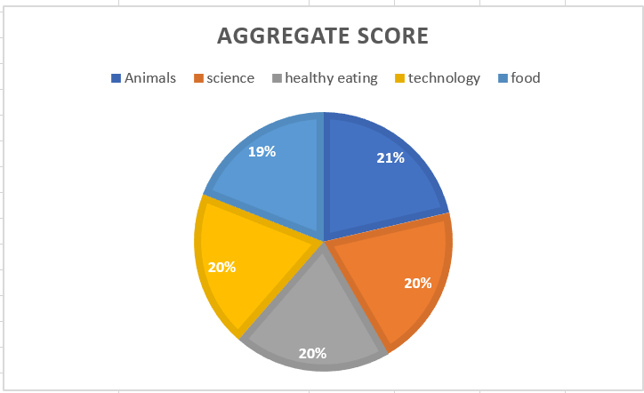
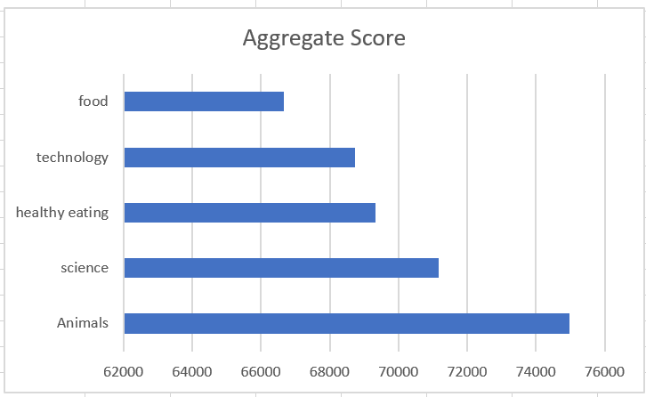

Insights
How many unique categories are there?

Slide 8
How many reactions are there to the most popular category?

Slide 9
How many reactions are there to the most popular category?

Slide 10
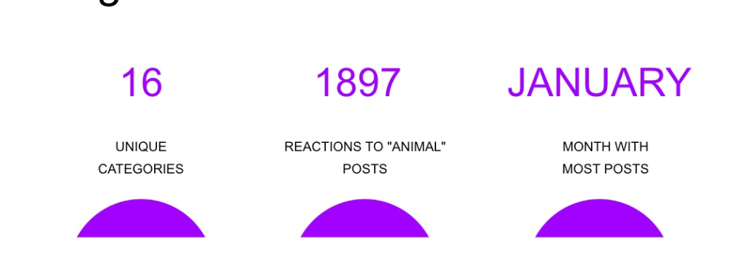
What was the month with the most posts?

Slide 11

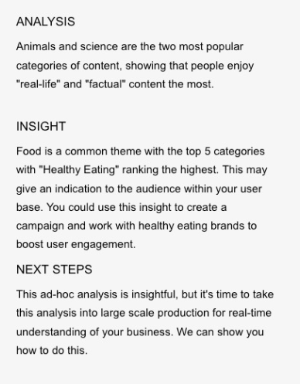
Summary

Slide 12
Thank you!
ANY QUESTIONS?

