Slide 1
Location Aware Message Me App
Group-05
Nitin
Sunand
Ushaswini

Slide 2
Introduction
Location Aware Message Me App allows user to chat in a context aware manner
Features
User can signup using unique username, firstname and lastname and then can login with these credentials
User can see the list of messages he received in homepage after successful login
User interface of list of messages is intuitive enough to distinguish between read/ un-read messages and locked/un-locked messages
User can compose a message to any registered user in any region; User can also reply to a message he received
User can un-lock messages he received when he is in the region pertaining to these messages for considerable time

Slide 3
API Design and Development
Microsoft - ASP.NET Identity Framework and JWT tokens to manage authentication and authorization
ASP.NET Web API is used to develop API for all features
Web APIs and Database are hosted in Microsoft Azure
Tables used are ASPNetUsers( customized to fit requirements) , Regions and Messages

Slide 4
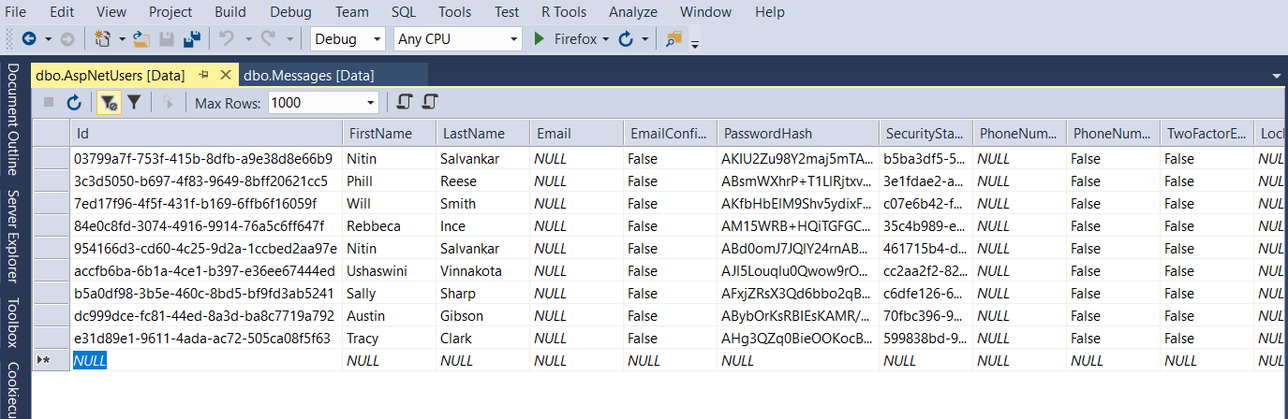
ASPNetUsers
(Customized to meet user profile requirements)
Columns:
Id
FirstName
LastName
UserName
PasswordHash
Identity based columns

Slide 5
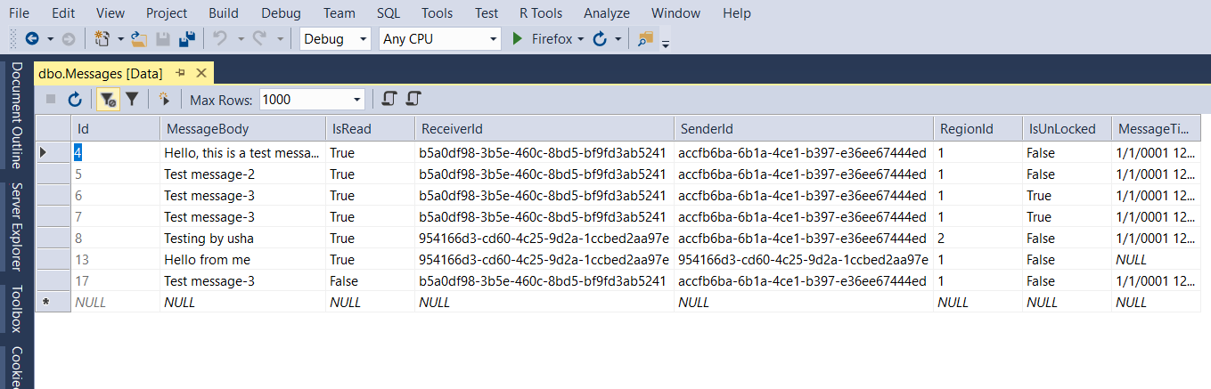
Table – Messages
Columns:
Id
MessageBody
IsRead
ReceiverId
SenderId,RegionId
IsUnlocked
MessageTime

Slide 6
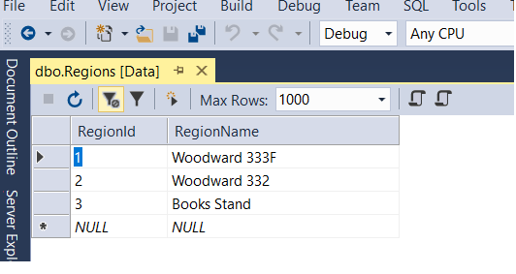
Regions – Seeded with initial data for 3 regions
Columns
RegionId
RegionName

Slide 7
API End Points
Base Url - homework01.azurewebsites.net/
Login - oauth2/token - POST
Register - api/Account/Register -POST
Send Message - api/Messages – POST
Edit Lock Status - api/Messages/EditLockStatus?messageId={id} – POST
Edit Read Status - api/Messages/EditReadStatus?messageId={id} –POST
Delete Message - api/Messages/{id} – DELETE

Slide 8
Test Data
Seeded Users table with this data
User Name | First Name | Last Name | Password
agibson | Austin | Gibson | test1
ssharp | Sally | Sharp | test2
preese | Phill | Reese | test3

Slide 9
Roles
Name | Role
Nitin | Android App Development
Sunand | Deploying API to AWS
Ushaswini | API Development, Xamarin App, Documentation

Slide 10
Tasks - Completed
Signup
Login
Chat-room - Composing message, Replying to message, Deleting message
API Development
Deploying to Azure
Tasks - In Progress
Deploying to AWS
Unlocking messages
Demo Video

