Slide 1
Assignment 1 Within-VR Performance Conditioned on Cognitive Function
INFO-B626 Human Factors Engineering for Health Informatic
Jung, Hee Tae, PhD

Slide 2
Assignment Goals
Devise research hypotheses, strategically choose statistical analysis methods, validate the hypotheses, and report in a professional way.

Slide 3
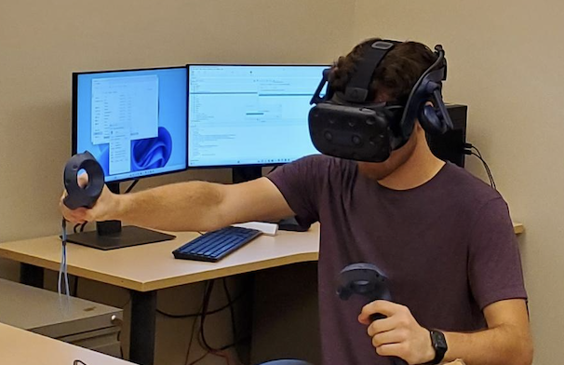
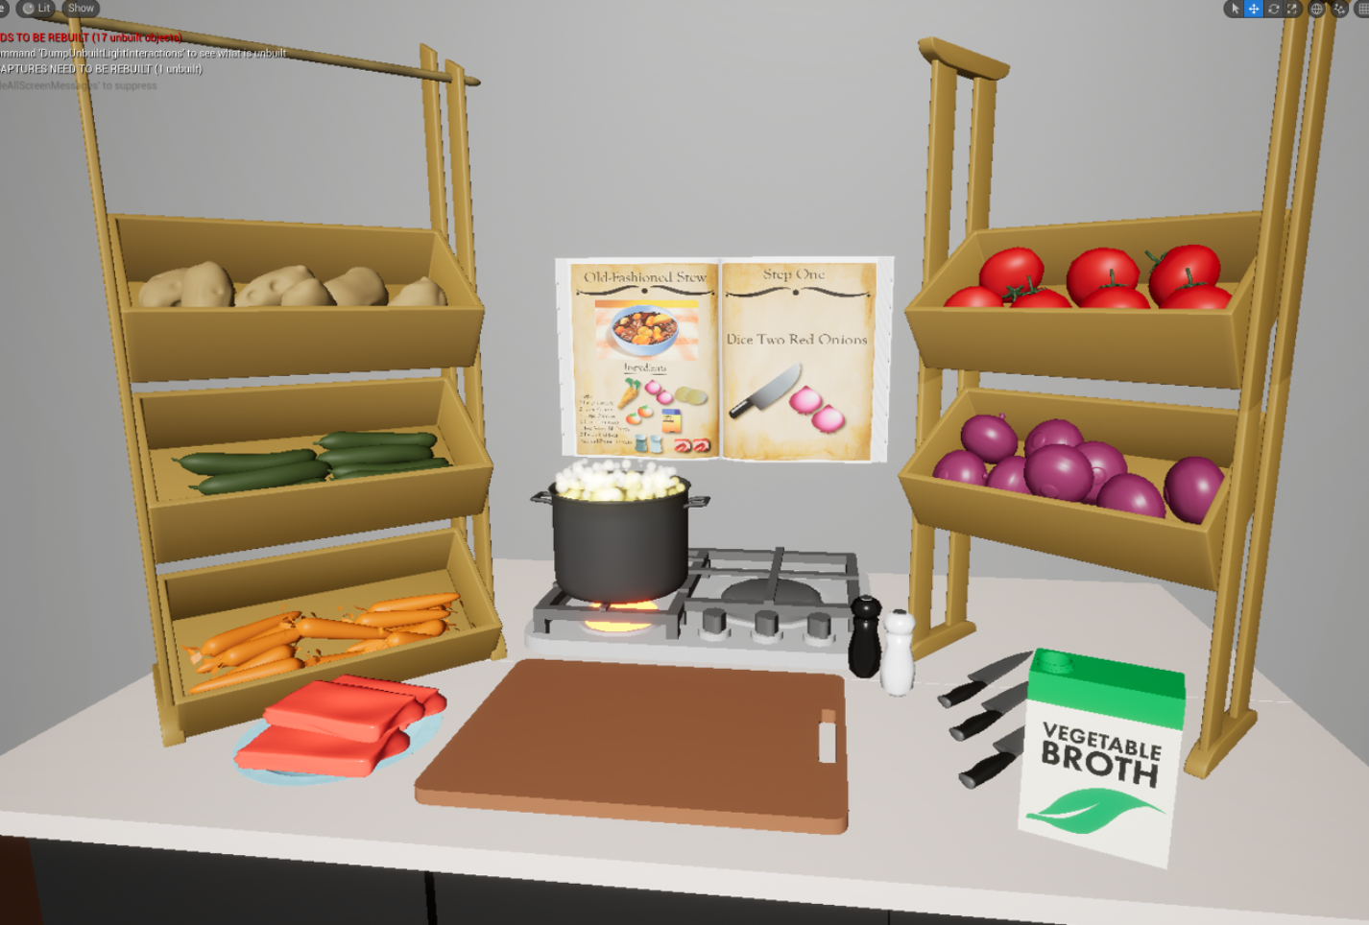
Background Information

Slide 4
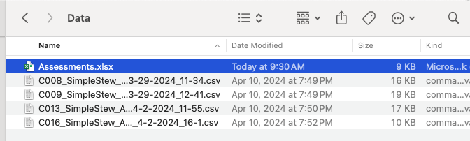
Background Information – Data
Assessment scores w/ Participant IDs

Slide 5
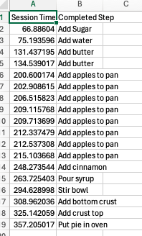
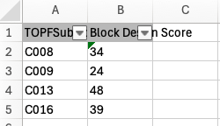
Background Information – Data
Assessment scores w/ Participant IDs
Task completion steps and time

Slide 6
What to Report?
For this assignment, students are expected to submit only the following file. If you are group 1, please name your MS Word document report as below and submit.
Assignment1Group1Report.doc

Slide 7
Points Breakdown (with Extra Points)
Computing the descriptive statistics for assessment scores (i.e., Block Design). Report the results in APA format (1 point) and explain the rationale for your choice of descriptive statistics (1 point). – 2 points
Explaining the implication of #1. – 1 point
Computing the total recipe completion time for each participant. – 1 point
Conducting a Spearman correlation analysis and computing a correlation coefficient. Report the results in APA format. – 1 point
Drawing a scatter plot with the computed completion times vs. Block Design scores. – 1 point
Explaining the implications of #4 and #5. – 1 point
(Extra Points) Devise quantitative measures that describe within-VR performance of study participants that show good correlation with their cognitive function. – 3 points
Propose and compute quantitative measures that go beyond simple total recipe completion time. – 1 point
Conduct a Spearman correlation analysis and compute a correlation coefficient to show a positive or negative relationship. Draw the scatter plot. – 1 point
Explain the implications. – 1 point

Slide 8
Due Date/Time
NOV 3, 2024
11:59PM

