Slide 1
Assignment 2 Conventional vs Physical Data
INFO-B626 Human Factors Engineering for Health Informatic
Jung, Hee Tae, PhD

Slide 2
Assignment Goals
Be able to read and process accelerometer data from stroke survivors to generate clinically meaningful movement measures.
Be able to analyze the accuracy of the computed measures.
Be able to evaluate the pros and cons of the movement measures compared to conventional approaches.
Be able to connect these concepts of macrocognition, distributed cognition (Module 3).

Slide 3
Background Information
Conventional Approaches
Fugl-Meyer Assessment
Motor Activity Log
Accelerometer-based Movements
M2 (in this particular assignment)

Slide 4
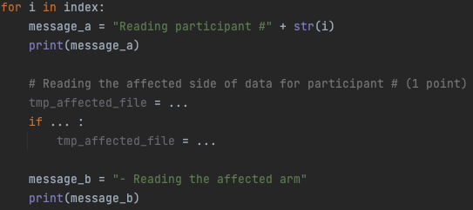
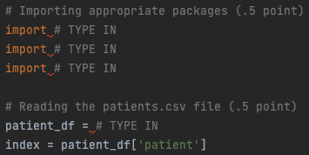
Code Base
Let’s see the actual file
A total of 9 sections that need to be completed For example…

Slide 5
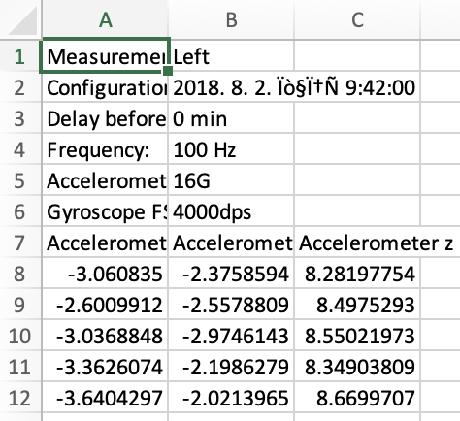
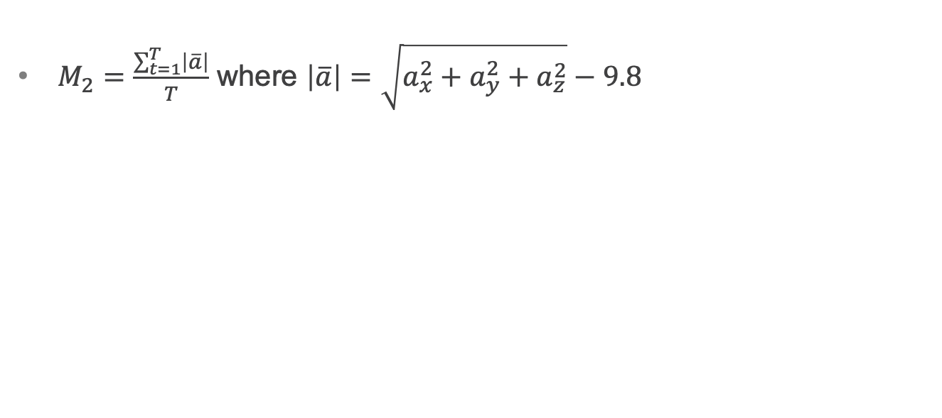
M2 Equations
$M_{2}=\frac{\sum_{t=1}^{T}{\left|\overline{a}\right|}}{T}$ where $\left|\overline{a}\right|=\sqrt{a_{x}^{2}+a_{y}^{2}+a_{z}^{2}}−9.8$
T is the total number of rows

Slide 6
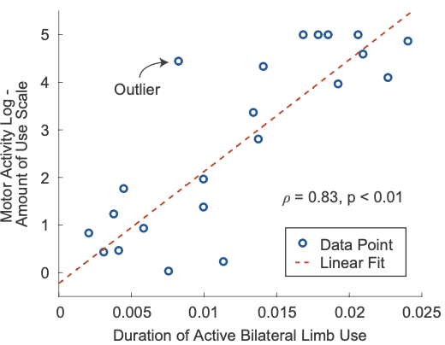
Anticipated Analysis Results

Slide 7
Major Expectations
The provided sample code is written in the PyCharm CE environment.
Please install the same PyCharm CE environment on your computer or a similar environment that can run complete Python code.
Submit a fully executable Python (.py) file. Code fragments for Jupyter Notebook are not acceptable.
Jupyter Notebook files (.ipynb) will not be accepted, graded, or awarded any points.

Slide 8
What to Report?
Zip the followings into a single file and name the zip file after your group number. For instance, if you are assignment group 1, name the file “Group1Assignment2.zip”
Main4students.py (8 points in total)
Assignment2Report.doc (2 points in total)

Slide 9
In Assignment2Report.doc
Include the following
The scatter plot + linearly fitted line that your code generates (see slide 6 for a sample) – no points on this. This is just a simple verifier that your code works.
The discussion of the pros and cons of M2 when compared to the conventional approaches (e.g., FMA and MAL) – 1 point
The discussion of the scenario that you can use the conventional approaches and M2 – 1 point

