Slide 1
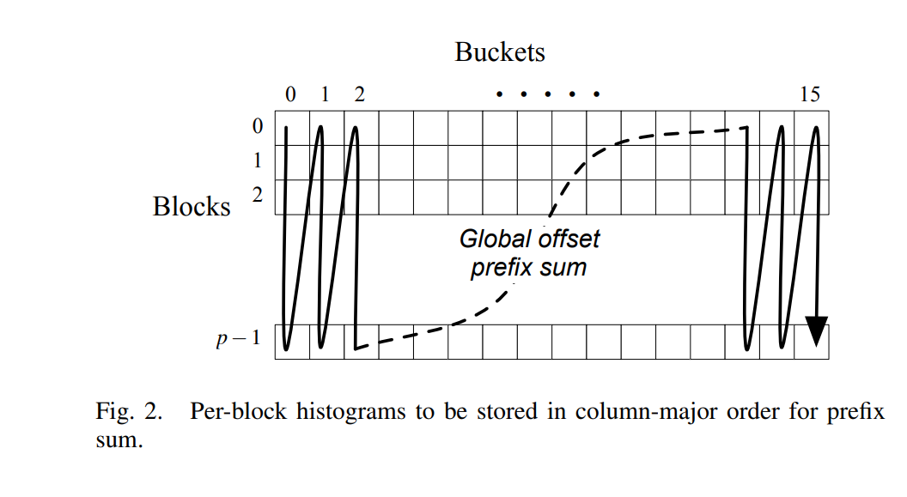
bucket[0] of block[0]
bucket[0] of block[1]
…
bucket[0] of block[15]
bucket[1] of block[0]
bucket[1] of block[1]
…

