Slide 1
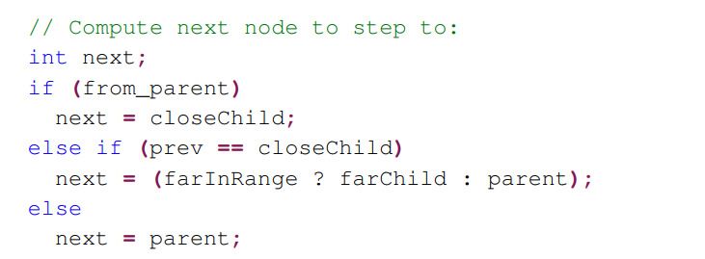
Case 1
prev
Case 2
curr
curr
farChild
closeChild
farChild
closeChild
=next
prev
=next
parent
=next
Case 3
curr
3.2. Pseudo-Code
farChild
closeChild
prev

