Slide 1
A Simplistic All Convolution Net For Efficient Real Time Object Recognition
Under The Supervision Of
Shreejita Mukherjee
Assistant Professor
Department of Computer Science & Engineering
Institute of Engineering & Management

Slide 2
Team Members:
SHUVOZIT GHOSE
USHNIK GHOSH

Slide 3
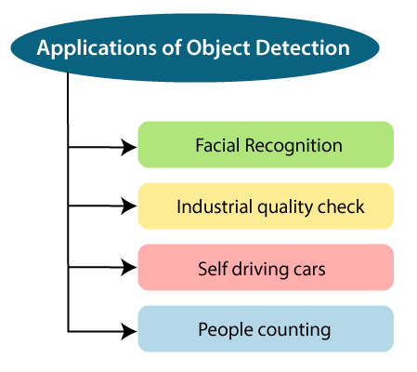
Object Detection in our life

Slide 4
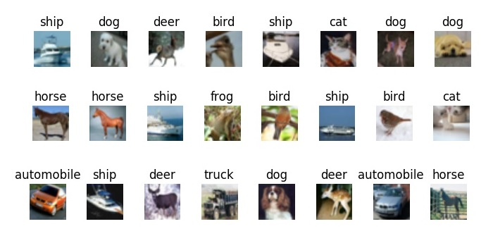
Object Detection
It is a very old computer vision problem.
It is basically a computer vision technique for locating instances of objects in images or videos.
Object Detection recognizes instances of a predefined set of object classes by using bounding boxes.
Why Object detection?
What are the complexity?

Slide 5
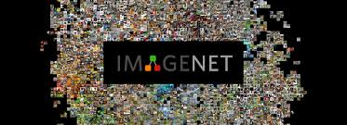
ImageNet Dataset
More than 14 million images with bounding boxes
subset of 1000 categories selected for the ImageNet Challenge
very deep network AlexNet and Resnet used for detection purpose
But it is not feasible for real time object detection

Slide 6
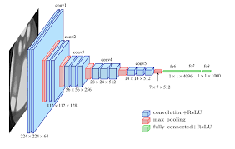
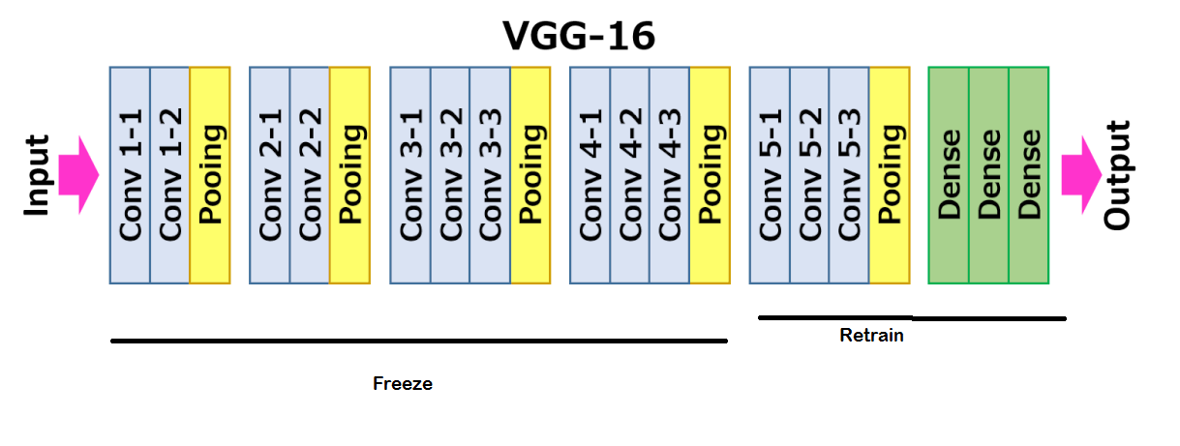
Popular Convolutional Neural Network
same principles: Alternating convolution and max-pooling layers followed by a small number of fully connected layers

Slide 7
Drawbacks
But the max-pooling operation does not extract feature and computation heavy process
Moreover it increases the dimensionality of the input image and takes more memory space
For real time object detection, it is a very one of the constraint
For example, input of shape 32 x 32 x 3 converted to 8 x 8 x 1024 tensor in the fifth layer of VGG 16 network

Slide 8
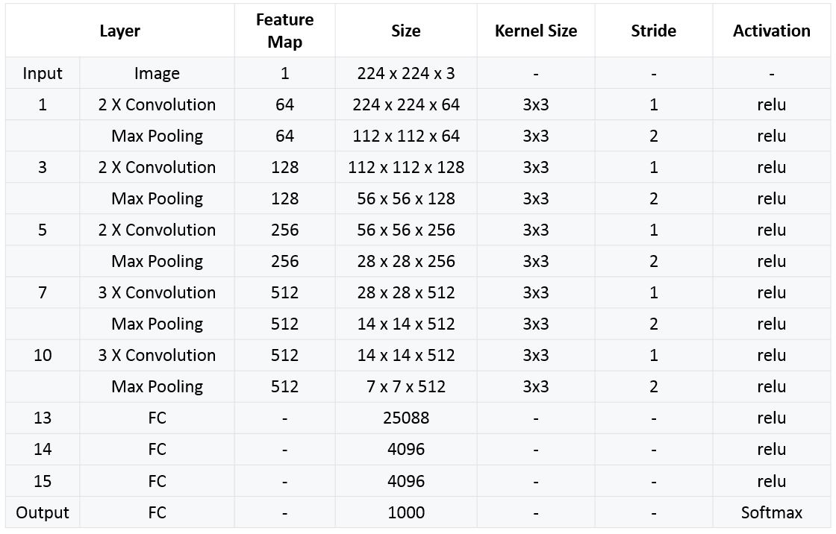
Key points of popular Networks
3 x 3 convolution is used
Sub-sample of factor 2 is applied in the max-pooling layer
The process repeats

Slide 9
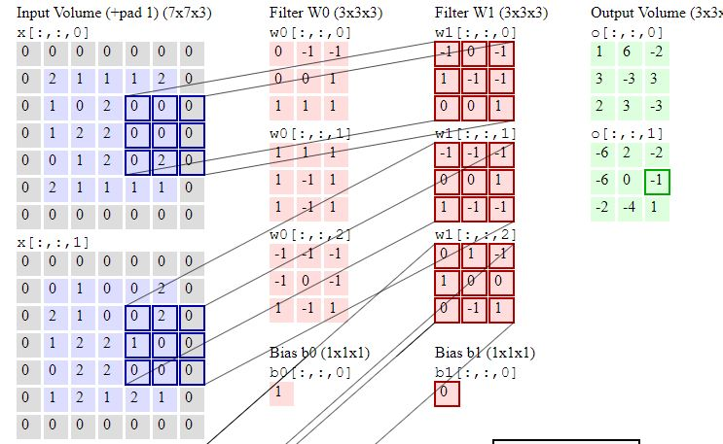
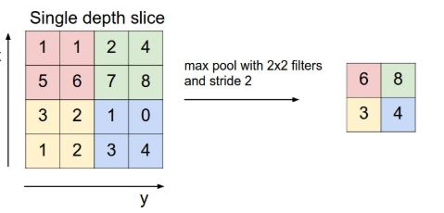
In Depth

Slide 10
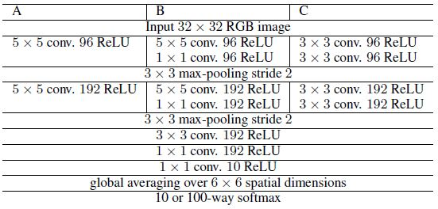
ALL CNN Framework

Slide 11
ALL CNN Framework
We propose a new architecture that consists solely of convolutional layers and yields competitive or state of the art performance on several object recognition datasets (CIFAR-10, CIFAR-100, ImageNet).
To analyse the network, we introduce a new variant of the “deconvolution approach” for visualizing features learned by CNNs, which can be applied to a broader range of network structures than existing approaches.
the effect of transitioning from a more standard architecture to our simplified CNN by performing an ablation study on CIFAR-10 and compare our model to the state of the art on CIFAR-10, CIFAR-100 .

Slide 12
Advantage of our Network
It is a simple network
Applicable for image of small size dataset like CIFAR 10 & CIFAR 100
Time required to detect object small
Computation cost is quite small
So convenient for Real time object detection

Slide 13
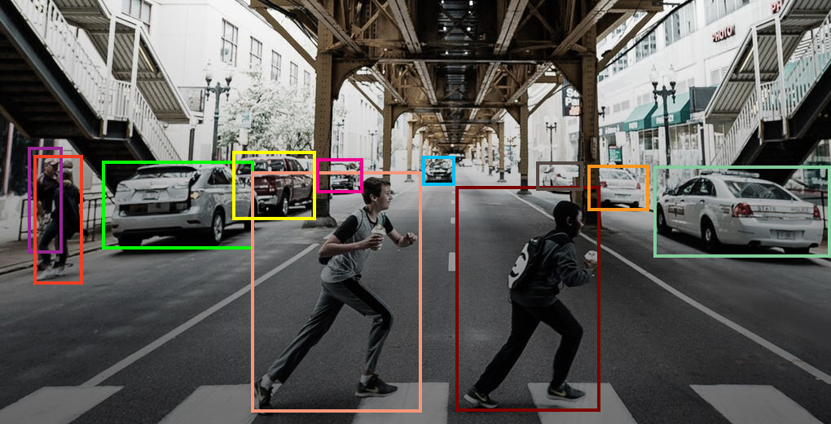
Question ?
Will it able to detect multiple object in high resolution Photo?

Slide 14
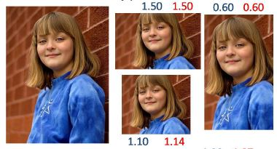
Pre-processing is required
Divide the image into bounding boxes using Region Proposal Network
Then to reduce dimensionality, thumbnail need to generated
Feed the Bounding boxes patch-wise

Slide 15
The End
Thank You For Your Cooperation.

