Slide 1

HEART DISEASE PREDICTION SYSTEM
PRESENTED BY:
191FA04002
191FA04040
191FA04052
191FA04377
191FA04376
Department of Computer Science and Engineering VFSTR Deemed to Be University

Slide 2
INDEX
Abstract
Function Requirements
Input attributes
Screenshots
Conclusion

Slide 3
ABSTRACT
Heart disease, alternatively known as cardiovascular disease, encases various conditions that impact the heart and is the primary basis of death worldwide over the span of the past few decades. It associates many risk factors in heart disease and a need of the time to get accurate, reliable, and sensible approaches to make an early diagnosis to achieve prompt management of the disease.
Data mining is a commonly used technique for processing enormous data in the healthcare domain. Researchers apply several data mining and machine learning techniques to analyze huge complex medical data, helping healthcare professionals to predict heart disease. This research paper presents various attributes related to heart disease, and the model on basis of supervised learning algorithms as Naive Bayes, decision tree, K-nearest neighbor, and random forest algorithm.

Slide 4
Cont……
It uses the existing dataset from the Cleveland dataset of UCI repository of heart disease patients. The dataset comprises 303 instances and 76 attributes. Of these 76 attributes, only 14 attributes are considered for testing, important to substantiate the performance of different algorithms. This research paper aims to envision the probability of developing heart disease in the patients. The results portray that the highest accuracy score is achieved with K-nearest neighbor. Keywords Heart disease prediction : Data mining , Decision tree, Naive Bayes, K-NN, Random forest, Machine learning

Slide 5
Function Requirements
Visual studio Code – code Editor
Any Browser – for web app

Slide 6
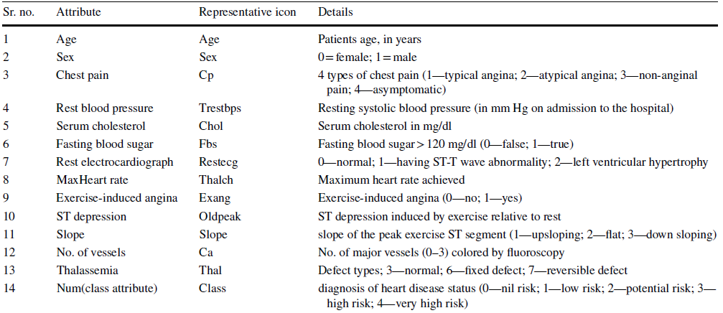
Input attributes

Slide 7
Algorithms used..
Decision tree
Naive bayes
KNN
Random forest
Logistic Regression
SVM

Slide 8
In detail…
Naïve Bayes classifier is a supervised algorithm. It is a simple classification technique using Bayes theorem. It assumes strong (Naive) independence among attributes. Bayes theorem is a mathematical concept to get the probability..(An accuracy of 84.71% has been achieved in Naïve Bayes)
The K-nearest neighbors algorithm is a supervised classification algorithm method. It classifies objects dependant on nearest neighbor. It is a type of instance-based learning. The calculation of distance of an attribute from its neighbors is measured using Euclidean distance..(An accuracy 78.10% has been achieved in KNN)
Decision tree is a classification algorithm that works on categorical as well as numerical data. Decision tree is used for creating tree-like structures. Decision tree is simple and widely used to handle medical dataset. It is easy to implement and analyse the data in tree-shaped graph..(An accuracy of 100.00% has been achieved by the decision tree )

Slide 9
Cont..
Random forest algorithm is a supervised classification algorithmic technique. In this algorithm, several trees create a forest. Each individual tree in random forest lets out a class expectation and the class with most votes turns into a model’s forecast. In the random forest classifier, the more number of trees give higher accuracy..(An accuracy of 100.0% with Cleveland dataset )
Support Vector Machine(SVM) is a supervised machine learning algorithm used for both classification and regression. ... The objective of SVM algorithm is to find a hyperplane in an N-dimensional space that distinctly classifies the data points. The dimension of the hyperplane depends upon the number of features.
(An accuracy of 85.54% with Cleveland dataset)
Logistic regression is a statistical model that in its basic form uses a logistic function to model a binary dependent variable, although many more complex extensions exist. In regression analysis, logistic regression (or logit regression) is estimating the parameters of a logistic model (a form of binary regression).
(An accuracy of 85.12% with Cleveland dataset)

Slide 10
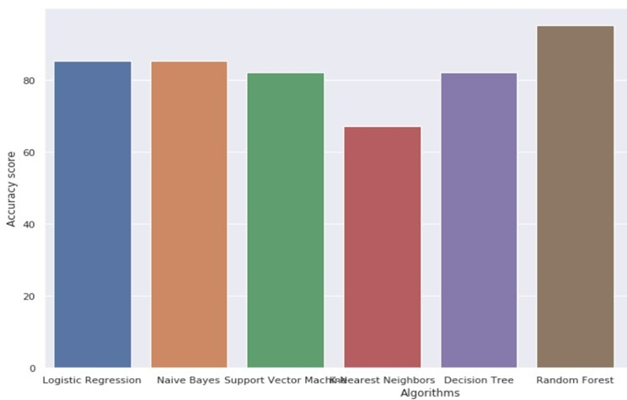
Histogram

Slide 11
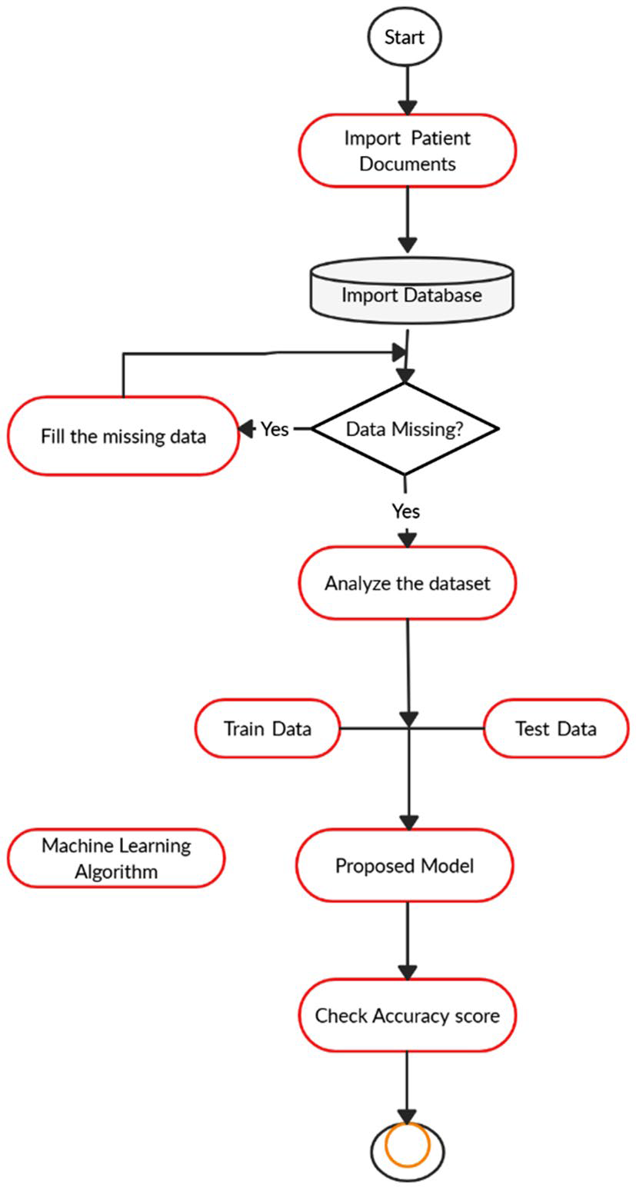
Sequential flow of project

Slide 12
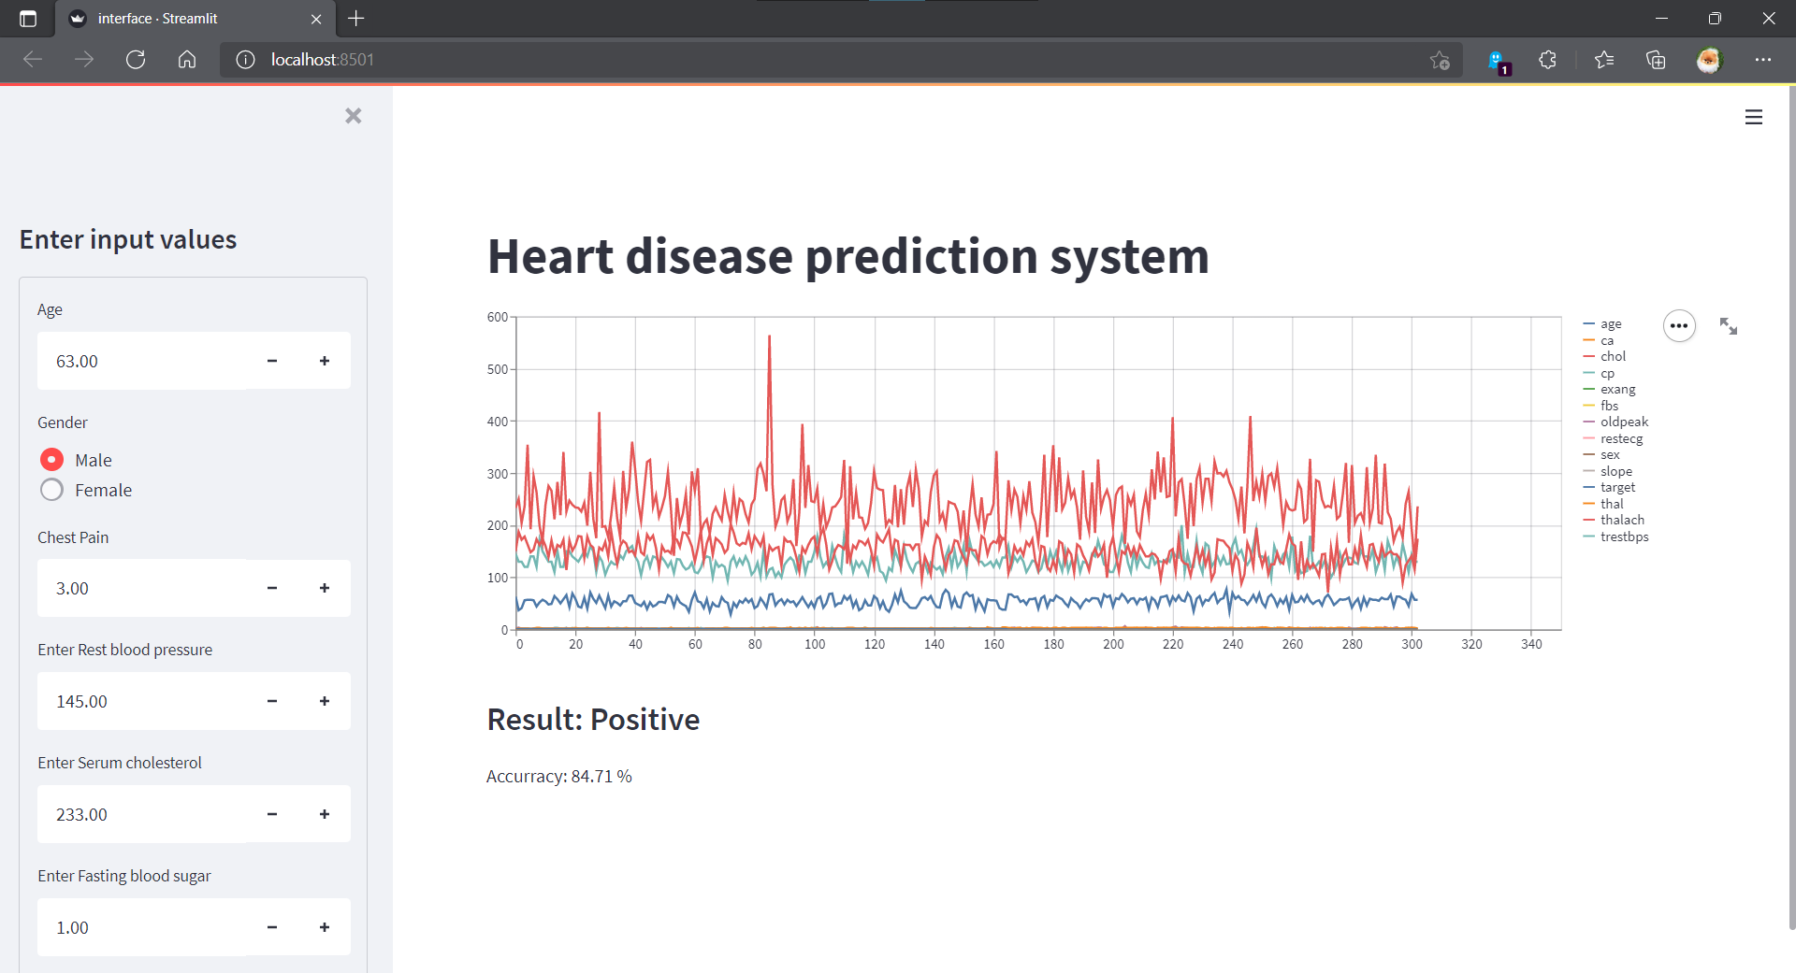
Screen shots

Slide 13
Conclusion
The overall aim is to define various data mining techniques useful in effective heart
disease prediction. Efficient and accurate prediction with a lesser number of
attributes and tests is our goal. In this study, We consider only 14 essential attributes.
We applied 6 data mining classification techniques, K-nearest neighbor, Naive Bayes,
Decision tree, Logistic Regression, SVM, Random forest.
The data were pre-processed and then used in the model. Decision Tree and Random
Forest are the algorithms showing the best results in this model.

Slide 14
THANK
YOU

