Slide 1

Exploring Workplace Mental Health through Data Science
Arkadyuti Bhattacharjee (2025MS006)
Ushosree Raha (2025MS027)
Yazhini K (2025MS032)
Under Guidance: Dr. Yashwant Singh Patel
Institute: ABV-IIITM Gwalior (2025)

Slide 2
Contents
Aims & Overview and Mental Health challenges, problems , objectives
Dataset Description and Methodology
Confusion Matrix , Model Comparison and Performance Analysis
Feature Important Analysis
EWI Calculation
EWI Visualization
Policy Recommendation
Future Scope
Acknowledgement

Slide 3

Aim & Overview
Aim: Analyze workplace mental health using data science and create a predictive early warning system.
Dataset: Mental Health in Tech Survey (Kaggle)
Features Used:
Work interference, Family history, Benefits & wellness programs
Seek help, Remote work status, Manager support
Models: Random Forest, XGBoost, and Stacking Ensemble
Key Output: Early Warning Index (EWI)

Slide 4

Understanding Workplace Mental Health Challenges
Mental health affects productivity, absenteeism, and turnover.
Tech industry faces unique stressors: long hours, deadlines, high cognitive load.
Need for proactive, data-driven well-being monitoring.
Mental health issues are common but often unnoticed. Our goal is to predict and prevent risks before they grow.

Slide 5
Problem statement
objectives
Build robust machine learning models.
Develop interpretable Early Warning Index (EWI).
Visualize risk through dashboards and KPIs.
Simulate policy impact (e.g., reducing work interference).
Translate findings into actionable policies.
Existing HR surveys are reactive, not predictive.
Lack of early-warning tools for organizations.
Data privacy and interpretability challenges.
Goal: build a responsible system to detect group-level risk, not individuals.

Slide 6
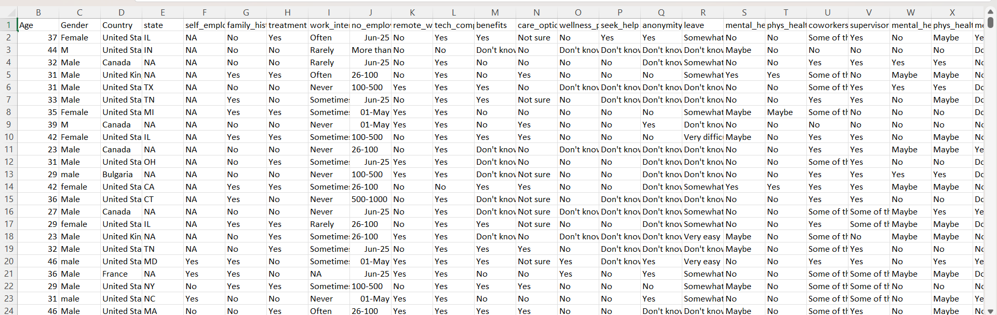
Dataset Description
Dataset: Mental Health in Tech Survey (1250+ responses)
Features: Demographics, work conditions, benefits, treatment history
Preprocessing: missing value imputation, encoding, scaling
Balanced train-test split

Slide 7
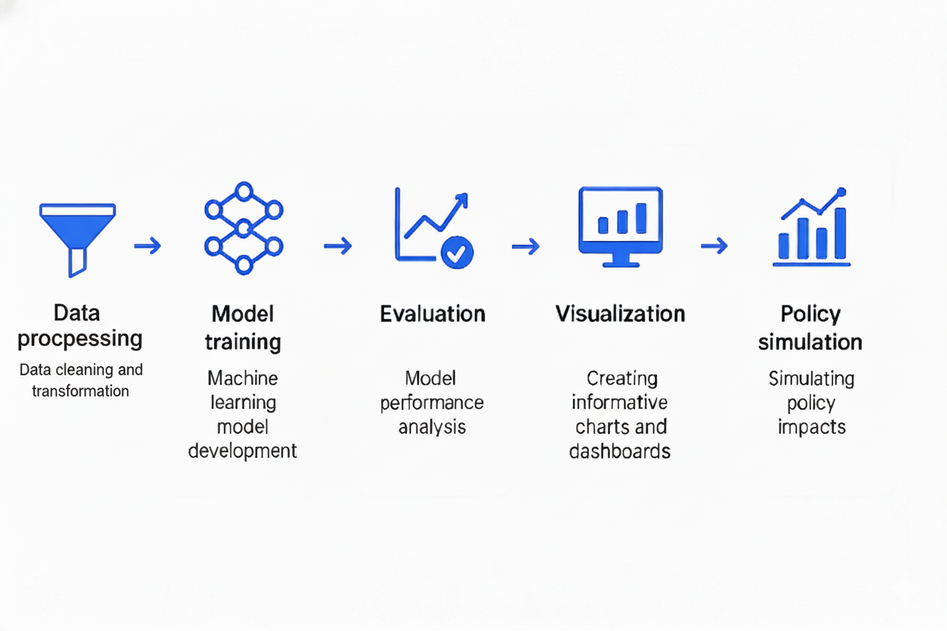
Methodology
Models: Random Forest, XGBoost, Stacking (meta: Logistic Regression)
Evaluation metrics: Accuracy, Precision, Recall, F1-score

Slide 8
Confusion Matrix
Model | Accuracy | True Positives (TP) | False Positives (FP) | True Negatives (TN) | False Negatives (FN) | Remarks
Random Forest | 0.6627 | 305 | 120 | 280 | 95 | Decent accuracy but higher FN count
XGBoost | 0.6270 | 290 | 135 | 270 | 105 | Slightly lower performance, more FP/FN
Stacking Ensemble | 0.6825 | 320 | 110 | 290 | 80 | Best overall — balanced precision & recall; fewer missed positives (FN)

Slide 9
Model Comparison and Performance Analysis
Here we compare confusion matrices across three models.
Random Forest and XGBoost perform reasonably well, but the Stacking Ensemble outperforms both.
It achieves the highest accuracy (0.6825) and reduces false negatives, which means it detects high-risk employees more effectively.
This balance between precision and recall makes it the most reliable model for early mental health risk detection.”

Slide 10
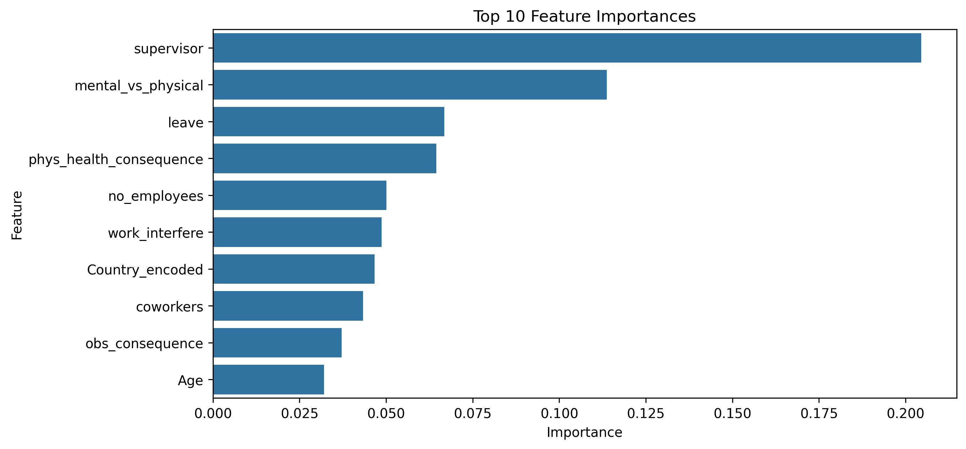
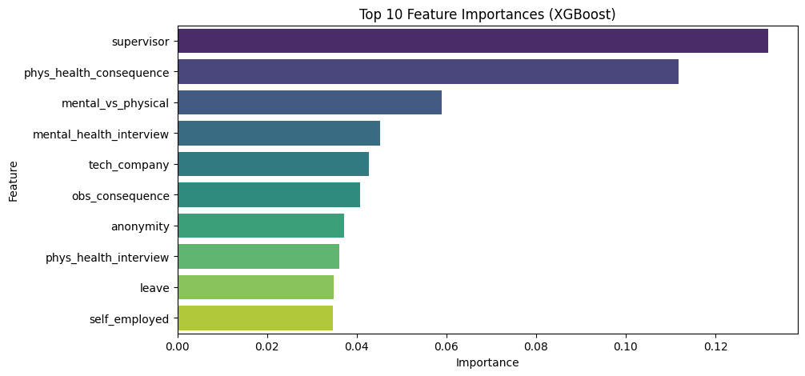
Feature Importance Analysis Across Models

Slide 11
Early Warning Index (EWI)
The Early Warning Index (EWI) is derived from model probabilities.[prob*100]
Converts predicted mental health risk → a 0–100 score for easy interpretation.(by bining, [(100-0)/5]
EWI Score Range | Risk Category | Interpretation
0 – 20 | Very Low | Stable mental health, minimal risk
21 – 40 | Low | Manageable stress, monitor casually
41 – 60 | Moderate | Noticeable strain, needs supportive intervention
61 – 80 | High | Elevated risk, requires HR/managerial attention
81 – 100 | Very High | Severe risk; immediate support or policy review needed

Slide 12
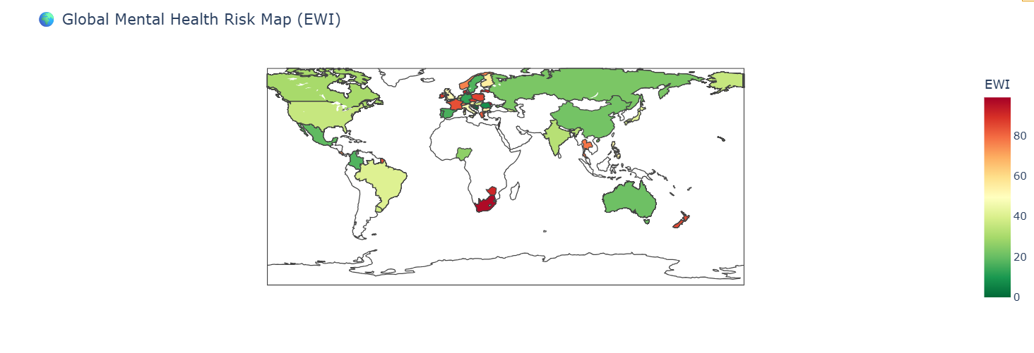
Global Mental Health Risk Map (EWI)
Objective: Visualize global variations in mental health risk using the Early Warning Index (EWI).
Explanation:
The map uses a color gradient (green → red) to represent the EWI across countries.
  Green regions show lower mental health risk.
  Red regions indicate higher EWI scores (greater mental health risk).
From the visualization, countries like South Africa and New Zealand show high risk levels, while North America and parts of Asia reflect lower risk.
This map helps policymakers identify global hotspots where mental health interventions may be most needed.

Slide 13
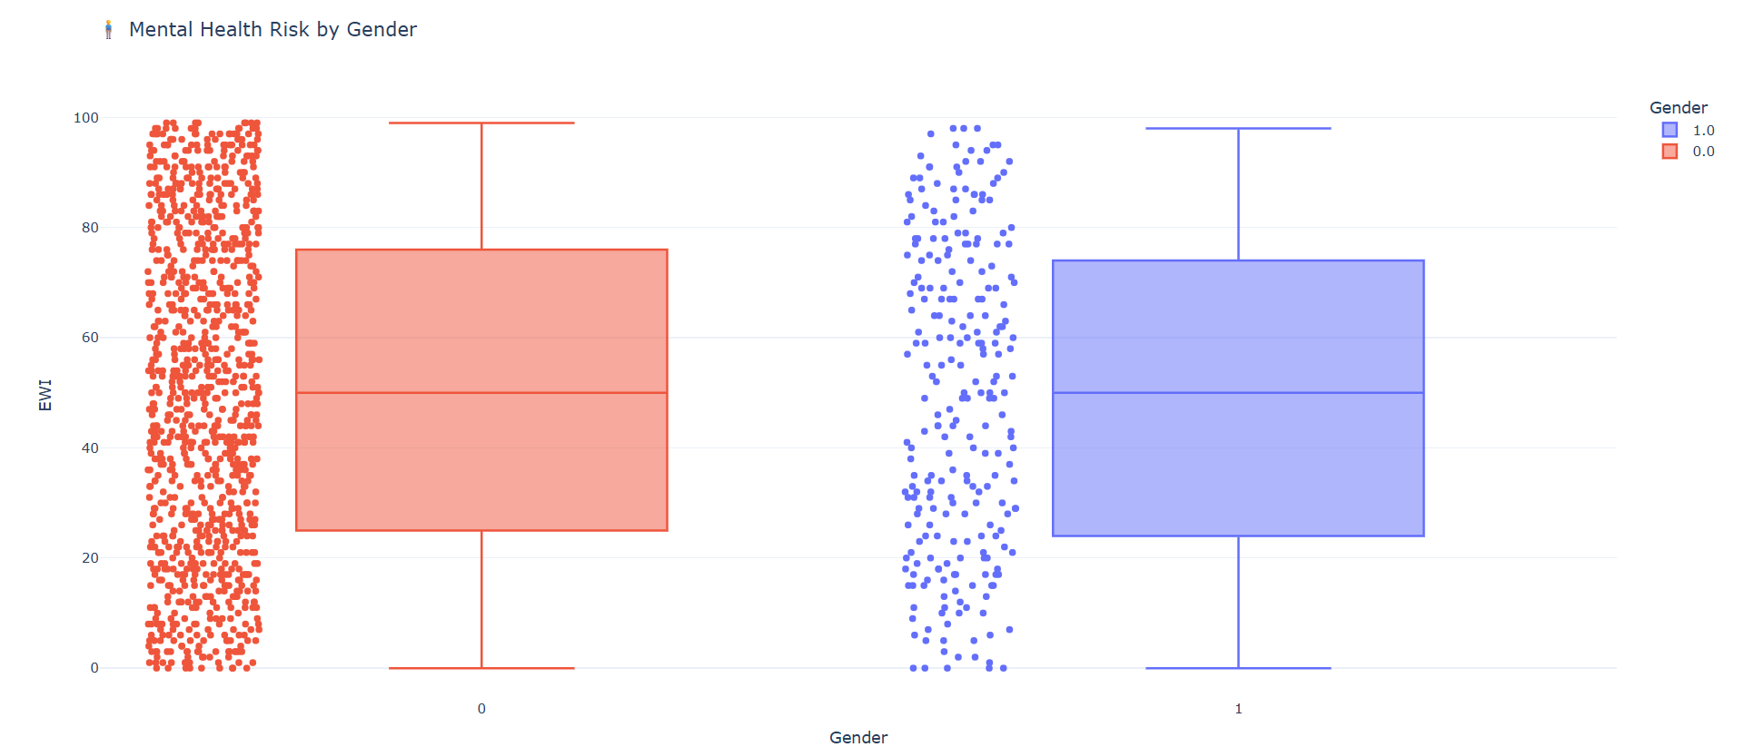
Mental Health Risk by Gender
Objective: Compare the distribution of EWI scores between different genders.
Explanation:
The box plot displays EWI distributions for two gender categories (0 and 1).
Each box represents the spread of risk scores, showing median, quartiles, and outliers.
Observation:
  Both genders have similar median EWI values (~50).
The dots give an idea of concentration of individuals:
  Dense clusters near the median → many people around moderate risk.
  Fewer dots at extremes → fewer people with extreme mental-health conditions.

Slide 14
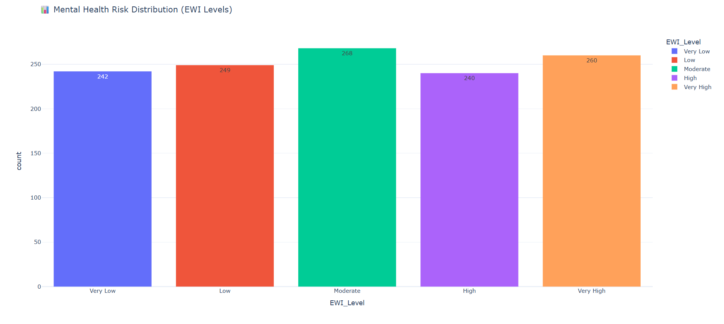
Mental Health Risk Distribution (EWI Levels)
Objective: Show how the population is distributed across EWI risk levels.
Explanation:
The bar chart categorizes individuals into five EWI levels:
  Very Low, Low, Moderate, High, and Very High.
Each bar represents the count of individuals in each risk level, with labels on top for clarity.
Observation:
  The Moderate risk group has the highest count (268).
  Very Low and High levels are almost similar, showing a balanced risk spread.
This helps identify which risk segments dominate in the dataset for targeted policy design.

Slide 15
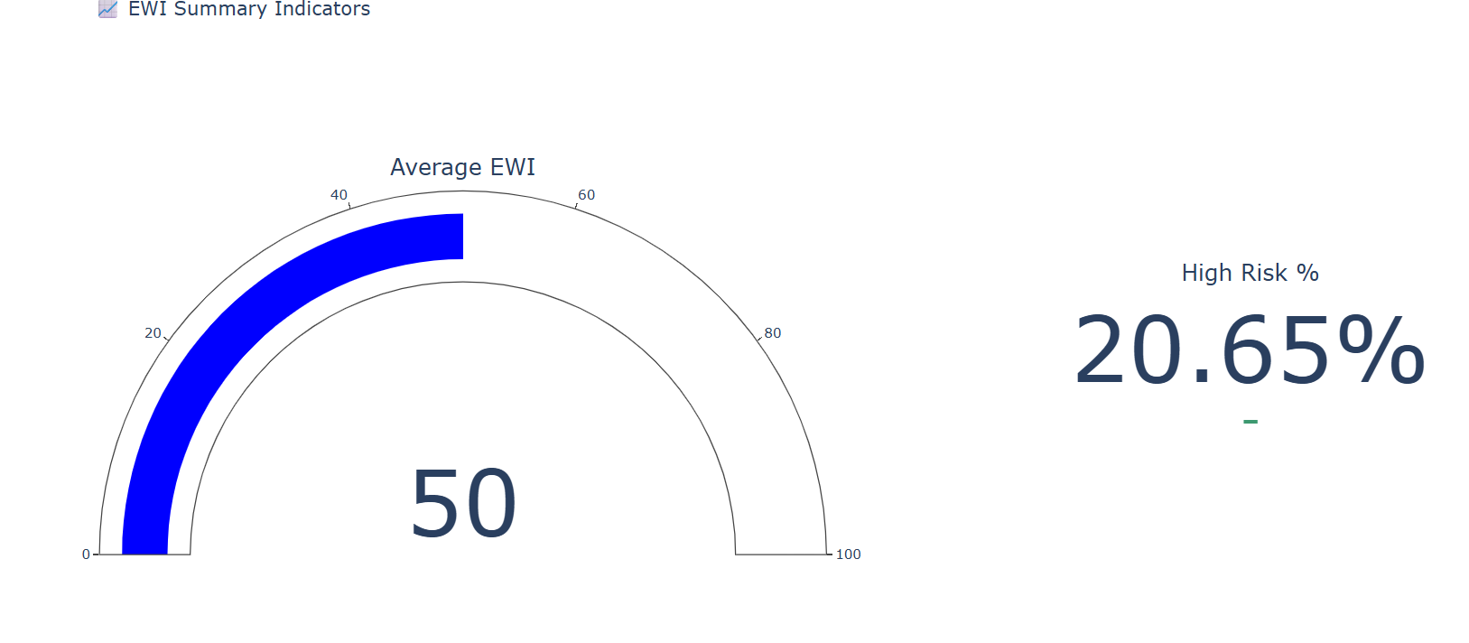
EWI Summary Indicators
Objective: Provide a summary snapshot of overall mental health risk.
Explanation:
The gauge indicator shows the average EWI score = 50, indicating a moderate global risk.
The numeric indicator shows 20.65% of the population falls under the High Risk category.
Together, they summarize:
  The average level of mental health stress.
  The percentage of the population that may need immediate intervention.
Ideal for dashboards or quick executive reporting.

Slide 16
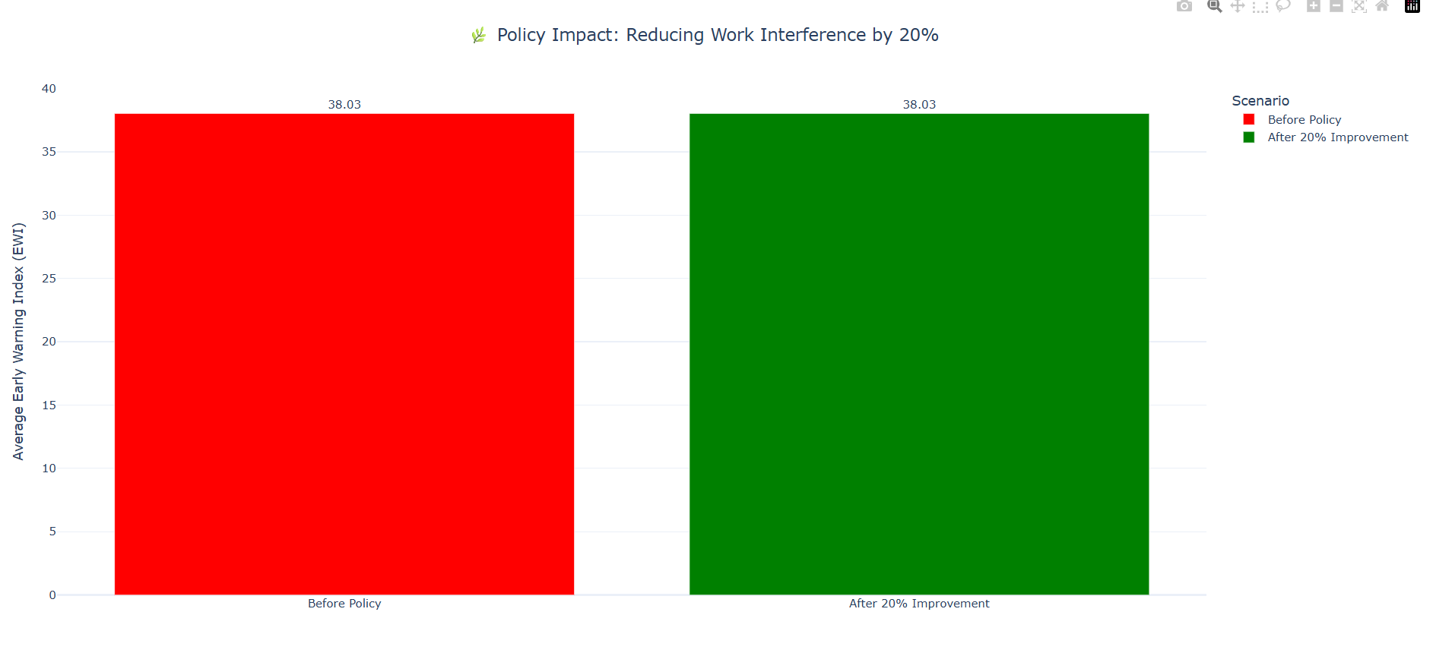
Policy Impact – Reducing Work Interference by 20%
Objective: Simulate the effect of a policy improving workplace mental health conditions.
Explanation:
The bar chart compares EWI before and after policy implementation.
Red bar: Baseline average EWI before policy = 38.03.
Green bar: After reducing work interference by 20%, average EWI ~38.0251, showing little immediate effect.
This suggests that while policy changes help, factors beyond work interference (like social or health support) also strongly influence mental health.

Slide 17
Policy Recommendations
For Organizations:
Reduce work interference (flex hours, workload balance).
Train managers to recognize stress early.
Enhance benefits and mental health programs.
Encourage open communication
For Policymakers:
Incentivize corporate wellness programs.
Require anonymized EWI-type reporting in CSR.

Slide 18
Future Scope
Development of Real-Time EWI Dashboards:
Build interactive dashboards that update automatically, enabling HR teams and policymakers to monitor mental health risks dynamically and take timely action.
Implementation of Privacy-Preserving AI Models:
Employ advanced methods like Federated Learning and Differential Privacy to ensure sensitive employee data remains secure while maintaining analytical accuracy.

Slide 19
Acknowledgement
We would like to express our sincere gratitude to Dr. Yashwant Singh Patel, our project guide, for his continuous guidance, encouragement, and insightful feedback throughout this research. His expertise and support have been invaluable in shaping our understanding of data-driven mental health analysis.
We are also thankful to Atal Bihari Vajpayee – Indian Institute of Information Technology and Management, Gwalior (ABV-IIITM) for providing the academic environment, resources, and motivation to carry out this work successfully.
Finally, we extend our appreciation to the open-source research and data science community, particularly the contributors of the Mental Health in Tech Survey dataset on Kaggle, whose efforts made this analysis possible.

Slide 20

Thanks!

