Slide 1

The Technology Value Stream
CSD 380-A311 DevOps
Module 1.2 Assignment
Usiel Figueroa
May 25, 2025
Notes:
Name, title, and explain that this presentation explores the technology value stream in the context of DevOps practices.

Slide 2

What is the Technology Value Stream?
A series of steps required to convert a business hypothesis into a technology-enabled service or product.
Key Components: Development, Testing, Deployment, Operations
Reference: Prakash (n.d.)
Notes:
Explain the definition and importance of the technology value stream, highlighting its role in delivering customer value.

Slide 3

Value Stream Mapping and Management
Value Stream Mapping: Visual representation of every step in the work process.
Goal: Identify inefficiencies, delays, and bottlenecks.
Value Stream Management: Real-time governance and continuous improvement.
Reference: Shariff (2022)
Notes:
Describe how mapping and managing value streams helps identify inefficiencies and guide improvement initiatives.

Slide 4


Lead Time vs. Processing Time
Lead Time: Total time from request initiation to delivery.
Processing Time: Actual time spent working on the request.
Example: A feature might have 5 days of processing time within a 30-day lead time.
Reference: Kim (2021), Lawrence (2020)
Notes:
Clarify the difference between lead time and processing time.

Slide 5
Common Scenario – Long Deployment Lead Times
Traditional IT Deployments: Lead times of weeks or months.
Causes: Manual approvals, lack of automation, siloed teams.
Consequences: Delayed feedback, high risk of failure.
Reference: Kim (2021),
Walsh (2025)
Notes:
Discuss traditional deployment challenges including long lead times and their root causes.

Slide 6
DevOps Ideal – Short Deployment Lead Times
DevOps Goal: Deployment lead times of minutes.
Achieved Through: CI/CD pipelines, automation, small batch changes.
Benefits: Faster innovation, reduced risk, better customer satisfaction.
Reference: Kim (2021), Walsh (2025)
Notes:
Display how DevOps practices can drastically reduce deployment lead times and improve overall workflow.

Slide 7
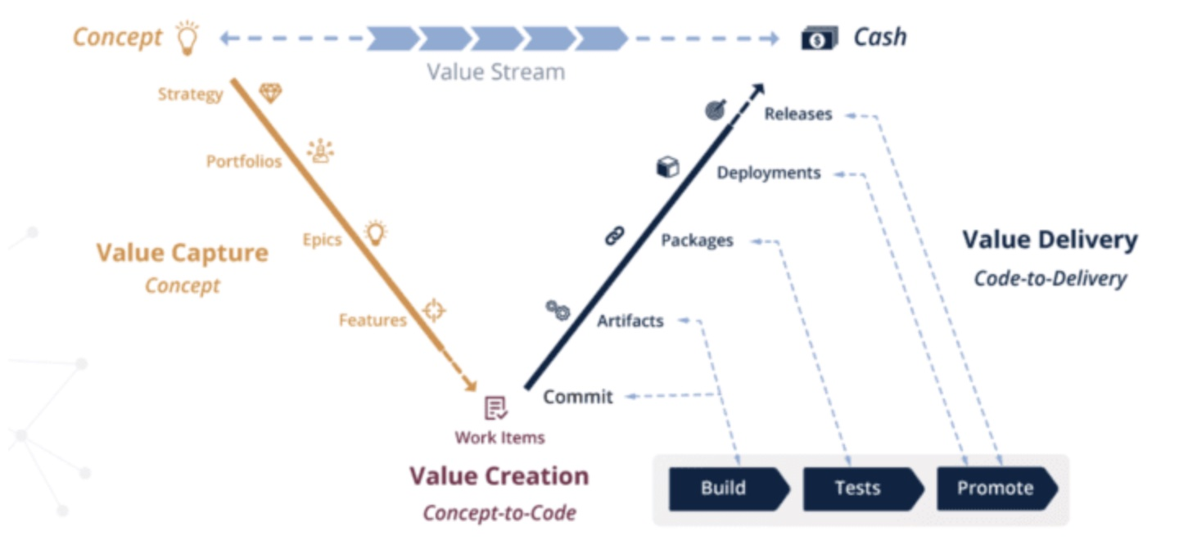
Visual – The Technology Value Stream
Hughart, N. (2024). What is Value Stream Management? [Photograph]. Buildfire. https://buildfire.com/value-stream-management/
Notes:
Display the value stream shown in the graphic. Emphasize how integration across phases improves flow.

Slide 8

Key Takeaways
Understanding the value stream helps identify delays and improve flow.
DevOps aims to reduce lead time and increase efficiency.
Value stream mapping and management are critical for continuous improvement.
Notes:
Summarize the major takeaways about optimizing the value stream and aligning with DevOps principles.

Slide 9
References
Beal, H. (2022, February 24). The technology side of value stream management. Medium. Retrieved May 25, 2025, from https://www.dasa.org/blog/value-streams/
Hughart, N. (2024). What is value stream management? [Photograph]. Buildfire. https://buildfire.com/value-stream-management/
Kim, G., Humble, J., Debois, P., & Willis, J. (2021). The DevOps handbook: How to create world-class agility, reliability, & security in technology organizations (2nd ed.). IT Revolution Press.
Lawrence, C. (2020, June 10). Lead time – a key metric in DevOps. Humanitec. Retrieved May 25, 2025, from https://humanitec.com/blog/lead-time-a-key-metric-in-devops
Prakash, S. (n.d.). What is a value stream, value stream mapping, and value stream management? DevOps Institute. Retrieved May 25, 2025, from https://www.devopsinstitute.com/value-stream-management-explained-in-plain-english/
Shariff, I. (2022, September 27). Value streams definition and guide. DASA. Retrieved May 25, 2025, from https://www.dasa.org/blog/value-streams/
Walsh, A. (2025, May 12). Deployment time: What it is, how to measure & improve. Axify. Retrieved May 25, 2025, from https://axify.io/blog/deployment-time
Notes:
The sources used.

