Slide 1
Credit Card Acquisition — Funnel & Commerce Impact
Sample analysis; assumptions in notes

Slide 2
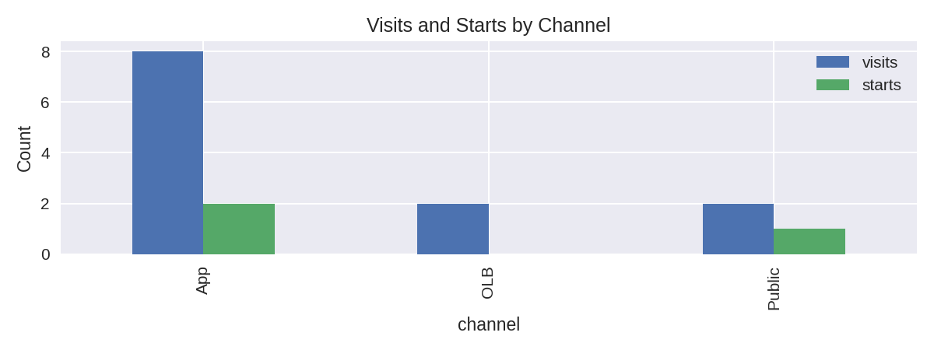
Acquisition Funnel (Visits → Starts)
Funnel by channel. Visits are aggregated visit_count; Starts are unique application_id.

Slide 3
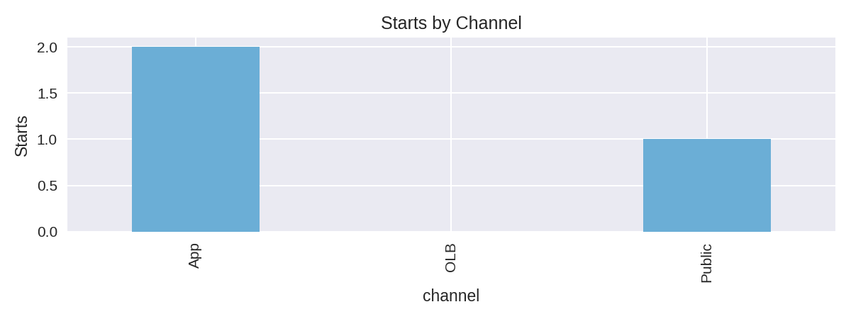
Impact & Recommendations
Sample assumptions: avg_rev £200; approval_rate 60%; +5pp Visits→Starts uplift modelled.
Estimated lost revenue (abandonments): £1,080.00
Estimated incremental revenue from +5pp uplift: £0.00
Recommendations:
1) Provide Submissions and Decisions (with revenue) and marketing spend for ROI analysis.
2) Prioritise App UX tests (highest absolute traffic).

