Slide 1


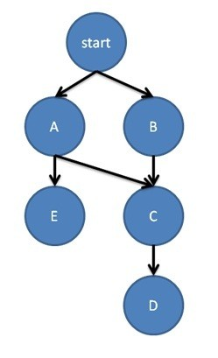

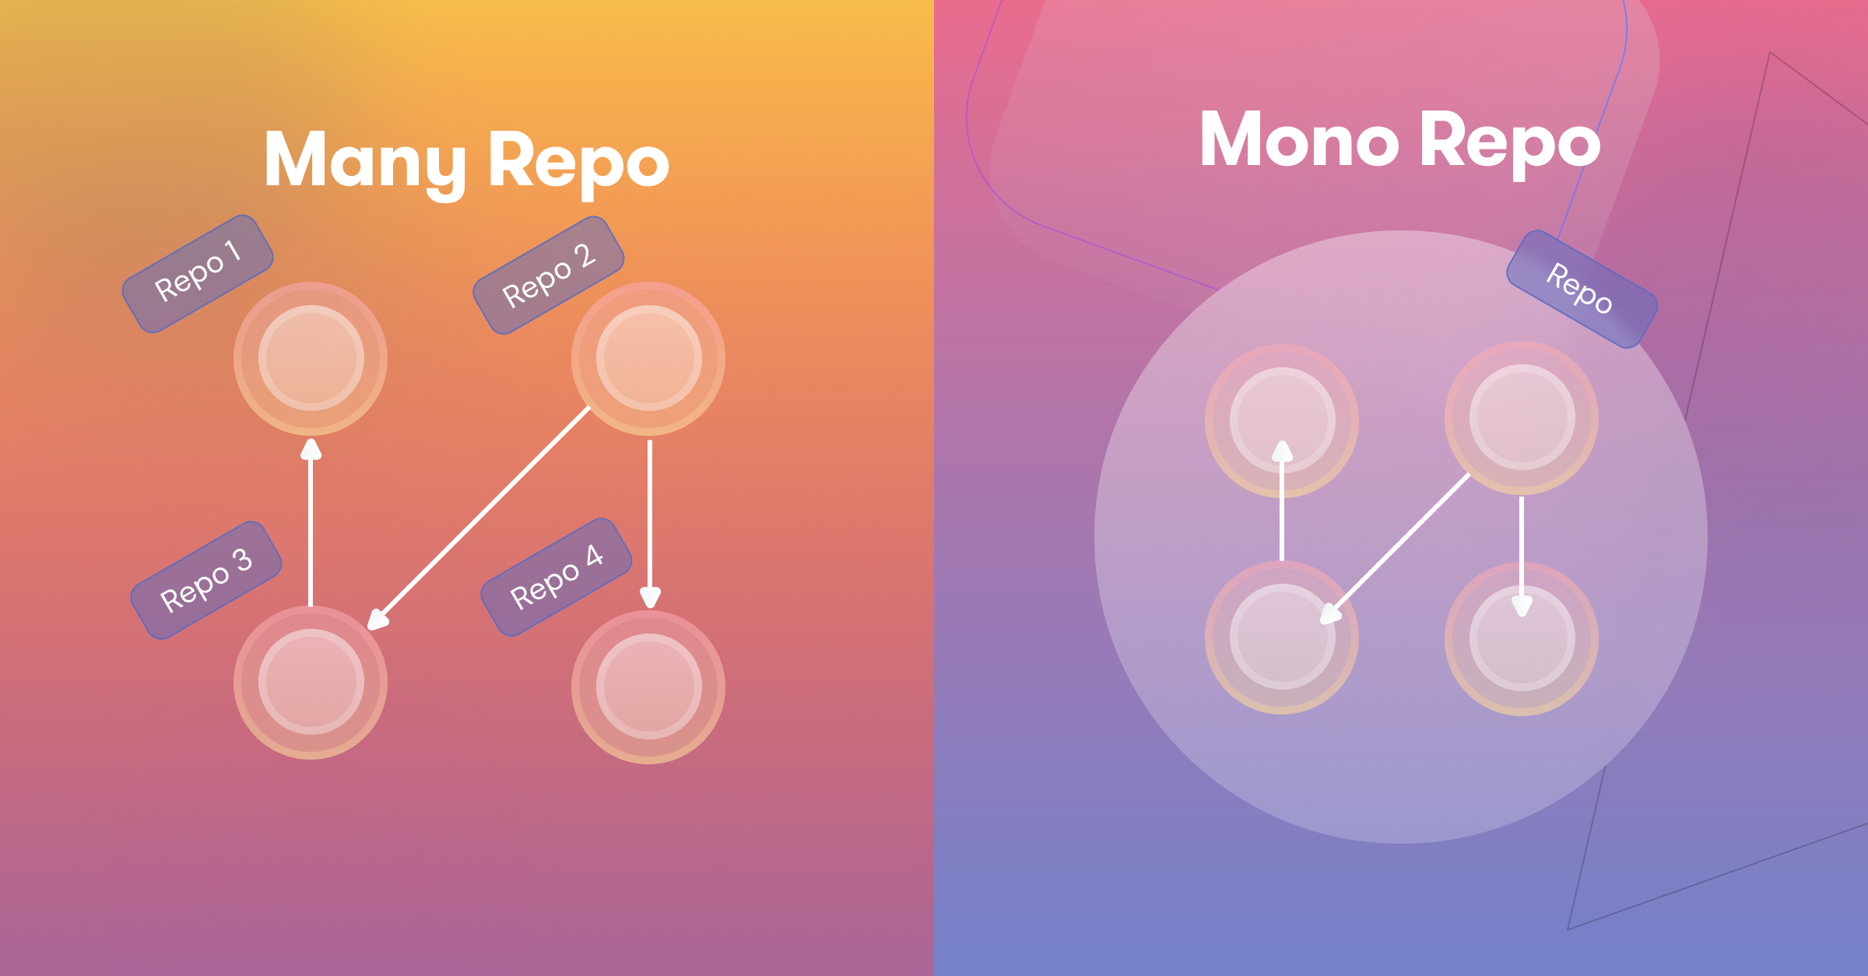
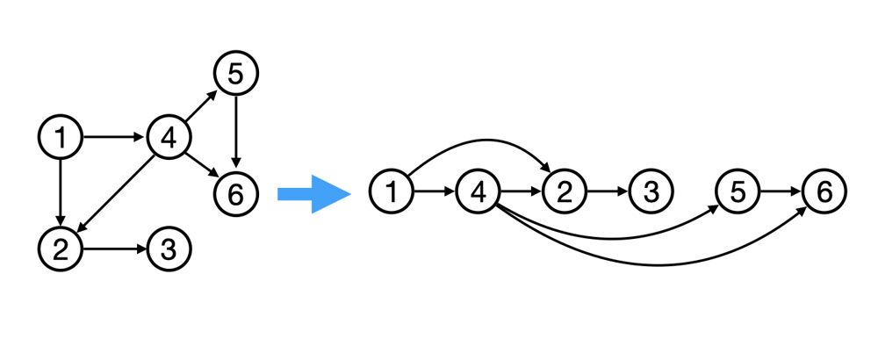
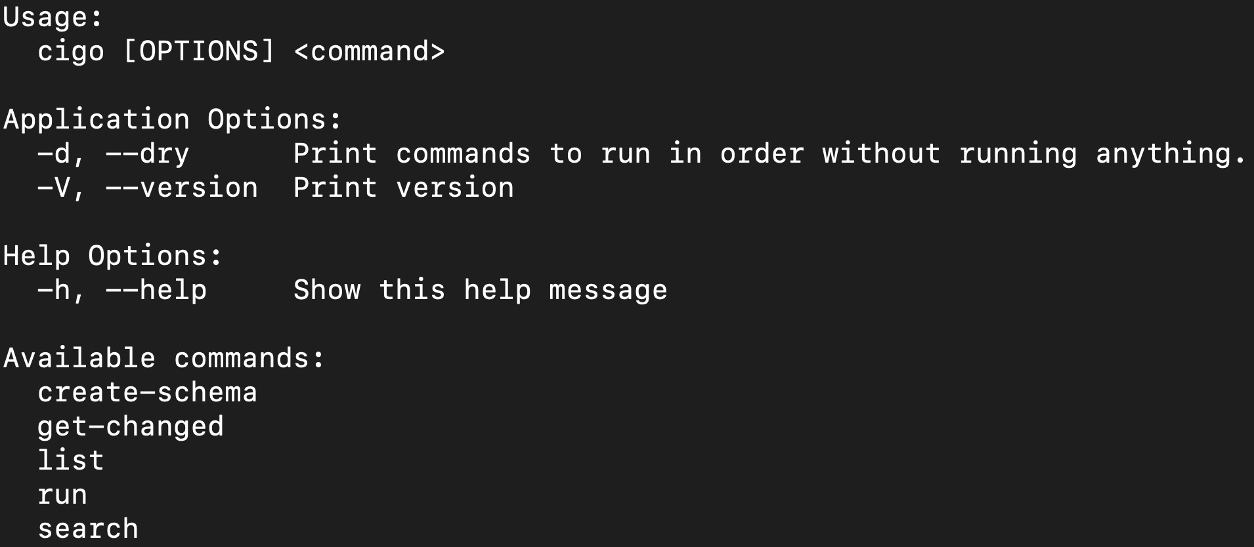
CIGO – TEAM MONOREPO
Omar Alkersh, Ahmed Al-Sabounchi, Usman Asad, Ali Khan, Tanveer Shakeel
Computer Science, McMaster University, Hamilton, Canada
Motivation
A number of companies use the monorepo development philosophy, and more are starting to adopt it. Excluding in-house solutions, there is currently only one real competitor in this space, with others catching up. Monorepos are more complicated to manage than traditional repositories, and would benefit greatly from a tool that helps automate and manage them. Current leading monorepo tools include NX, Bazel, and others. Each tool has features the others lack, or are slow to run or load in CI/CD (Continuous Integration/ Continuous Deployment) environments.
Our Product
Testing
Features/Commands
add-project: Adds a project to the workspace. Upon addition, it updates the workspace and creates a project.json file create-schema: Creates a JSON schema that helps validate the workplace and project files get-changed: list affected projects list: Lists all the projects in the workspace search: Searches all the projects with key:value pairs to find specific information run: Runs target processes Running multiple tasks at the same time. Tasks organized using topological sort Handling task dependency Handling project dependencies Results cached so that expensive operations don’t have to be re-run
References
[1] https://semaphoreci.com/blog/what-is-monorepo [2] https://aws.amazon.com/devops/continuous-integration/#:~:text=Continuous%20integration%20refers%20to%20the,for%20a%20release%20to%20production. [3] https://www.ibm.com/topics/continuous-deployment#:~:text=Continuous%20deployment%20is%20a%20strategy,directly%20to%20the%20software's%20users. [4] https://en.wikipedia.org/wiki/Topological_sorting
This project is a compiled Command Line Interface (CLI) tool used to manage monorepos. This tool should allow the user to check for changes in the code, execute targets, check project dependencies, and provide tooling to aid in CI/CD pipelines where appropriate.
The goal is to provide a portable, fast, and easy to use program to help in CI/CD for monorepos.
This main advantage of our product is the ability to carry out the same functionality as current industry leaders, while maintaining smaller and faster install size. For context, installing Nx and its dependencies could take up to 10 minutes. Our project, on the other hand, installs almost instantaneously.
The product is currently designed to work only on UNIX machines, and was build using the Go programming language.
Used sample project files to test the code’s functionality
Unit testing: achieved 81.80% test coverage over the code
Integration testing: done by extensively testing all the commands, as they utilize the different modules all at once
In the process of maximizing test coverage, all the functions listed in the features section were tested
Assumption of no race conditions between the tests was made
Glossary
Continuous Integration: software development practice where developers regularly merge their code changes into a central repository, after which automated builds and tests are run. [2] Continuous Deployment: strategy in software development where code changes to an application are released automatically into the production environment. This automation is driven by a series of predefined tests. Once new updates pass those tests, the system pushes the updates directly to the software's users. [3] Task Dependency: relationship between two or more tasks, where one task relies on the completion or output of another task before it can begin Topological Sort: algorithm that linearly orders the vertices of a directed acyclic graph (DAG) in such a way that for every directed edge (u, v), vertex u comes before vertex v in the ordering [4]
Design Choices
Language: Go was selected because the project required a compiled, type-checked language. It was favored over C/C++ and Java due to its usability and safety concerns, and over Rust due to its simpler learning curve. Architecture: a component-based architecture was chosen to allow for further expansion of the code without significant rewrites. The different features and logic are encapsulated in different components There are 5 modules: command runner, parser, data, algorithms, and common utility command runner: responsible for running the correct command depending on the user’s input. It also provides any specialized data definitions parser: provides functions to parse files to their respective data types data: provides the data definitions for the program, mainly the project and workspace definitions algorithms: provides functions and data types to schedule the execution of targets and tasks common utility: workaround to Golang’s import limitation, which does not allow cyclic imports. This module contains all the common functionality to avoid cyclic imports
What is a monorepo?
A monorepo (short for monolithic repository) is a software development philosophy where multiple projects are managed within a single repository. These projects may be related, but are often logically independent and run by different teams. Some companies host all their code in a single repository. Most famous example: Google Advantages: Visibility (everyone can see everyone’s code), ease of collaboration, increased code reuse, guaranteed CI, unifed CI/CD deployment (same process used for every project in the repo) Disadvantages: Increased complexity (thus difficult to scale up), longer build and test times, maintaining ownership and conflicts between different projects [1]
How it Works
The program is setup with all the files required to run the program. In the root directory, the workspace.json contains information about the workspace. The projects will be located in the /apps/ directory, with each project setup with its own project.json file. After ensuring that Go is installed on your Unix machine, the program can be compiled by running the command go build after navigating to the /src/ directory. This would create the binary file cigo. To view the available commands, you can type ./cigo –h to get a list of the available commands. Running ./cigo <command> -h outputs information about specific commands.
Dr. Frantisek Franek
McMaster University, Department of Computer Science
ITB-126
Email: franek@mcmaster.ca
Phone: +1(905) 525-9140 Ext. 23233

