Slide 1
Convolutional Neural Network (CNN) Represented by Usman Ahmad

Slide 2


Overview
Problems in Multi-Layer-Perceptron (MLP)
Convolutional Neural Network (CNN)
How Convolutional Neural Network (CNN) Works

Slide 3
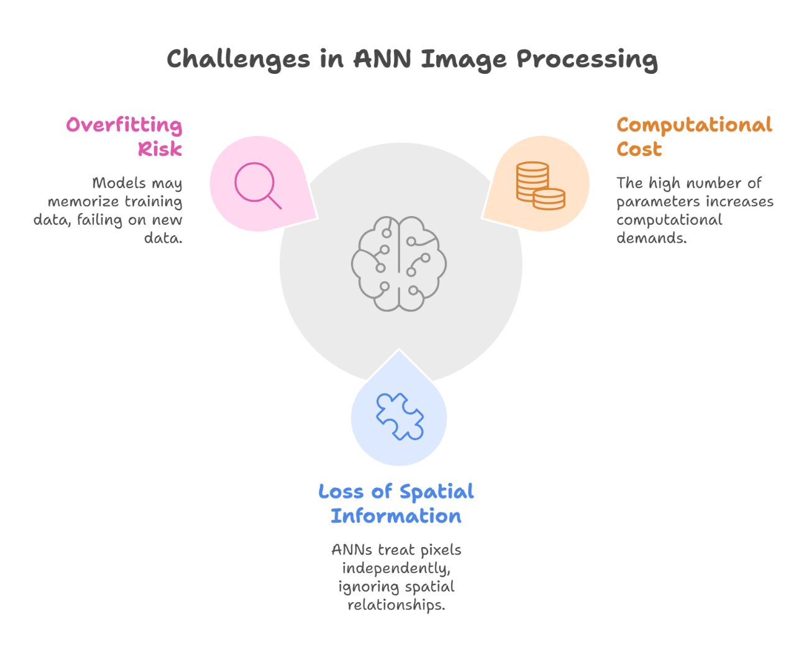
Problems in Multi-Layer-Perceptron

Slide 4
Convolutional Neural Network
A Convolutional Neural Network is a specialized deep learning architecture designed primarily for processing grid-like data, such as images
CNN consist of layers like convolutional layers, pooling layers, and fully connected layers.
The convolutional layer, the building block of CNN uses filters to perform convolution operations by computing dot products with local regions of the image, extracting essential features

Slide 5
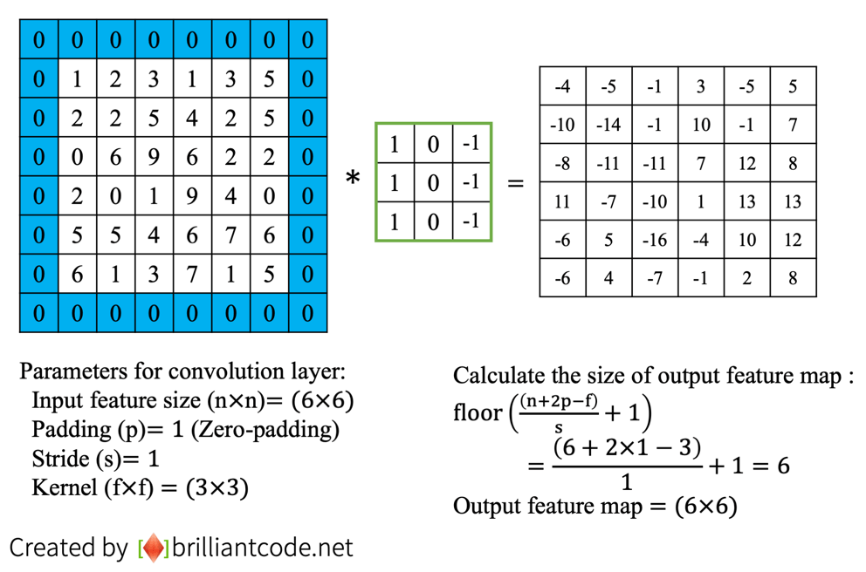
Convolutional Neural Network
Padding:
Padding adds extra rows and columns (typically zeros) around the image.
P = Filter Size−1​
2
Stride:
Stride refers to how much the filter moves (or slides) across the input during the convolution operation.
Output Size = Input Size+2P−Filter Size​ + 1
Stride

Slide 6
How CNN Works
1 Input Layer:
The network accepts raw input (e.g., RGB image).
2 Convolutional Layer:
Filters slide across the input, performing dot products to extract features.
3 Activation Function (ReLU):
Apply (relu) on the output of convolution layer feature map to introduces non-linearity by replacing negative values with zero.
4 Pooling Layer:
Reduces spatial dimensions while retaining important features. Mostly use Max pooling.

Slide 7
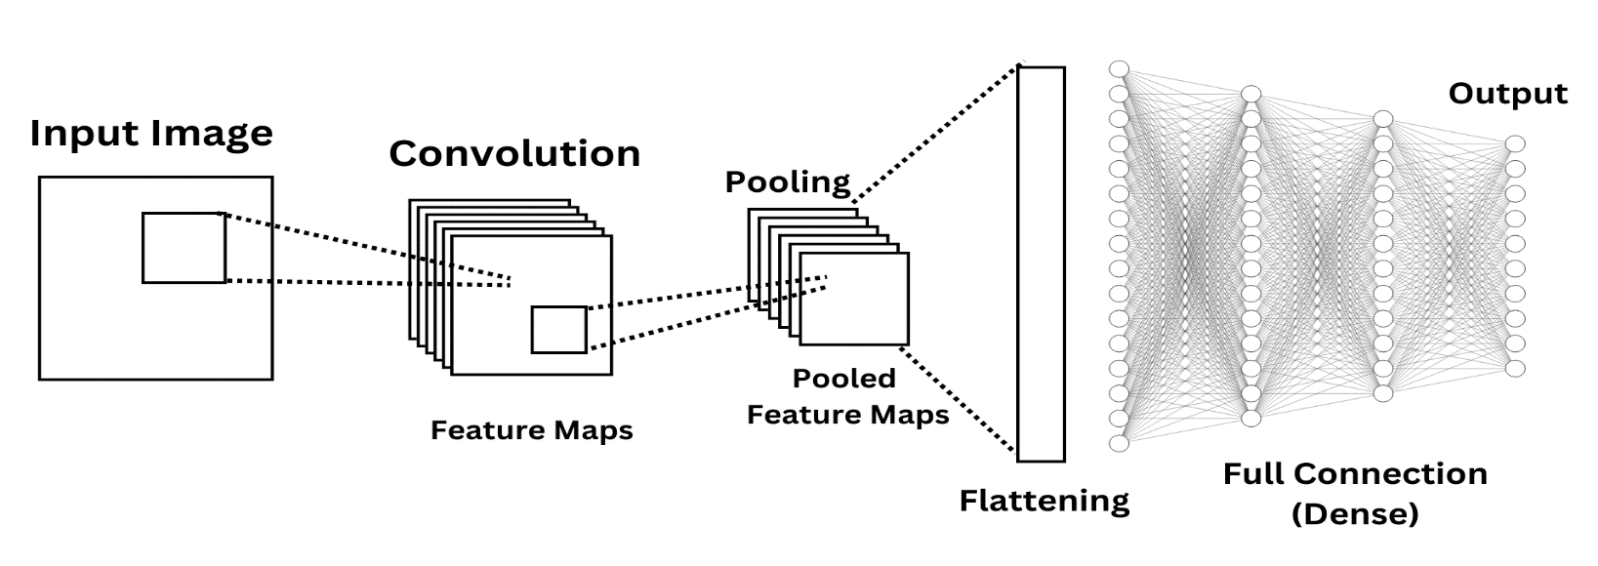
5 Fully Connected Layer:
Flattening Converting 2D feature maps to 1D vector.
6 Output Layer:
The final layer generates predictions, typically using activation functions like sigmoid or softmax to output probabilities for classification tasks.

