Slide 1
Artifical Neural Network (ANN)
Presented by :Usman Ahmad

Slide 2
Overview
Perceptron
ANN
Component of ANN
Evolution of Ann
Problem in ML
ML vs DL
Multi-Layer-Perceptron

Slide 3
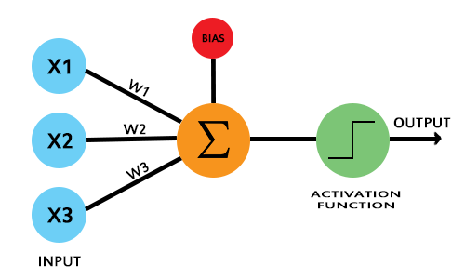
Perceptron
Perceptron was introduced by Frank Rosenblatt in 1958.
It's an algorithm that is used for Supervised machine learning
It is a single-layer neural network used for binary classification, learning linear decision boundaries
It processes inputs with weighted connections and a bias, producing binary outputs through an activation function.
A perceptron network is a group of simple logical statements that come together to create an array of complex logical statements, known as the neural network.
A perceptron takes multiple inputs with associated weights and a bias. It calculates a weighted sum of the inputs, adds the bias, applies a step activation function, and produces an output either 0 or 1.

Slide 4
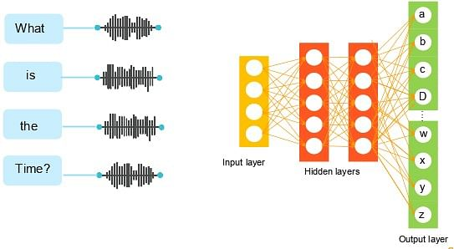
ANN
An Artificial Neural Network (ANN) is a computational model inspired by the way biological neural networks in the human brain process information.
Like the human brain, an ANN consists of neurons that are connected to each other, forming layers. These neurons process and receive information from nearby neurons and send it to others, enabling data transformation throughout the network.
ANNs learn patterns and relationships in data automatically, reducing the need for manual feature engineering. This makes them powerful tools for handling complex and non-linear data.
ANNs are a fundamental technology in machine learning and artificial intelligence, used for a variety of applications such as classification, regression, clustering, and optimization tasks.
They are widely used in real-world applications like facial recognition, speech-to-text systems, fraud detection, and medical diagnosis.

Slide 5
Component of Ann
Neurons (Nodes)
Basic units of an ANN.
Receive input, process it, and pass the output to the next layer.
Layers
Input Layer: The layer that receives the input data.
Hidden Layers: Intermediate layers where the processing is done. There can be one or more hidden layers.
Output Layer: Produces the final output of the network.
Weights
Parameters that are adjusted during training.
Represent the strength of the connection between neurons.
Bias
An additional parameter in each neuron that allows the model to fit the data better.
4. Activation Function
Introduces non-linearity to the model.
Common activation functions include Sigmoid, Tanh, ReLU (Rectified Linear Unit), and Softmax.

Slide 6
The Evolution of Artificial Neural Networks (ANNs)
The Perceptron (1958)
Frank Rosenblatt introduced the Perceptron, the first neural network model capable of binary classification, using weights and an activation function to learn from data. This was a foundational step in deep learning.
Backpropagation and Early Neural Networks (1960s)
In the 1960s, Henry Kelley and Stuart Dreyfus developed backpropagation, which allowed neural networks to adjust weights and propagate errors. This method was crucial for future deep learning models. Alexey Ivakhnenko experimented with multi-layer models, building a foundation for modern neural networks.
The AI Winter (1970s)
The first AI Winter occurred in the 1970s, where optimism in AI research waned. However, Kunihiko Fukushima's Neocognitron in 1979, an early form of convolutional neural networks (CNNs), showed promise in visual pattern recognition, inspiring future CNNs.
Resurgence of Backpropagation (1980s)
In 1985, David Rumelhart, Geoffrey Hinton, and Ronald Williams made backpropagation more effective for training deep networks. In 1989, Yann LeCun applied it to CNNs for recognizing handwritten digits, leading to practical applications.

Slide 7
Continue..
SVMs and LSTMs (1990s)
Despite the second AI Winter, advancements continued. In 1995, Vladimir Vapnik and Dana Cortes introduced Support Vector Machines (SVMs) for classification. In 1997, Sepp Hochreiter and Jürgen Schmidhuber introduced Long Short-Term Memory (LSTM) networks, improving RNNs for sequence-based tasks.
Rise of Data and GPUs (2000-2010)
In the 2000s, the Vanishing Gradient Problem was tackled with techniques like LSTM. In 2009, ImageNet launched, providing a large dataset for deep learning. GPU advancements sped up computations, making deep learning more practical.
Breakthroughs in Deep Learning (2011-2020)
In 2012, AlexNet revolutionized image classification, winning ImageNet's visual recognition challenge. ReLU and dropout layers improved performance. In 2014, GANs (Generative Adversarial Networks) were introduced by Ian Goodfellow, advancing image generation.
Deep Learning Today (2020s Onward)
Deep learning now powers industries such as finance, healthcare, and retail. Companies like Google and Amazon refine models for image search, facial recognition, and NLP. AI's future involves smarter, more context-aware systems.

Slide 8
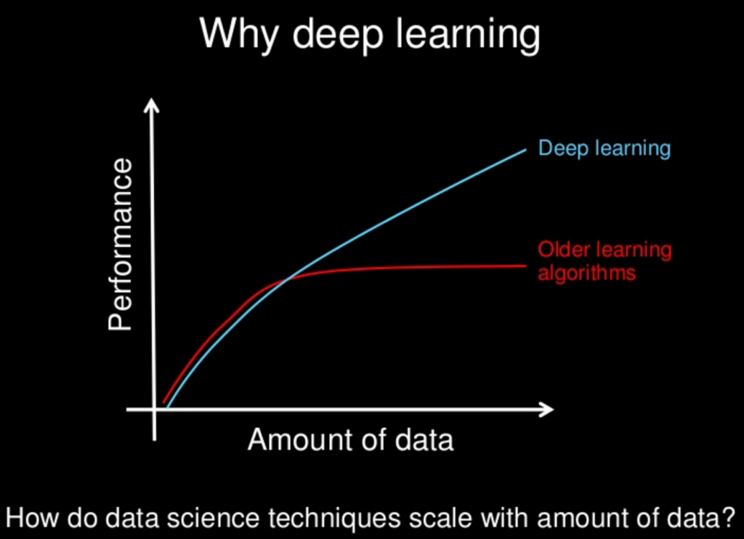
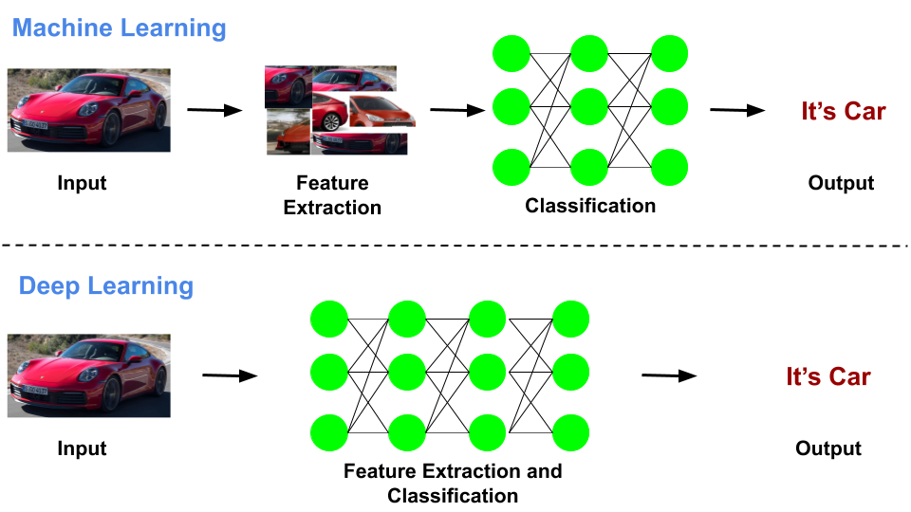
Why ML Failed
As technology advances, the volume of data generated daily continues to increase rapidly. Traditional Machine Learning (ML) faces challenges in handling this massive influx of data due to the following reasons:
LML algorithms struggle to maintain high performance when exposed to large-scale datasets. Their ability to learn complex patterns diminishes as data grows, limiting their scalability.
imited Performance on Large Datasets: Challenges in Feature Engineering: ML relies heavily on manual feature engineering, which requires domain expertise and deep knowledge of the data. This process is time-consuming and error-prone, often leading to suboptimal model performance.
Struggles with Unstructured and Complex Data: ML models perform poorly with unstructured data (e.g., images, text, audio) and complex patterns. Unlike DL, traditional ML models require significant preprocessing and simplification of raw data, which often results in a loss of valuable information

Slide 9
ML vs DL
Aspect | Machine Learning (ML) | Deep Learning (DL)
Architecture | Simpler, based on statistical models. | Uses multi-layer neural networks.
Data Needs | Small to medium-sized datasets. | Requires large datasets.
Feature Engineering | Manual feature selection required. | Automatically extracts features.
Performance | Performs well on simple tasks. | Excels in complex tasks (e.g., images, speech).
Training Time | Faster training on smaller data. | Requires more computational power and time.
Interpretability | Easier to interpret. | Difficult to interpret (black-box models).
Applications | Fraud detection, customer segmentation. | Image recognition, autonomous driving.

Slide 10
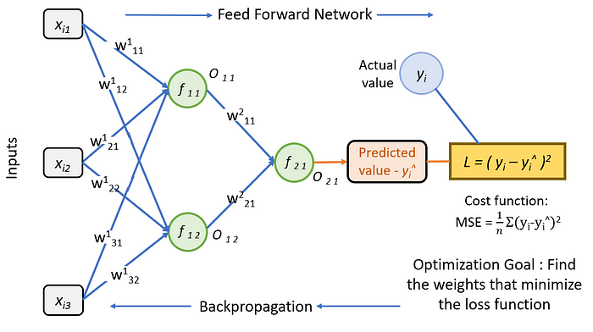
Multi-layer Perceptron
An MLP is a type of neural network with multiple layers of nodes (neurons). It's used for classification and regression tasks.
It contains an input layer, one or more hidden layers, and an output layer.
These hidden layer can have n-number of neurons, in which the first hidden layer takes input from input layer and process them using activation function and pass them to next hidden layers until output layer.
MLP Working Mechanism:
Forward Propagation:
The input data is passed through the network (input → hidden → output) to compute the prediction.
Backpropagation:
After a prediction, the error is calculated, and the network uses backpropagation to adjust the weights of the connections between neurons, minimizing the error gradually using gradient descent.

Slide 11
Thank You

