Slide 1

CE222 · COMPUTER ORGANIZATION GIK INSTITUTE · 2026
VERA-16
A 2-Address 16-bit Processor
Architecting Efficiency with General-Purpose Register Files
Usman Azhar
Reyan Kashif
Muhammad Saim
ID: 2024653
ID: 2024538
ID: 2024453

Slide 2

PROBLEM & MOTIVATION: WHY VERA-16?
THE ACCUMULATOR BOTTLENECK
THE VERA-16 SOLUTION
01
Single accumulator (AC) for all arithmetic operations.
01
8 general-purpose 16-bit registers (R0–R7).
02
16 bits Instruction but 1 address
→
02
16-bits, with 2-address format: any register as source or destination.
03
Results must return to memory before reuse.
03
Register access eliminate memory use between code execution
04
Limited instruction types (8) and addressing modes (2).
04
33 instructions across 5-bit opcode space.

Slide 3

DESIGN AT A GLANCE: ARCHITECTURE OVERVIEW
WORD SIZE
MEMORY (RAM)
REGISTER FILE
16-BIT
4096×16
8 REGS
Unified data and instruction width
Addressable memory space
R0–R7 General-Purpose Registers
INSTRUCTION SET
OPCODE SPACE
ADDRESSING
33 OPS
5-BIT
4 MODES
Comprehensive functional coverage
Up to 32 instruction slots
Reg, Imm, Direct, Reg-Indirect
INSTRUCTION WORD: OPCODE(5) | MODE(2) | DST(3) | SRC(6) = 16 BITS

Slide 4
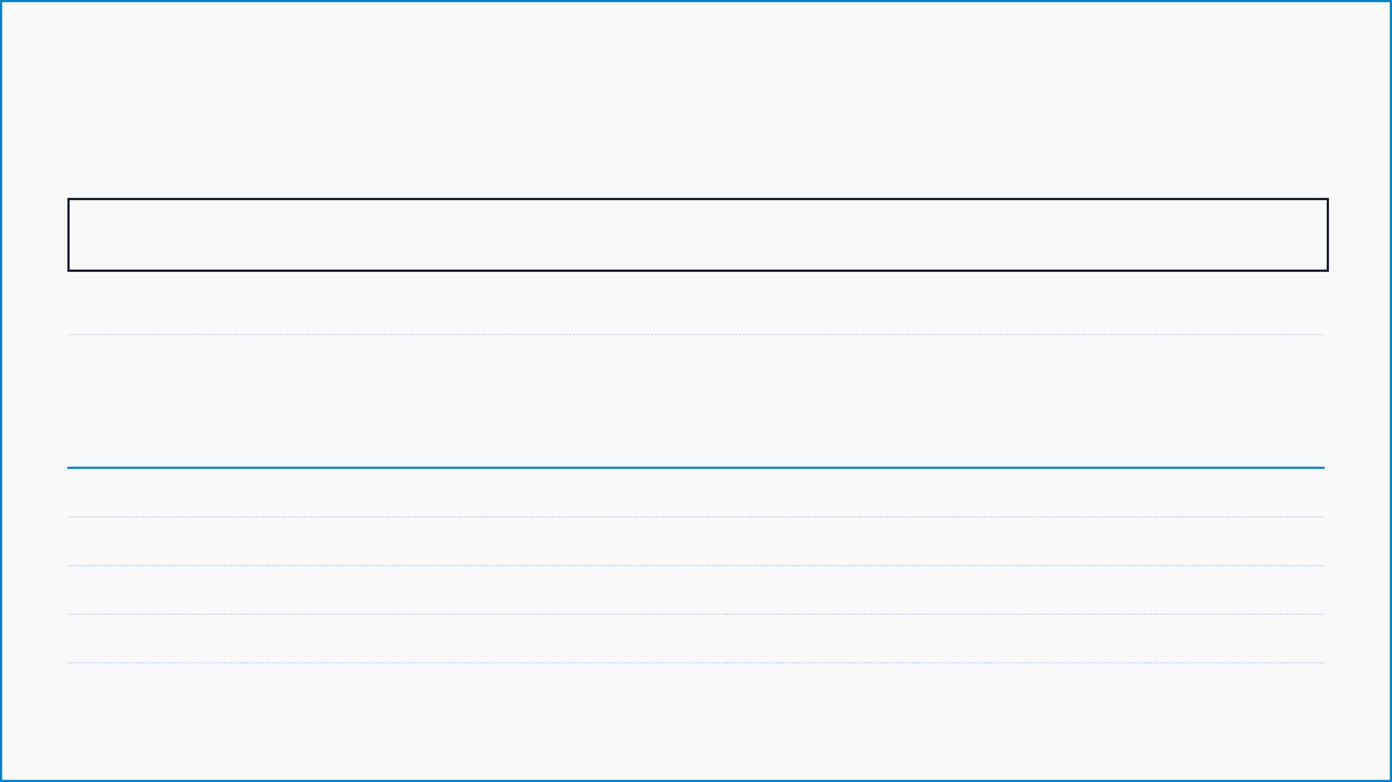
16-BIT INSTRUCTION WORD FORMAT
OPCODE
MODE
DST
SRC
15 : 11
10 : 9
8 : 6
5 : 0
5 bits → 32 instruction slots
4 addressing modes
Destination Reg (R0–R7)
Register, value, or address
WORKED EXAMPLE: ADD R2, R5
FIELD
VALUE
BINARY REPRESENTATION
OPCODE
ADD (0)
00000
MODE
Reg-to-Reg (0)
00
DST
R2
010
SRC
R5
000101
FULL INSTRUCTION: 00000 00 010 000101

Slide 5

33 INSTRUCTIONS: FUNCTIONAL CATEGORIES
ARITHMETIC
LOGIC
SHIFT
ADD SUB MUL INC DEC CMP
AND OR XOR NOT CMR
SHL SHR
DATA TRANSFER
CONTROL
I/O & INTERRUPT
MOV LDI LDM STM
JMP JZ JNZ HLT
INP OUT SKI SKO ION IOF
TECHNICAL NOTE: Register-reference group (opcode 11110) uses one-hot bit encoding for 7 sub-operations.

Slide 6

INSIDE THE ALU: ARITHMETIC LOGIC UNIT
RIPPLE-CARRY ADDER
LOGIC UNIT
BARREL SHIFTER
ARRAY MULTIPLIER
16-bit Architecture. Handles ADD, SUB, INC, and DEC operations. Utilizes a MUX-selected Y-input for versatile arithmetic processing.
16 One-bit Slices. Performs AND, OR, XOR, and NOT operations. Each slice features a 4×1 MUX for rapid logical computation.
Dynamic Shifting. Shifts left or right by n positions (n from IR[3:0]). Captures the shifted-out bit in the Carry flag.
Hardware Native. 16 rows of AND gates + 15 adders. Produces a 32-bit product; the lower 16 bits are stored in the DST register.
OUTPUT SELECTION: A 4×1 MUX (controlled by S3, S2) selects the sub-unit result for the register file.

Slide 7

FETCH-DECODE-EXECUTE: CONTROL UNIT CYCLE
PHASE 01
PHASE 02
PHASE 03
FETCH
DECODE
EXECUTE
AR ← PC
IR[15:11] → DEC
CTRL GEN
Address of next instruction moved to Address Register.
5-bit Opcode sent to the instruction decoder.
Control Unit generates timing signals (T0-T7).
IR ← M[AR]
IR[10:9] → MODE
ALU OP
Instruction fetched from memory into Instruction Register.
2-bit Addressing Mode identified.
Arithmetic or Logic operation performed by ALU.
IR[8:0] → REGS
PC ← PC + 1
REG WRITE
Destination (3-bit) and Source (6-bit) fields extracted.
Program Counter incremented for the next cycle.
Result stored back into the Destination Register.

Slide 8

I/O OPERATIONS & INTERRUPT MECHANISM
INPUT / OUTPUT
INTERRUPT HANDLING
TRIGGER: IEN=1 AND (FGI=1 OR FGO=1) → R ← 1
INP (Input)
Data from Input Device → INPR → AC
PHASE
MICRO-OPERATIONS
DESCRIPTION
OUT (Output)
RT0
AR ← 0, TR ← PC
Save return address in TR
AC → OUTR → Output Device
RT1
M[AR] ← TR, PC ← 0
Store PC at memory address 0
SKI (Skip Input Flag)
If FGI = 1, increment PC (Skip next)
RT2
PC ← 1, IEN ← 0, R ← 0
Jump to ISR (Addr 1), clear flags
SKO (Skip Output Flag)
If FGO = 1, increment PC (Skip next)
Note: Interrupts are processed only after a full Fetch-Decode-Execute cycle is completed.

Slide 9

VERA-16 VS. MANO MACHINE: ARCHITECTURAL EVOLUTION
FEATURE
MANO MACHINE
VERA-16 PROCESSOR
Architecture
1-address (Accumulator)
2-address (Register File)
Opcode Bits
3 bits → 8 instructions slots
5 bits → 32 instruction slots
Registers
1 (AC only)
8 GP registers (R0–R7)
Addressing
2 (Direct, Indirect)
4 (Reg, Imm, Direct, Reg-Indirect)
Hardware Multiply
Software loop required
Array Multiplier (Native)
ALU Operations
ADD, AND, Complement, Shift
ADD, SUB, MUL, AND, OR, XOR, NOT, Shifts
Sequence Counter
4-bit (T0–T15)
3-bit (T0–T7) — Reduced Hardware

Slide 10

CONCLUSION & PRESENTATION SPLIT
KEY TAKEAWAYS
TEAM
Efficiency: VERA-16 eliminates the accumulator bottleneck with 8 general-purpose registers.
Usman Azhar
ID: 2024653
Versatility: 2-address format and 5-bit opcode enable 33 instructions and 4 addressing modes.
Reyan Kashif
ID: 2024538
Performance: Hardware array multiplier and barrel shifter provide superior ALU capability.
Muhammad Saim
Simplicity: 3-bit sequence counter reduces control unit hardware complexity.
ID: 2024453
Validation: Fully functional software simulator validates every instruction in real-time.
VERA-16 · CE222 · GIK INSTITUTE · APRIL 2026

