Slide 1
🛡 INCIDENT REPORTING SYSTEM
Incident Reporting
System
A database-driven platform to report, track and resolve incidents
NAME : Usman Aslam & Abdullah Amjad
ID : (41566 & 41195)
COURSE : Database Systems
Submitted to
Ma'am Tayyaba Shehzad

Slide 2
1
Introduction
What the system is about
The Incident Reporting System is a database-powered platform that helps an organization report, manage and resolve incidents in an organized way.
Instead of handling incidents through phone calls, emails or paper forms, everything is stored in a central relational database.
• Users report incidents with full details
• Admins review, verify, assign and resolve them
• Every record is stored securely in MySQL
At a glance
1
Report — users submit incidents
2
Track — follow live status
3
Manage — admins verify & assign
4
Resolve — record the fix
5
Notify — users are informed

Slide 3
2
Problem Statement
Why this system is needed
Scattered reporting
Incidents come via calls, emails and paper — information gets lost.
The Solution
A centralized database system where incidents are:
✓ reported in one place
✓ stored permanently
✓ tracked end-to-end
✓ resolved with a clear record
No central records
Without a database it is hard to store and find incident history.
Hard to track status
Reporters cannot see whether their issue is being handled.
Delays & confusion
Manual handling slows down response and accountability.

Slide 4
3
Objectives & Key Features
What the system can do
1
2
3
Secure Login
Report Incidents
Track Status
Registration & login for users and admins, with hashed passwords.
Submit title, description, category, severity and location.
Users follow their incident from Pending to Resolved.
4
5
6
Manage Incidents
Status Updates
Notifications
Admins verify, assign to staff, and resolve.
Each step updates the incident's status automatically.
Users are notified of every change to their incident.

Slide 5
4
System Requirements
Tools and technologies used
Database
Backend
Frontend
Tools
MySQL 8.0
Python + Flask
HTML · CSS · JS
VS Code · MySQL
Relational database storing all 7 tables, keys and constraints.
Handles requests and runs raw SQL queries (no ORM).
Web pages for login, reporting and management.
Code editor and database client used to build it.

Slide 6
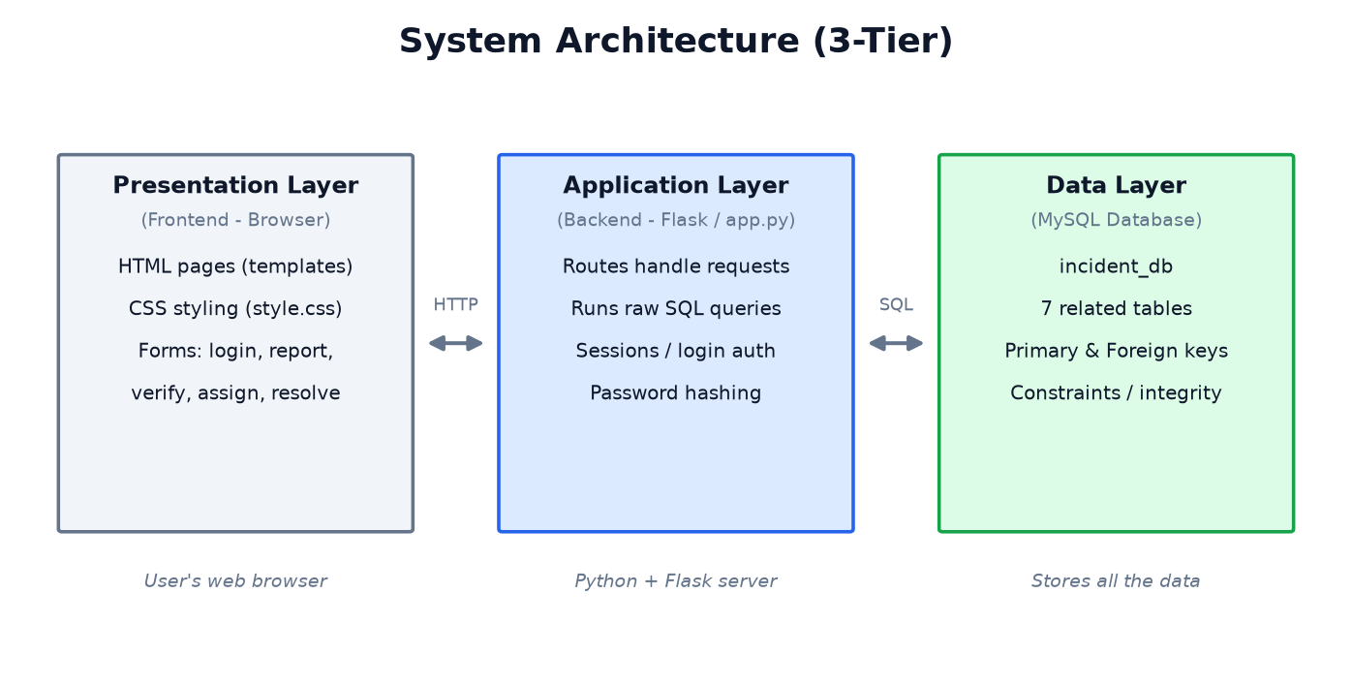
5
System Architecture
Three-tier design
The browser (frontend) sends requests to the Flask server (backend), which runs SQL queries against the MySQL database (data layer) and returns the results.

Slide 7
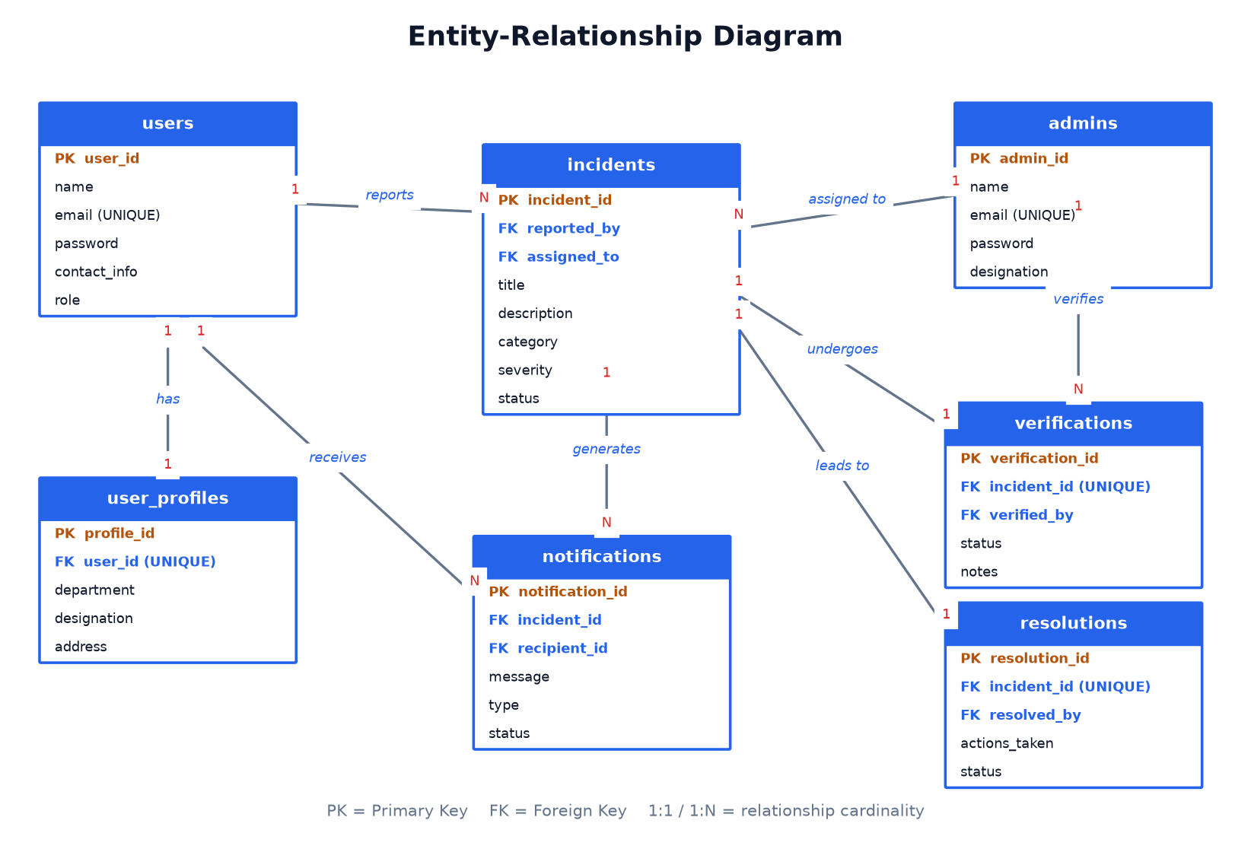
6
Database Design — ER Diagram
7 entities linked by primary & foreign keys

Slide 8
7
The Database — 7 Tables
Each table stores one kind of information
users
people who report incidents
Key idea
Relationships are built with primary keys (PK) and foreign keys (FK).
1:1 links use a UNIQUE foreign key; 1:N links use a normal foreign key.
The design is in 3rd Normal Form (3NF) — no duplicate or inconsistent data.
user_profiles
extra details (1:1 with users)
admins
staff who manage incidents
incidents
the central table of reports
verifications
admin's validity check (1:1)
resolutions
how the incident was fixed (1:1)
notifications
messages sent to users (1:N)

Slide 9
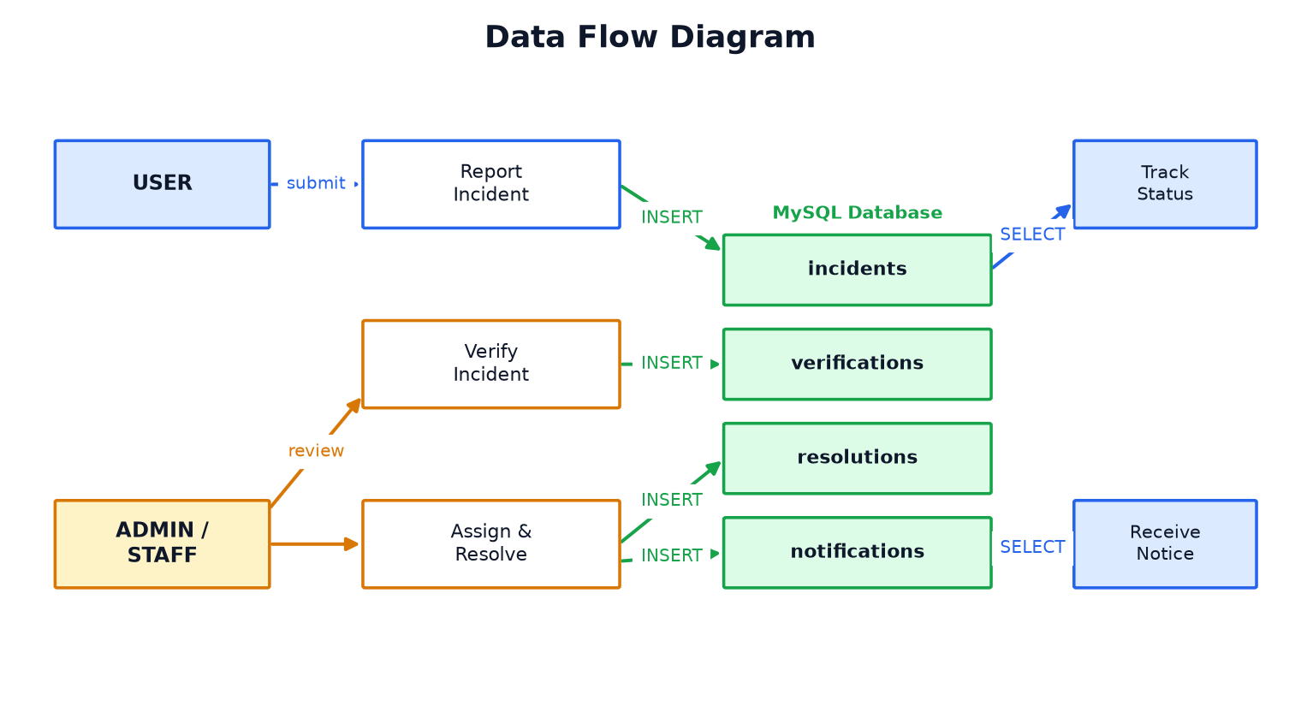
8
Data Flow Diagram
How information moves through the system
A user reports an incident (stored in incidents); an admin verifies, assigns and resolves it; and notifications are generated for the user.

Slide 10
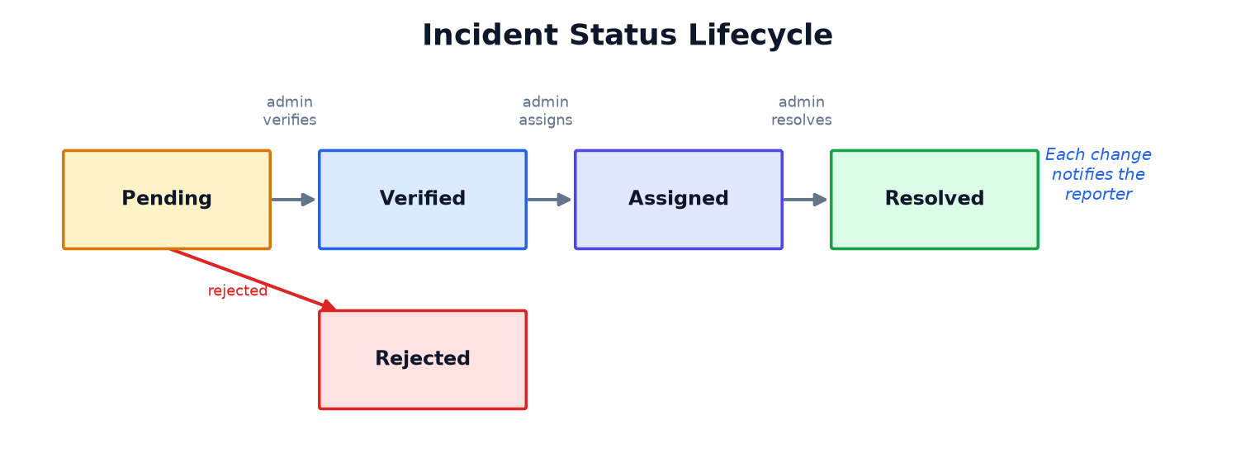
9
Incident Lifecycle
The statuses an incident moves through
A new incident is Pending. After review it becomes Verified (or Rejected), then it is Assigned to staff, and finally Resolved. Each change updates the status column and notifies the reporter.

Slide 11
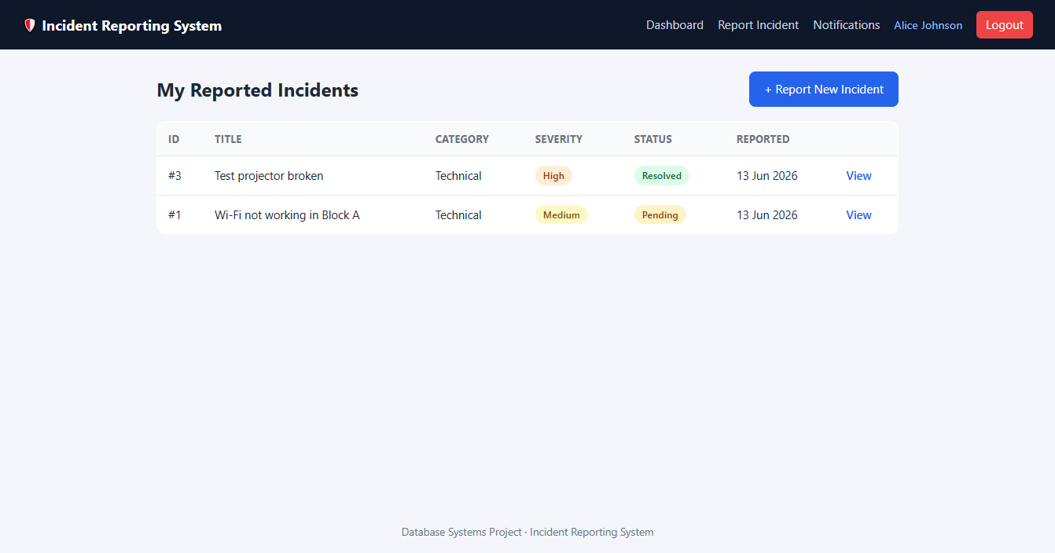
10
Demo — User Dashboard
What a user sees after logging in
What is shown
• Each user sees only their own incidents (the query filters WHERE reported_by = the user).
• Columns show the ID, title, category, severity and live status.
• Colored badges make the status easy to read at a glance.
• Clicking 'View' opens the full tracking page for that incident.

Slide 12
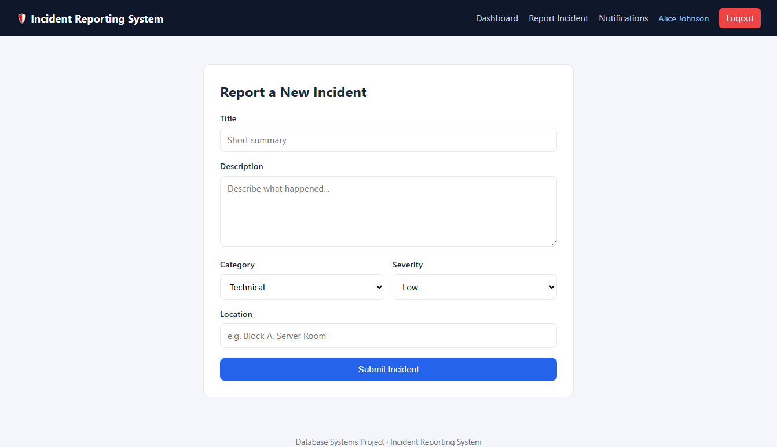
11
Demo — Reporting an Incident
How a user submits a new incident
How it works
• The user fills a simple form: title, description, category, severity and location.
• On submit, the system runs an INSERT into the incidents table.
• The new incident starts with the status 'Pending'.
• A notification row is created so the user gets confirmation.

Slide 13
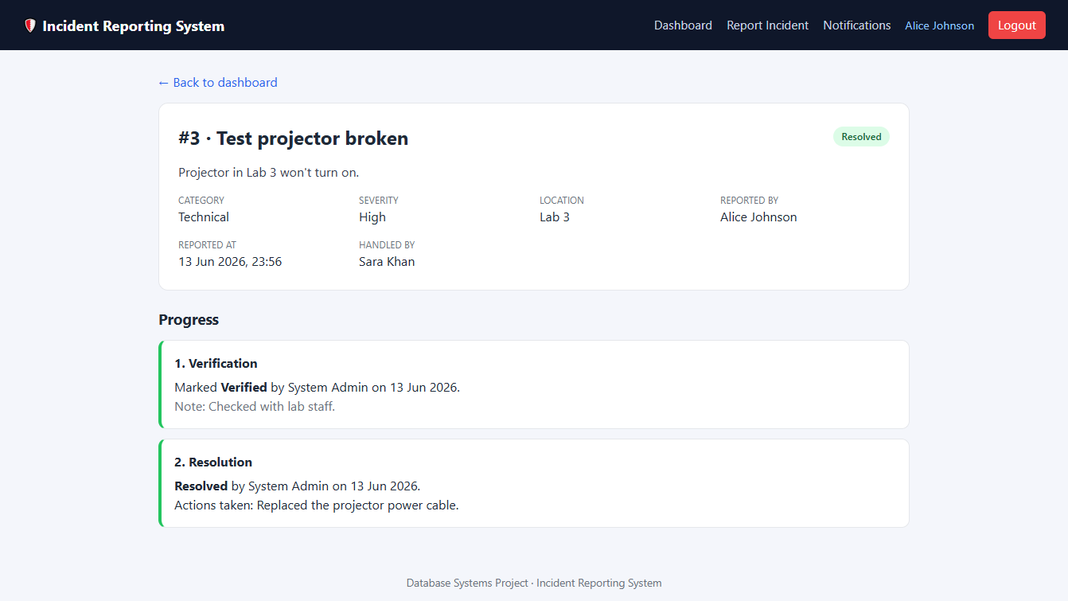
12
Demo — Tracking the Incident
Following progress from report to resolution
What is shown
• This page joins the incidents, verifications and resolutions tables.
• It shows who verified the incident and the decision made.
• It shows the final resolution and the actions taken.
• The status updates automatically at every step.

Slide 14
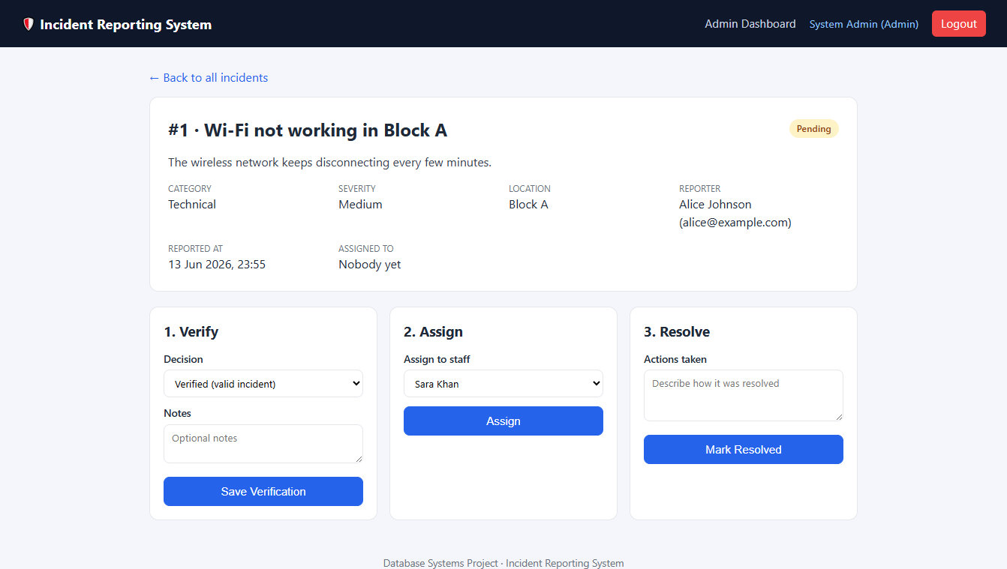
13
Demo — Admin Management
How an admin handles an incident
Admin actions
• Admins manage every incident from one screen.
• Verify — mark the incident valid or invalid.
• Assign — give it to a staff member to handle.
• Resolve — record the actions taken; the database updates and the user is notified.

Slide 15
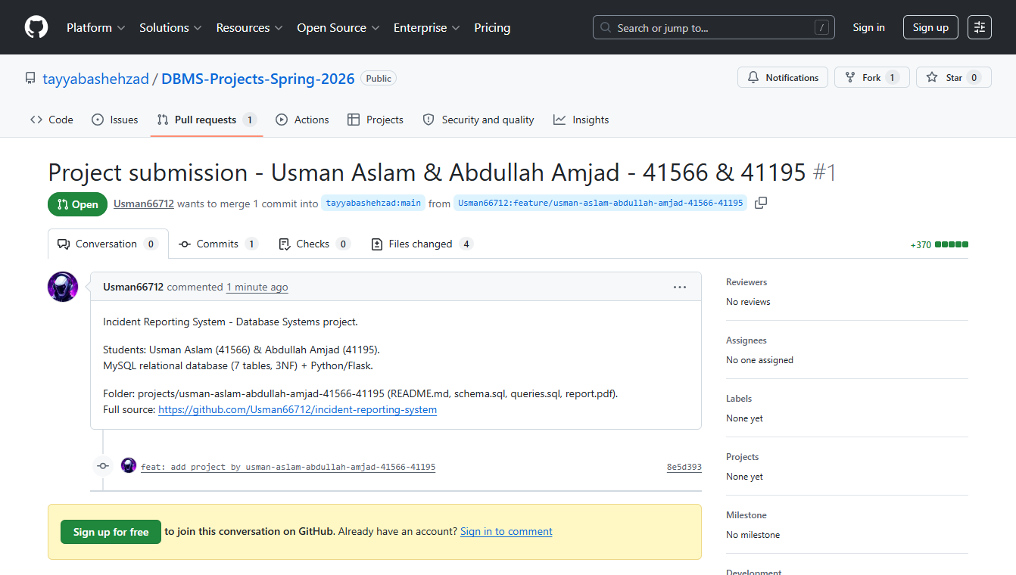
14
Project on GitHub
Version-controlled and submitted to the course repository
Submission
• The full project is version-controlled on GitHub.
• Submitted to the official course repository via a Pull Request.
• Includes the database schema, SQL queries and the project report.
• Full source code: github.com/Usman66712/incident-reporting-system

Slide 16
Conclusion
The Incident Reporting System provides an organized, reliable way to record and handle incidents in an organization.
✓ A relational MySQL database of 7 well-designed tables
✓ Primary & foreign keys enforce data integrity
✓ Normalized to 3NF — no duplicate or inconsistent data
✓ Improves response time, transparency and record-keeping
Usman Aslam (41566) & Abdullah Amjad (41195)
Database Systems
Thank you

