Slide 1
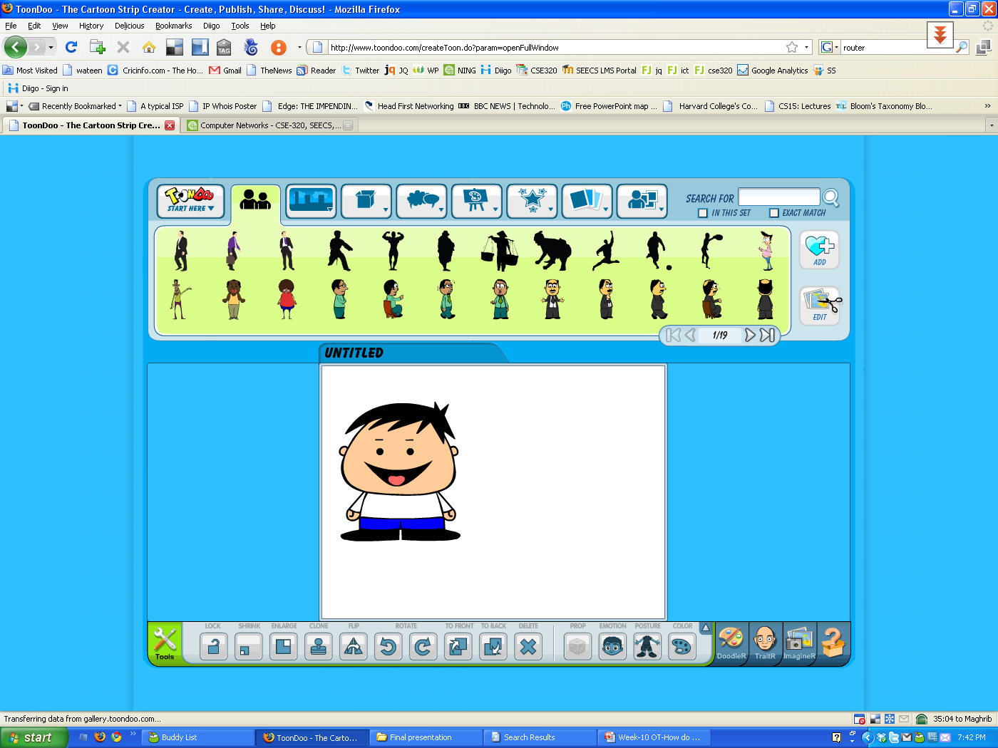
OT: How do ISPs work?
Internet
Internet Service Provider (ISP)
Internet User

Slide 2
Core/ Distribution/ Access
Core
Connected to other core switches/ routers
Distribution
Server Farms
Access
Broadband Remote
Access Server or DSLAM
POTS
Local Loop
Remote
Access Server
DSL Modem
Modem

Slide 3
Typical ISP network

Slide 4

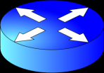

Typical ISP network topology
WWW, Proxy, DNS, AAA, Mail Servers
Upstream service provider
Access link
RAS
Distribution and core routers are connected *
Dialup Modem
DSL Link
DSLAM
and BRAS
DSL Modem
* Sometime’s there’s no distinction between core and distribution networks

Slide 5
Access Network

Slide 6
Dialup Access- RAS
Access
POTS
Local Loop
Remote
Access Server
Modem

Slide 7
DSL Access – Broadband RAS
Access
POTS
Local Loop
DSL Access Multiplexor
(DSLAM)
DSL Modem

Slide 8
Distribution Network
Connects to the access network

Slide 9

Distribution Network
ISP Servers
Access Network
Distribution Router
Access Network

Slide 10

Essential ISP Servers
Proxy Server
Mail Server
AAA Server
DNS Server
Web Server

Slide 11

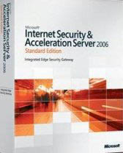
Proxy Server
Server grade hardware
(lots of CPU, memory, disk resources)
Commonly used software:
Squid proxy server (more popular, stable)
Microsoft ISA server

Slide 12



Mail Server
Server grade hardware
(lots of CPU, memory, disk resources)
Commonly used software:
Sendmail server (most popular, stable)
Microsoft Exchange Server
Qmail (secure)

Slide 13

DNS Server
Server grade hardware
(lots of CPU, memory, disk resources)
Commonly used software:
BIND server (most popular, stable)

Slide 14

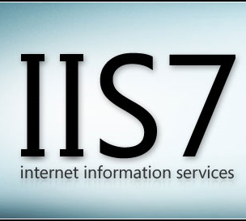
Web Server
Server grade hardware
(lots of CPU, memory, disk resources)
Commonly used software:
Apache server (most popular, stable)
Microsoft IIS server

Slide 15
AAA Server
Server grade hardware
(lots of CPU, memory, disk resources)
Commonly used protocols:
TACACS
RADIUS
DIAMETER

Slide 16
Core Network
For small networks, core/ distribution networks are joint
Connects to the distribution network

Slide 17
Core Network
Distribution Network
Peering Router of
Upstream Telco 1
Core Router
Peering Router of
Upstream Telco 2

Slide 18
That will be it for today … then.
Internet User

