Slide 1
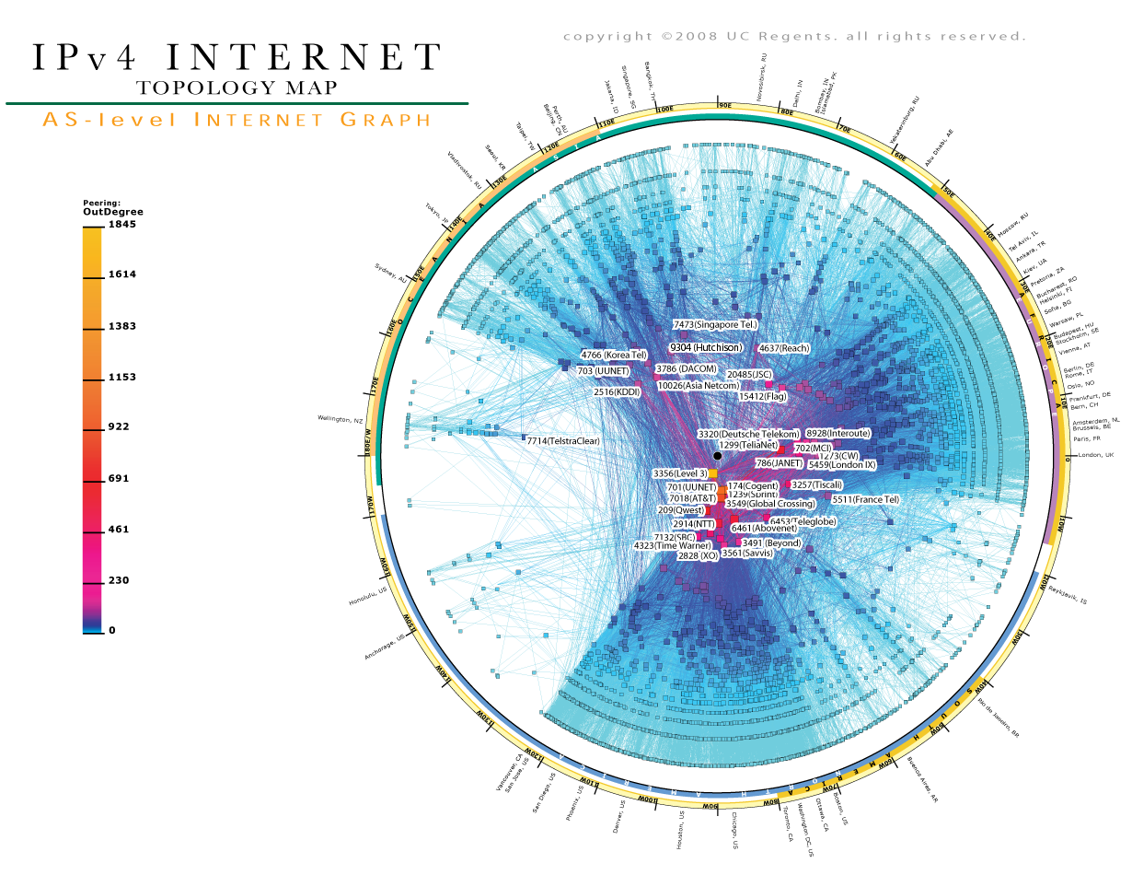
Topic 4: Internetworking
source: www.caida.org
Notes:
Image source: www.caida.org

Slide 2
Topic’s objectives
To find out about:
1) Inter AS routing
2) Multiprotocol Label Switching (MPLS)
Notes:
In last week lectures, we had discussed why a single routing protocol does not scale to the size of Internet due to scaling and administrative autonomy issues.
In today’s lecture we are going to cover two important topics.
1) The first being that how do we exchange routing information between different autonomous systems (AS) that may potentially be using totally different interior gateway (IGP) routing protocols. As we will see in this lecture, the issue of inter-AS routing (or interdomain routing, as it is also known) is quite challenging.
We will also cover the most popular exterior gateway routing protocol (EGP) of the Internet – BGP. BGP is virtually the only EGP used to exchange routing information between different AS on the Internet. It’s quite a complex protocol and it is not our intention to discuss BGP in all its detail today.
We will instead focus on the basics of BGP so that you can understand how inter-AS routing works. Interested students may want to look up this topic independently since BGP is perhaps the most important Internet routing protocol.
2) We will focus on a technology that is very commonly used in the core networks driving today’s Internet. This technology, called MPLS, was designed to alleviate some of the overheads associated with plain IP forwarding which requires population of routing/ forwarding tables and then longest-prefix matches.
While, the primary aim of MPLS is to improve the switching/ routing speed of packets through the core network, it has some other advantages as well as we will see (which includes easy VPN creation, explicit route definition, and traffic engineering).

Slide 3
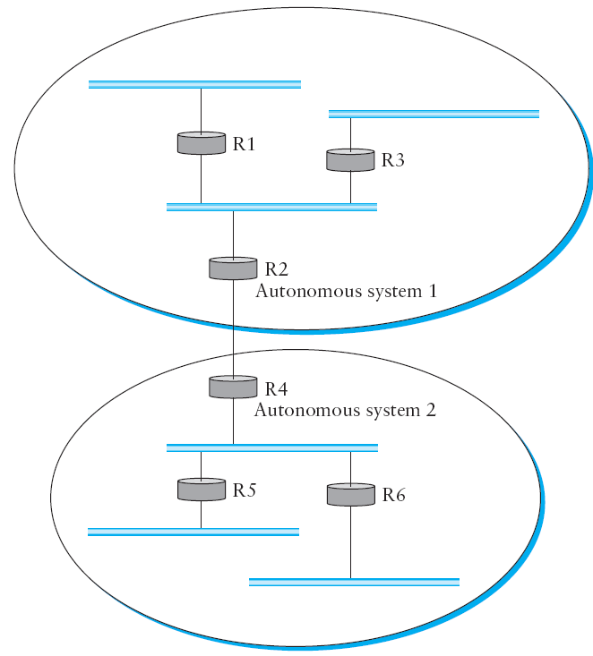
Part I - Inter-AS Routing
Notes:
In the previous lectures, we introduced the notion that the Internet is organized as autonomous systems, each of which is under the control of a single administrative entity. A corporation’s complex internal network might be a single AS, as may the network of a single Internet service provider. The figure above shows a simple network with two autonomous systems.
The basic idea behind autonomous systems is to provide an additional way to hierarchically aggregate routing information in a large internet, thus improving scalability. We now divide the routing problem into two parts: routing within a single autonomous system and routing between autonomous systems. Since another name for autonomous systems in the Internet is routing domains, we refer to the two parts of the routing problem as inter-domain routing and intra-domain routing.
In addition to improving scalability, the AS model decouples the intra-domain routing that takes place in one AS from that taking place in another. Thus, each AS can run whatever intra-domain routing protocols it chooses. It can even use static routes or multiple protocols if desired. The inter-domain routing problem is then one of having different ASs share reachability information with each other.
One feature of the autonomous system idea is that it enables some ASs to dramatically reduce the amount of routing information they need to care about by using default routes. For example, if a corporate network is connected to the rest of the Internet by a single router (this router is typically called a border router since it sits at the boundary between the AS and the rest of the Internet), then it is pretty easy for a host or router inside the autonomous system to figure out where it should send packets that are headed for a destination outside of this AS—they first go to the AS’s border router. This is the default route. Similarly, a regional Internet service provider can keep track of how to reach the networks of all its directly connected customers and can have a default route to some other provider (typically a backbone provider) for everyone else. Of course, this passing of the buck has to stop at some point; eventually the packet should reach a router connected to a backbone network that knows how to reach everything. Managing the amount of routing information in the backbones is an important issue that we discuss below.

Slide 4
Challenges in Interdomain Routing (1)
Matter of scale
200,000 routes (or network prefixes) in Internet’s BGP table
The objectives in such large-scale routing is more modest.
Our goal, more specifically, is:
To have loop-free routing that is policy compliant
Notes:
There are a few reasons why inter-domain routing is hard.
The first challenge is simply a matter of scale. An Internet backbone router must be able to forward any packet destined anywhere in the Internet. That means having a routing table that will provide a match for any valid IP address. While CIDR has helped to control the number of distinct prefixes that are carried in the Internet’s backbone routing, there is inevitably a lot of routing information to pass around—on the order of 200,000 prefixes at the time of writing.
The third challenge involves the issue of trust. Provider A might be unwilling to believe certain advertisements from provider B for fear that provider B will advertise erroneous routing information. For example, trusting provider B when he advertises a great route to anywhere in the Internet can be a disastrous choice if provider B turns out to have made a mistake configuring his routers or to have insufficient capacity to carry the traffic. Closely related to this issue is the need to support very flexible policies in inter-domain routing.
One common policy is the prevention of transit traffic. For example, the multi-homed corporation in Figure 4.29 may not wish to carry any traffic between the two providers to whom it connects. As a more complex example, provider A might wish to implement policies that say, “Use provider B only to reach these addresses,” “Use the path that crosses the fewest number of ASs,” or “Use AS x in preference to AS y.” The goal is to specify policies that lead to “good” paths, if not to optimal ones. When configuring BGP, the administrator of each AS picks at least one node to be a “BGP speaker,” which is essentially a spokesperson for the entire AS. That BGP speaker establishes BGP sessions to other BGP speakers in other ASs. These sessions are used to exchange reachability information among ASs. In addition to the BGP speakers, the AS has one or more border “gateways,” which need not be the same as the speakers. The border gateways are the routers through which packets enter and leave the AS. In our simple example in Figure 4.28, routers R2 and R4 would be border gateways. Note that we have avoided using the word “gateway” until this point because it tends to be confusing. We can’t avoid it here, given the name of the protocol we are describing. The important point to understand here is that, in the context of inter-domain routing, a border gateway is simply an IP router that is charged with the task of forwarding packets between Ass.

Slide 5
Challenges in Interdomain Routing (2)
Autonomous domains
Routing metric across AS are meaningless.
A metric of 100 might have different meanings in different AS
Accordingly, metrics are not advertised across AS and only reachability is advertised
Notes:
There are a few reasons why interdomain routing is hard. The first is simply a matter of scale. An Internet backbone router must be able to forward any packet destined anywhere in the Internet. That means having a routing table that will provide a match for any valid IP address. While CIDR has helped to control the number of distinct prefixes that are carried in the Internet’s backbone routing, there is inevitably a lot of routing information to pass around—on the order of 200,000 prefixes at the time of writing.
The second challenge in interdomain routing arises from the autonomous nature of the domains. Note that each domain may run its own interior routing protocols and use any scheme it chooses to assign metrics to paths. This means that it is impossible to calculate meaningful path costs for a path that crosses multiple ASs. A cost of 1000 across one provider might imply a great path, but it might mean an unacceptably bad one from another provider. As a result, interdomain routing advertises only “reachability.” The concept of reachability is basically a statement that “you can reach this network through this AS.” This means that for interdomain routing to pick an optimal path is essentially impossible.
The third challenge involves the issue of trust. Provider A might be unwilling to believe certain advertisements from provider B for fear that provider B will advertise erroneous routing information. For example, trusting provider B when he advertises a great route to anywhere in the Internet can be a disastrous choice if provider B turns out to have made a mistake configuring his routers or to have insufficient capacity to carry the traffic. Closely related to this issue is the need to support very flexible policies in interdomain routing.
One common policy is the prevention of transit traffic. For example, the multihomed corporation in Figure 4.29 may not wish to carry any traffic between the two providers to whom it connects. As a more complex example, provider A might wish to implement policies that say, “Use provider B only to reach these addresses,” “Use the path that crosses the fewest number of ASs,” or “Use AS x in preference to AS y.” The goal is to specify policies that lead to “good” paths, if not to optimal ones. When configuring BGP, the administrator of each AS picks at least one node to be a “BGP speaker,” which is essentially a spokesperson for the entire AS. That BGP speaker establishes BGP sessions to other BGP speakers in other ASs. These sessions are used to exchange reachability information among ASs. In addition to the BGP speakers, the AS has one or more border “gateways,” which need not be the same as the speakers. The border gateways are the routers through which packets enter and leave the AS. In our simple example in Figure 4.28, routers R2 and R4 would be border gateways. Note that we have avoided using the word “gateway” until this point because it tends to be confusing.We can’t avoid it here, given the name of the protocol we are describing. The important point to understand here is that, in the context of interdomain routing, a border gateway is simply an IP router that is charged with the task of forwarding packets between ASs.

Slide 6
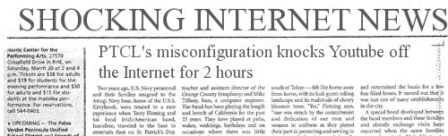

Challenges in Interdomain Routing (3)
Matters of trust
How to ensure routing misconfigurations are non-disruptive?
http://i25.tinypic.com/jsyr8l.jpg
Notes:
There are a few reasons why interdomain routing is hard. The first is simply a matter of scale. An Internet backbone router must be able to forward any packet destined anywhere in the Internet. That means having a routing table that will provide a match for any valid IP address. While CIDR has helped to control the number of distinct prefixes that are carried in the Internet’s backbone routing, there is inevitably a lot of routing information to pass around—on the order of 200,000 prefixes at the time of writing.
The second challenge in interdomain routing arises from the autonomous nature of the domains. Note that each domain may run its own interior routing protocols and use any scheme it chooses to assign metrics to paths. This means that it is impossible to calculate meaningful path costs for a path that crosses multiple ASs. A cost of 1000 across one provider might imply a great path, but it might mean an unacceptably bad one from another provider. As a result, interdomain routing advertises only “reachability.” The concept of reachability is basically a statement that “you can reach this network through this AS.” This means that for interdomain routing to pick an optimal path is essentially impossible.
The third challenge involves the issue of trust. Provider A might be unwilling to believe certain advertisements from provider B for fear that provider B will advertise erroneous routing information. For example, trusting provider B when he advertises a great route to anywhere in the Internet can be a disastrous choice if provider B turns out to have made a mistake configuring his routers or to have insufficient capacity to carry the traffic. Closely related to this issue is the need to support very flexible policies in interdomain routing.
One common policy is the prevention of transit traffic. For example, the multihomed corporation in Figure 4.29 may not wish to carry any traffic between the two providers to whom it connects. As a more complex example, provider A might wish to implement policies that say, “Use provider B only to reach these addresses,” “Use the path that crosses the fewest number of ASs,” or “Use AS x in preference to AS y.” The goal is to specify policies that lead to “good” paths, if not to optimal ones. When configuring BGP, the administrator of each AS picks at least one node to be a “BGP speaker,” which is essentially a spokesperson for the entire AS. That BGP speaker establishes BGP sessions to other BGP speakers in other ASs. These sessions are used to exchange reachability information among ASs. In addition to the BGP speakers, the AS has one or more border “gateways,” which need not be the same as the speakers. The border gateways are the routers through which packets enter and leave the AS. In our simple example in Figure 4.28, routers R2 and R4 would be border gateways. Note that we have avoided using the word “gateway” until this point because it tends to be confusing.We can’t avoid it here, given the name of the protocol we are describing. The important point to understand here is that, in the context of interdomain routing, a border gateway is simply an IP router that is charged with the task of forwarding packets between ASs.

Slide 7
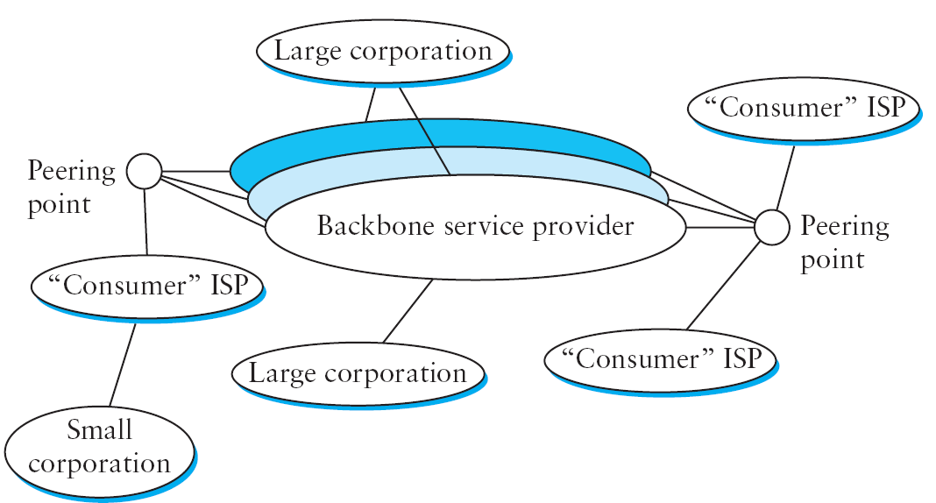
Multi backbone Internet
Multihomed AS
Transit AS
Stub AS
Notes:
Given this rough sketch of the Internet, if we define local traffic as traffic that originates at or terminates on nodes within an AS, and transit traffic as traffic that passes through an AS, we can classify ASs into three types:
■ Stub AS: an AS that has only a single connection to one other AS; such an AS will only carry local traffic. The small corporation in the figure above is an example of a stub AS.
■ Multihomed AS: an AS that has connections to more than one other AS but that refuses to carry transit traffic; for example, the large corporation at the top of the figure above.
■ Transit AS: an AS that has connections to more than one other AS and that is designed to carry both transit and local traffic, such as the backbone providers in the figure above.

Slide 8
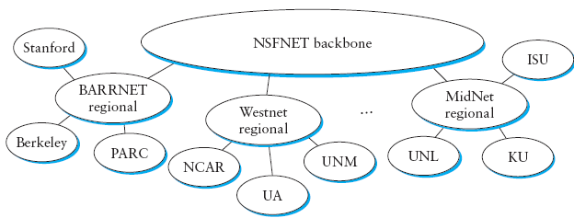
Inter-AS protocols: EGP
EGP (name of protocol) is an example of an inter-AS routing protocol used in the early Internet
EGP was not scalable since it assumed simple relationships between AS (parent/ child relationship; tree structure; single-backbone – as shown below)
Notes:
Whereas the discussion of routing in the previous week’s lectures (IGP routing – DV and LS) focused on finding optimal paths based on minimizing some sort of link metric, the problem of inter-domain routing turns out to be so difficult that the goals are more modest.
First and foremost, the goal is to find any path to the intended destination that is loop-free. That is, we are more concerned with reachability than optimality. Finding a path that is anywhere close to optimal is considered a great achievement.We will see why this is so as we look at the details of BGP.
Now, we are in a position to discuss the two major inter-domain routing protocols in the recent history of the Internet.
1) The first was the Exterior Gateway Protocol (EGP). EGP had a number of limitations, perhaps the most severe of which was that it constrained the topology of the Internet rather significantly. EGP basically forced a treelike topology onto the Internet, or to be more precise, it was designed when the Internet had a treelike topology. EGP did not allow for the topology to become more general. Note that in this simple treelike structure, there is a single backbone, and autonomous systems are connected only as parents and children and not as peers.
2) The replacement for EGP is the Border Gateway Protocol (BGP), which is in its fourth version at the time of this writing (BGP-4). BGP is also known for being rather complex. This section presents the highlights of BGP-4. As a starting position, BGP assumes that the Internet is an arbitrarily interconnected set of ASs. This model is clearly general enough to accommodate non-tree structured internetworks, like the simplified picture of today’s multi-backbone Internet shown in the previous slide.
Unlike the simple tree-structured Internet shown in Figure 4.24, today’s Internet consists of an interconnection of multiple backbone networks (they are usually called service provider networks, and they are operated by private companies rather than the government), and sites are connected to each other in arbitrary ways. Some large corporations connect directly to one or more of the backbones, while others connect to smaller, non-backbone service providers. Many service providers exist mainly to provide service to “consumers” (i.e., individuals with PCs in their homes), and these providers must also connect to the backbone providers. Often many providers arrange to interconnect with each other at a single “peering point.” In short, it is hard to discern much structure at all in today’s Internet.

Slide 9
Inter-AS protocols: BGP
BGP is currently the most popular inter-AS routing protocol (virtually the only one used in the Internet)
BGP is a complex protocol (current version: BGPv4) that can cater to more complex inter-AS topologies
Notes:
Whereas the discussion of routing in the previous week’s lectures (IGP routing – DV and LS) focused on finding optimal paths based on minimizing some sort of link metric, the problem of inter-domain routing turns out to be so difficult that the goals are more modest.
First and foremost, the goal is to find any path to the intended destination that is loop-free. That is, we are more concerned with reachability than optimality. Finding a path that is anywhere close to optimal is considered a great achievement.We will see why this is so as we look at the details of BGP.
Now, we are in a position to discuss the two major inter-domain routing protocols in the recent history of the Internet.
1) The first was the Exterior Gateway Protocol (EGP). EGP had a number of limitations, perhaps the most severe of which was that it constrained the topology of the Internet rather significantly. EGP basically forced a treelike topology onto the Internet, or to be more precise, it was designed when the Internet had a treelike topology. EGP did not allow for the topology to become more general. Note that in this simple treelike structure, there is a single backbone, and autonomous systems are connected only as parents and children and not as peers.
2) The replacement for EGP is the Border Gateway Protocol (BGP), which is in its fourth version at the time of this writing (BGP-4). BGP is also known for being rather complex. This section presents the highlights of BGP-4. As a starting position, BGP assumes that the Internet is an arbitrarily interconnected set of ASs. This model is clearly general enough to accommodate non-tree structured internetworks, like the simplified picture of today’s multi-backbone Internet shown in the previous slide.
Unlike the simple tree-structured Internet shown in Figure 4.24, today’s Internet consists of an interconnection of multiple backbone networks (they are usually called service provider networks, and they are operated by private companies rather than the government), and sites are connected to each other in arbitrary ways. Some large corporations connect directly to one or more of the backbones, while others connect to smaller, non-backbone service providers. Many service providers exist mainly to provide service to “consumers” (i.e., individuals with PCs in their homes), and these providers must also connect to the backbone providers. Often many providers arrange to interconnect with each other at a single “peering point.” In short, it is hard to discern much structure at all in today’s Internet.

Slide 10
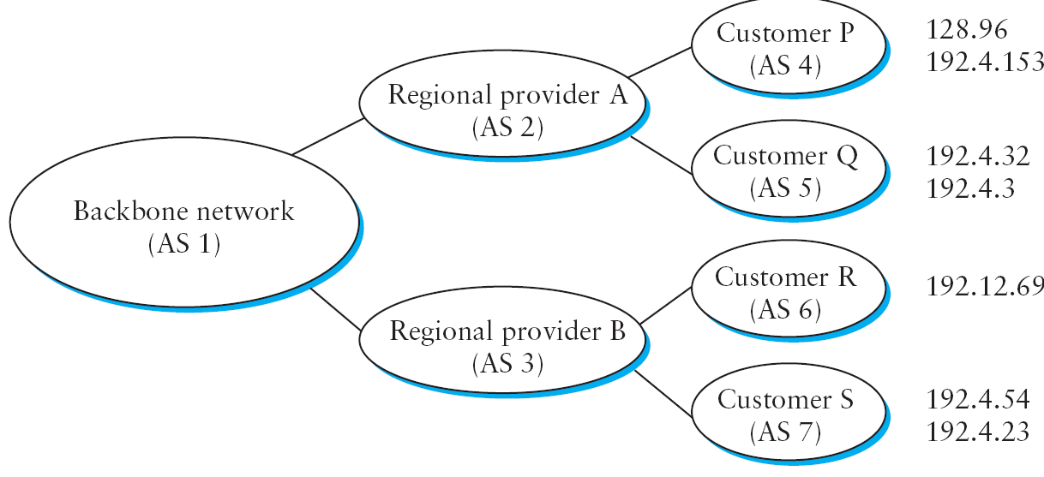
Border Gateway Protocol
Notes:
Whereas the discussion of routing in the previous week’s lectures (IGP routing – DV and LS) focused on finding optimal paths based on minimizing some sort of link metric, the problem of inter-domain routing turns out to be so difficult that the goals are more modest.
First and foremost, the goal is to find any path to the intended destination that is loop-free. That is, we are more concerned with reachability than optimality. Finding a path that is anywhere close to optimal is considered a great achievement.We will see why this is so as we look at the details of BGP.
Now, we are in a position to discuss the two major inter-domain routing protocols in the recent history of the Internet.
1) The first was the Exterior Gateway Protocol (EGP). EGP had a number of limitations, perhaps the most severe of which was that it constrained the topology of the Internet rather significantly. EGP basically forced a treelike topology onto the Internet, or to be more precise, it was designed when the Internet had a treelike topology. EGP did not allow for the topology to become more general. Note that in this simple treelike structure, there is a single backbone, and autonomous systems are connected only as parents and children and not as peers.
2) The replacement for EGP is the Border Gateway Protocol (BGP), which is in its fourth version at the time of this writing (BGP-4). BGP is also known for being rather complex. This section presents the highlights of BGP-4. As a starting position, BGP assumes that the Internet is an arbitrarily interconnected set of ASs. This model is clearly general enough to accommodate non-tree structured internetworks, like the simplified picture of today’s multi-backbone Internet shown in the previous slide.
Unlike the simple tree-structured Internet shown in Figure 4.24, today’s Internet consists of an interconnection of multiple backbone networks (they are usually called service provider networks, and they are operated by private companies rather than the government), and sites are connected to each other in arbitrary ways. Some large corporations connect directly to one or more of the backbones, while others connect to smaller, non-backbone service providers. Many service providers exist mainly to provide service to “consumers” (i.e., individuals with PCs in their homes), and these providers must also connect to the backbone providers. Often many providers arrange to interconnect with each other at a single “peering point.” In short, it is hard to discern much structure at all in today’s Internet.

Slide 11
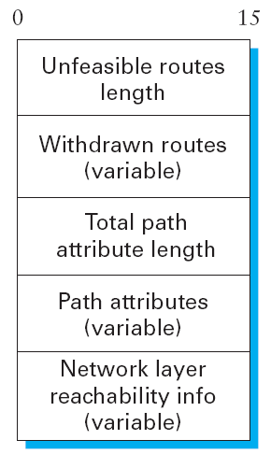
BGP Update Format
BGP is a classless routing protocol and runs on TCP

Slide 12
Integrating IGP and EGPs
Limited number of BGP speakers/ AS
Other AS routers only run IGP or static routes
First Scenario: Stub AS
Border router injects a default route into the IGP
(feasible only in Stub AS, not in Transit AS)
Injecting routes into IGP is called ‘redistribution’
Notes:
Integrating Interdomain and Intradomain Routing
While the preceding discussion illustrates how a BGP speaker learns interdomain routing information, the question still remains as to how all the other routers in a domain get this information. There are several ways this problem can be addressed. We have already alluded to one very simple situation, which is also very common. In the case of a stub AS that only connects to other ASs at a single point, the border router is clearly the only choice for all routes that are outside the AS. Such a router can “inject” a default route into the intradomain routing protocol. In effect, this is a statement that any network that has not been explicitly advertised in the intradomain protocol is reachable through the border router. Recall from the discussion of IP forwarding in Section 4.1 that the default entry in the forwarding table comes after all the more specific entries, and it matches anything that failed to match a specific entry. The next step up in complexity is to have the border routers inject specific routes they have learned from outside the AS. Consider, for example, the border router of a provider AS that connects to a customer AS. That router could learn that the network prefix 192.4.54/24 is located inside the customer AS, either through BGP or because the information is configured into the border router. It could inject a route to that prefix into the routing protocol running inside the provider AS. This would be an advertisement of the sort “I have a link to 192.4.54/24 of cost X.” This would cause other routers in the provider AS to learn that this border router is the place to send packets destined for that prefix.
The final level of complexity comes in backbone networks, which learn so much routing information from BGP that it becomes too costly to inject it into the intradomain protocol. For example, if a border router wants to inject 10,000 prefixes that it learned about from another AS, it will have to send very big link-state packets to the other routers in that AS, and their shortest-path calculations are going to become very complex. For this reason, the routers in a backbone network use a variant of BGP called interior BGP (IBGP) to effectively redistribute the information that is learned by the BGP speakers at the edges of the AS to all the other routers in the AS. IBGP enables any router in the AS to learn the best border router to use when sending a packet to any address. At the same time, each router in the AS keeps track of how to get to each border router using a conventional intradomain protocol with no injected information. By combining these two sets of information, each router in the AS is able to determine the appropriate next hop for all prefixes.

Slide 13
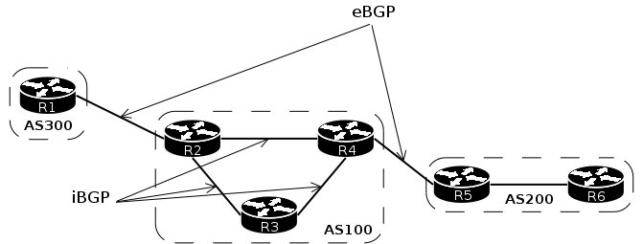
Integrating IGP and EGPs
Second Scenario: Transit AS
The routers run a variant of BGP called iBGP
iBGP enables any AS router to learn the best border router to use when sending a packet to any address
Notes:
Integrating Interdomain and Intradomain Routing
While the preceding discussion illustrates how a BGP speaker learns interdomain routing information, the question still remains as to how all the other routers in a domain get this information. There are several ways this problem can be addressed. We have already alluded to one very simple situation, which is also very common. In the case of a stub AS that only connects to other ASs at a single point, the border router is clearly the only choice for all routes that are outside the AS. Such a router can “inject” a default route into the intradomain routing protocol. In effect, this is a statement that any network that has not been explicitly advertised in the intradomain protocol is reachable through the border router. Recall from the discussion of IP forwarding in Section 4.1 that the default entry in the forwarding table comes after all the more specific entries, and it matches anything that failed to match a specific entry. The next step up in complexity is to have the border routers inject specific routes they have learned from outside the AS. Consider, for example, the border router of a provider AS that connects to a customer AS. That router could learn that the network prefix 192.4.54/24 is located inside the customer AS, either through BGP or because the information is configured into the border router. It could inject a route to that prefix into the routing protocol running inside the provider AS. This would be an advertisement of the sort “I have a link to 192.4.54/24 of cost X.” This would cause other routers in the provider AS to learn that this border router is the place to send packets destined for that prefix.
The final level of complexity comes in backbone networks, which learn so much routing information from BGP that it becomes too costly to inject it into the intradomain protocol. For example, if a border router wants to inject 10,000 prefixes that it learned about from another AS, it will have to send very big link-state packets to the other routers in that AS, and their shortest-path calculations are going to become very complex. For this reason, the routers in a backbone network use a variant of BGP called interior BGP (IBGP) to effectively redistribute the information that is learned by the BGP speakers at the edges of the AS to all the other routers in the AS. IBGP enables any router in the AS to learn the best border router to use when sending a packet to any address. At the same time, each router in the AS keeps track of how to get to each border router using a conventional intradomain protocol with no injected information. By combining these two sets of information, each router in the AS is able to determine the appropriate next hop for all prefixes.

Slide 14
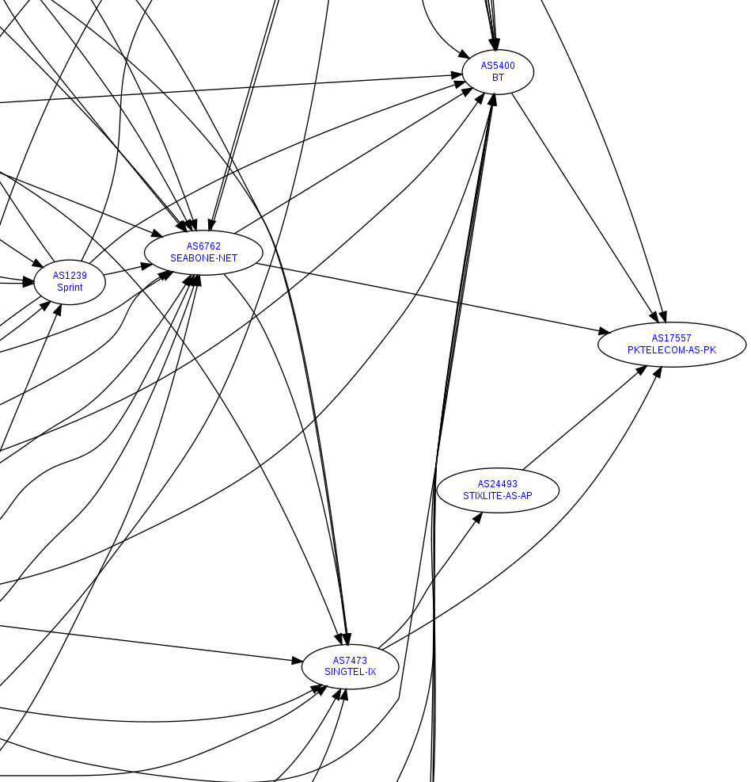
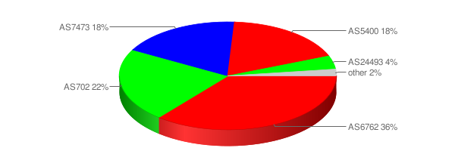
Practical Example: PTCL’s network
PTCL
AS 17557
http://www.robtex.com/as/as17557.html

Slide 15
Part II- Multiprotocol Label Switching
Notes:
The idea, called Multiprotocol Label Switching (MPLS), tries to combine some of the properties of virtual circuits with the flexibility and robustness of datagrams. On the one hand, MPLS is very much associated with the Internet Protocol’s datagram-based architecture—it relies on IP addresses and IP routing protocols to do its job. On the other hand, MPLS-enabled routers also forward packets by examining relatively short, fixed-length labels, and these labels have local scope, just like in a virtual circuit network. It is perhaps this marriage of two seemingly opposed technologies that has caused MPLS to have a somewhat mixed reception in the Internet engineering community.
Before looking at how MPLS works, it is reasonable to ask, “What is it good for?” Many claims have been made for MPLS, but there are three main things that it
is used for today:
■ To enable IP capabilities on devices that do not have the capability to forward IP datagrams in the normal manner
■ To forward IP packets along “explicit routes”—precalculated routes that don’t necessarily match those that normal IP routing protocols would select
■ To support certain types of virtual private network services
It is worth noting that one of the original goals—improving performance— is not on the list. This has a lot to do with the advances that have been made in forwarding algorithms for IP routers in recent years, and with the complex set of factors beyond header processing that determine performance.
The best way to understand how MPLS works is to look at some examples of its use.
We will look at examples to illustrate the three applications of MPLS mentioned above.

Slide 16
Motivation of Label Switching
1) While IP is fixed length (32 bits), data forwarding uses longest-prefix match route lookups
(longest-prefix match requires searching through all routing entries)
2) MPLS aims to avoid longest-prefix matching overhead by using exact matching lookups
(MPLS does this by using labels)

Slide 17
Advantages of MPLS
Quicker switching/ routing of traffic
“Traffic Engineering” ability
Ability to explicitly define routes
Supports IP traffic over non-IP technologies

Slide 18
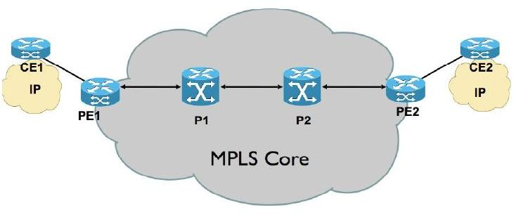
MPLS networks
Customer’s edge device
Provider’s edge device
Notes:
Note that while the forwarding algorithm has been changed from longest match to exact match, the routing algorithm can be any standard IP routing algorithm (e.g., OSPF). The path that a packet will follow in this environment is the exact same path that it would have followed if MPLS were not involved—the path chosen by the IP routing algorithms. All that has changed is the forwarding algorithm. The major effect of changing the forwarding algorithm is that devices that normally don’t know how to forward IP packets can be used in an MPLS network. The most notable early application of this result was to ATM switches, which can support MPLS without any changes to their forwarding hardware. ATM switches support the label swapping forwarding algorithm just described, and by providing these switches with IP routing protocols and a method to distribute label bindings, they could be turned into label switching routers (LSRs)—devices that run IP control protocols but use the label switching forwarding algorithm. More recently, the same idea has been applied to optical switches of the sort described in Section 3.1.2.
However, if an ATM switch is to function as an MPLS LSR, then the label needs to be in a place where the switch can use it, and that means it needs to be in the ATM cell header, exactly where we would normally find the VCI and VPI fields, as shown in Figure 4.42(a). Having now devised a scheme by
which an ATM switch can function as an LSR, what have we gained? One thing to note is that we could now build a network that used a mixture of conventional
IP routers, label edge routers, and ATM switches functioning as LSRs, and they would all use the same routing protocols. To understand the benefits of using the same protocols, consider the alternative. In Figure 4.43(a) we see a set of routers interconnected by virtual circuits over an ATM network, a configuration called an “overlay” network. At one point in time, networks of this type were often built because commercially available ATM switches supported higher total throughput than routers. Today, networks like this are less common because routers have caught up with and even surpassed ATM switches. However, these networks still exist because of the significant installed base of ATM switches in network backbones, which in turn is partly a result of ATM’s ability to support a range of capabilities such as circuit emulation and virtual circuit services.

Slide 19
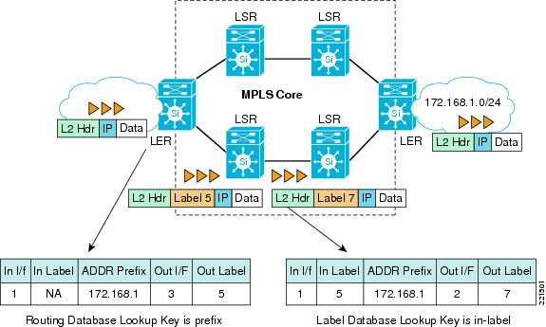
MPLS Routers – LERs and LSRs
Label Switching Router
Label Edge Router
Image Source: Cisco’s website
Notes:
Note that while the forwarding algorithm has been changed from longest match to exact match, the routing algorithm can be any standard IP routing algorithm (e.g., OSPF). The path that a packet will follow in this environment is the exact same path that it would have followed if MPLS were not involved—the path chosen by the IP routing algorithms. All that has changed is the forwarding algorithm. The major effect of changing the forwarding algorithm is that devices that normally don’t know how to forward IP packets can be used in an MPLS network. The most notable early application of this result was to ATM switches, which can support MPLS without any changes to their forwarding hardware. ATM switches support the label swapping forwarding algorithm just described, and by providing these switches with IP routing protocols and a method to distribute label bindings, they could be turned into label switching routers (LSRs)—devices that run IP control protocols but use the label switching forwarding algorithm. More recently, the same idea has been applied to optical switches of the sort described in Section 3.1.2.
However, if an ATM switch is to function as an MPLS LSR, then the label needs to be in a place where the switch can use it, and that means it needs to be in the ATM cell header, exactly where we would normally find the VCI and VPI fields, as shown in Figure 4.42(a). Having now devised a scheme by
which an ATM switch can function as an LSR, what have we gained? One thing to note is that we could now build a network that used a mixture of conventional
IP routers, label edge routers, and ATM switches functioning as LSRs, and they would all use the same routing protocols. To understand the benefits of using the same protocols, consider the alternative. In Figure 4.43(a) we see a set of routers interconnected by virtual circuits over an ATM network, a configuration called an “overlay” network. At one point in time, networks of this type were often built because commercially available ATM switches supported higher total throughput than routers. Today, networks like this are less common because routers have caught up with and even surpassed ATM switches. However, these networks still exist because of the significant installed base of ATM switches in network backbones, which in turn is partly a result of ATM’s ability to support a range of capabilities such as circuit emulation and virtual circuit services.

Slide 20
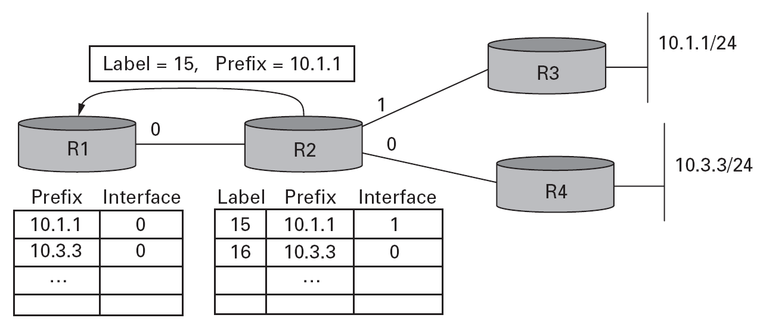
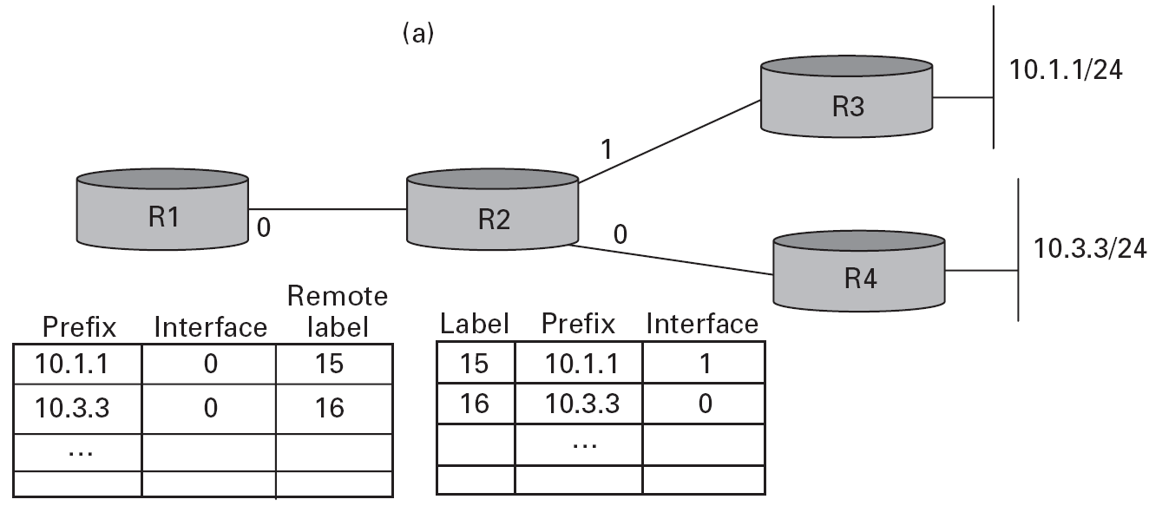
MPLS through an example
24
24
Remote labels
Label lookups are exact lookups, and therefore label switching is quicker
Label swapping

Slide 21
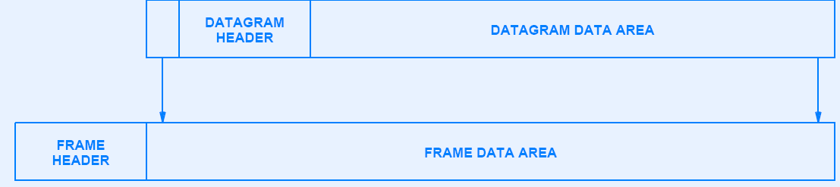
MPLS Encapsulation
MPLS header
Also, called a Shim header (or a Layer 2.5 header)

Slide 22
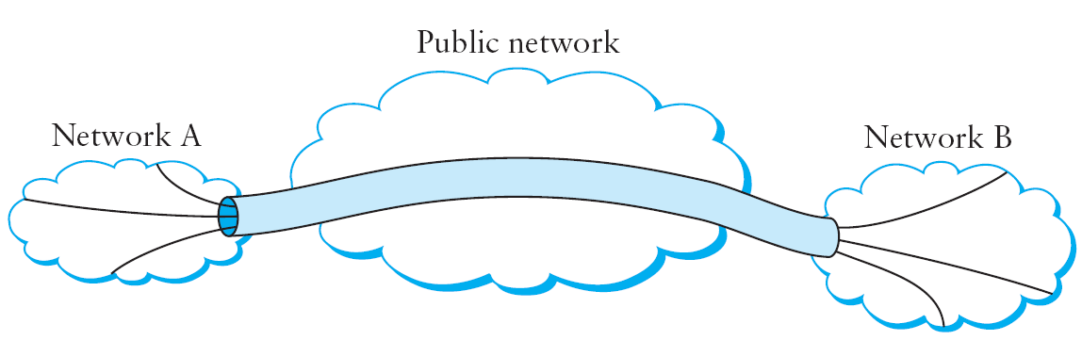
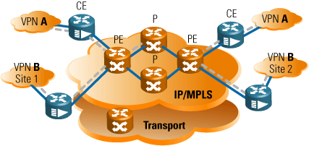
MPLS VPNs
VPN
Notes:
Note that while the forwarding algorithm has been changed from longest match to exact match, the routing algorithm can be any standard IP routing algorithm (e.g., OSPF). The path that a packet will follow in this environment is the exact same path that it would have followed if MPLS were not involved—the path chosen by the IP routing algorithms. All that has changed is the forwarding algorithm. The major effect of changing the forwarding algorithm is that devices that normally don’t know how to forward IP packets can be used in an MPLS network. The most notable early application of this result was to ATM switches, which can support MPLS without any changes to their forwarding hardware. ATM switches support the label swapping forwarding algorithm just described, and by providing these switches with IP routing protocols and a method to distribute label bindings, they could be turned into label switching routers (LSRs)—devices that run IP control protocols but use the label switching forwarding algorithm. More recently, the same idea has been applied to optical switches of the sort described in Section 3.1.2.
However, if an ATM switch is to function as an MPLS LSR, then the label needs to be in a place where the switch can use it, and that means it needs to be in the ATM cell header, exactly where we would normally find the VCI and VPI fields, as shown in Figure 4.42(a). Having now devised a scheme by
which an ATM switch can function as an LSR, what have we gained? One thing to note is that we could now build a network that used a mixture of conventional
IP routers, label edge routers, and ATM switches functioning as LSRs, and they would all use the same routing protocols. To understand the benefits of using the same protocols, consider the alternative. In Figure 4.43(a) we see a set of routers interconnected by virtual circuits over an ATM network, a configuration called an “overlay” network. At one point in time, networks of this type were often built because commercially available ATM switches supported higher total throughput than routers. Today, networks like this are less common because routers have caught up with and even surpassed ATM switches. However, these networks still exist because of the significant installed base of ATM switches in network backbones, which in turn is partly a result of ATM’s ability to support a range of capabilities such as circuit emulation and virtual circuit services.

Slide 23
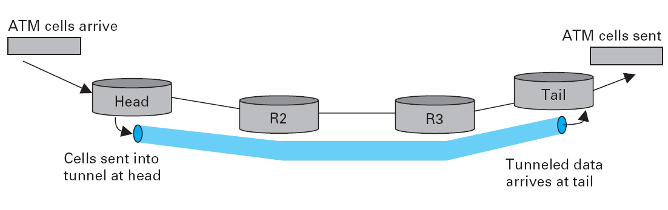
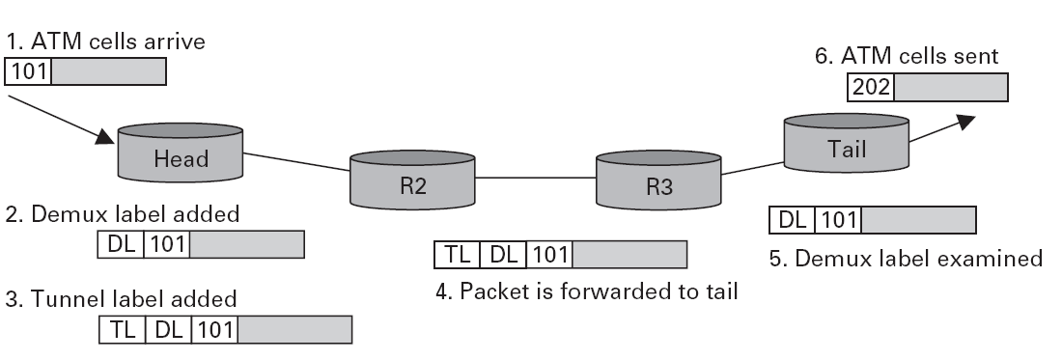
Tunneling
Notes:
We first talked about virtual private networks (VPNs) in Section 4.1.8, and we noted that one way to build them was using tunnels. It turns out that MPLS can be thought of as a way to build tunnels, and this makes it suitable for building VPNs of various types.
The simplest form of MPLS VPN to understand is a “layer 2” VPN. In this type of VPN, MPLS is used to tunnel layer 2 data (such as Ethernet frames or ATM cells)
across a network of MPLS-enabled routers. Recall from Section 4.1.8 that one reason for tunnels is to provide some sort of network service (such as multicast) that is not supported by some routers in the network. The same logic applies here: IP routers are not ATM switches, so you cannot provide an ATM virtual circuit service across a network of conventional routers. However, if you had a pair of routers interconnected by a tunnel, they could send ATM cells across the tunnel and emulate an ATM circuit. The term for this technique within the IETF is pseudowire emulation. Figure 4.45 illustrates the idea. We have already seen how IP tunnels are built: The router at the entrance of the tunnel wraps the data to be tunneled in an IP header (the “tunnel header”), which represents the address of the router at the far end of the tunnel, and sends the data like any other IP packet. The receiving router receives the packet with its own address in the header, strips the tunnel header, and finds the data that was tunneled, which it then processes. Exactly what it does with that data depends on what it is. For example, if it were another IP packet, it would then be forwarded like a normal IP packet. However, it need not be an IP packet, as long as the receiving router knows what to do with non-IP packets. We’ll return to the issue of how to handle non-IP data in a moment.
An MPLS tunnel is not too different from an IP tunnel, except that the “tunnel header” consists of an MPLS header rather than an IP header. Looking back to our
first example, in Figure 4.41, we saw that router R1 attached a label (15) to every packet that it sent toward prefix 10.1.1. Such a packet would then follow the path R1-R2-R3, with each router in the path examining only the MPLS label. Thus, we observe that there was no requirement that R1 only send IP packets along this path— any data could be wrapped up in the MPLS header, and it would follow the same path because the intervening routers never look beyond the MPLS header. In this regard, an MPLS header is just like an IP tunnel header.7 The only issue with sending non-IP traffic along a tunnel, MPLS or otherwise, is this: What do we do with non-IP traffic when it reaches the end of the tunnel? The general solution is to carry some sort of demultiplexing identifier in the tunnel payload that tells the router at the end of the tunnel what to do. It turns out that an MPLS label is a perfect fit for such an identifier. An example will make this clear. Let’s assume we want to tunnel ATM cells from one router to another across a network of MPLS-enabled routers, as in Figure 4.45. Further, we assume that the goal is to emulate an ATM virtual circuit; that is, cells arrive at the entrance, or head, of the tunnel on a certain input port with a certain VCI and should leave the tail end of the tunnel on a certain output port and potentially different VCI. This can be accomplished by configuring the “head” and “tail” routers as follows:
■ The head router needs to be configured with the incoming port, the incoming VCI, the “demultiplexing label” for this emulated circuit, and the address of
the tunnel end router.
■ The tail end router needs to be configured with the outgoing port, the outgoing VCI, and the demultiplexing label.
Once the routers are provided with this information, we can see how an ATM cell would be forwarded. Figure 4.46 illustrates the steps.
1 An ATM cell arrives on the designated input port with the appropriate VCI value (101 in this example).
2 The head router attaches the demultiplexing label that identifies the emulated circuit.
3 The head router then attaches a second label, which is the tunnel label that will get the packet to the tail router. This label is learned by mechanisms just like
those described in Section 4.5.1.
4 Routers between the head and tail forward the packet using only the tunnel label.
5 The tail router removes the tunnel label, finds the demultiplexing label, and recognizes the emulated circuit.
6 The tail router modifies the ATM VCI to the correct value (202 in this case) and sends it out the correct port.
One item in this example that might be surprising is that the packet has two labels attached to it. This is one of the interesting features of MPLS—labels may be
“stacked” on a packet to any depth. This provides some useful scaling capabilities. In this example, it enables a single tunnel to carry a potentially large number of emulated circuits. The same techniques described here can be applied to emulate many other layer 2 services, including Frame Relay and Ethernet. It is worth noting that virtually identical capabilities can be provided using IP tunnels; the main advantage of MPLS here is the shorter tunnel header.
In summary, MPLS is a rather versatile tool that has been applied to a wide range of different networking problems. It combines the label swapping forwarding
mechanism that is normally associated with virtual circuit networks with the routing and control protocols of IP datagram networks to produce a class of network that is somewhere between the two conventional extremes. This extends the capabilities of IP networks to enable, among other things, more precise control of routing and the support of a range of VPN services.

Slide 24
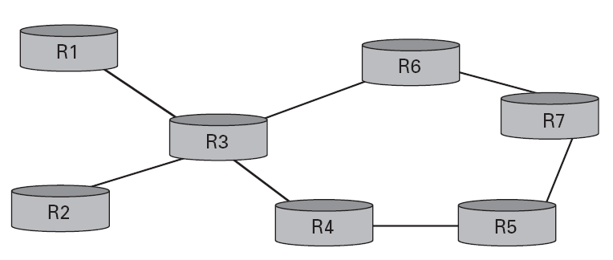
Explicit Routing
Such a network is called a fish network
Explicit routing is similar to similar routing but:
It is specific to the MPLS environment
Instead of the source, the LER can also explicitly set the route
Notes:
In Section 3.1.3 we introduced the concept of source routing. IP has a source routing option, but it is not widely used for several reasons, including the fact that only a limited number of hops can be specified, and because it is usually processed outside the “fast path” on most routers.
MPLS provides a convenient way to add capabilities similar to source routing to IP networks, although the capability is more often called “explicit routing” rather than “source routing.” One reason for the distinction is that it usually isn’t the real source of the packet that picks the route. More often it is one of the routers inside a service provider’s network. Figure 4.44 shows an example of how the explicit routing capability of MPLS might be applied. This sort of network is often called a “fish” network because of its shape (the routers R1 and R2 form the tail; R7 is at the head). Suppose that the operator of the network in Figure 4.44 has determined that any traffic flowing from R1 to R7 should follow the path R1-R3-R6-R7, and that any traffic going from R2 to R7 should follow the path R2-R3-R4-R7. One reason for such a choice would be to make good use of the capacity available along the two distinct paths from R3 to R7. This cannot easily be accomplished with normal IP routing because R3 doesn’t look at where traffic came from in making its forwarding decisions.
Because MPLS uses label swapping to forward packets, it is easy enough to achieve the desired routing if the routers are MPLS-enabled. If R1 and R2 attach distinct labels to packets before sending them to R3, then R3 can forward packets from R1 and R2 along different paths. The question that then arises is, How do all the routers in the network agree on what labels to use and how to forward packets with particular labels? Clearly, we can’t use the same procedures as described in the preceding section to distribute labels because those procedures establish labels that cause packets to follow the normal paths picked by IP routing, which is exactly what we are trying to avoid. Instead, a new mechanism is needed. It turns out that the protocol used for this task is the Resource Reservation Protocol (RSVP). We’ll talk more about this protocol in Section 6.5.2, but for now it suffices to say that it is possible to send an RSVP message along an explicitly specified path (e.g., R1-R3-R6-R7) and use it to set up label forwarding table entries all along that path. This is very similar to the process of establishing a virtual circuit described in Section 3.1.2. One of the applications of explicit routing is “traffic engineering,” which refers to the task of ensuring that sufficient resources are available in a network to meet the demands placed on it. Controlling exactly which paths the traffic flows on is an important part of traffic engineering. Explicit routing can also help to make networks more resilient in the face of failure, using a capability called fast reroute. For example, it is possible to precalculate a path from router A to router B that explicitly avoids a certain link L. In the event that link L fails, router A could send all traffic destined to B down the precalculated path. The combination of precalculation of the “backup path” and the explicit routing of packets along the path means that A doesn’t need to wait for routing protocol packets to make their way across the network or for routing algorithms to be executed by various other nodes in the network. In certain circumstances, this can significantly reduce the time taken to reroute packets around a point of failure.
One final point to note about explicit routing is that explicit routes need not be calculated by a network operator as in the above example. There are a range of algorithms that routers can use to calculate explicit routes automatically. The most common of these is called constrained shortest path first (CSPF), which is like the link-state algorithms described in Section 4.2.3, but which also takes “constraints” into account. For example, if it was required to find a path from R1 to R7 that could carry an offered load of 100 Mbps, we could say that the “constraint” is that each link must have at least 100 Mbps of available capacity. CSPF addresses this sort of problem. More details on CSPF, and the applications of explicit routing, are provided in the “Further Reading” section at the end of the chapter.

Slide 25

References
Chapter 4:
Internetworking
Section 4.3.3; 4.5
[P&D]

Slide 26
?
?
Questions/ Confusions?
?
Use the discussion forum at:
http://compnets.ning.com/
Credits/ Acknowledgement at:
http://sites.google.com/site/cse320site/

