Slide 1
Topic 1: Foundation
Lecture
1
Notes:
Sheraz_awan@gcuf.edu.pk
03340009694

Slide 2
Lecture Outline
Core network requirements
Connectivity
Cost-effective resource sharing
Support for common services
Network architecture
Layering/ Encapsulation
OSI architecture
Internet architecture

Slide 3
Requirements from
Computer Networks
Notes:
We want to understand how a computer network can be built from ground up. Our approach to accomplish this will be to start from the first principles, and then ask the questions we would naturally ask if we were building an actual network. Today’s protocols will be discussed to illustrate various design choices but they will not be accepted as the final word.
The first step is to identify the set of constraints and requirements that influence network design

Slide 4
1
Connectivity
[1.2.1; P&D]
Notes:
Connectivity is obviously necessary for networks
Privacy concerns can lead to limiting connectivity to certain nodes
Internet is an open system
A private network will be a closed system (with connectivity options provided to only a few selected nodes)
Scalability:
Internet as a model, we want to build scalable networks

Slide 5
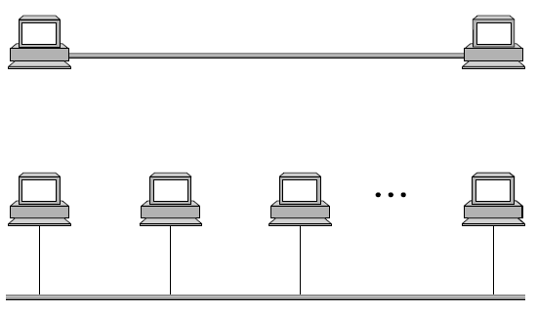
Direct link networks
Direct Link
Multiple-access Link
Notes:
The idea of abstraction: (copy/ paste from MIT’s link)
Link: Physical medium; Physical medium can be electromagnetic waves (i.e., wireless)
Online assignment: What are the different kinds of physical medium?

Slide 6
Links/ Nodes/ Clouds
Direct Link
Multiple-access Link
Notes:
Link: Physical medium; Physical medium can be electromagnetic waves (i.e., wireless)
Online assignment: What are the different kinds of physical medium?
Modularity, abstraction and modeling (from MIT’s OCW course 6.01 on “Introduction to EECS”)
Whether proving a theorem by building up from lemmas to basic theorems to more specialized
results, or designing a circuit by building up from components to modules to complex
processors, or designing a software system by building up from generic procedures to classes
to class libraries, humans deal with complexity by exploiting the power of abstraction and
modularity. And this is because there is only so much complexity a single person can consciously
manage at a time.
Modularity is the idea of building components that can be re-used; and abstraction is the
idea that after constructing a module (be it software or circuits or gears), most of the
details of the module construction can be ignored and a simpler description used for module
interaction (the module computes the square root, or doubles the voltage, or changes the
direction of motion).
One can move up a level of abstraction and construct a new module by putting together
several previously-built modules, thinking only of their abstract descriptions, and not their
implementations. This process gives one the ability to construct systems with complexity
far beyond what would be possible if it were necessary to understand each component in
detail.
Any module can be described in a large number of ways. We might describe the circuitry
in a digital watch in terms of how it behaves as a clock and a stopwatch, or in terms of
voltages and currents within the circuit, or in terms of the heat produced at different parts
of the circuitry. Each of these is a different model of the watch. Different models will be
appropriate for different tasks: there is no single correct model.

Slide 7
Links/ Nodes/ Clouds
Links connect computers through physical medium
Wide variety of transmission links:
Magnetic media (transported)
Copper Twisted pair
Coaxial Cable
Optical Fiber
Wireless media
To be discussed on the discussion forum;
For reference, see [Chapter 2, Tanen]
Notes:
Link: Physical medium; Physical medium can be electromagnetic waves (i.e., wireless)
Online assignment: What are the different kinds of physical medium?

Slide 8
Links/ Nodes/ Clouds
Direct Link
Multiple-access Link

Slide 9
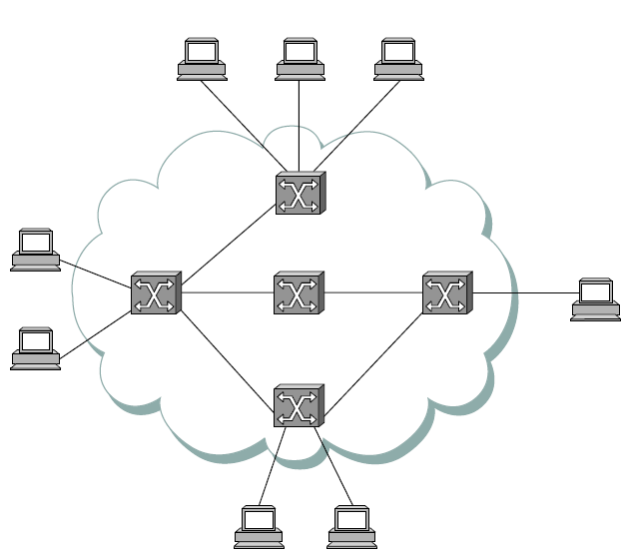
Links/ Nodes/ Clouds
Nodes that implement the network: Switches/ Routers

Slide 10
Links/ Nodes/ Clouds
Nodes that utilize the network: Hosts, PCs.

Slide 11
Links/ Nodes/ Clouds
Cloud is used for abstraction; can represent (inter)network
A network can be defined recursively as two or more nodes connected by a physical link, or by two or more networks connected by one or more nodes.
Notes:
Thus, bigger networks can be built by using the building blocks discussed: links, nodes, clouds, internets

Slide 12
Circuit switched networks
Source
(Caller)
Call establishment
(before data transfer)
Data transfer
Connection close
Destination
(Callee)
Notes:
Each phone call is allocated 64kb/s. So, a 2.5Gb/s trunk line can carry about 39,000 calls.

Slide 13
Packet Switching
Message is broken down in packets
Each packet is addressed is separately routed
Packet switches use ‘store and forward’ paradigm
More suitable for data traffic (which is bursty)
Service like a post-gram (snail-mail) service unlike the telephone-like service of circuit switching
Notes:
Difference between message and packet
‘Store and forward’ paradigm in contrast to ‘message steam’ paradigm of circuit switching.
Definition of switches and hosts.

Slide 14
Packet Switching
Packets (of a message) may take different routes
Source
1
2
Destination
Message
1
2
Packets
Notes:
Difference between message and packet
‘Store and forward’ paradigm in contrast to ‘message steam’ paradigm of circuit switching.
Definition of switches and hosts.

Slide 15
Packet Switching
Packets (of a message) may be delivered out-of-order
Source
1
2
Message
Destination
1
2
Packets
Notes:
Difference between message and packet
‘Store and forward’ paradigm in contrast to ‘message steam’ paradigm of circuit switching.
Definition of switches and hosts.

Slide 16
Packet Switching
Packets may be dropped and be not delivered at all
Link goes down
Source
1
2
Message
Destination
1
2
Packets
Notes:
Difference between message and packet
‘Store and forward’ paradigm in contrast to ‘message steam’ paradigm of circuit switching.
Definition of switches and hosts.

Slide 17
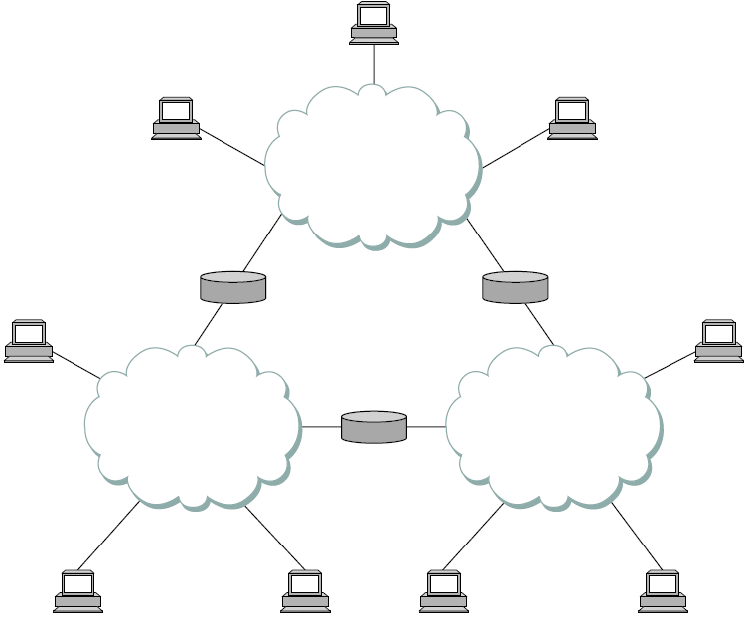
Internetworking
Net 1
Net 2
Net 3
Notes:
Router/ gateway is a node that has interfaces with two different networks.
Internetworking is the interconnection of two distinct disparate networking technology into a single homogeneous logical network.

Slide 18
Internetworking
Important issues:
Addressing
Routing messages
Support for unicast/ multicast/ broadcast
Notes:
Router/ gateway is a node that has interfaces with two different networks.
Internetworking is the interconnection of two distinct disparate networking technology into a single homogeneous logical network.

Slide 19
2
Cost effective resource sharing
[1.2.2; P&D]
Notes:
Connectivity is obviously necessary for networks
Privacy concerns can lead to limiting connectivity to certain nodes
Internet is an open system
A private network will be a closed system (with connectivity options provided to only a few selected nodes)
Scalability:
Internet as a model, we want to build scalable networks

Slide 20
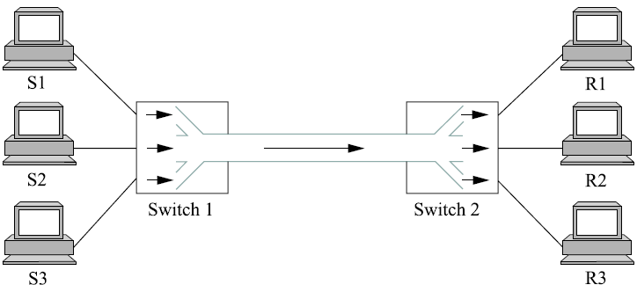
Multiplexing
Analogous to time-sharing operating systems that make multiple jobs share a CPU.
Notes:
Multiplexing is a fundamental concept which means that a system resource is shared among multiple users.
OS analogy: time sharing system in which CPU is shared between multiple processes (jobs)
Similarly, data being sent by multiple users can be multiplexed over the physical links that make up the network.
Multiplexing is of three basic types:
1 and 2) STDM, FDM used in circuit switching
3) Statistical Multiplexing used in packet switching.
Issues of QoS and Congestion.

Slide 21
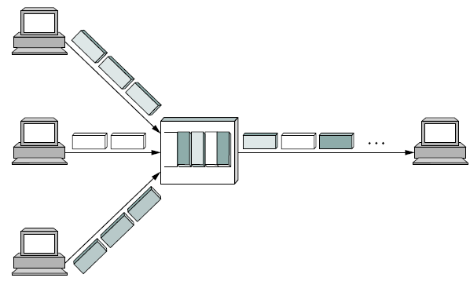
Multiplexing
Notes:
STDM
FDM
Statistical Multiplexing
Issues of QoS and Congestion.

Slide 22
Multiplexing (circuit sw.)
Time Division Multiplexing
(TDM)
Frequency Division Multiplexing
(FDM)
frequency
frequency
time
time
Notes:
STDM
FDM
Statistical Multiplexing
Issues of QoS and Congestion.

Slide 23





Statistical multiplexing
No fixed slot but allocation according to need
Packets
Notes:
STDM
FDM
Statistical Multiplexing
Issues of QoS and Congestion.

Slide 24
3
Support from common services
[1.2.3; P&D]
Notes:
Connectivity is obviously necessary for networks
Privacy concerns can lead to limiting connectivity to certain nodes
Internet is an open system
A private network will be a closed system (with connectivity options provided to only a few selected nodes)
Scalability:
Internet as a model, we want to build scalable networks

Slide 25
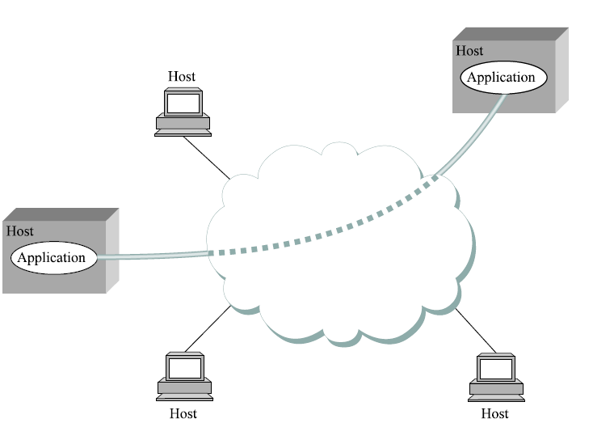
Logical channels
Notes:
It’s simplistic to view a computer network as simply delivering packets among a collection of computers.
It’s more accurate to think of a network as a means for a set of application processes that are distributed over computers to communicate.
Channel is a logical application to application abstraction
Explain here what’s a client/ server.
Message steam channel will be useful for Video on Demand and Video conferencing applications.

Slide 26
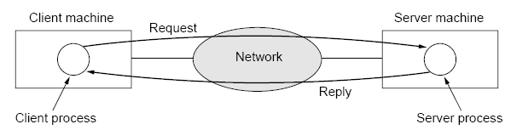
Request/ Reply channels
Notes:
Request Reply Channels and Message Stream Channels

Slide 27
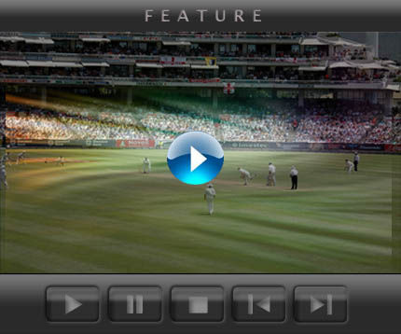
Message Stream Channels
Streaming video/ audio; Video on Demand
Requirements:
Packet loss is tolerable but sequencing is important
Notes:
Request Reply Channels and Message Stream Channels
Source: http://img.dailyradar.com/media/uploads/irock/story_large/2009/02/19/watch_live_cricket_streaming.jpg

Slide 28
Reliability
To provide reliable service, failures must be understood.
1. Bit or burst errors
Typically due to power surge, lightning, interference, etc.
Typically low: 1 in 10⁶/10⁷ for Cu Cable; 1 in 10¹²/10¹⁴ for Optical fiber
2. Packet delivery failure (errors)
Uncorrectable bit error;
Lack of buffer space; buggy software
Difficult to distinguish between late/ lost packets
Notes:
Reliable message delivery is one of the most important functions that a network can provide.
It is difficult to determine how to provide this reliability, however, without understanding how networks can fail.
Computer networks do not exist in a perfect world.
Machine crashes
Links are cut (fiber are cut)
Electrical interference can corrupt bits
Lack of buffer space
Sometimes software error causes packet to be routed to nowhere or to-and-fro.
Three general classes of failure:
Bit error (a single bit is corrupted) or burst error (several consecutive bits are corrupted)
The errors above occur due to power surge, lightning, etc.
1/ 10^6, 10^7 for Cu; 1/ 10^12, 10^13
There are techniques that can detect bit errors with high probability. Once detected, it is sometimes possible to correct for such errors.
2) Packet failure rather than bit:
A complete packet is lost by the network (uncorrectable bit error; lack of buffer space; buggy software makes a mistake)
How to know that a packet is lost or simply late?
3) Node or link level:

Slide 29
Reliability (contd.)
To provide reliable service, failures must be understood.
3. Node/ link failure
Buggy software
Power failure
Misconfiguration of a network device
Notes:
The key message from this discussion: Defining useful channels involves both understanding the application requirements and recognizing the limitations of the underlying technology. The challenge is to fill in the gap between what the application requires and what the underlying technology can provide.
Reliable message delivery is one of the most important functions that a network can provide.
It is difficult to determine how to provide this reliability, however, without understanding how networks can fail.
Computer networks do not exist in a perfect world.
Machine crashes
Links are cut (fiber are cut)
Electrical interference can corrupt bits
Lack of buffer space
Sometimes software error causes packet to be routed to nowhere or to-and-fro.
Three general classes of failure:
Bit error (a single bit is corrupted) or burst error (several consecutive bits are corrupted)
The errors above occur due to power surge, lightning, etc.
1/ 10^6, 10^7 for Cu; 1/ 10^12, 10^13
There are techniques that can detect bit errors with high probability. Once detected, it is sometimes possible to correct for such errors.
2) Packet failure rather than bit:
A complete packet is lost by the network (uncorrectable bit error; lack of buffer space; buggy software makes a mistake)
How to know that a packet is lost or simply late?
3) Node or link level:

Slide 30
Logical channels
Defining useful channels involves:
Understanding the application requirements
Limitations of underlying technology
Our aim is to close the gap (called semantic gap) between application requirement and what technology can provide
Design choice:
Where the functionality of providing a logical channel (switches, or hosts) is implemented?
Notes:
The key message from this discussion: Defining useful channels involves both understanding the application requirements and recognizing the limitations of the underlying technology. The challenge is to fill in the gap between what the application requires and what the underlying technology can provide.
Reliable message delivery is one of the most important functions that a network can provide.
It is difficult to determine how to provide this reliability, however, without understanding how networks can fail.
Computer networks do not exist in a perfect world.
Machine crashes
Links are cut (fiber are cut)
Electrical interference can corrupt bits
Lack of buffer space
Sometimes software error causes packet to be routed to nowhere or to-and-fro.
Three general classes of failure:
Bit error (a single bit is corrupted) or burst error (several consecutive bits are corrupted)
The errors above occur due to power surge, lightning, etc.
1/ 10^6, 10^7 for Cu; 1/ 10^12, 10^13
There are techniques that can detect bit errors with high probability. Once detected, it is sometimes possible to correct for such errors.
2) Packet failure rather than bit:
A complete packet is lost by the network (uncorrectable bit error; lack of buffer space; buggy software makes a mistake)
How to know that a packet is lost or simply late?
3) Node or link level:

Slide 31
Architecture of Computer Networks

Slide 32
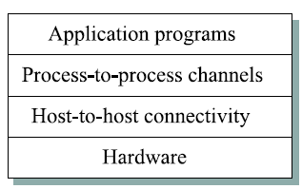
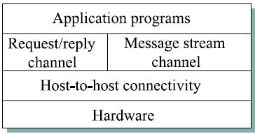
Layering and Protocols
Layering reduces the complexity of building scalable networks through encapsulation and modularity
Notes:
Peers communicate indirectly except at the hardware layer.
Encapsulation and modularity
OSI and Internet

Slide 33
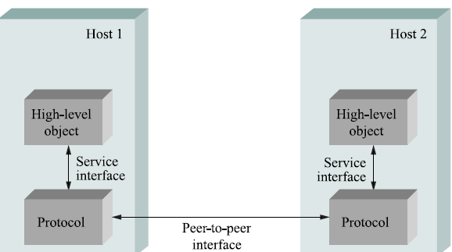
Protocols
Protocols specify and implement peer-to-peer interface as well as provide service interface to higher layers
Notes:
Term “protocol” is overloaded
Specification of peer-to-peer interface
Module that implements this interface
Encapsulation and modularity
OSI and Internet

Slide 34
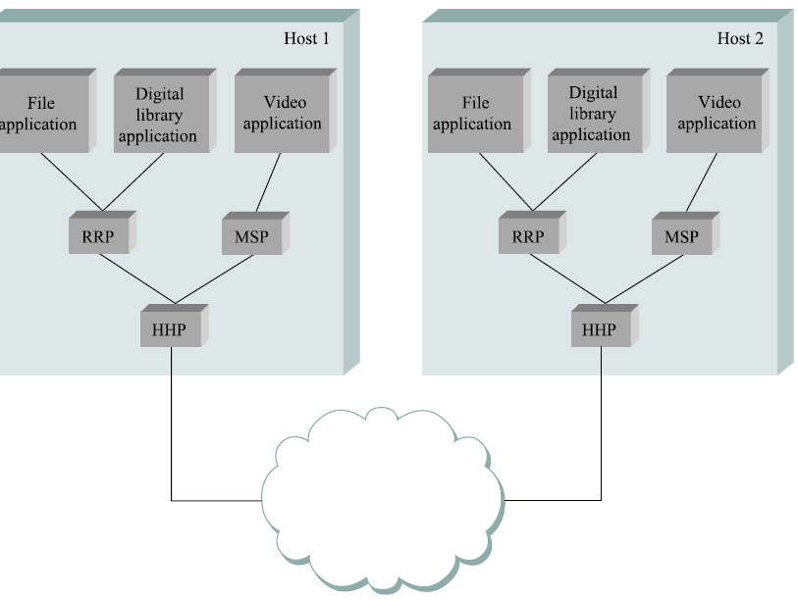
Protocol Graph
Protocols are nodes and edges specify relationship
Notes:
Encapsulation and modularity
OSI and Internet

Slide 35
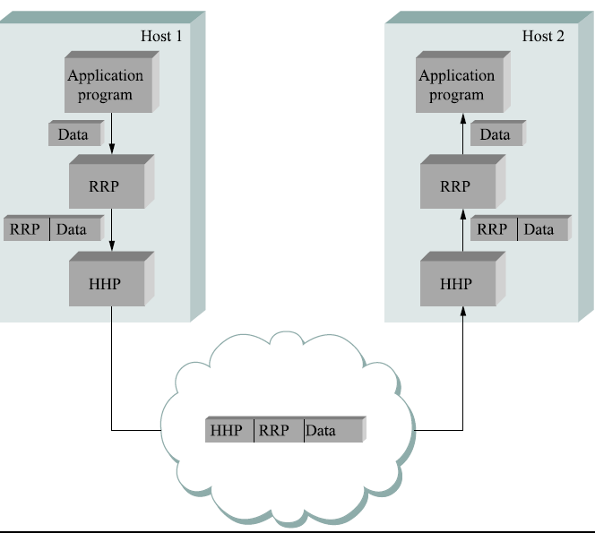
Encapsulation
A protocol passes (uninterpreted) data to its peer along with control information about handling this data
Notes:
For a lower layer, data from upper layer is uninterpreted data that has to be delivered to the peer interface.
However, the delivery is not done as is. Certain bits, called control information, is added to inform the receiving peer interface how to handle these packets (including which applications to deliver to---which will be covered in the next slides about mux/demux of higher layer data over lower layers).

Slide 36
Protocol Mux/ Demux
Notes:
For a lower layer, data from upper layer is uninterpreted data that has to be delivered to the peer interface.
However, the delivery is not done as is. Certain bits, called control information, is added to inform the receiving peer interface how to handle these packets (including which applications to deliver to---which will be covered in the next slides about mux/demux of higher layer data over lower layers).

Slide 37
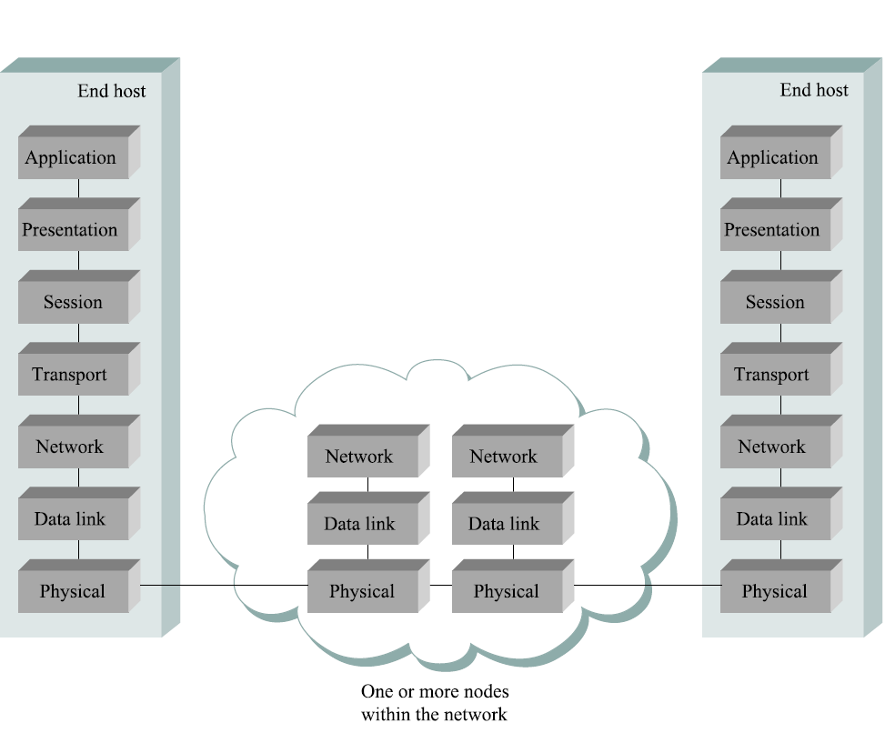
OSI
Architecture
Notes:
OSI architecture:
ISO was one of the first organizations to formally define a common standard way to connect computers.
Their architecture called Open Systems Interconnection architecture partitioned network functionality into seven layers where one or more protocols implement the functionality assigned to a given layer. In this sense, OSI model is not a protocol graph (since it defines layers and not relationships between protocols) but a reference model.
ISO, in conjunction with another standardization body called ITU, publishes a series of protocol specifications based on the OSI model. This series is sometimes called the X dot series since the protocols are given names like X.25, X.400 and X.500.
Starting at the bottom and moving up, the physical layer handles the transmission of raw bits over a communications link. The data link layer then collects a stream of bits into a large aggregate called a frame. Network adapters, along with device drivers, running in the node's OS typically implement this layer. This means that frames (and not raw bits) are delivered to hosts. The network layer handles routing among nodes within a packet switched network. At this layer, the unit of data exchange is a packet rather than a frame, although they are fundamentally the same thing. The lower three layers are implemented on all nodes nodes in cluding switches within the netwok and hosts connected along the exterior of the network. The transport layer then implements what we have up to this point being called the process to process channel. Here the unit of data is called a message (or segment) rather than a packet or a frame. The transport layer and the higher layers typically run only on the end hosts and not on the intermediata switches or routers.
There is less agreement about the definition of the top layers. Skipping ahead to the seventh layer (the top most layer), we find the application layer. Example protocols include HTTP and FTP. Below that presentation layer is concerned with the format of data exchanged between peers; e.g., whether an integer is 16/32/64 bits long and whether the MSB is trasmitted first or last. Finally, the session layer provides a name space that is used to tie together potentially different transport streams that are part of a single application. For example, an audio stream and a video stream may be managed in a teleconferening application.

Slide 38
Internet Architecture
FTP
HTTP
NV
TFTP
Applications
TCP
UDP
UDP
TCP
Narrow Waist
IP
Data Link
NET₁
NET₂
…
NET_{n}
Physical
The Hourglass Model
Notes:
Internet Architecture:
The internet architecture, also called TCP/ IP architecture based on its two most famous protocols. is shown above. The architecture evolved from experience in implementing ARPANET.
While the 7 layer OSI model can be applied to the Internet (with some imagination), a four layer model is used instead. At the lowest layer is a variety of network protocols (also called data link layer or subnetwork layer). In practice, these protocols are implemented using a combination of hardware (network adapters) and software (network device driver). For example, you might find Ethernet card or Fiber Distributed Data Interface (FDDI) protocols at this layer.
The second layer consists of a single protocol called Internet Protocol (IP). This is the protocol that supports the interconnection of multiple networking technologies into a single logical internetwork.
The third layer consists of two main protocols---the Transmission Control Protocol and the User Datagram Protocol (UDP). TCP and UDP provide alternative logical channels to application programs. TCP provides a bye steam channel and UDP provides an unreliable datagram service. TCP and UDP are sometimes called end to end protocol.
Running above the transport layer are a range of applicatio protocol such as FTP, TFTP, HTTP, SMTP, Telnet, etc.
Difference between application programs and application layer protocol. All the WWW browsers (Safari, Firefox, IE, Opera, Lynx, etc.) There is a similarly large numbers of webservers. The reason all of them can interwork is that they all conform to the HTTP application layer protocol.
Internet architecture does not imply strict layering. The application is free to bypass the defined transport layer protocols and to directly use IP or any of the underlying networks. In fact, programmers are free to define new channel abstractions.
Hour glass shape: Wide at the top and bottom but narrow at the waist: IP serves as the focal point of the architecture. IP is a common method of exchaning packets among a wide collection of networks.
Image source: Jennifer Ruxford

Slide 39
Protocol Demultiplexing
Multiple choices at each layer;
identifier is usually used to identify higher layer protocol
FTP
HTTP
NV
TFTP
TCP
UDP
Network
IP
TCP/UDP
IP
Type Field
Protocol Field
Port No.
NET₁
NET₂
…
NET_{n}
Notes:
Applies up and down protocol graphs
Practically, what it implies is a 8/16/32 bit field for identifying upper layer protocols.
Type field at the network (or data link layer) identifies the protocol at the internetworking layer.
Protocol field (in the IP header) identifies the transport protocol.
Port no (in the TCP header) identifies the application protocol.

Slide 40
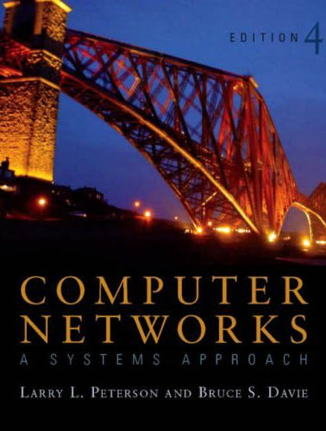
References
[P&D]
Chapter 1 - Foundation
1.1 Applications;
1.2 Requirements;
1.3 Architecture

