Slide 1
Topic 2: Direct Link Network
Week
3
Direct-link networks
datagram
Link layer protocol
Adapter
Adapter
frame
frame
Sender
Receiver

Slide 2
Topic’s objectives
To find out the answers to:
1 – What are common types of error detection?
2 – What are common methods of ensuring reliability?

Slide 3
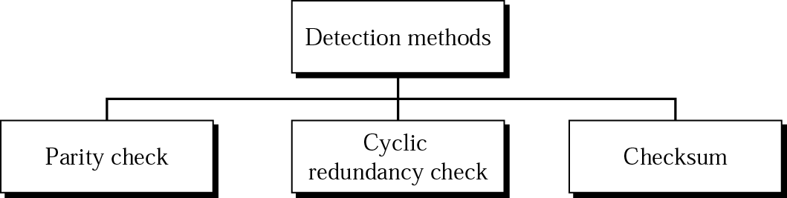
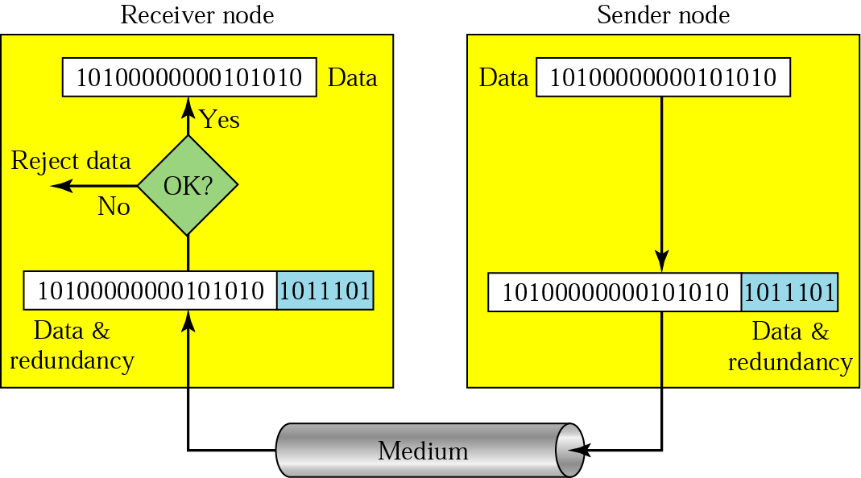
Part I - Error Detection
Notes:
As discussed in previous lectures, bit errors are sometimes introduced into frames. This happens, for example, because of electrical interference or thermal noise. Although errors are rare, especially on optical links, some mechanism is needed to detect these errors so that corrective action can be taken.
There is a long history of techniques for dealing with bit errors in computer systems, dating back to Hamming and Reed/Solomon codes that were developed for use when storing data on magnetic disks and in early core memories. This section describes some of the error detection techniques most commonly used in networking.
One of the most common techniques for detecting transmission errors is a technique known as the cyclic redundancy check (CRC). It is used in nearly all the link-level protocols discussed in the previous section—for example, HDLC, DDCMP—as well as in the CSMA and token ring protocols described in previous lectures. We will briefly describe the basic CRC algorithm. Before discussing that approach, we consider two simpler schemes that are also widely used: two-dimensional parity and checksums.
The former is used by the BISYNC protocol when it is transmitting ASCII characters (CRC is used as the error code when BISYNC is used to transmit EBCDIC), and the latter is used by several Internet protocols. The basic idea behind any error detection scheme is to add redundant information to a frame that can be used to determine if errors have been introduced. In the extreme, we could imagine transmitting two complete copies of the data. If the two copies are identical at the receiver, then it is probably the case that both are correct. If they differ, then an error was introduced into one (or both) of them, and they must be discarded. This is a rather poor error detection scheme for two reasons. First, it sends n redundant bits for an n-bit message. Second, many errors will go undetected—any error that happens to corrupt the same bit positions in the first and second copies of the message.
Fortunately, we can do a lot better than this simple scheme. In general, we can provide quite strong error detection capability while sending only k redundant bits for an n-bit message, where k ≪ n. On an Ethernet, for example, a frame carrying up to 12,000 bits (1500 bytes) of data requires only a 32-bit CRC code, or as it is commonly expressed, uses CRC-32. Such a code will catch the overwhelming majority of errors, as we will see below.
We say that the extra bits we send are redundant because they add no new information to the message. Instead, they are derived directly from the original message using some well-defined algorithm. Both the sender and the receiver know exactly what that algorithm is. The sender applies the algorithm to the message to generate the redundant bits. It then transmits both the message and those few extra bits. When the receiver applies the same algorithm to the received message, it should (in the absence of errors) come up with the same result as the sender. It compares the result with the one sent to it by the sender. If they match, it can conclude (with high likelihood) that no errors were introduced in the message during transmission. If they do not match, it can be sure that either the message or the redundant bits were corrupted, and it must take appropriate action, that is, discarding the message, or correcting it if that is possible.

Slide 4
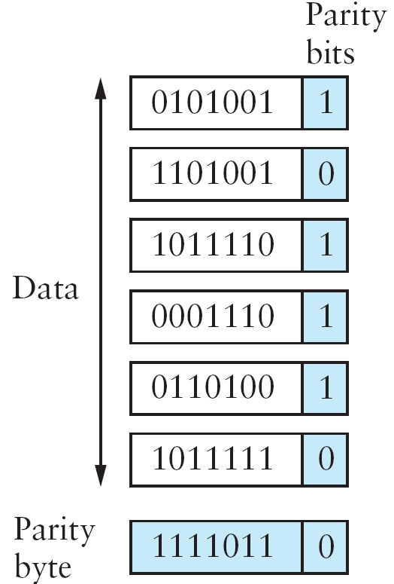
Repetition code – Naïve approach
Original Message
(k bits)
Repeated Message
(n bits)
Most errors detected with high probability
However, the overhead is very large (n = k bits)
Desired Goal:
Detect error with high probability but with n <<< k bits
Notes:
Single parity bit checking can check all single-bit errors. It can also detect burst errors as long as the total number of bits changed is odd.
Single parity bit check is also called ‘Vertical Redundancy Check’

Slide 5
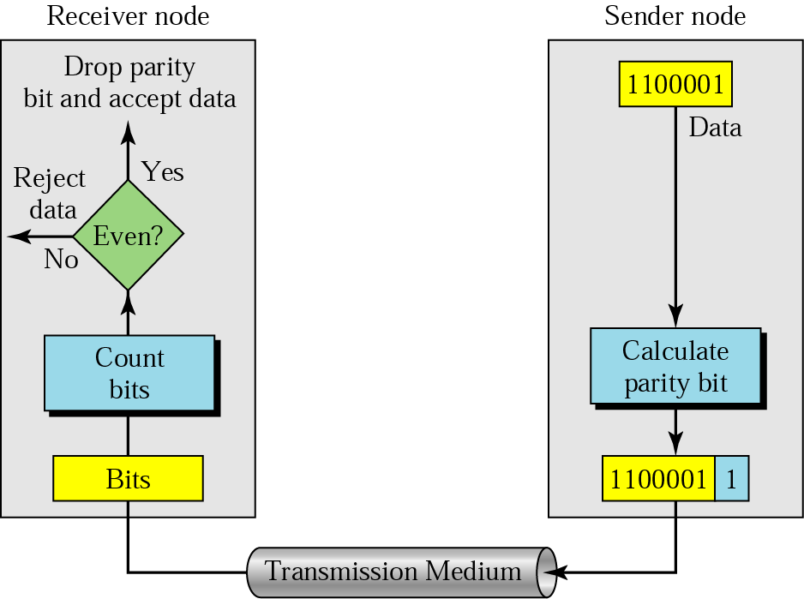
Single (even) parity bit
Can pick up odd number of bit errors (but not even) with low overhead
Notes:
Single parity bit checking can check all single-bit errors. It can also detect burst errors as long as the total number of bits changed is odd.
Single parity bit check is also called ‘Vertical Redundancy Check’

Slide 6
Two dimensional parity
Catches all 1, 2, 3 and most 4 bit errors with some additional overhead
Notes:
Two-dimensional parity is exactly what the name suggests. It is based on “simple” (one-dimensional) parity, which usually involves adding one extra bit to a 7-bit code to balance the number of 1s in the byte. For example, odd parity sets the eighth bit to 1 if needed to give an odd number of 1s in the byte, and even parity sets the eighth bit to 1 if needed to give an even number of 1s in the byte. Two-dimensional parity does a similar calculation for each bit position across each of the bytes contained in the frame. This results in an extra parity byte for the entire frame, in addition to a parity bit for each byte.
The figure above illustrates how two-dimensional even parity works for an example frame containing 6 bytes of data. Notice that the third bit of the parity byte is 1 since there are an odd number of 1s in the third bit across the 6 bytes in the frame. It can be shown that two-dimensional parity catches all 1-, 2-, and 3-bit errors, and most 4-bit errors. In this case, we have added 14 bits of redundant information to a 42-bit message, and yet we have stronger protection against common errors than the “repetition code” described above.

Slide 7
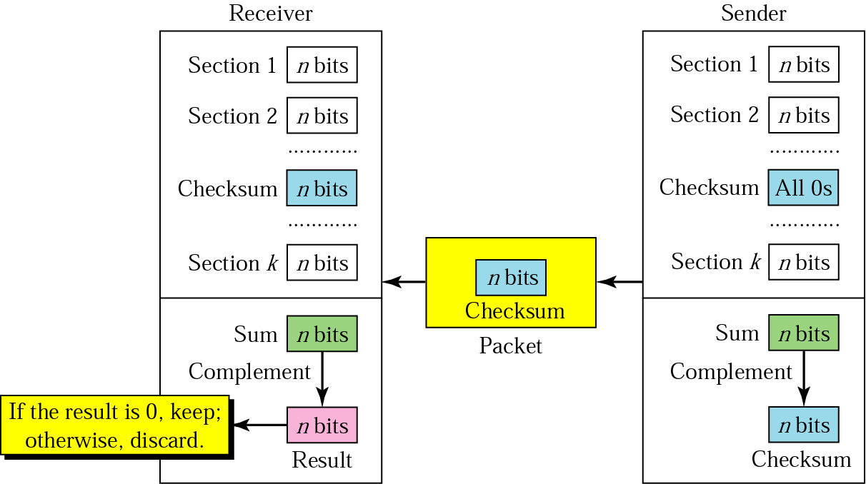
Checksum
Fixed overhead for any data size; Not as robust as CRC;
CRC used at lower layers; Checksum at higher layers
Notes:
A second approach to error detection is exemplified by the Internet checksum. Although it is not used at the link level, it nevertheless provides the same sort of functionality as CRCs and parity, so we discuss it here. We will see examples of its use later on in this course as well.
The idea behind the Internet checksum is very simple—you add up all the words that are transmitted and then transmit the result of that sum. The result is called the checksum. The receiver performs the same calculation on the received data and compares the result with the received checksum. If any transmitted data, including the checksum itself, is corrupted, then the results will not match, so the receiver knows that an error occurred.
You can imagine many different variations on the basic idea of a checksum. The exact scheme used by the Internet protocols works as follows. Consider the data being checksummed as a sequence of 16-bit integers. Add them together using 16-bit ones complement arithmetic (explained below) and then take the ones complement of the result. That 16-bit number is the checksum.
Compared to our repetition code, this algorithm scores well for using a small number of redundant bits—only 16 for a message of any length—but it does not score extremely well for strength of error detection. For example, a pair of single-bit errors, one of which increments a word, one of which decrements another word by the same amount, will go undetected. The reason for using an algorithm like this in spite of its relatively weak protection against errors (compared to a CRC, for example) is simple: This algorithm is much easier to implement in software. Experience in the ARPANET suggested that a checksum of this form was adequate. One reason it is adequate is that this checksum is the last line of defense in an end-to-end protocol; the majority of errors are picked up by stronger error detection algorithms, such as CRCs, at the link level.

Slide 8
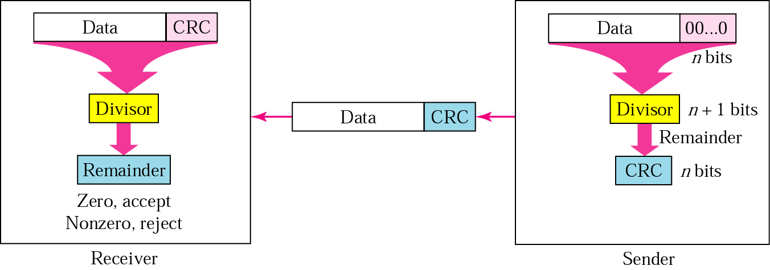
Cyclic Redundancy Check
To be valid, a CRC must have two properties:
1) CRC should have one less bit than the divisor
2) Appending CRC to data string makes it exactly divisible by divisor
Notes:
It should be clear by now that a major goal in designing error detection algorithms is to maximize the probability of detecting errors using only a small number of redundant bits. Cyclic redundancy checks use some fairly powerful mathematics to achieve this goal. For example, a 32-bit CRC gives strong protection (probability of catching error of the order of 99.99%) against common bit errors in messages that are thousands of bytes long. The theoretical foundation of the cyclic redundancy check is rooted in a branch of mathematics called finite fields. We will not delve too much into the mathematical details but will provided a high-level view.

Slide 9
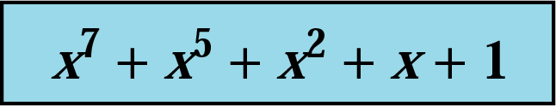
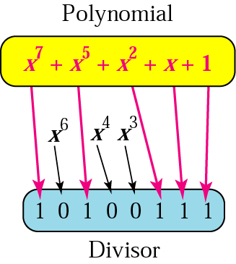
CRC Divisor Polynomial
Notes:
To be valid, a CRC must have two properties:
The CRC should have exactly one bit less than the divisor.
Appending it to the end of the data string must make it exactly divisible by the divisor.

Slide 10
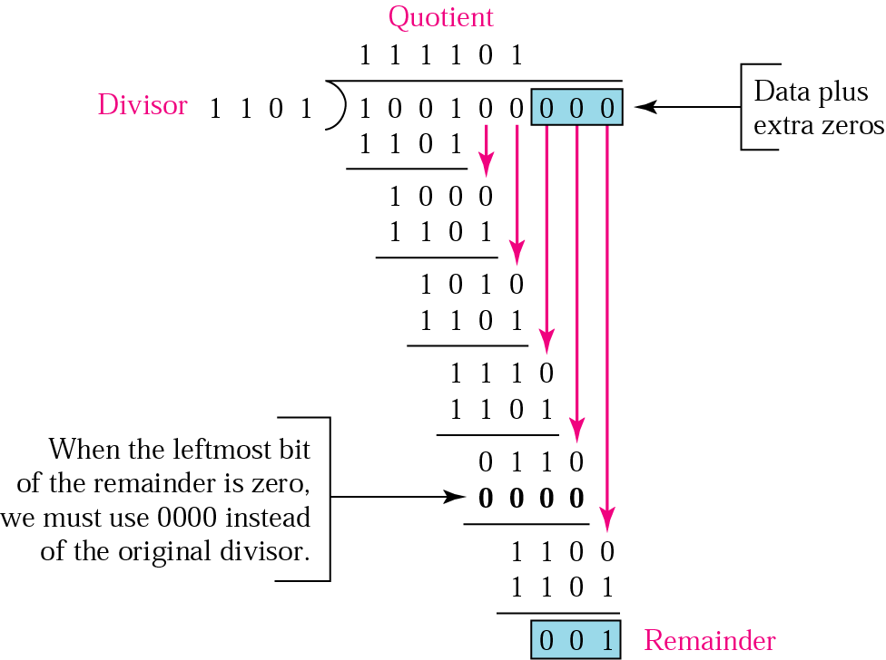
Cyclic Redundancy Check
Notes:
To be valid, a CRC must have two properties:
The CRC should have exactly one bit less than the divisor.
Appending it to the end of the data string must make it exactly divisible by the divisor.

Slide 11
Part II - Reliable Transmission
Automatic Repeat Request (ARQ) – Error Control
Stop and wait
Sliding windows
Forward Error Correction (FEC)
Selective Repeat
Go back N
Notes:
Detecting errors is only one part of the problem. The other part is correcting errors once detected. There are two basic approaches that can be taken when the recipient of a message detects an error. One is to notify the sender that the message was corrupted so that the sender can retransmit a copy of the message (called Automatic Repeat Request Protocols). If bit errors are rare, then in all probability the retransmitted copy will be error-free. Alternatively, there are some types of error detection algorithms that allow the recipient to reconstruct the correct message even after it has been corrupted; such algorithms are called Forward Error Correction protocols.
While some error codes are strong enough also to correct errors, in practice the overhead is typically too large to handle the range of bit and burst errors that can be introduced on a network link. Even when error-correcting codes are used (e.g., on wireless links), some errors will be too severe to be corrected. As a result, some corrupt frames must be discarded. A link-level protocol that wants to deliver frames reliably must somehow recover from these discarded (lost) frames. This is usually accomplished using a combination of two fundamental mechanisms—acknowledgments and timeouts. An acknowledgment (ACK for short) is a small control frame that a protocol sends back to its peer saying that it has received an earlier frame. By control frame we mean a header without any data, although a protocol can piggyback an ACK on a data frame it just happens to be sending in the opposite direction. The receipt of an acknowledgment indicates to the sender of the original frame that its frame was successfully delivered. If the sender does not receive an acknowledgment after a reasonable amount of time, then it retransmits the original frame. This action of waiting a reasonable amount of time is called a timeout.
The general strategy of using acknowledgments and timeouts to implement reliable delivery is sometimes called automatic repeat request (normally abbreviated ARQ). This section describes three different ARQ algorithms using generic language; that is, we do not give detailed information about a particular protocol’s header fields.

Slide 12
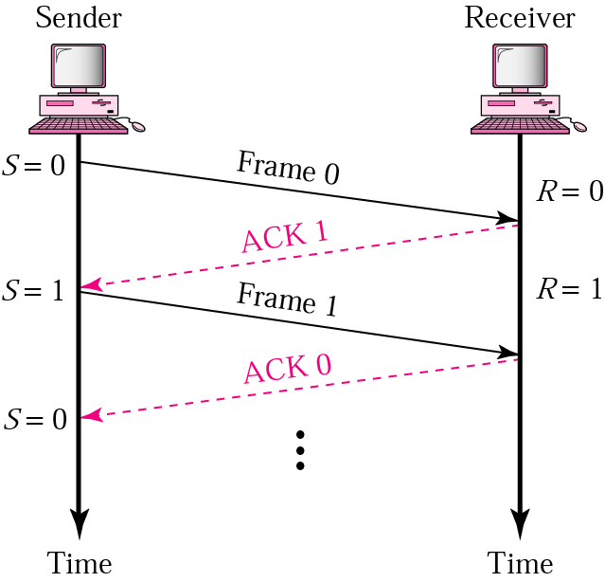
Stop and Wait Protocol
(Normal Operation)
Notes:
The simplest ARQ scheme is the stop-and-wait algorithm. The idea of stop-and-wait is straightforward: After transmitting one frame, the sender waits for an acknowledgment before transmitting the next frame. If the acknowledgment does not arrive after a certain period of time, the sender times out and retransmits the original frame.
This slide and the next three slides illustrate four different scenarios that result from this basic algorithm (normal operation, lost packet, lost ACK, delayed ACK). Recall that by “lost” we mean that the frame was corrupted while in transit, that this corruption was detected by an error code on the receiver, and that the frame was subsequently discarded.

Slide 13
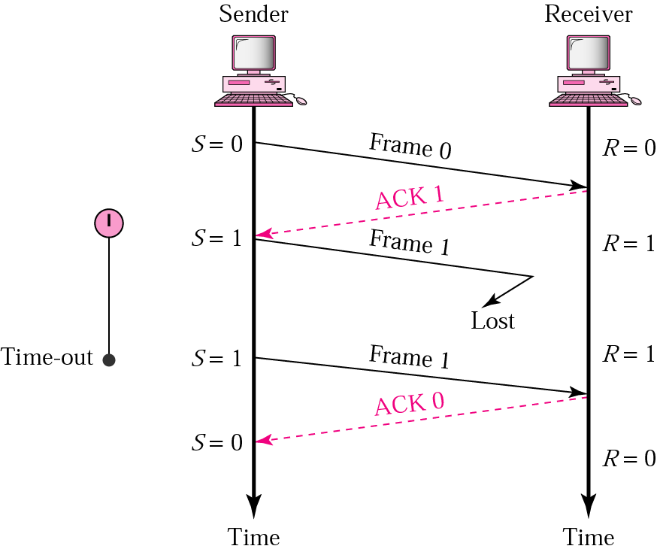
Stop and Wait (Lost Frame)
Notes:
If a frame is lost (i.e., it is received and is damaged or not received at all), the sender node will retransmit after the timeout of a timer that it runs after each transmission. If an acknowledgement is received, it will move on to the next packet; else, it will keep retransmitting until an acknowledgement is received.

Slide 14
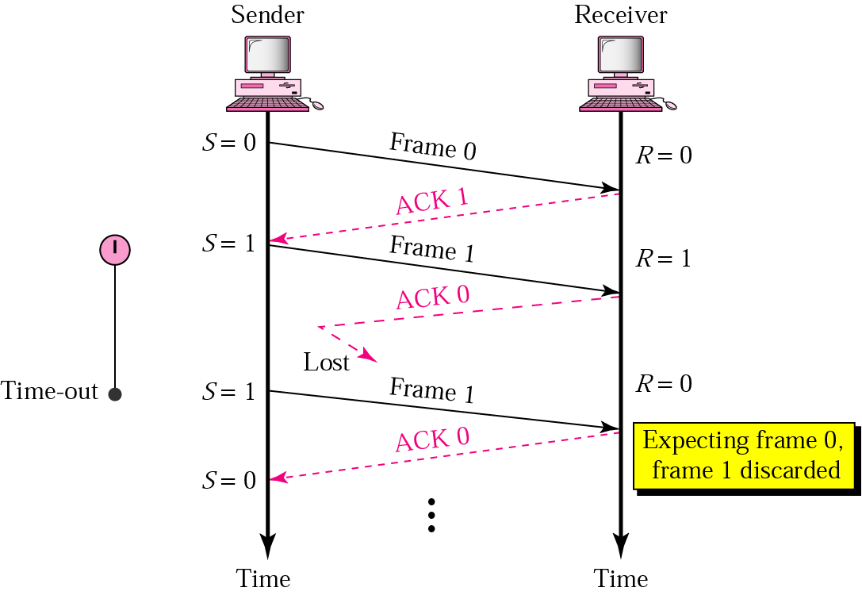
Stop and Wait (Lost ACK)
Notes:
The same problem could surface if the packet is not lost, but is properly received and the receiver sends an ACK; this ACK does not reach the sender. The sender will again retransmit after a timer it runs after transmission of a frame expires.
The receiver node has received this frame earlier, therefore, it will discard the packet and send an acknowledgement asking for the next frame.

Slide 15
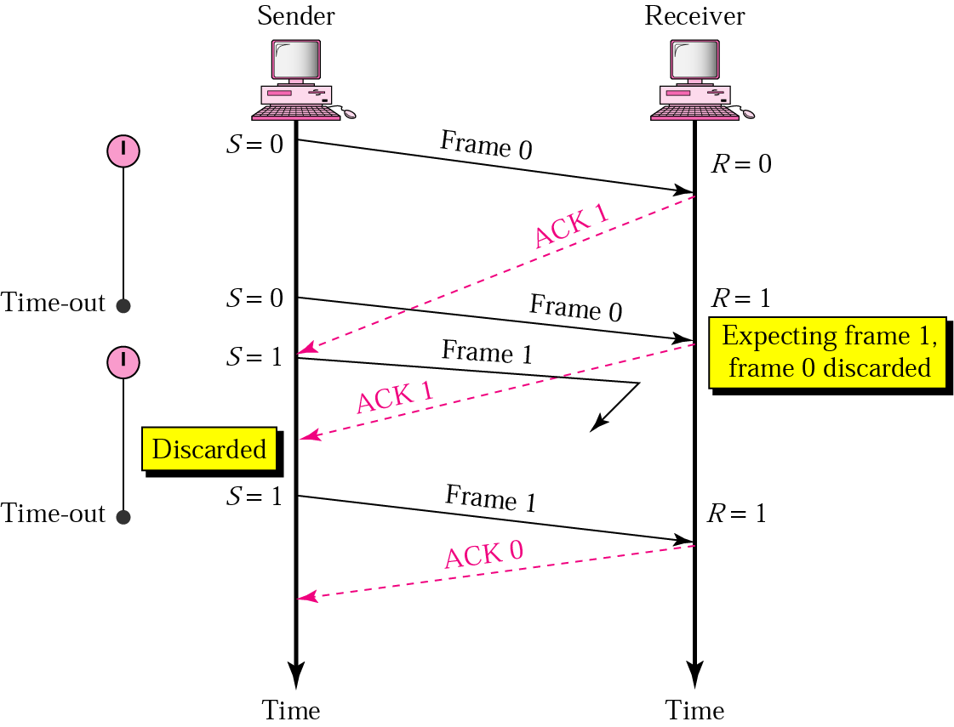
Stop and Wait (Delayed ACK)
Notes:
A retransmission due to a delayed ACK will be discarded at the receiver, and a duplicate ACK will be discarded at the sender.

Slide 16
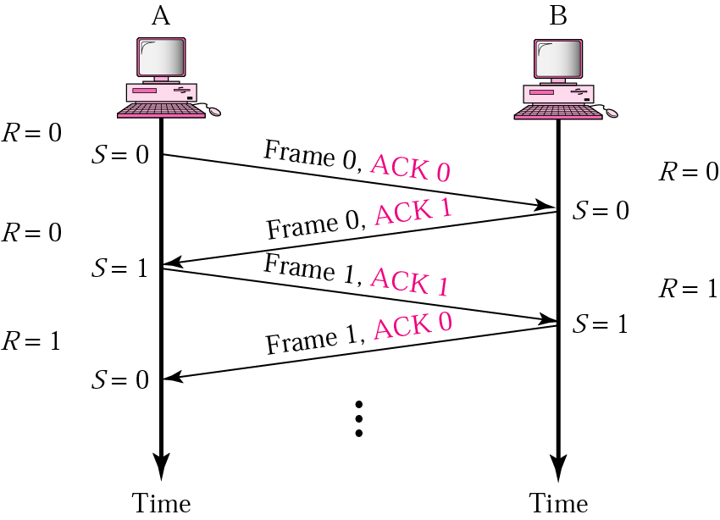
Stop and Wait (Piggybacking)
Notes:
An ACK frame is sent piggybacked inside a data frame. The ACK frame tells the other end, what frame is expected from the other end.

Slide 17
Stop and Wait’s Drawbacks
Frame delivered reliably and in order
but
Only one frame can be sent per RTT
Example:
BW= 1.5 Mbps; RTT= 45ms; Frame size = 1 KB
Delay x BW product: 67.5 Kb (~8 KB)
Throughput: 1 frame/ RTT = 1024*8 bits per 45 ms
= 182 kbps (instead of 1.5 Mbps)
Notes:
The main shortcoming of the stop-and-wait algorithm is that it allows the sender to have only one outstanding frame on the link at a time, and this may be far below the link’s capacity. Consider, for example, a 1.5-Mbps link with a 45-ms round-trip time. This link has a delay × bandwidth product of 67.5 Kb, or approximately 8 KB. Since the sender can send only one frame per RTT, and assuming a frame size of 1 KB, this implies a maximum sending rate of
BitsPerFrame ÷ TimePerFrame
= 1024 × 8 ÷ 0.045
= 182 Kbps
or about one-eighth of the link’s capacity. To use the link fully, then, we’d like the sender to be able to transmit up to eight frames before having to wait for an acknowledgment.

Slide 18
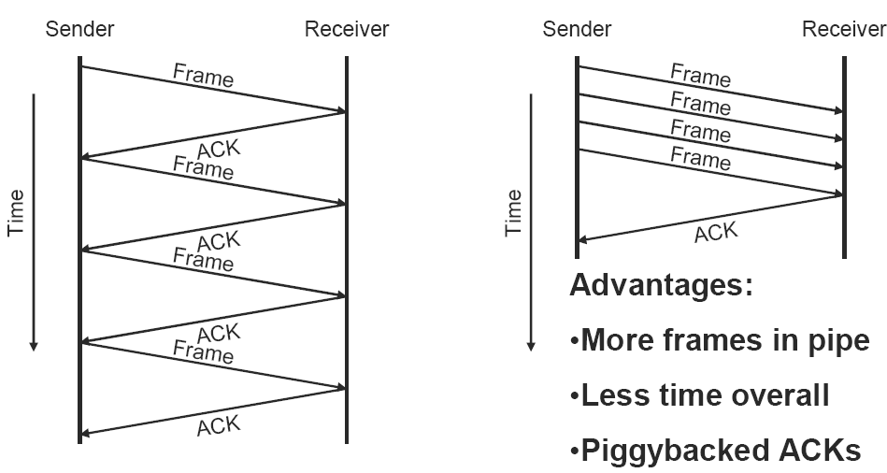
Sliding Windows
Most important and general ARQ scheme
Used by TCP for reliability
Two types: 1) Go-back-N; 2) Selective Repeat
Notes:
Consider again the scenario in which the link has a delay × bandwidth product of 8 KB and frames are of 1-KB size. We would like the sender to be ready to transmit the ninth frame at pretty much the same moment that the ACK for the first frame arrives. The algorithm that allows us to do this is called sliding window, and an illustrative timeline above (RHS figure).

Slide 19
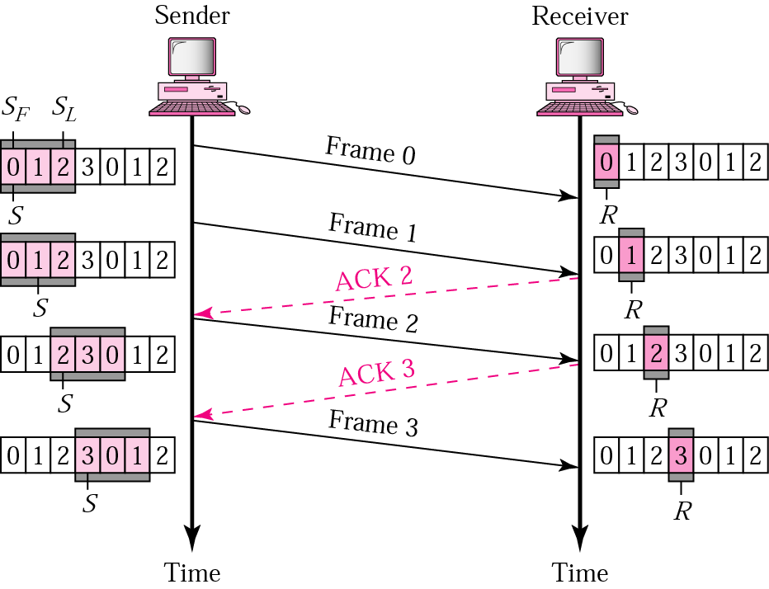
Go-back-N ARQ (Normal Operation)
LAR LFS
Notes:
Go-Back-N ARQ is a specific instance of the Automatic Repeat-reQuest (ARQ) Protocol, in which the sending process continues to send a number of frames specified by a window size even without receiving an ACK packet from the receiver.
The receiver process keeps track of sequence number of the next frame it expects to receive, and sends that number with every ACK it sends. The receiver will ignore any frame that does not have the exact sequence number it expects -- whether that frame is a "past" duplicate of a frame it has already ACK'ed or whether that frame is a "future" frame past the lost packet it is waiting for. Once the sender has sent all of the frames in its window, it will detect that all of the frames since the first lost frame are outstanding, and will go back to sequence number of the last ACK it received from the receiver process and fill its window starting with that frame and continue the process over again.
Go-Back-N ARQ is a more efficient use of a connection than Stop-and-wait ARQ, since unlike waiting for an acknowledgement for each packet, the connection is still being utilized as packets are being sent. In other words, during the time that would otherwise be spent waiting, more packets are being sent. However, this method also results in sending frames multiple times -- if any frame was lost or damaged, or the ACK acknowledging them was lost or damaged, then that frame and all following frames in the window (even if they were received without error) will be re-sent.
To avoid this, Selective Repeat ARQ can be used.

Slide 20
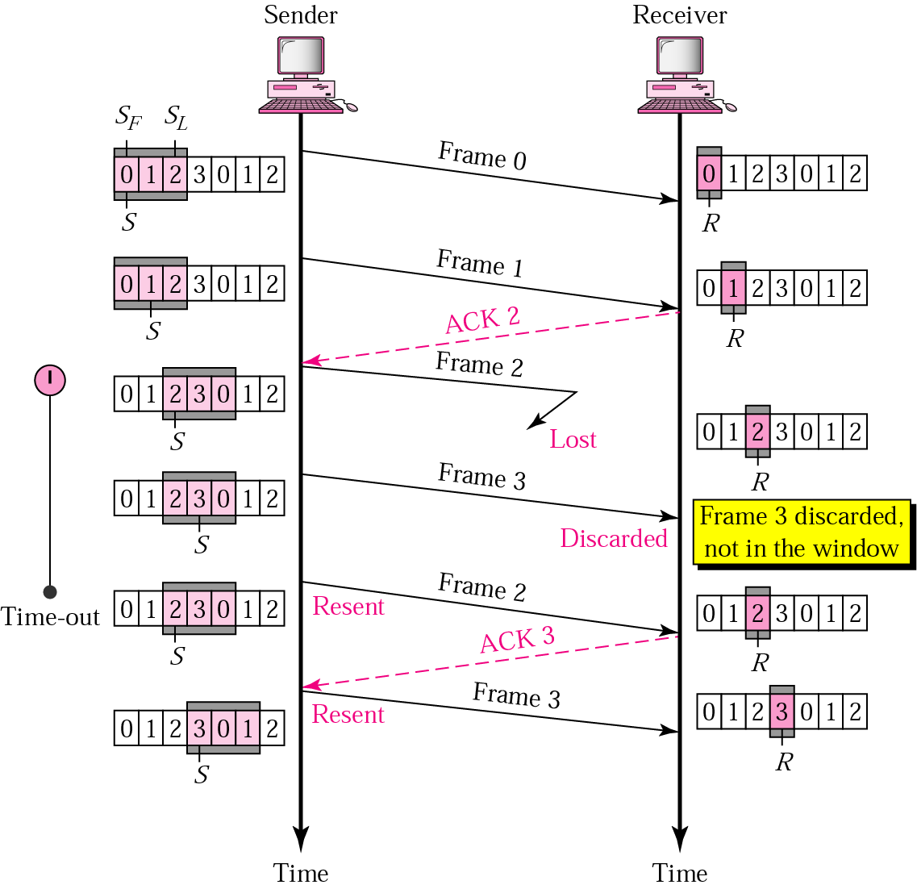
Go-back-N ARQ (Lost Frame)
LAR LFS

Slide 21
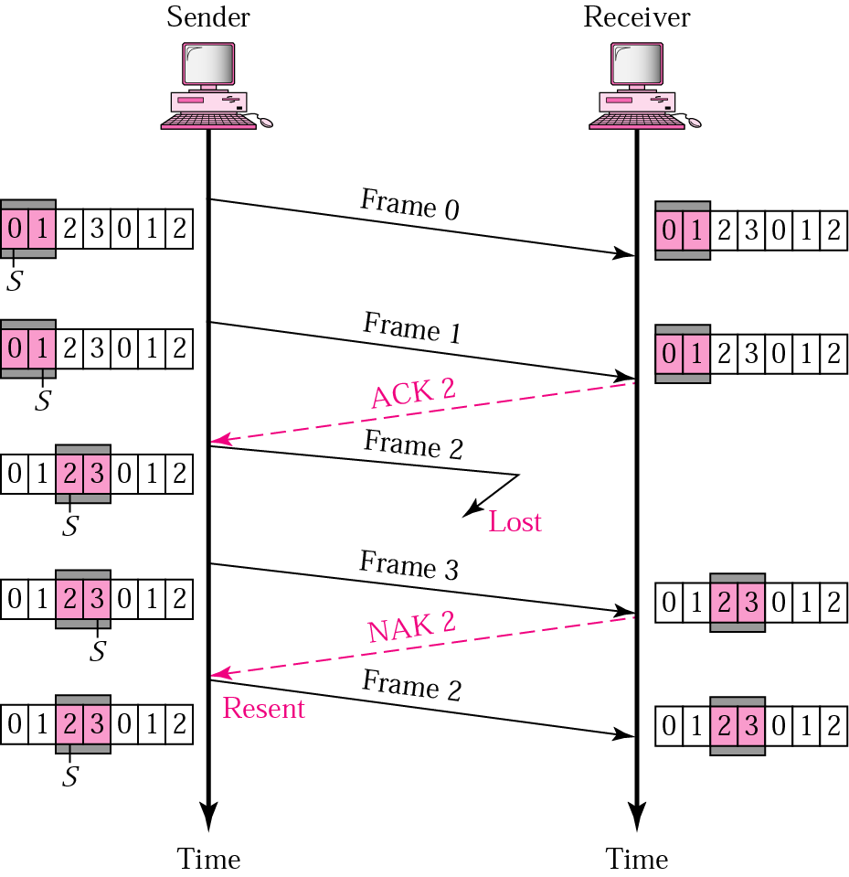
Selective Repeat (Lost Frame)
LAR LFS
LFR LAF
Notes:
When used as the protocol for the delivery of messages, the sending process continues to send a number of frames specified by a window size even after a frame loss. Unlike Go-Back-N ARQ, the receiving process will continue to accept and acknowledge frames sent after an initial error.

Slide 22
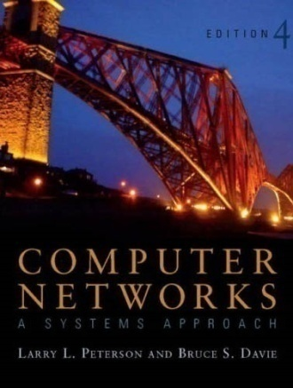
References
Sections [P&D]
2.4 and 2.5:
Direct Link
Networks

Slide 23

?
?
Questions/ Confusions?
?
Use the discussion forum at:
http://compnets.ning.com/
Credits/ Acknowledgement at:
http://sites.google.com/site/cse320site/

