Slide 1
Topic 1: Foundation
Lecture
3
Part 1: Addressing; Routing;
Part 2: Network’s Performance Analysis
Notes:
Today’s lecture is going to build upon the lecture last week to discuss network addressing in some more detail.
To build a globally scalable network, we need the ability to address each node. The challenge is that not all networking technologies interwork; many of them have incompatible proprietary addressing schemes. E.g., the addressing scheme used by Ethernet is different from that used by ATM which is in turn different to that used by FR.
The trick adopted by the Internet designers is to have an extra layer of addressing (which is called logical addressing) above the physical addressing (that are sometimes incompatible).
Using these logical addressing, we are able to identify unambiguously source and destination ends of communication. However, since source and destination are, more often that not , not directly connected, there is an additional challenge of routing the message somehow to the destination. This routing is compounded by the fact that source and destination may be using completely different network technologies. Furthermore, the path from the source to the destination may transit through a number of different networks. The challenge in routing is thus obvious.
In the last part of this lecture, we are going to address how do we analyze the performance of computer networks. How do we quantify which network is better, quicker, speedier, or faster. We will study the metrics (such as bandwidth, throughput, delay and jitter) that will help us describe the performance of networks.

Slide 2
Layered Communication
Recap
TCP/IP model
Application layer
GET / HTML/1.1
Source Port | Destination Port
> 1024 | 80
Payload
Transport layer
Payload
Internet layer
Source IP | Destination IP
202.125.157.150 | 202.125.157.196
Payload
Payload
Link layer
Source MAC address | Destination MAC address 23:34:aa:bb:cc:dd | 12:34:aa:bb:cc:dd
Payload
FCS
Notes:
We’ve described earlier the benefit of a layered protocol approach. The principle on which layering works is: [Comer]
“Layer N software on the destination computer must receive the exact message sent by layer N software on the sending computer.”
In other words, whatever transformation a protocol applies before sending a frame must be completely reversed when the frame is received. If a particular layer, prepends a header to a frame, the corresponding layer on the receiver must remove the header. If one of the layer encrypts a frame before sending, the corresponding layer must decrypt the frame.

Slide 3
Part 1:
Addressing, Routing
Notes:
See the notes of first slide.

Slide 4
Addressing
Each station must be addressable
Two kinds of addresses:
1) Physical addressing (MAC addresses)
2) Logical addressing (IP addresses)
The communicating applications (source/ destination applications) must also be identifiable
Identified through TCP ports
A socket (IP address + TCP port) identifies both an application and the machine it’s on.
Notes:
Physical addressing is the addressing employed by various networking schemes (e.g., Ethernet, ATM, FDDI, AppleTalk, PPP, HDLC, etc.) These network have different frame formats and use different addressing scheme.
Logical addressing is an addressing scheme above the physical addressing. This is used for universal communication between different networks. The most popular logical addressing protocol is Internet Protocol (IP).
Just, like there’s a need to address source and destination nodes of a communication, it’s also necessary to identify source and destination application processes since in the end, it is the applications that are exchanging packets.

Slide 5
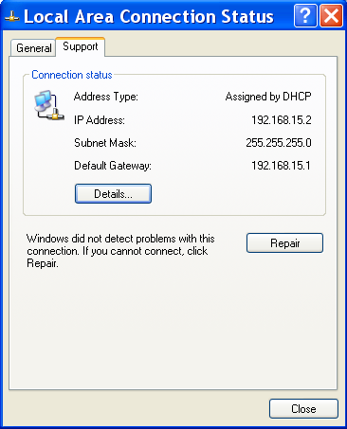
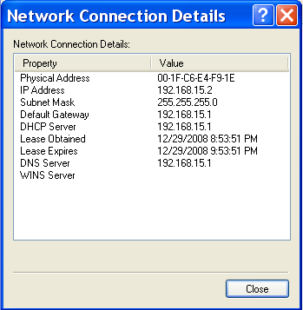
Physical addressing: MAC
MAC Address: 48 bits (Ethernet)
Flat addressing -> does not facilitate routing
Usually non-configurable but hackable
Notes:
Other technologies may use other physical addressing techniques:
E.g., ATM uses 20 byte addressing
Courtesy: www.layertwo.net
www.tcpipguide.com

Slide 6
Logical addressing: IP
4,294,967,296
possible addresses = 2³²
IP Version 4; Address: 32 bits
IP Version 6; Address: 128 bits
Hierarchical addressing
2 parts (variable bits): network, host.
How do we know how many bits of an IP address represents the network?
Machines in a LAN have same network part
Subnet mask
Notes:
Internet Protocol (IP) comes in two main versions: IPv4 and IPv6.
In an IPv4 address, that comprises of 32 bits, there are two parts by design. The first part is called the network part, and the second part is called the host part.
The designers

Slide 7
IP addressing: example
IP Address
192.168.15.2 (decimal)
11000000 10101000
00001111 00000010 (binary)
Subnet Mask:
255.255.255.0 (decimal)
11111111 11111111
11111111 00000000 (binary)
IP Address
192.168.15.2 (decimal)
11000000 10101000
00001111 00000010 (binary)
Subnet Mask:
255.255.255.0 (decimal)
11111111 11111111
11111111 00000000 (binary)
Network part Host part
Notes:
As an example to demonstrate how IP addressing works, consider the following example:
A machine is configured with an IP address 192.168.15.2 and a subnet mask of 255.255.255.0. We want to determine what is the network address for this network. This can be done through a logical AND between the IP address and the subnet mask. We obtain the network address as 192.168.15.0 after the logical AND of IP address and subnet mask which shows that the first 24 bits of the IP address is the network part and the last 8 bits of the IP address is for hosts that belong to this network.
Also note that the address 192.168.15.2 is actually 110000000 10101000 00001111 00000010 where the first three octets (192.168.15) are for network and the last octet is for host.
It’s not necessary that the last octet always be for the host part. You can have any division; e.g., 192.168.0.0/16 represents a network having 16 bits for the host part (implying 2^16 - 2 possible host addresses)

Slide 8
IP addressing example (contd.)
Range: 192.168.15.0 to 192.168.15.255;
Two addresses are reserved in every network
1) host bits → all zeros (for representing the network)
2) host bits → all ones (for the broadcast address)
192.168.15.0/24
For our example:
192.168.15.255 -> broadcast address;
.254
.254
…
…
Packet sent to broadcast address
.1
.1
A packet sent to broadcast address will be received by all nodes.
Notes:
Note that there are 8 bits for the host part which means 256 valid addresses. Of these 256 valid addresses, two addresses are reserved (all zeros for the network address and all ones for the broadcast address of the network 192.168.15.0/24 ). Note that the subnet mask can also be represented in a slash format in which the number of network bits follow the /. In this example, the subnet mask 255.255.255.0 can also be represented as /24.

Slide 9
Communication in same LAN (same network)
Application
Application
Transport
Transport
Network
Network
Data Link
Data Link
Bits
Bits
Destination Host
(Same LAN)
Bridges/
Switches
Source Host
Repeater/
Hub
Device used in a single LAN: hub, bridge, switch
Notes:
How does routing take place in a single LAN:
Technically speaking, routing is used to connect two different LANs. We use routing here, loosely, to define delivery of the packet to the destination.
The application layer data is prepended with a transport layer header, and then an IP header, and lastly with a MAC header. When the destination node (on the same LAN) receives the frame, it removes the IP address, recognizes its own IP address in the destination field, demuxes the packet to the right application using the Transport layer (TCP or UDP) port information. There is no intermediate routing node enroute.
When the distance between source host and destination host increases, or the number of nodes increase, switches or bridges can be used.
In a hub: a frame is received; it is copied on all other ports; it’s called a physical layer device. Show a frame being copied on all ports.
Motivate the question? Why copy on all ports, when you can just copy to the port the destination MAC is in? This can improve throughput as it will reduce some collisions and enable simultaneous transmissions.
In a switch, the frame is copied to the port destination MAC is connected to; how are the MAC addresses learnt?
A router is used to connect different LANs; An example?

Slide 10
Internetworking LANs
Application
Application
Routers/
Gateway
Transport
Transport
Network
Network
Data Link
Data Link
Bits
Bits
Source Host
Destination Host
(Different network)
Notes:
A router or a gateway is a specialized device that only implements functionality up to the network layer. It receives the MAC frame from the source host since the source host has kept the destination MAC as the MAC address of the router. Once, it has received the packet, it will inspect the IP address, recognizing that the IP address is not its own, it will route the packet towards the destination. For this, it will choose a next hop that will take the packet towards the destination. The router will add a new MAC header, insert its own MAC address as the source MAC address and the MAC address of the next hop as the destination MAC address.
This process will go on until the packet reaches the destination node. The destination node will remove the MAC header and recognize that the packet is destined towards its ownself. It will then use the transport layer port information to deliver the packet to the right application.

Slide 11
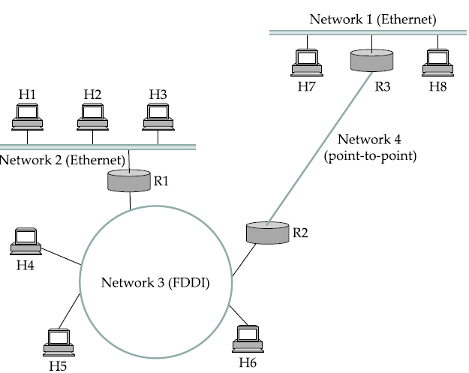
Internetworking example
Source
Destination
Notes:
Let’s crystallize the theory we’ve learn up till now with this example.
The source and destination nodes both use Ethernet technology; however, they are on different LANs. The route from the source to the destination goes through networks other than Ethernet (FDDI and PPP). Network 3 and Network 4 cannot understand Ethernet packets. Therefore, the router R1 should send the Ethernet frame as a FDDI frame on network 3 and R2 should send the Ethernet frame as a PPP frame on Network 4.
Network 1 can understand Ethernet frame.

Slide 12
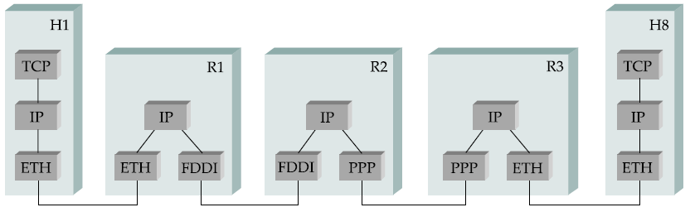
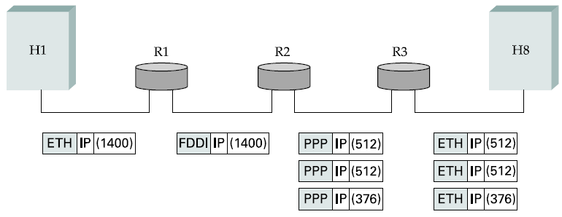
Internetworking example (contd)
Fragmentation
Notes:
Another problem sometimes arises, sometimes network place an upper limit on the size of packet they can deliver. This is ~1500 bytes for Ethernet and around 600 bytes for PPP. Thus packets will have to be fragmented, these fragmented packets have to be routed to the destination and reassembled at the destination.

Slide 13
Part 2:
Network Performance Analysis
Notes:
In this part of the lecture, we’d cover Section 1.5 of the textbook P&D.
The core topic we’ll cover is how do we analyze and quantify the performance of a computer network.

Slide 14
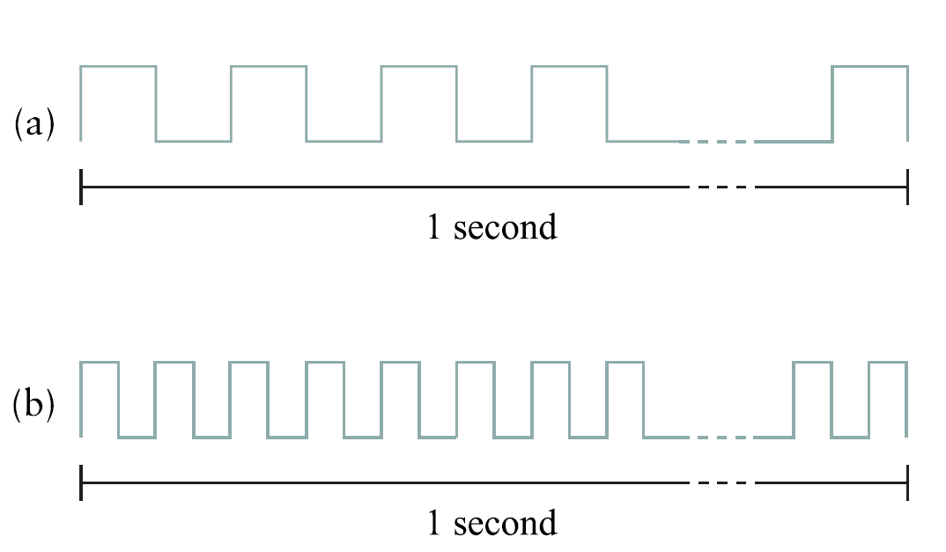
Bandwidth (throughput)*
* Refer to textbook’s discussion
1 Mbps; each bit 1 uS wide
2 Mbps; each bit .5 uS wide
Notes:
Bandwidth and throughput are two of the most confusing terms used in networking; primarily, because it can be defined in various ways.
Bandwith is literally the width of frequency band; e.g., voice-grade telephone can support frequencies from 300 Hz to 3300 Hz and said to have a bandwidth of 3KHz.
When we talk to bandwidth of a link, we usually refer to the number of bits per second that can be transmitted on the link. We might say that the bandwidth of an Ethernet link is 10 Mbps. This is also referred to as the throughput.
More generally, we tend to use the term throughput to refer to the measured performance of the system. E.g., due to various inefficiencies, a pair of nodes connected by a link of 10 Mbps may achieve a throughput of only 2 Mbps.
We can also talk of the bandwidth required by an application (in bps). This will be covered again in the last slide.

Slide 15
Latency (delay)
transmission
A
propagation
B
nodal
processing
queueing
Latency = Propagation + Transmit + Queue
Propagation = Distance/ Speed of Light
Transmit = Size/ Bandwidth
Notes:
Another term that is used to analyze and quantify networking performance is called latency (or delay). This is always measured in terms of time. It usually has three components (if we ignore nodal processing delay): 1) Transmit delay, 2) Queuing delay and 3) Propagation delay.
There are certain situations where it’s important to measure time to send a message from one end of the network to the other end and back. This is called Round Trip Time.
Transmission delay is the time taken by the node to put the links on the medium from its output buffers.
Queuing delays are because of packet switches since packet switches need to store packets before forwarding them on a link. If the output queue of a link is already full, the new packets will have wait.
Propagation delay is the time taken for the signal representing the bit to propagate at the speed of the light to the other end. Propagation delay = distance/ speed of light which is 3 x 10^8 in vacuum; 2.3 x 10^8 in a cable and 2.0 x 10^8 in a fiber.
Bandwidth and delay together combine to define the performance characteristics of a given link/ channel. The relative importance, however, depends on the application. For some applications, latency dominates bandwidth. For example, a client that delivers one byte message and receives one byte message from the server is latency bound. Assuming no computation is involved (no nodal delay), the application will perform much different on a 100 ms RTT link than on 1 ms RTT link.

Slide 16
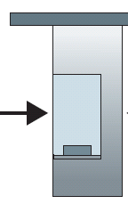
Caravan (analogy)
100 km
100 km
ten-car caravan
toll
booth
toll
booth
Cars “propagate” at 100 km/hr
Toll booth takes 12 sec to service car
(transmission time)
Analogy: car ~ bit; caravan ~ packet
How long until caravan is lined up before 2nd toll booth?
* From Kurose and Ross

Slide 17
Caravan (analogy)
100 km
100 km
ten-car caravan
toll
booth
toll
booth
Time to “push” entire caravan through toll booth onto highway = 12*10 = 120 sec
Time for last car to propagate from 1st to 2nd toll both: 100km/(100km/hr)= 1 hr
Answer: 62 minutes

Slide 18
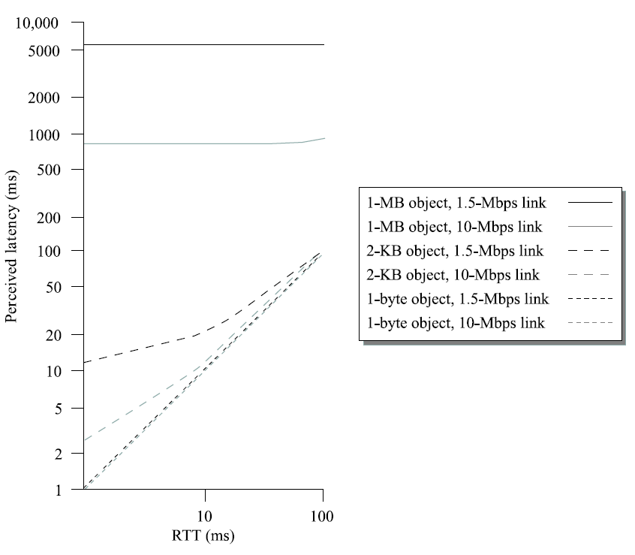
Effect of RTT and
link throughput on perceived latency

Slide 19
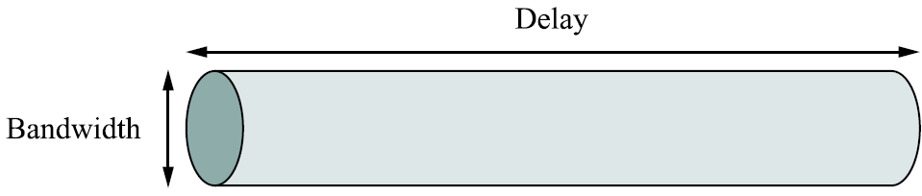
Delay x Bandwidth product
Delay depends on distance covered and is limited by laws of physics (speed of light)
Typical delay - Transcontinental link: 100 ms

Slide 20
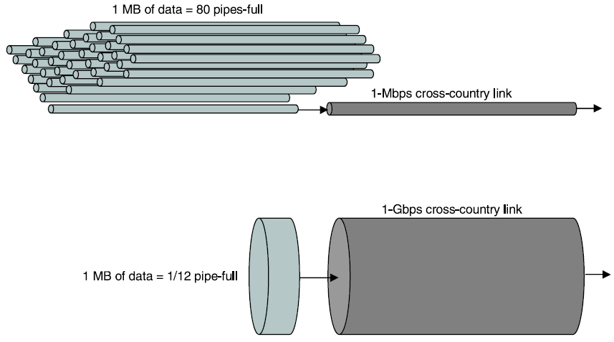
High Speed Networks
1 MB of data; RTT: 100 ms
RTT becomes more important than Bandwidth

Slide 21
Throughput
Throughput = Transfer Size/ Transfer Time
= RTT + Transfer Size/ Bandwidth
= 100 ms + 8 ms (for 1 Gbps link)
= 108 ms
Throughput = 1 MB/ 108 ms = 74.1 Mbps
RTT becomes the limiting factor for throughput
Throughput increases for large size transfers (limiting case -> 1 Gbps)

Slide 22
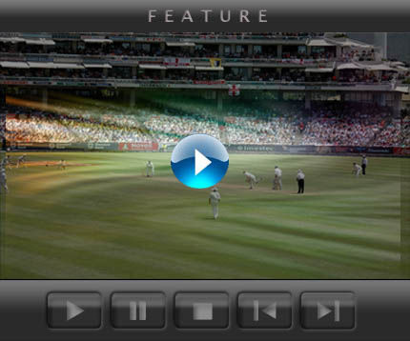
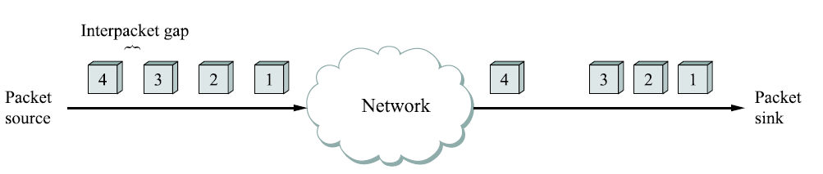
Application need for performance
Streaming video/ audio; Video on Demand
Requirements:
Packet loss is tolerable but sequencing is important
Jitter (variable delay) should be minimized

Slide 23
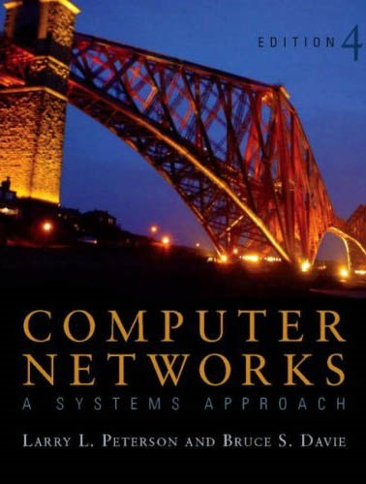
References
[P&D]
Chapter 1 - Foundation
1.5 Performance
Chapter 4 - Internetworking
4.1.1 Internetwork

Slide 24
?
?
Questions/ Confusions?
?
What is Topology?
Differentiate between different topologies
Star, Bus, Mesh, Tree, Ring and any others

